Slide 1
Tools and procedures for radiation damage modelling and intercomparison of experiments
Fernando Mota, Christophe J. Ortiz, Rafael Vila
Laboratorio Nacional de Fusión – CIEMAT, 28040 Madrid, Spain

Slide 2
Motivation: Calculation and comparison of radiation damage under DONES and Fusion conditions
Goal of DONES: Test materials under equivalent neutron fusion irradiation conditions
Will IFMIF-DONES produce similar radiation damage to DEMO ?
Then our main objective is to identify in which conditions two neutron irradiation experiments are equivalent.
In order to compare the radiation damage induced by neutron irradiation experiments, several issues that affect the damage dose in the materials have to be considered:
Calculation of the atomic displacement induced by neutrons
Calculation of the PKA spectrum induced by different neutron sources (MCNP, NJOY, nuclear data libraries)
Calculation of the radiation damage associated to the PKA spectrum
Simulation of thermally-activated processes during irradiation
Identification of atomistic mechanisms and impurities (He, C,…) that play important role
Use of adequate kinetic models (diffusion equations, kinetic Monte Carlo, etc…)

Slide 3
Issues to reproduce fusion damage in materials with other irradiation facilities
The root cause of the differences between neutron irradiation experiments
Total dose
Neutron spectrum
Gas production (H, He)
PKA spectrum - primary damage and clustering
Transmutation Impurities could affects to the macroscopic properties
The root cause of the differences between ion irradiation experiments and neutron irradiation experiments
Damage dose rate is different
The PKA spectrum is different
The volume of irradiation is different (The damage induced by ions is more concentrated than the one induced by neutrons)
But, the most import issue is to identify why all these previous parameters produce different damage. To find the most important magnitudes to compare.

Slide 4
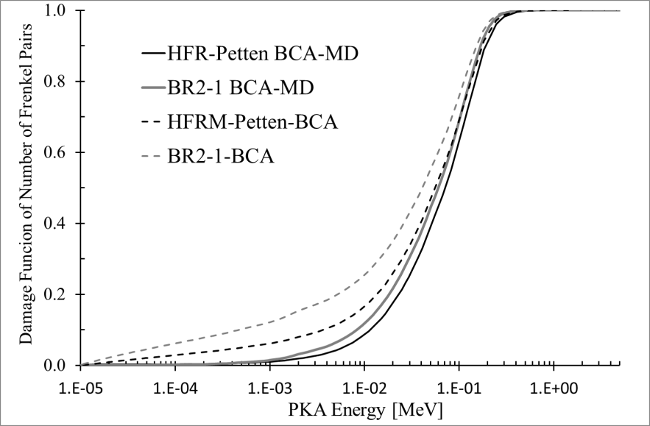
How to compare irradiation experiments
The dpa is widely used to characterize the primary displacement damage induced by neutron, but currently, there are several concepts of dpa.
dpa_{NRT}
dpa_{arc-dpa}
dpa_{BCA}
Therefore, we have to be careful when we use them because the comparison of different irradiation experiments using different dpa concepts could give contradictory conclusions.
In addition, any dpa concepts only give information about point defects
Therefore, more information about the primary damage would be desirable to compare irradiation experiments
In order to give more information to the comparison of irradiation experiment We have developed a methodology coupling BCA-MD (BCAMD-CIEMAT methodology) to compare irradiation experiments in order to compare damages functions taking into account:
Number of defects (Frenkel pairs) – dpa_{BCAMD-CIEMAT})
Fraction of defects in clusters
Size distribution of clusters
Therefore, this technique will give valuable information which could help to design more reliable nuclear fusion equivalent irradiation experiments to test materials.

Slide 5
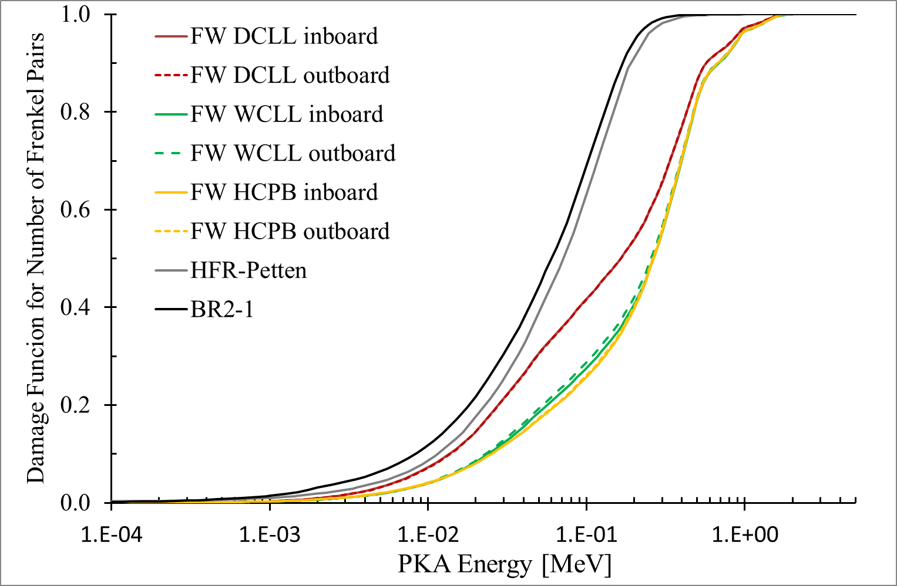
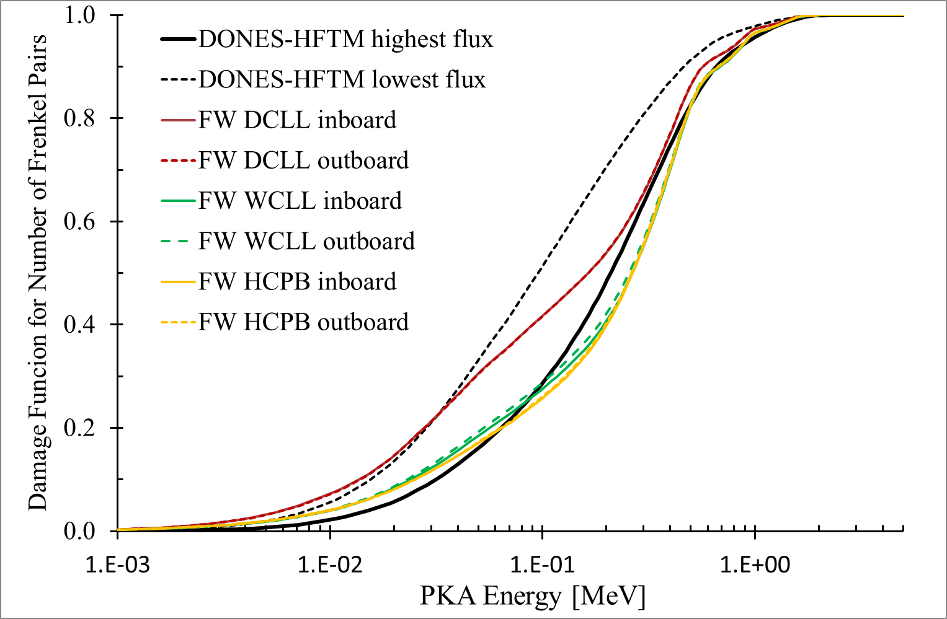
Results with BCAMD-CIEMAT
The damage functions of number of Frenkel Pair for different DEMO concepts (DCLL, WCLL, HCPB), IFMIF-DONES and nuclear fission facilities (BR2, HFR-PETTEN) have been compared using this methodology
Comparison of different DEMO concepts with Fission facilities damage functions for Iron
Comparison of HFTM of IFMIF-DONES with different concept of DEMO (DCLL, WCLL, HCPB) damage functions for Iron
As it is expected, as results of the comparison of the damage function of iron for number of Frenkel pairs is that , DONES-HFTM resulting an excellent facility to reproduce nuclear fusion conditions for structural materials. Contrary to the results obtained for nuclear fission facilities.

Slide 6
Proposal
Therefore, it is important to make a comparison of the different dpa concepts calculated for different irradiation facilities like fission reactor, spallation neutron sources, fusion facilities and DONES-HFTM in order to quantify how far are from each others.
But the most important issue is to identify the minimum amount of parameters representative of the damage is needed to compare, with the aim to figure out whether two irradiation experiments are similar or not.
In addition, to comment that the BCAMD-CIEMAT methodology could give valuable information to try to solve this question, whether two irradiation experiments are equivalent or not, because both, the defect formation calculation is more realistic and information about the clustering is provided.

