Slide 1
Comment on the middle flux module
- Proposal of the blanket functional tests -
Takeo Nishitani
¹National Institute for Fusion Science, 322-6 Oroshi-cho, Toki 509-5292, Japan

Slide 2
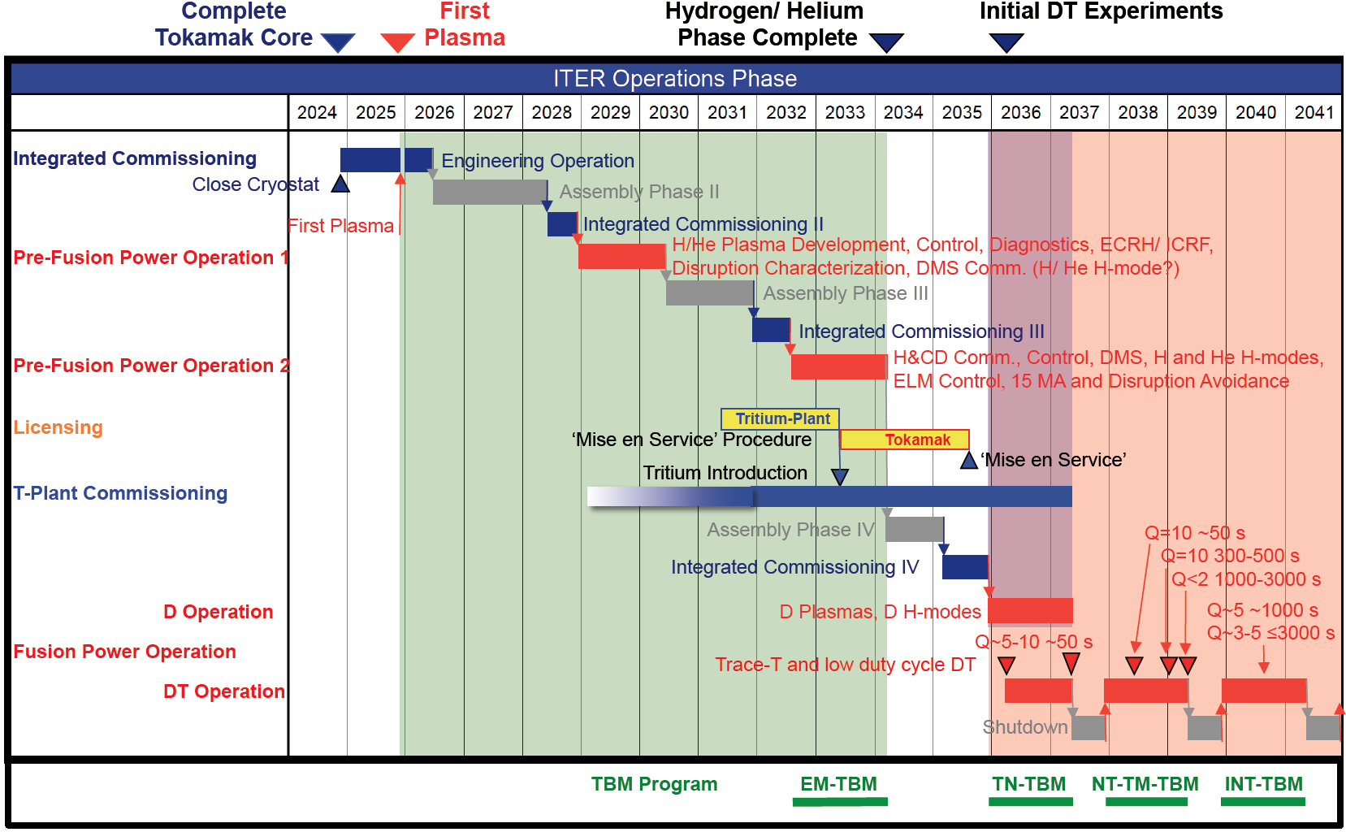
ITER program is delayed. Substantial TMB test is later than 2038.
Nuclear functional test of the blanket is required much earlier.

Slide 3
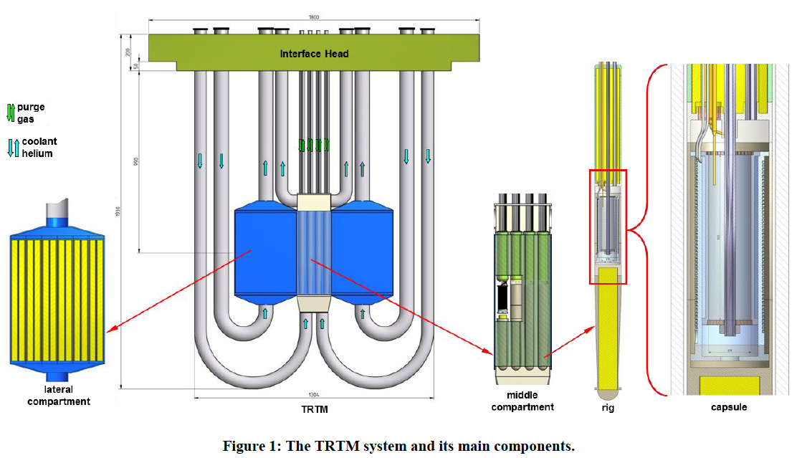
Tritium Release Test Module (from Intermediate Eng. Design Report)

Slide 4
Comment and proposal
Partial model of the blanket or small scale blanket module should be considered.
for the blanket functional test, not only tritium release but also nuclear heating.
to assess irradiation effect in the breeding/multiplying materials including impact on the tritium permeation

