Slide 1





Further potential for using fast neutron sources
Complementary Experiments at DONES
W. Królas, A. Ibarra, A. Maj, F. Arbeiter
Activities of the WPENS Early Neutron Source work package (2015-20) of EUROfusion
White Book on the „Complementary Scientific Programme at IFMIF-DONES” (2016)
Decision: Extension of DONES scope by adding „Complementary Experiments” areas

Slide 2

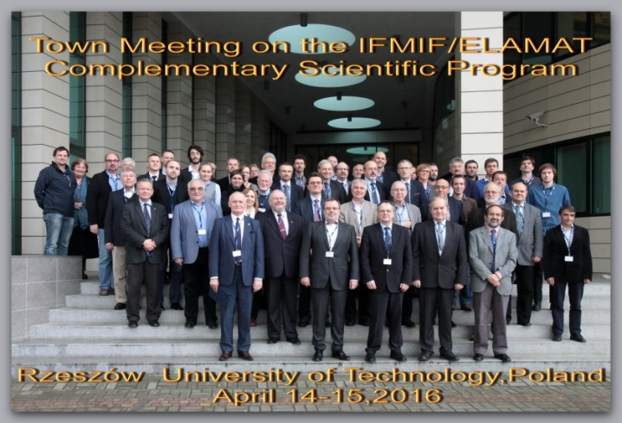
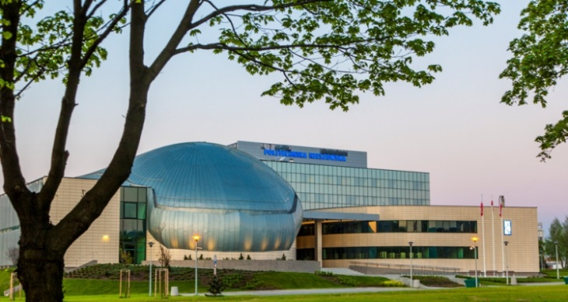
DONES Complementary Science Program
The ELAMAT Consortium which was preparing the bid to site DONES in Poland proposed
to extend the objectives of IFMIF-DONES beyond fusion materials studies
An international science committee was formed, meetings were held during which various scientific areas were considered as complementary research topics.

Slide 3
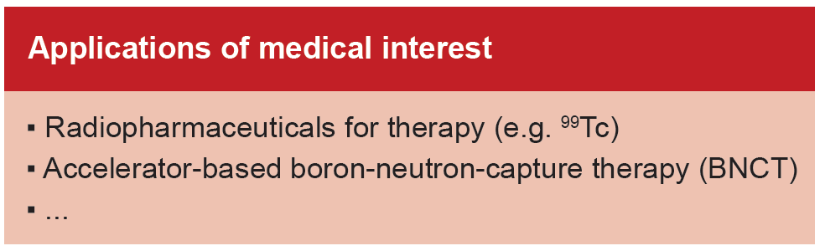
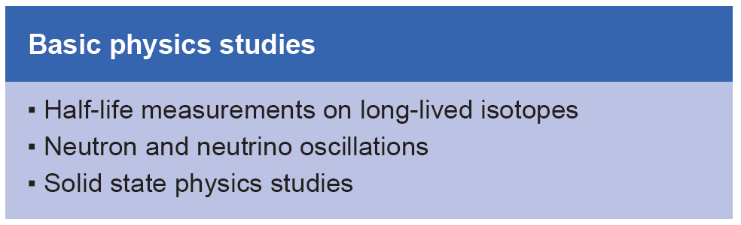

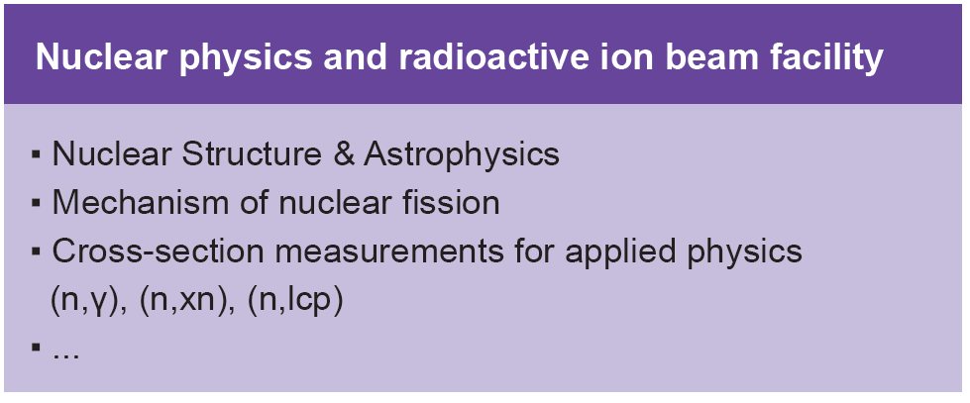
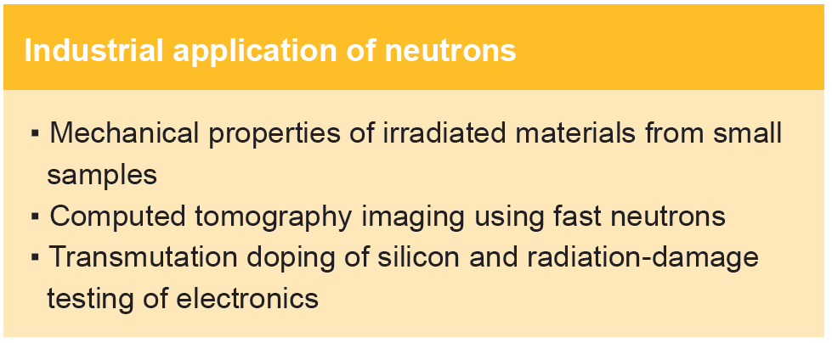
DONES Complementary Science Program
The ELAMAT Consortium which was preparing the bid to site DONES in Poland proposed
to extend the objectives of IFMIF-DONES beyond fusion materials studies
An international science committee was formed, meetings were held during which various scientific areas were considered as complementary research topics.
Their feasibility and compatibility with
the main DONES role must be evaluated

Slide 4
DONES Complementary Science Program
The ELAMAT Consortium which was preparing the bid to site DONES in Poland proposed
to extend the objectives of IFMIF-DONES beyond fusion materials studies
An international science committee was formed, meetings were held during which various scientific areas were considered as complementary research topics.
„A White Book report on on the
Complementary Scientific Programme at IFMIF-DONES”
IFJ PAN Report No. 2094/PL, 2016
Eds. A. Maj, M.N. Harakeh, M. Lewitowicz, A. Ibarra, W. Królas
https://www.ifj.edu.pl/publ/reports/2016/2094.pdf
Adapted by the EUROfusion WPENS work package
as Technical Report EFDA_D_2MP66K

Slide 5
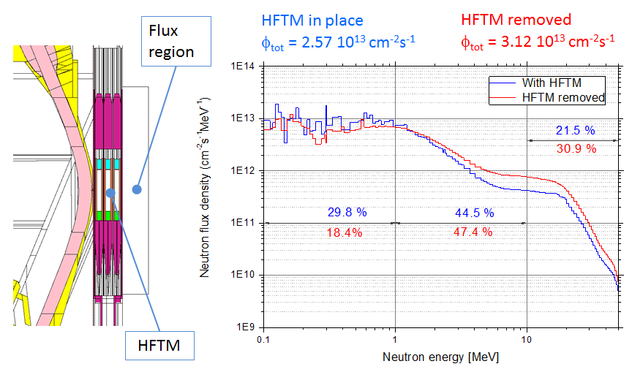
Complementary Experiments: Boundry conditions
Main DONES mission: irradiation of fusion materials
Complementary experiments could use:
Deuterons extracted from
the accelerator beam but only
a small fraction (a few percent)
Neutrons available behind the
Irradiation Module either inside
the Test Cell or in a dedicated additional experimental hall
Courtesy
of U. Fischer
Flux region behind High Flux Test Module with HFTM in place and removed

Slide 6
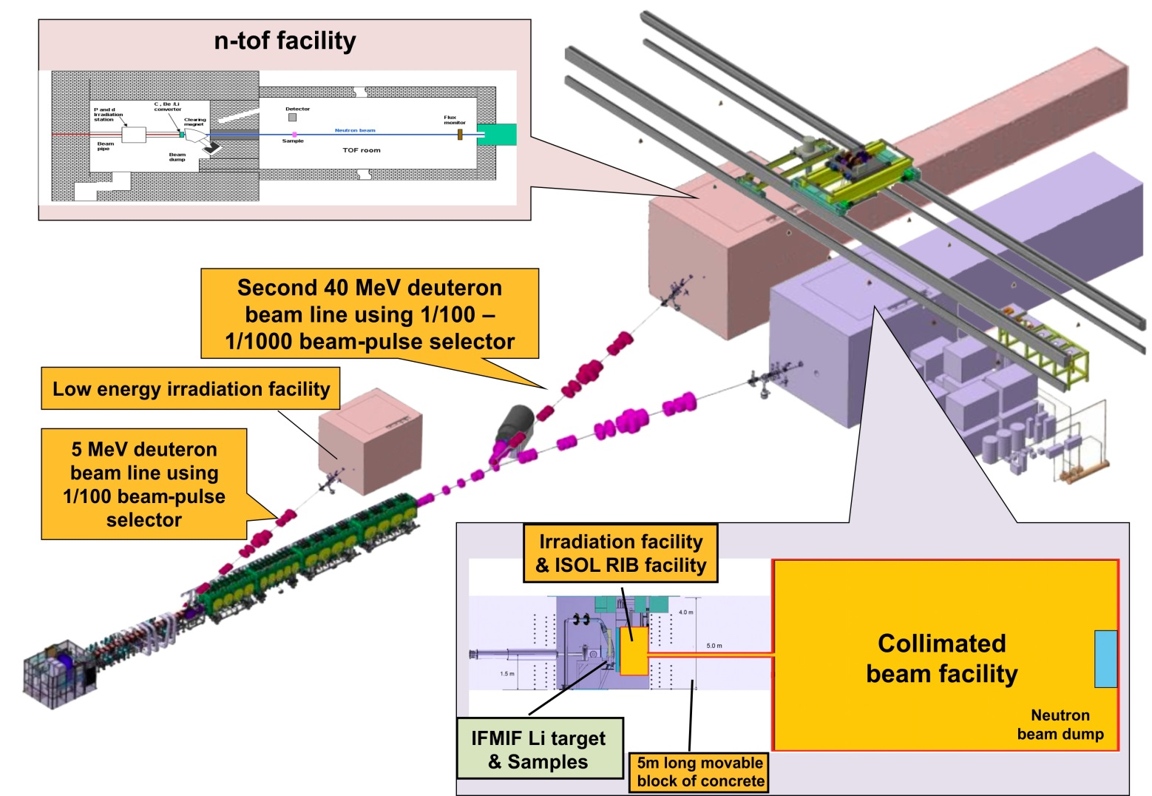
Complementary Experiments Areas: White Book proposal
C. A second 40 MeV
deuteron beam line
using 1/100 to 1/1000
beam-pulse selector
to a neutron Time-of-Flight
facility – feasibility must be verified!
C.
B. A 5 MeV deuteron
beam line using 1/100
beam-pulse selector
to a low-energy irradiation facility
B.
A.
A. Irradiation facility and ISOL RIB facility behind the HFTM;
Collimated beam facility with an 8 m long neutron line

Slide 7
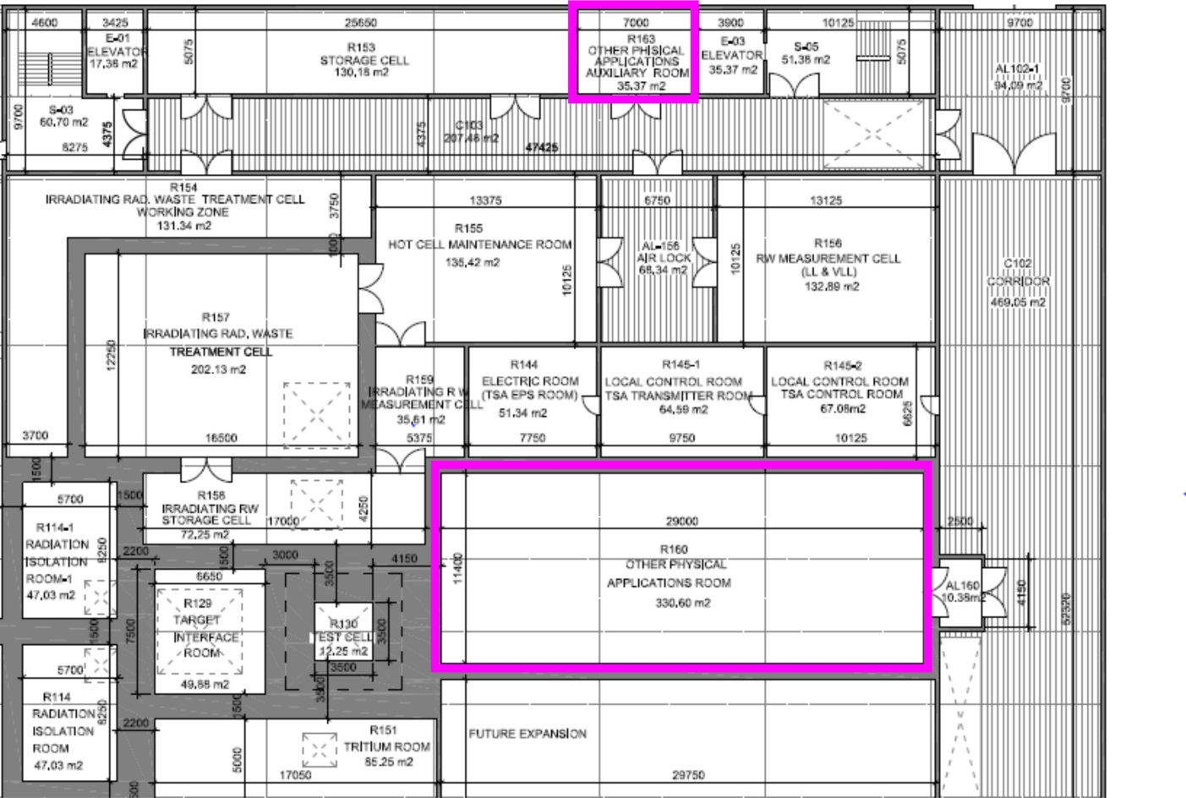
Complementary Experiments Area (option A)
incorporated into the DONES building design
Complementary Exp Area
Room R160
Dimensions
29.00 m x 11.40 m,
height 8.00 m, 330.60 m²
Auxiliary Room R163
7.00 m x 5.07 m, 35.37 m²
40 MeV deuteron beam
arrives from this direction
Part of the DONES first floor plan (as in the PEDR)
Ongoing discussion on shielding, arrangement of experimental setups in R160
Other remaining proposals (deuteron beam kicker at 5 or 40 MeV) are on-hold
pending feasibility confirmation and external user interest

Slide 8
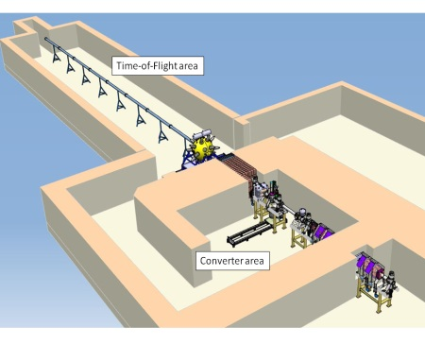
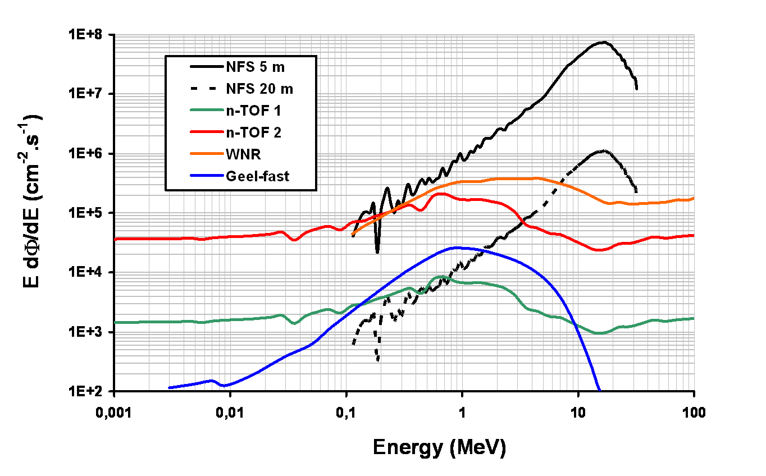
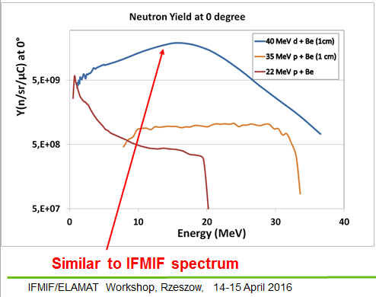
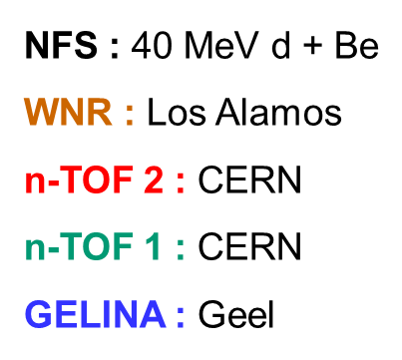
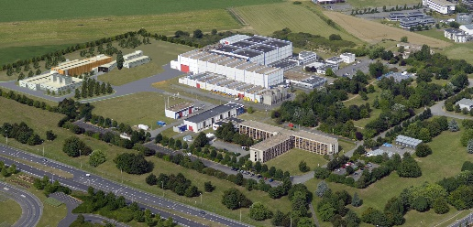
For comparison: NFS Neutrons for Science facility at GANIL
40 MeV deuteron or 33 MeV proton beam from LINAG:
I = 50 μA – 5 mA, pulsed beam T = 11 ns
40 MeV d + Be, on rotating thick Be target (2000 rpm)
Courtesy of X. Ledoux and the NFS collaboration
A very rich nuclear physics program planned from 2018 onwards:
Neutron induced reaction studies: (n,xn), activation and prompt spectroscopy
Fission: distributions, neutron multiplicities, gamma-ray spectroscopy in induced fission
Measurements of reaction cross sections by activation
Biology, R&D for the production of isotopes for medicine
Neutron detector development

