Slide 1
Workshop on Advanced Neutron Source and its Application
Technical Session 3-1 : High Power Neutron Sources
Irradiation-area related issues - introductory slides
F. Arbeiter (KIT), A. Ibarra (Ciemat), A. Möslang (KIT), M. Serrano (Ciemat)

Slide 2
Challenges of high power neutron sources for the irradiation area
Shielding of the high intensity neutron radiation
providing interfaces (cooling, power, signal) through shielding (connectors!)
safety of involved alkali metals (if applicable)
no moderation of spectrum
Exploitation of „directed“ limited extent neutron source
gradients of nuclear responses
shape of irradiation volume (cuboid vs. cylinders)
small irradiation volume ➔ small specimens
Handling of high volumetric heating in the specimens
limitation of specimen stack size
application of heat transfer media
Lifetime of involved structural and functional materials
lifetime (creep, fatigue) of pressure vessel components
lifetime of electrical heaters and instrumentation (n detectors)
Priorization of functions / test matrix
Irradiation of specimens for PIE
In-situ test experiments (creep fatigue, tritium release, ...)
general nuclear physics applications, isotopes production etc.

Slide 3
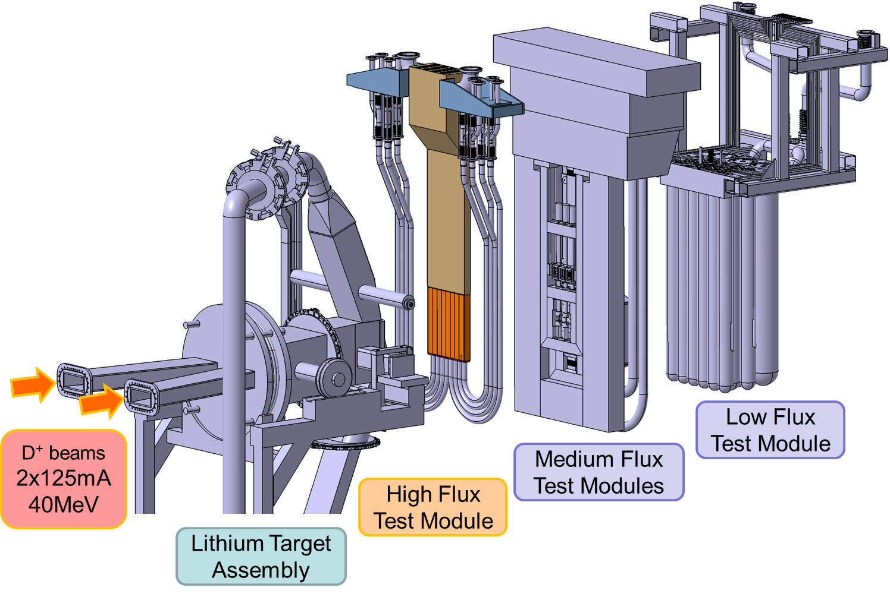
Example: Irradiation experiments in the IFMIF Test Cell
The HFTM occupies the irradiation space closest to the neutron source
~10¹⁵ #n/cm²/s
at FW/blanket conditions
(LFTM)
(MFTM)
(HFTM)
not planned in IFMIF-DONES
Exploded view of TA and TMs

Slide 4
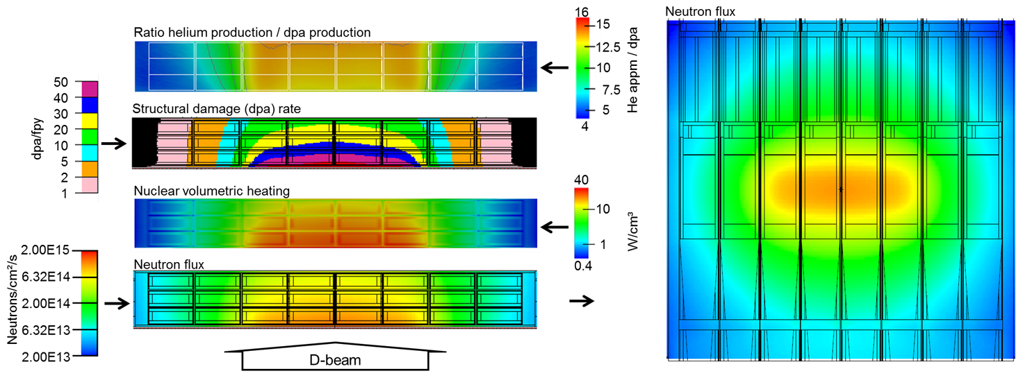
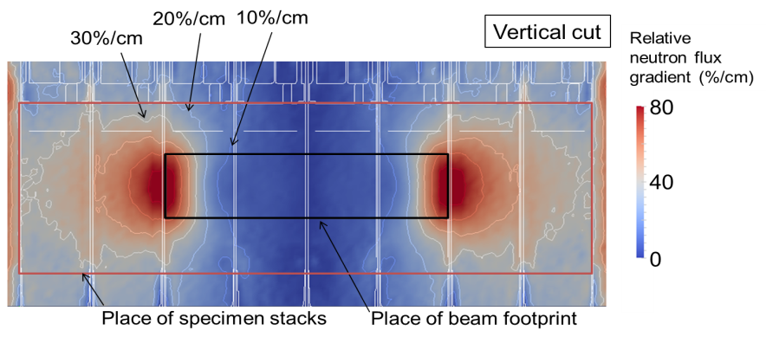
Example: IFMIF HFTM irradiation performance
As developed 06/2013 (IFMIF/EVEDA DDD-III for 2x 125mA 40MeV D+
„337 cm³ specimens at > 10dpa/fpy“
(uniaxial horizontal gradients)
[Keitaro Kondo, IFMIF/EVEDA HFTM DDD-III, 2013]

Slide 5
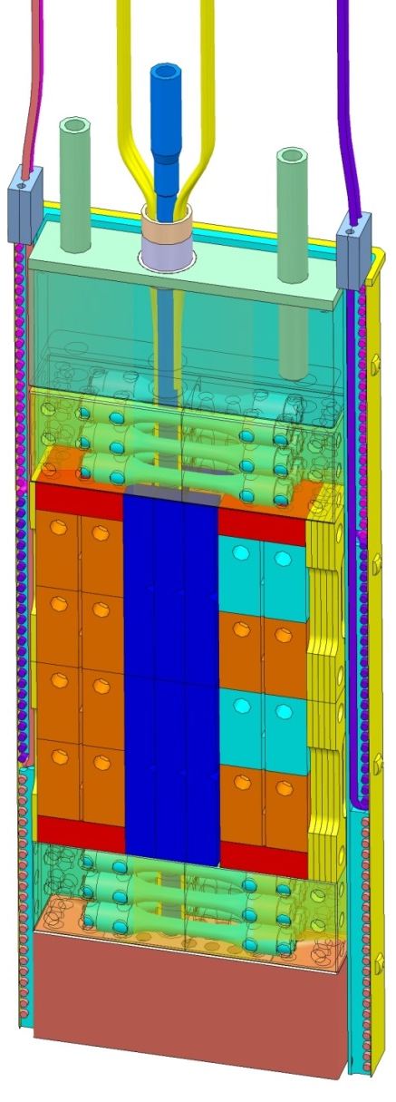
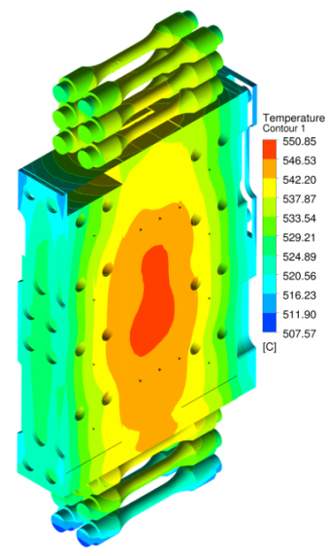
HFTM specimen payload (working proposal)
551°C
81mm
[F. Arbeiter et al., ICFRM-17, 2015]
511°C
specimen stack 81 x 40 x 9.3 mm³
3D temperature map with resolved specimens
#/caps. | Test type | Bounding box [mm]
2x12 | Flat tensile (static) | 27 x 4.6 x 0.76
2x2 | Fracture toughness (Compact Tension) | 11.5 x 11.5 x 2.3
2x12 | Bend bar / Charpy impact | 27 x 4 x 3
2x6 | Cylindrical fatigue | 27 x D4 (gauge 9 x D2)
2x3 | Fatigue Crack Growth | 11.5 x 11.4 x 4.6
2x8 | Pressurized creep tubes | 27 x D2.5 t0.25
 | TEM plates
[A. Möslang, Final Report on the EFDA Task TW4-TTMI-003 D4, 2006]

Slide 6
Impact of heating intensities
For allowed max. temperature spread, the maximum thickness of the specimen stack inside the capsule depends on the nuclear volumetric heating intensity:
Thick capsules allow higher specimen usage fraction vs. „parasitic“ volumes !
[F. Schwab, 2015]
$$∆T ∝\frac{q^{′′′}⋅b^{2}}{λ}$$
IFMIF 2x125mA : ~3 W/g
IFMIF-DONES 1x125mA : ~1.5 W/g

Slide 7
Conclusions
The usable volume x dpa product of planned fusion-relevant irr. facilities is limited and neccessitates the use of SSTT
A certain spread of nuclear responses (dpa, He/dpa) within the specimen set and even a gradient within individual specimens gage volume have to be accepted and needs to be accommodated in the SSTT data assimilation procedures
The spread of temperatures can be limited (on cost of irradiation volume), a few outliers may however occur

Slide 8
Issues to discuss
Proper definition of the requirements for the irradiation experiments/facilities now being designed will maximize their use for fusion materials science and FPP licensing !
Priorities for the test matrix
materials (RAFM steels, W, Cu, ... base/welded/bonded)
test types (tensile, fracture toughness, creep, fatigue, ...)
Specimen / testing device for in-situ creep
Technologies and methodologies for data evaluation
Small Specimen Test Technique (SSTT)
data assimilation from „dispersed“ {T_{irr}, dpa} specimen bases
required statistics per test type
Promising solutions for technical realizations of the irradiation experiments (heating, cooling, structure, instrumentation)

