Slide 1
1st Workshop on Advanced Neutron Source and its Application
Design and technical challenges of Li target for IFMIF-based neutron sources
Davide BERNARDI (ENEA)
4-5 November, 2017 Aomori-city, Japan

Slide 2
Outline
IFMIF Li target concept
TA design basis
TA lifetime-related issues:
Irradiation embrittlement
Erosion/corrosion
Loss of gaskets performance
Other phenomena
Summary and conclusions

Slide 3
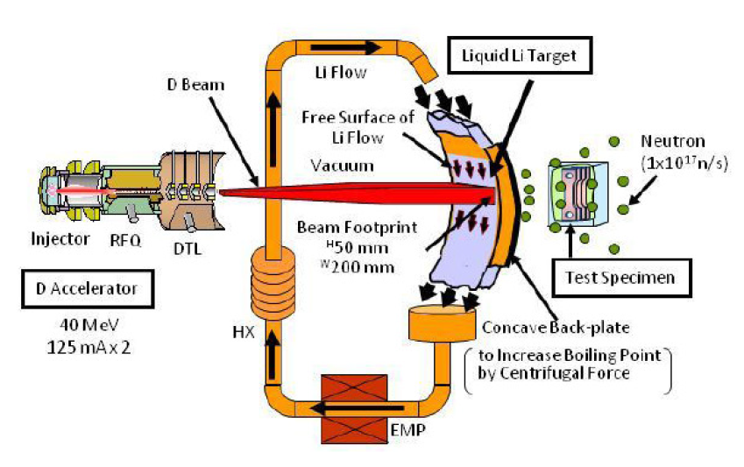
IFMIF Li target concept
d+⁷Li
n+2α
d+⁶Li
n+⁷Be
d+⁷Li
n+⁸Be
d+⁶Li
n+α+³He
d+⁷Li
n+p+⁷Be
d+⁶Li
n+p+⁶Li
d+⁷Li
2n+⁷Be
d+⁶Li
n+p+d+α
d+⁷Li
n+p+t+α
High Flux Test Module (HFTM)

Slide 4
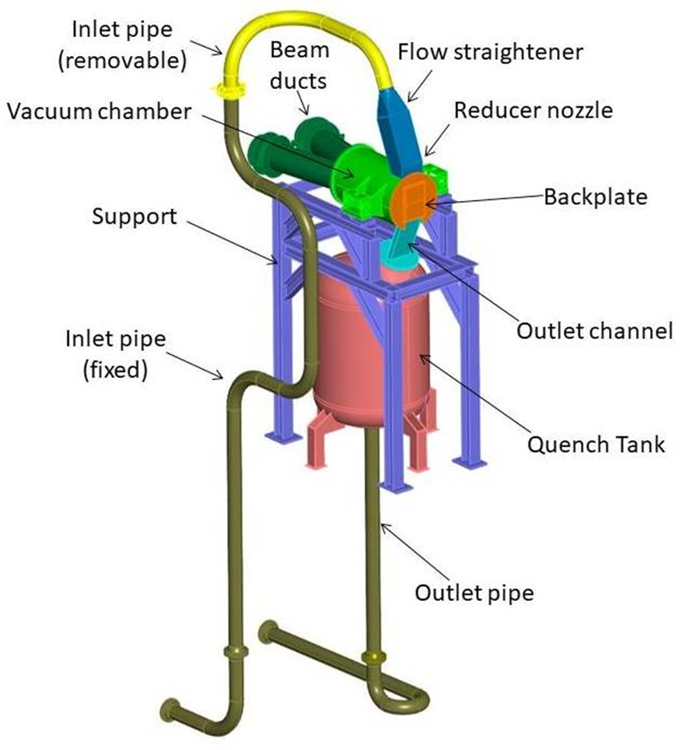
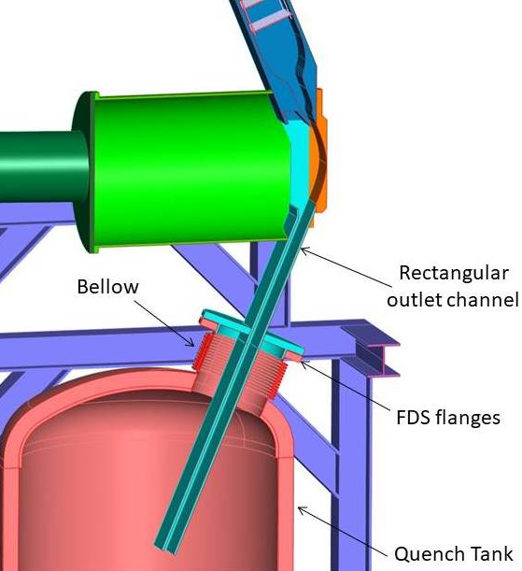
TA design basis /1
maintain a stable high-velocity, free surface flow of liquid lithium in front of the D+ beam
produce the adequate neutron flux to properly irradiate the test modules
remove the high thermal power deposited in the lithium jet by the D+ beam
Parameter | Value
Beam power | 10 MW (IFMIF) 5 MW (DONES)
Beam current | 250 mA (IFMIF) 125 mA (DONES)
Beam energy | 40 MeV
Beam footprint area | 20x5 cm² (nominal) 10x5 cm² (optional in DONES)
Surface heat flux | 1 GW/m² (IFMIF) 500 MW/m² (DONES)
Li channel width | 260 mm
Li velocity | 15 m/s (nominal)
Li inlet temperature | 250 °C (nominal)
Li jet thickness | 25 mm ± 1 mm
Vacuum pressure | 10⁻³ Pa
BP channel minimum thickness | 1.8 mm
Beam angle | 9°
Nozzle vertical inclination | 22.5°
BP distance to HFTM | 2 ± 1 mm
Materials | RAFM steel 316L
Availability | 94 %
Li channel

Slide 5
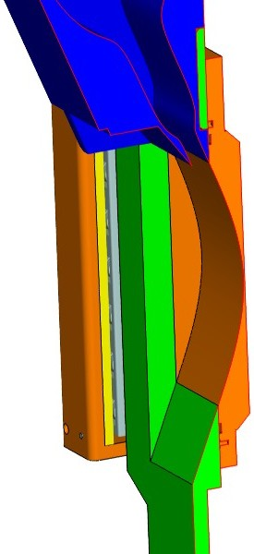
TA design basis /2
Backplate thermal field (DONES)
Li channel profile developed by ENEA
Avoid Li boiling
Create smooth pressure distribution
T_{max} = 300°C
Damage rate [dpa/fpy] (DONES)
Variable curvature profile allowing for gradual pressure increase to limit flow disturbances
Pressure distribution
Successfully tested in ELTL (Oarai, Japan) within IFMIF/EVEDA

Slide 6
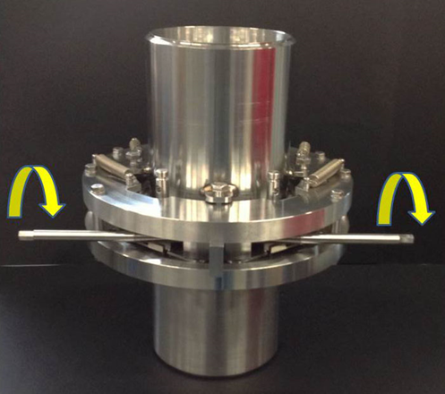
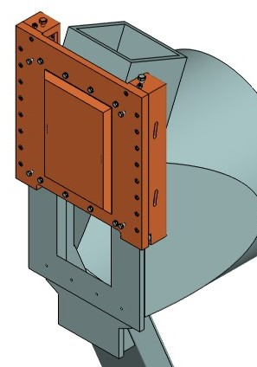
TA design basis /3
Average nuclear responses on the BP footprint volume
IFMIF conditions (two accelerators – 10 MW beam)
M. Frisoni et al. “Nuclear analysis of the IFMIF European lithium target assembly system, Fusion Engineering and Design, 89 (2014), 1959-1963
Fast Disconnecting System (FDS)
The BP is the TA most critical component due to severe irradiation and harsh working conditions
BP lifetime is expected to be limited and its assessment is crucial to performance and maintenance
Replacement of BP/TA is needed at some time:
Bayonet concept: only the BP is replaced
Integral concept: all the TA is replaced
Bayonet BP concept
Integral TA concept
Low activated waste
Maintenance optimized
Sealing gasket needed
Complex design
No gasket needed
Simplified design
Maintenance not optimized
More waste generated

Slide 7
TA lifetime related issues
Main life-limiting factors for the Li target:
Irradiation embrittlement (L_{emb})
Erosion/corrosion by high-speed Li flow (L_{corr})
Loss of sealing gaskets performance (L_{gask})
Other phenomena (swelling, creep,…)
TA lifetime = min (L_{emb,} L_{corr,} L_{gask,} ...)

Slide 8
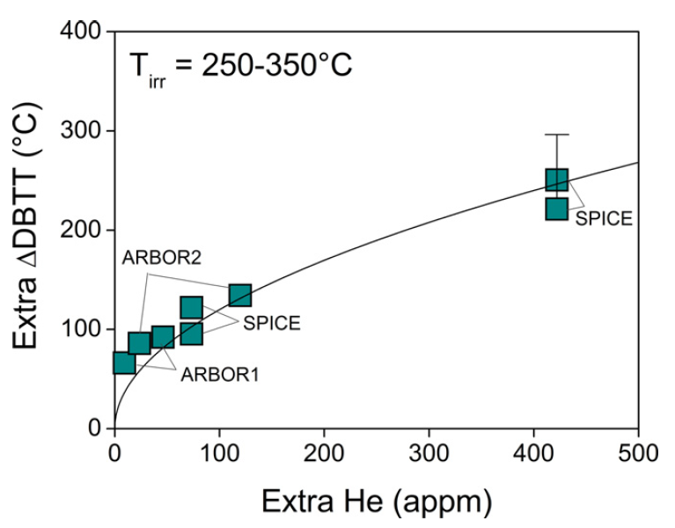
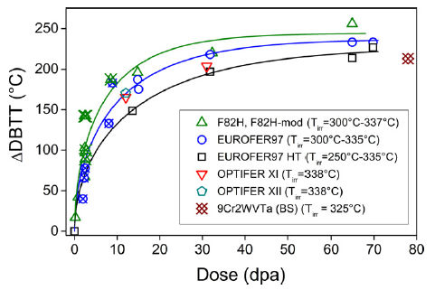
Irradiation embrittlement /1
Irradiation in Fast spectrum Reactors (HFR, BR2, BOR60) within different EU programmes (SPICE, ARBOR,…)
E. Gaganidze, J. Aktaa, Assessment of neutron irradiation effects on RAFM steels, Fusion Engineering and Design 88 (2013) 118–128
He effect
Radiation damage effect
Extra ∆DBTT = ∆DBTT(doped) - ∆DBTT(non-doped)
boron-doped EUROFER-like steels
1 fpy irradiation in DONES
Strong DBTT increase at low doses, saturation beyond 15 dpa, slow increase up to ~70 dpa
Large scatter of DBTT (unirrad.) but always lower than -50 °C
DBTT ~120°-125°C@30dpa (DONES), ~140°C-150°C@60 dpa (IFMIF)
He effect strongly enhances embrittlement in the concerned T range
Neutron irradiation of B-doped steel technique probably largely overestimates He embrittlement

Slide 9
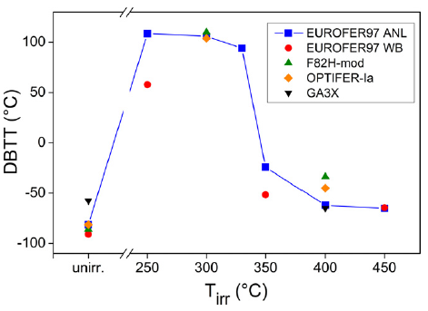
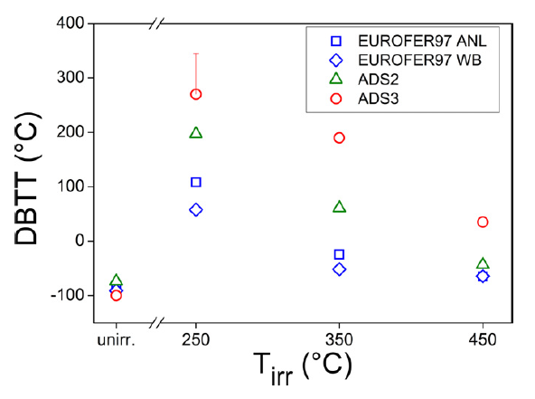
Irradiation embrittlement /2
Influence of temperature on DBTT shift
dpa-induced DBTT shift
He-induced DBTT shift
B-doped
Non-doped
E. Gaganidze, J. Aktaa, Assessment of neutron irradiation effects on RAFM steels, Fusion Engineering and Design 88 (2013) 118– 128
DBTT shift much more sensitive at lower temperatures (< 350 °C)
Possible mitigating actions:
increase TA operating temperature to ~350-360°C (limited by swelling)
Thermal annealing at high temperature (550°C/3 h)

Slide 10
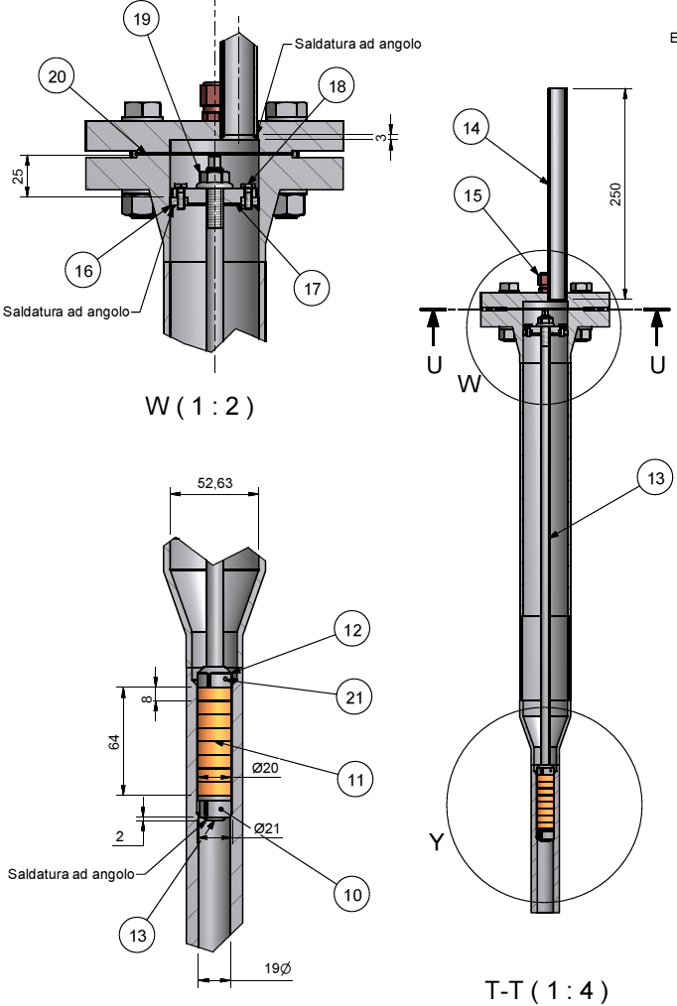
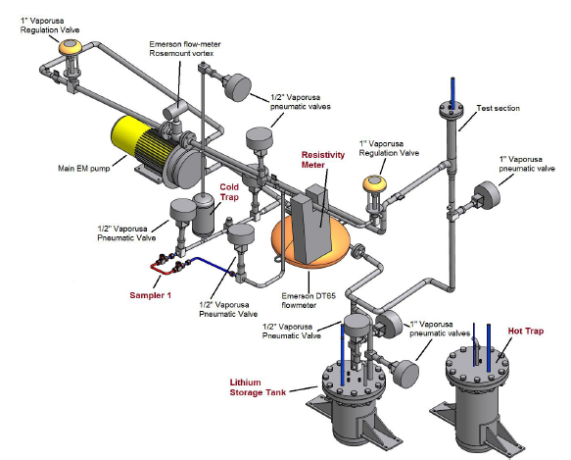
Erosion/corrosion
LIFUS-6 @ ENEA Brasimone
IFMIF/EVEDA validation results
Max corrosion rates observed: ~0.25 µm/y in 4000 h
Recent LIFUS-6 results:
Material: EUROFER 97
Li speed = 15 m/s
T = 330 °C
N concentration ~30 wppm
duration: 4000 hours
Erosion/corrosion is seen to play no role on the BP lifetime

Slide 11
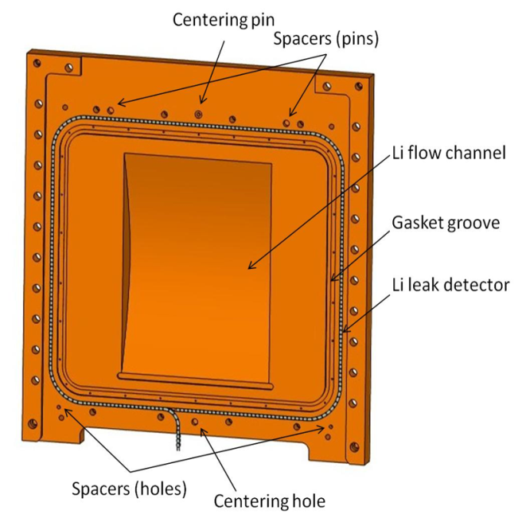
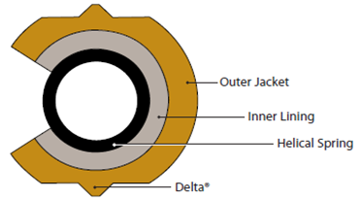
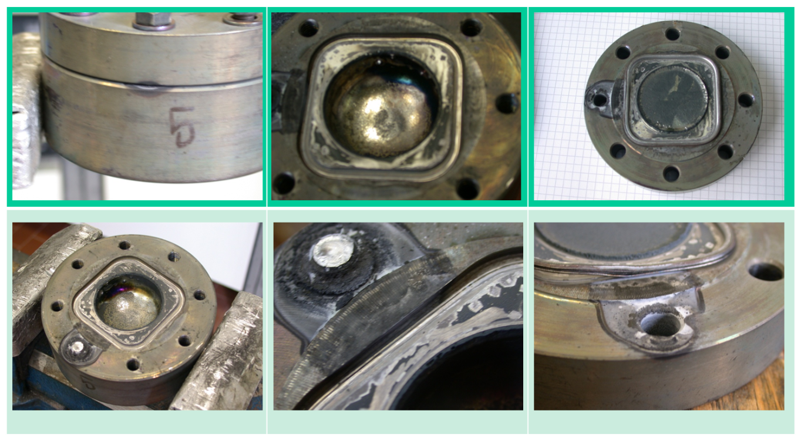
Loss of sealing gaskets performance
Exposure tests to stagnant Li were performed up to 7000 h at ENEA Brasimone within IFMIF/EVEDA validation activities
Helicoflex HNV 200 sealing gasket
Outer jacket : soft iron
Spring: Nimonic 90
Inner lining: AISI 304
Test conditions:
T=350 °C
N conc. in Li < 300 wppm (certified by supplier)
Post-test analysis after 7000 h exposure
Test results:
Test @ 5500 h: no leakage
Test @ 7000 h: leakage observed
Suitability of the gasket proved only up to 5500 h
but…suspect of some uncontrolled conditions in the 7000 h test →
more long-term tests are needed

Slide 12
Other phenomena
Thermal creep
According to RCC-MRx (Tome 6), for temperatures below 375°C EUROFER thermal creep is negligible whatever the holding time, thus at the TA operating temperature this effect is not significant
Swelling
For temperatures below 360 °C the Japanese RAFM steel F82H irradiated with heavy ion beams shows a negligible swelling up to 50 dpa. EUROFER is also reported to show long swelling incubation times at low temperatures (Material Property Handbook, EUROfusion WPMAT) and therefore this effect is expected to be not relevant for the TA
Irradiation creep
EUROFER presents a very low irradiation-creep deformation (less than 1%) after irradiation for 63 dpa at 325°C (A. Alamo, Post-Irradiation Examinations (PIE) of materials irradiated in BOR60 at 325°C up to 42 dpa Final Report - TW2-TTMS-001-D02)

Slide 13
Summary and conclusions
A rough assessment of the factors limiting the TA lifetime has been carried out based on available literature and experimental data
Two issues seem to be the most critical: irradiation embrittlement of F/M steel and loss of gasket performance
In the concerned temperature range, strong DBTT shift is expected even at low doses due to both displacement damage and He production effects
As a possible countermeasure, an increase of the TA operating temperature (up to ~350°-360 °C) or a thermal annealing could be considered to partially overcome or recover the irradiation embrittlement
Gasket integrity has been proved only until 5500 h
However…gasket exposure test @ 7000 h may have been jeopardized by some unexpected event (air entrance, oxidations,…) → a more extensive test campaign is needed for the full qualification of the gasket (possibly taking into account also irradiation)

Slide 14
Thank you

Slide 15
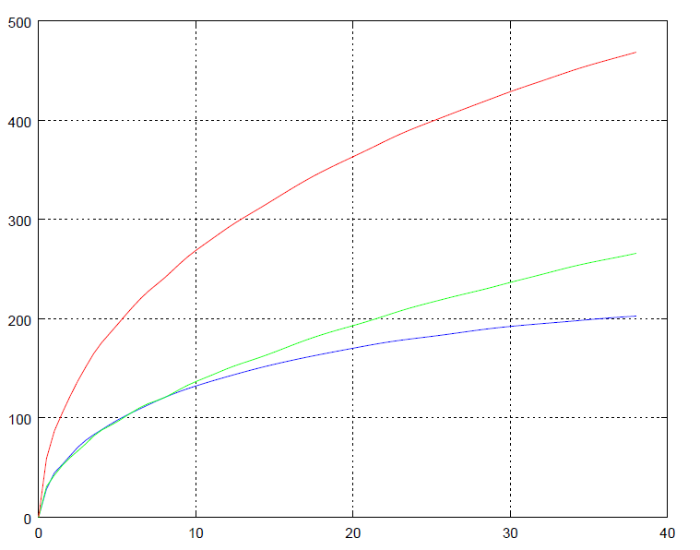
Irradiation embrittlement /3
Total ∆DBTT(rad. damage + He)
Based on 13 appm He/dpa (evaluated from nuclear analysis of TA under DONES conditions)
∆DBTT [°C]
extra He effect
Radiation damage effect
Dose [dpa]

Slide 16
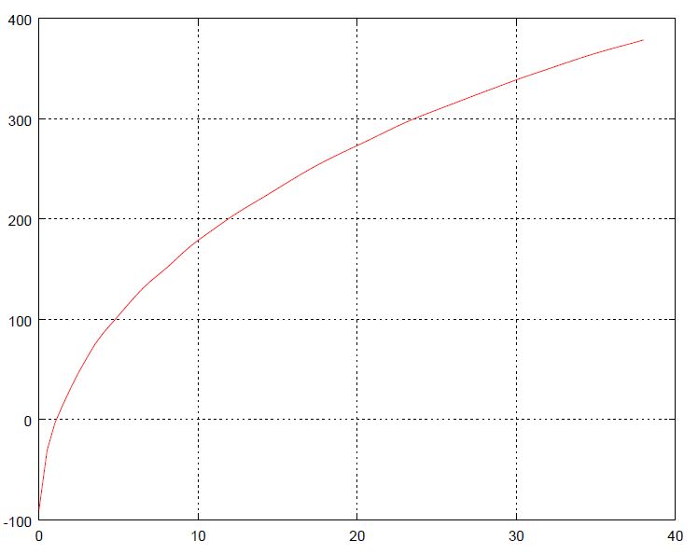
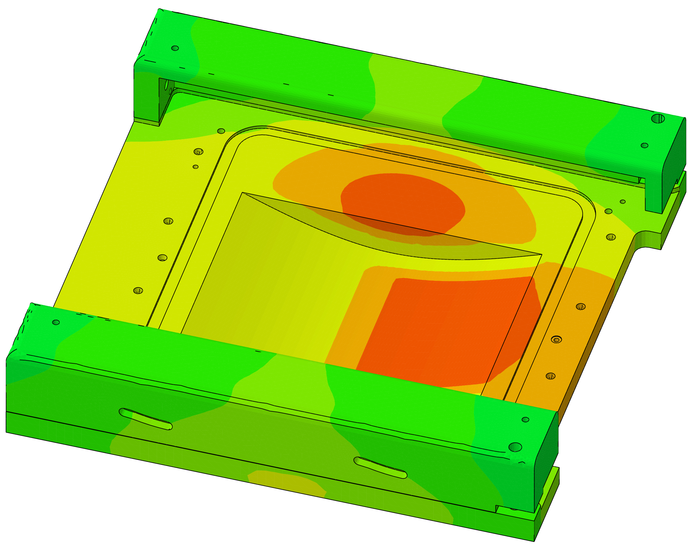
Irradiation embrittlement /4
DBTT of unirradiated EUROFER
Lifetime estimation due to dpa+He embrittlement
DBTT = -90 °C + ΔDBTT total
BP thermal field under DONES conditions (5 MW beam)
DBTT [°C]
1 fpy irradiation
BP operating temperature: ~250-300 °C
Dose [dpa]
BP lifetime ~20 dpa → 20/30*12 ~ 8 months
Rather conservative due to probable
overestimation of He-induced effect in B-doped steel

Slide 17
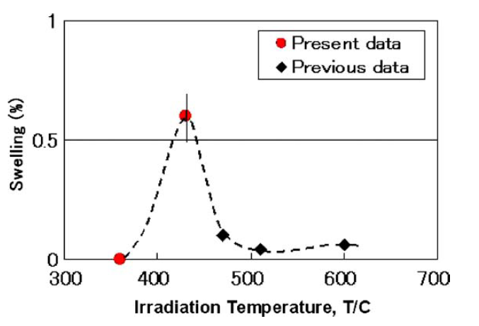
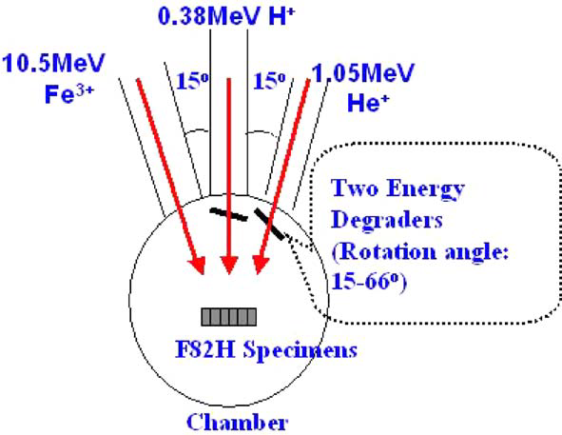
Swelling
E. Wakai et al., Effect of gas atoms and displacement damage on mechanical properties and microstructures of F82H, Journal of Nuclear Materials 356 (2006) 95–104
Literature data not available for EUROFER (only for F82H)
F82H @
50 dpa, 10-15 appm He/dpa
Dual-beam ion irradiation was performed:
Fe3+ ions @ 10.5 MeV
He+ ions @ 1.05 MeV
50 dpa
10-15 appm He/dpa (controlled by energy degraders)
Swelling negligible below 360 °C
Max. volumetric swelling @ 430 °C (~0.6%)
Since BP operating T is < 360 °C swelling is not expected to be an issue

Slide 18
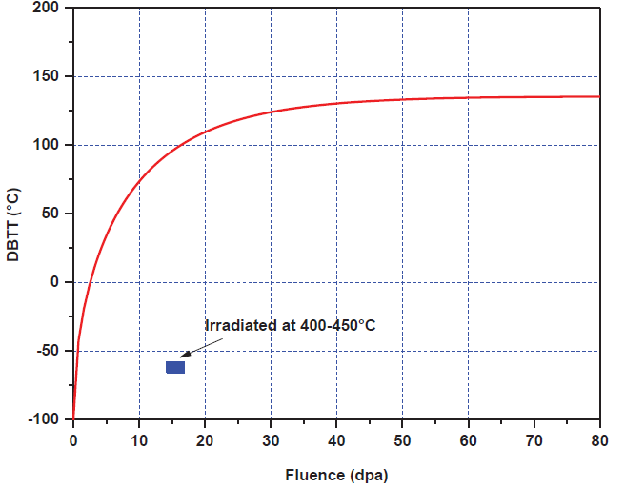
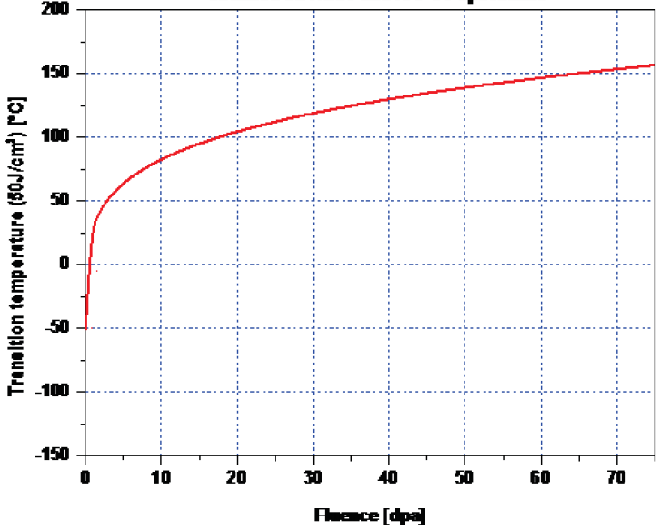
Irradiation embrittlement /1
Irradiation-induced DBTT shift of EUROFER 97
EUROfusion WPMAT, Material Property Handbook
CHARPY tests - criterion: 50% of USE
CHARPY tests - criterion: 50 J/cm²
KSLT (mini-CV) specimens irradiated @ 250°- 340°C
KSLT and standard ISO CV specimens
irradiated @ T < 350 °C

