Slide 1
Comparison of RFQ-Based Compact Neutron Sources
Shin-ichi Kurokawa
Cosylab/KEK
2017/11/05
Aomori, Japan

Slide 2
Applications of Compact Neutron Sources
High Intensity - BNCT (CW or Pulsed)
Medium Intensity - Thermal and cold neutron production (Pulsed) - Radiography (CW or Pulsed)
Detection of fissionable material, explosive, etc. (pulsed or CW)

Slide 3
Four Types of BNCT Neutron Sources
2.5-3 MeV proton onto Li target Ion source + RFQ Ion source + DC accelerator
(1) ~8 MeV proton onto Be target Ion source + RFQ + DTL (2) ~5MeV proton onto Be target Ion source +RFQ
1.5-3 MeV deuteron onto Be target Ion source + RFQ Ion source + DC accelerator
30 MeV proton onto Be target (not considered in this talk) Ion Sources + 30 MeV cyclotron

Slide 4
Requirements of BNCT (Boron Neutron Capture Therapy)

Slide 5
BNCT starting point ➔
Energy range of “BNCT epi-thermal”
➔ (0.5 eV ~ 10 keV)”
Neutron flux➔ > 1 X10⁹ n/cm²/s

Slide 6
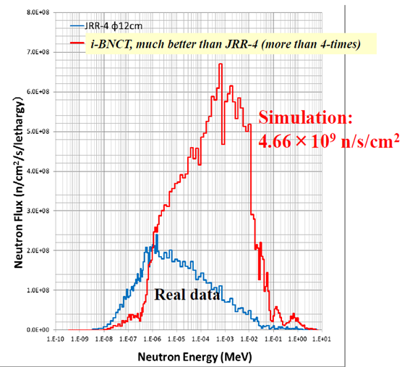
Ibaraki BNCT neutron energy spectrum (simulation)

Slide 7
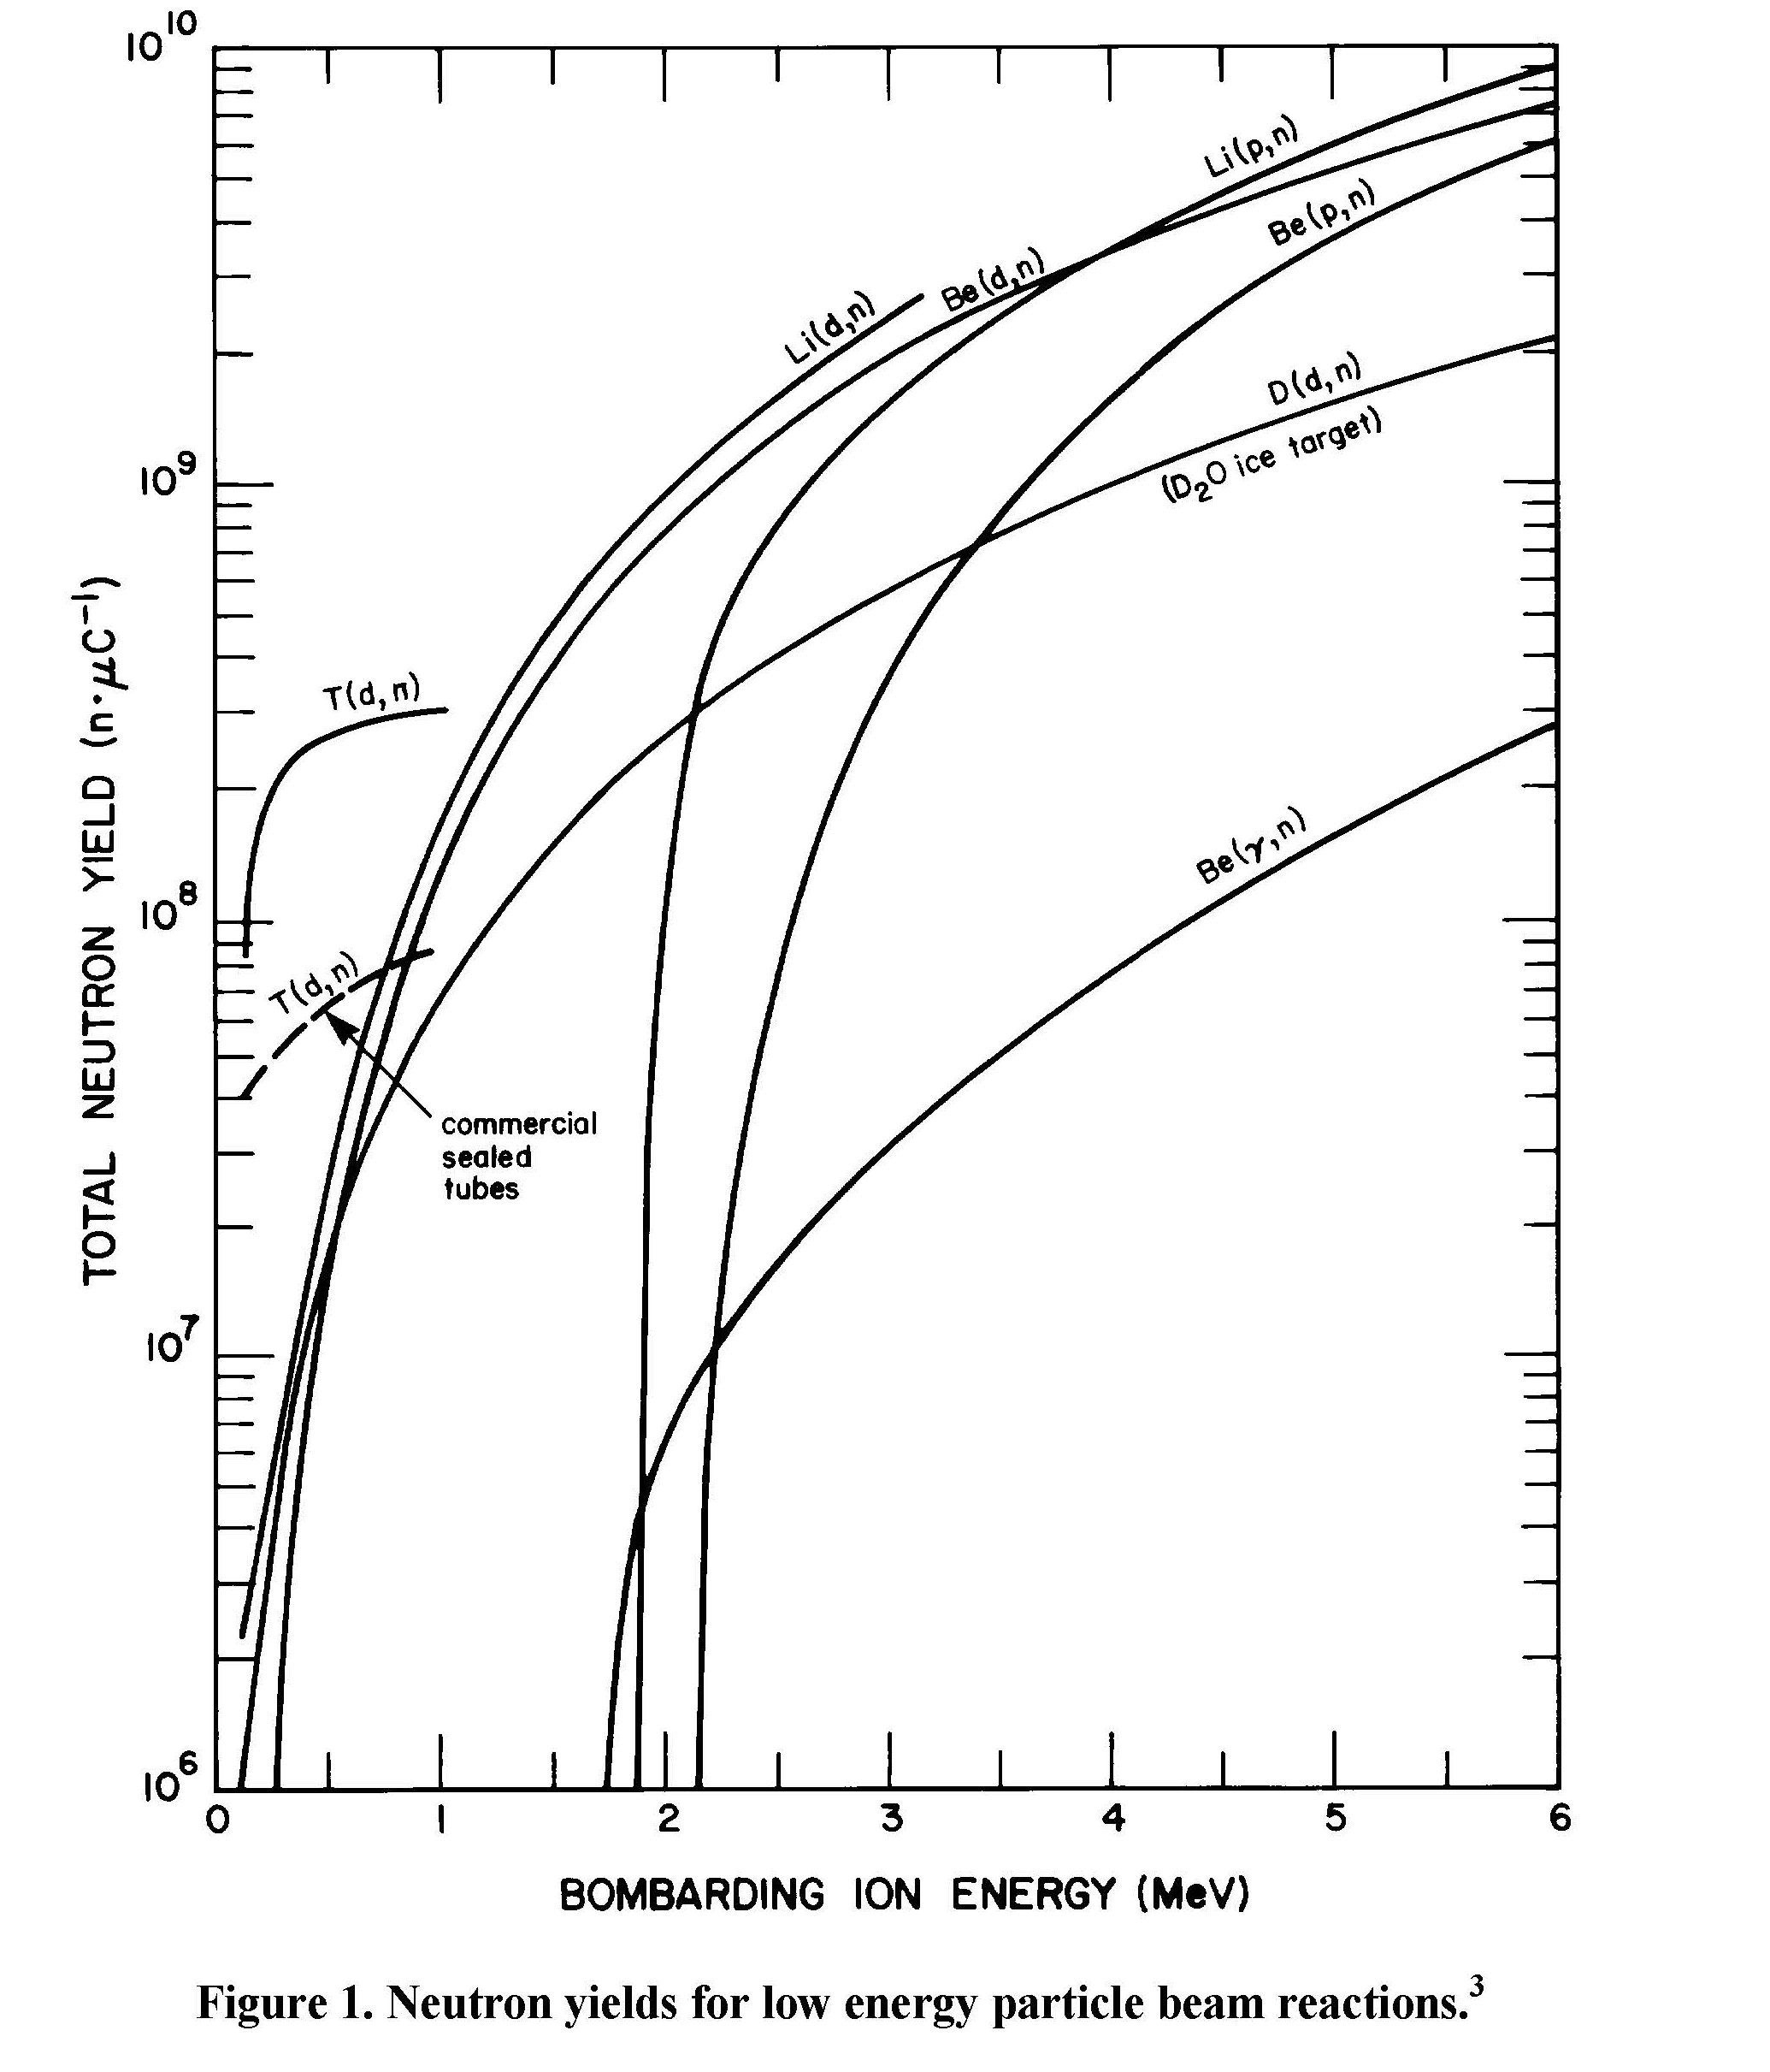
Comparison of Thick Target Yield of neutrons
Total Neutron Yield wrt Ion Energy onto Target by M.R. Hawkesworth AER 152 (1977)
Two types of Reactions:
Endothermic Exothermic

Slide 8
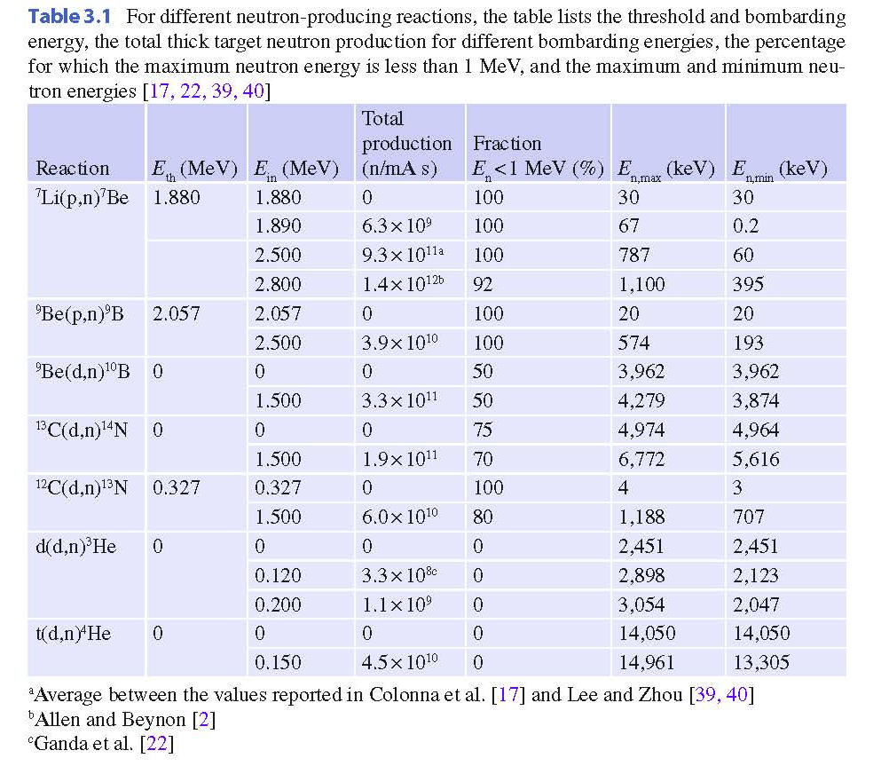
Endothemic
Exothemic

Slide 9
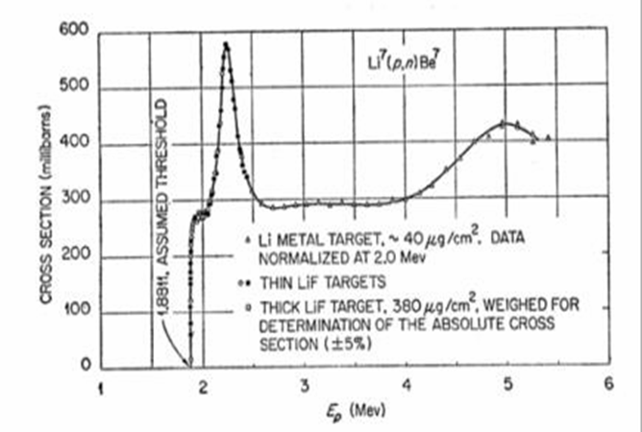
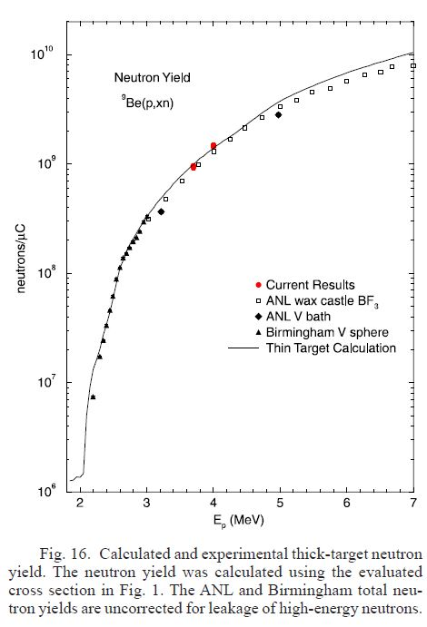
Comparison between Lithium and Beryllium ⁷Li(p,n)⁷Be ⁹Be(p,n)⁹B
Li

Slide 10
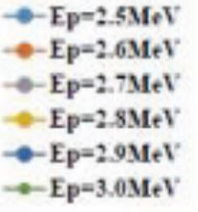
ICABU16
NEUTRON ENERGY SPECTRUM
OIST
Various production angle
Low neutron
energy
Neutron Yield (n/mA/sec/sr/keV)
Neutron energy (MeV)
Beryllium target
Forward angle
Lithium target
8 MeV Proton
Neutron energy (MeV)

Slide 11
Selection of Target Material
Li(p,n)Be reaction seams quite attractive; however, Li target is rather difficult to make, especially, for high current incident beam.
Also Li changes to radio active Be7 by Li(p,n)Be7 reaction, and the half lifetime of ~50 days of Be7 becomes an issue.
It is worthwhile to think about the use of Be target, impinged not by proton but by deuteron.

Slide 12
Compact Neutron Sources with Low-Energy Deuterons onto Be Target (Li target is relatively difficult to make and use compared to Be target if the beam power is high. Why not to try to find a possibility of compact neutron source using Be target ?)

Slide 13
The neutron emission for E_{d} = 0.9 MeV is characterized by a stripping process leading to a hard neutron spectrum with an average neutron energy in excess of 2.8 MeV. The dramatic change in the neutron spectral shape occurs when deuterons are accelerated above 1 MeV due to appearance of neutrons corresponding to the excitation of one or more of the 5.11 MeV, 5.16 MeV and 5.18 MeV levels in ¹⁰B residual nucleus. This considerably increases the yield and softens the neutron spectrum.
J. Guzek, et al.,
Characterisation of the 9Be(d,n)10B reaction as a source of neutrons employing commercially available radio frequency quadrupole (RFQ) linacs, SPIE Vol. 2867, pp 509 – 512 (1997)

Slide 14
This means that even though Be(d,n)B reaction is exothermic, if the energy of d⁺ exceeds ~1 MeV, this reaction becomes endothermic, Be(d,n)B*.

Slide 15
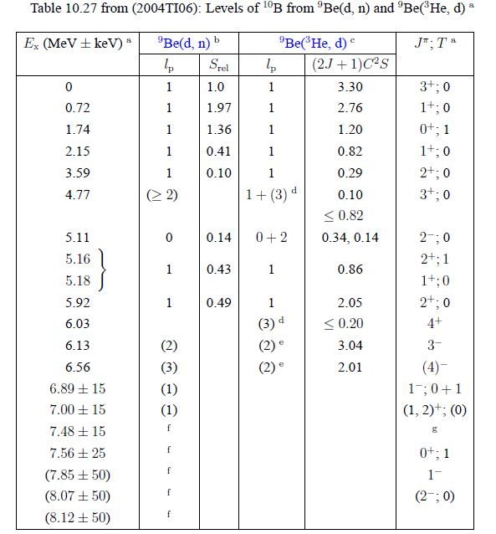

Slide 16
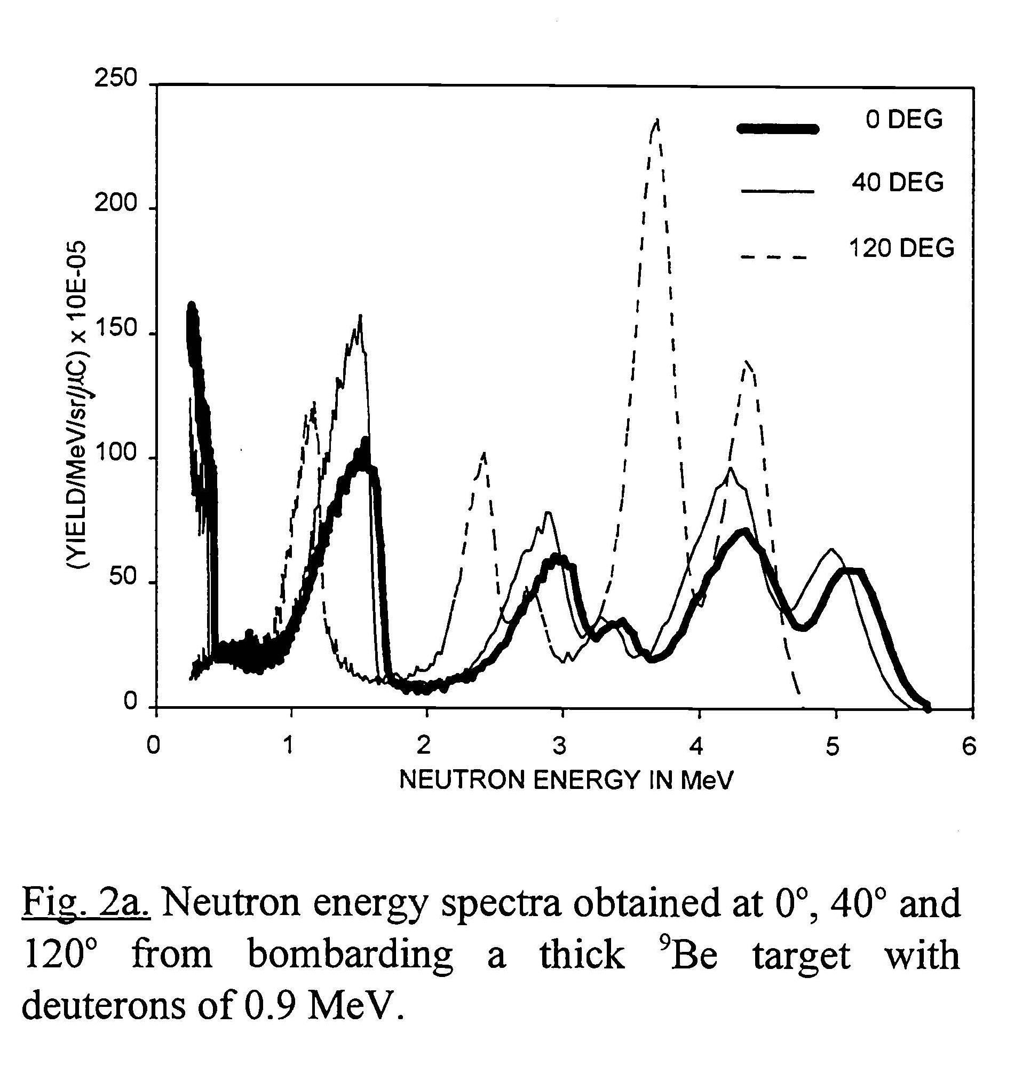

Slide 17
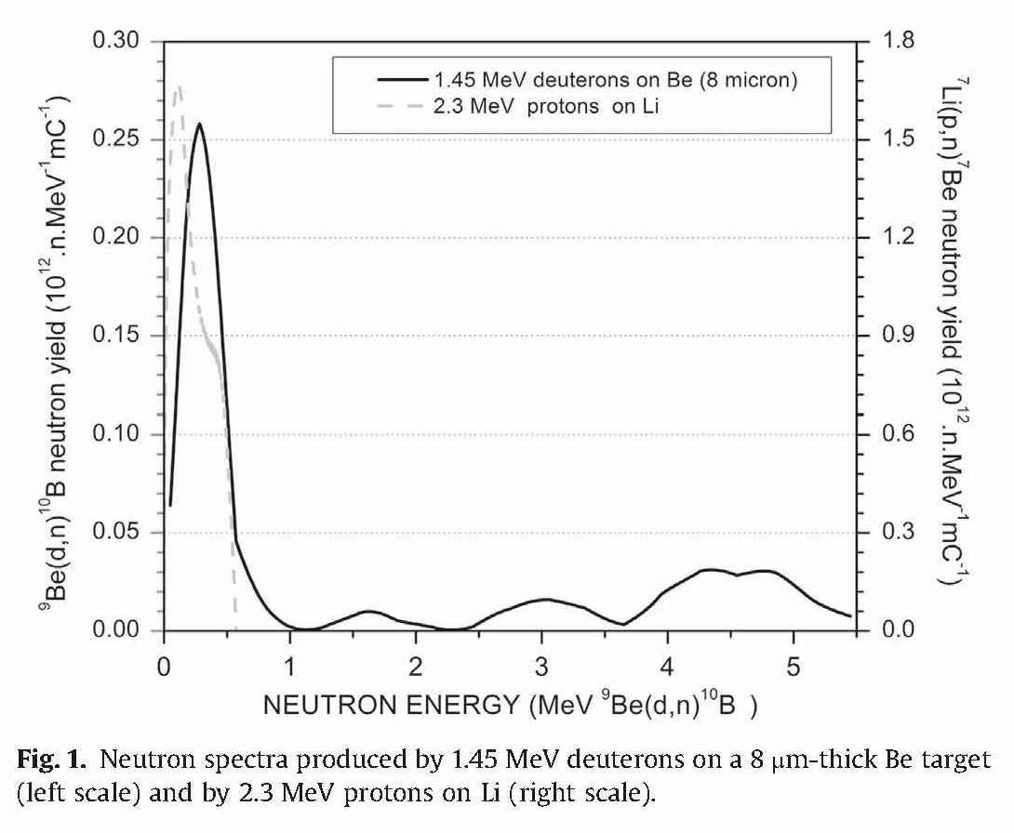

Slide 18
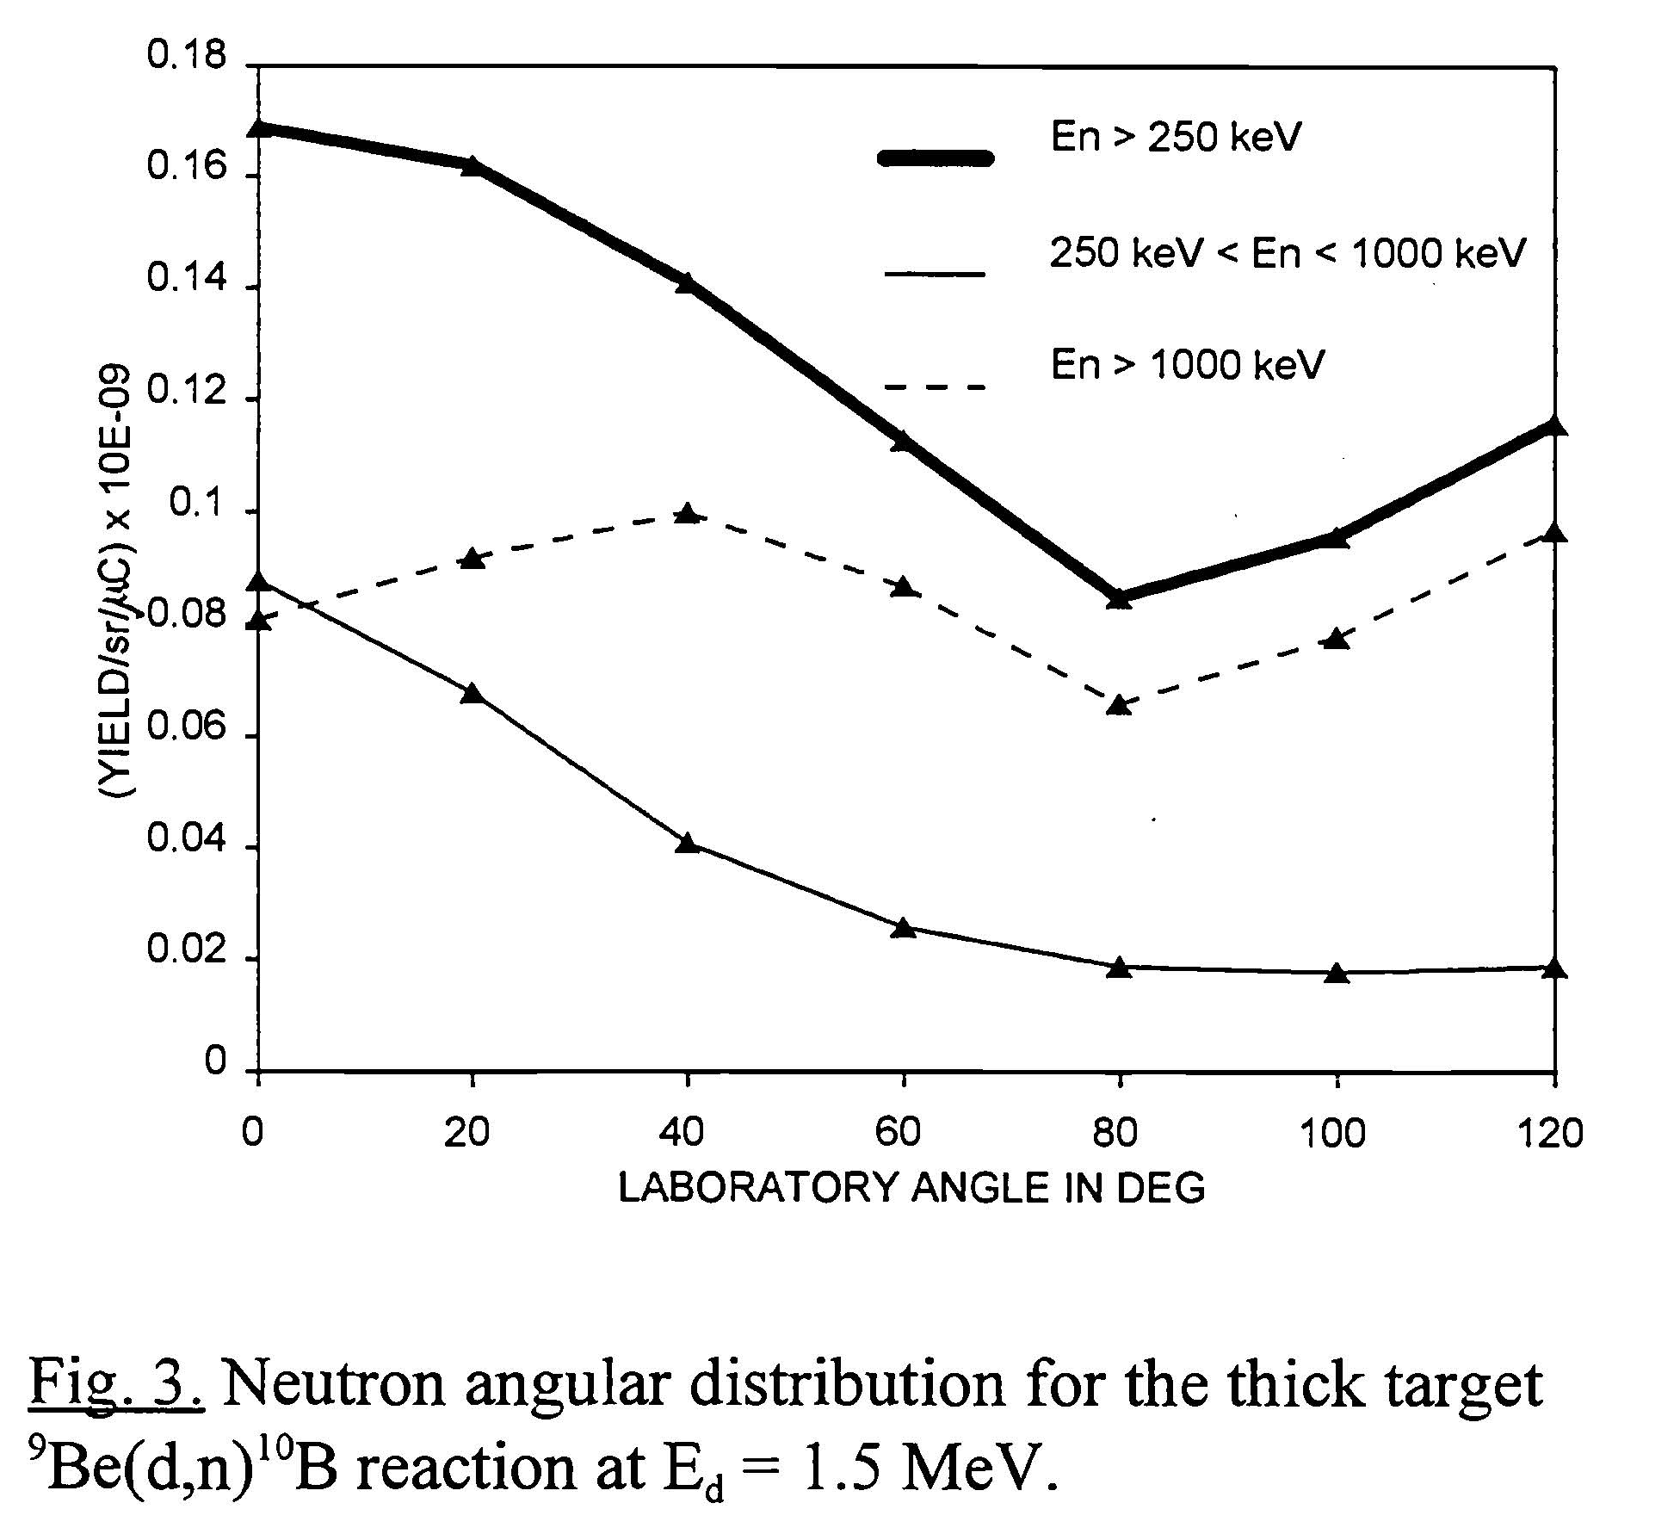

Slide 19
Comparison of Yields
Yield of neutrons <2.5 MeV by 3 MeV Be(d,n)B reaction is x ~8 of that of 1.5 MeV d case (1.7 x 10⁸ neutrons/uC) - 1.4 x 10⁹ neutrons/uC
Yield of neutrons < 1 MeV by Li(p,n)Be with 2.5 MeV p - 9.3 x 10⁸ neutrons/uC
Taking into account of the efficiency of moderation, 3 MeV Be(d,n) and 2.5 MeV Li(p,n) is equivalent in terms of number of neutrons.

Slide 20
Yield of neutrons by Be(p,n)B with 5 MeV p is ~40% of that of 8 MeV case, but the maximum energy of neutrons is 3 MeV in the former and 6 MeV in the latter. If we take into account the efficiency of moderation this ratio changes to about 2 : 3.
This means that 10 mA CW 3 MeV deuteron on Be target can produce almost equal number of neutrons to 10 mA CW 2.5 MeV proton on Lithium target and 10 mA CW 8 MeV protons on Be target.
15 mA CW 5 MeV protons on Be target can also produce the same number of neutrons.

Slide 21
A Few Comments on Be(d,n)B
IS + RFQ suffices. This scheme will make the system simpler, easier to operate, and more robust.
In order to reduce the higher energy neutron production, the thickness of the Be target should be finely controlled to make deuterons with lower than 1 MeV energy not to stop within the target. The thickness of the target will be ~20 um.
The study on this scheme is still rudimental. More detailed study has yet to be done.

Slide 22
Lessons from Deuteron RFQ and Deuteron Ion Source at LiPAC in Rokkasho
LiPAC has shown that higher than 100 mA CW deuteron beam is produced by its ion source with 100 KV extraction voltage. ~20 mA d ion source (~ 70 kV extraction voltage) will be of no problem.
LiPAC also has shown that 175 MHz 5 MeV deuteron CW RFQ can be made, although real beam operation has yet to be done. In this frequency TETRODEs can be used and we do not need to have any modulators even in the case of pulsed operation.
By decreasing the frequency down to ~175 MHz, the shunt impedance of RFQ has become more than doubled, and CW operation of RFQ for compact neutron sources will be within the reach of hospital and universities.

Slide 23
Summary
Discussion on neutron source on the basis of d(Be, n)B is still rudimental. The remaining main issues are: (1) exact estimation of neutron yield , (2) detailed design of RFQ and Ion Source, (3) development of thin (~20 um) Be target, and (4) design of the moderator.
CW 10 mA Be(p,n)B with 8 MeV p, CW 15 mA Be(p,n)B with 5 MeV p, CW 10 mA Li(p, n)Be with 2.5 MeV p, CW 10mA Be(d,n)B with 3 MeV d can produce about the same number of available neutrons for BNCT.
Except for the case of 8 MeV protons, IS + RFQ suffices, which make the system simpler and easier to operate.
Strong point is that we can learn much from LIPAc experiences, especially those of ion sources and CW RFQ.

Slide 24
Thank you for your attention!

