Slide 1
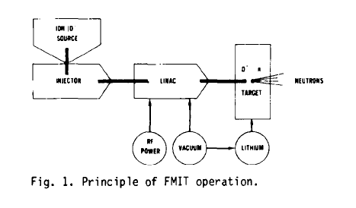
High Power Linacs
3.5 MW beam power
1979

Slide 2
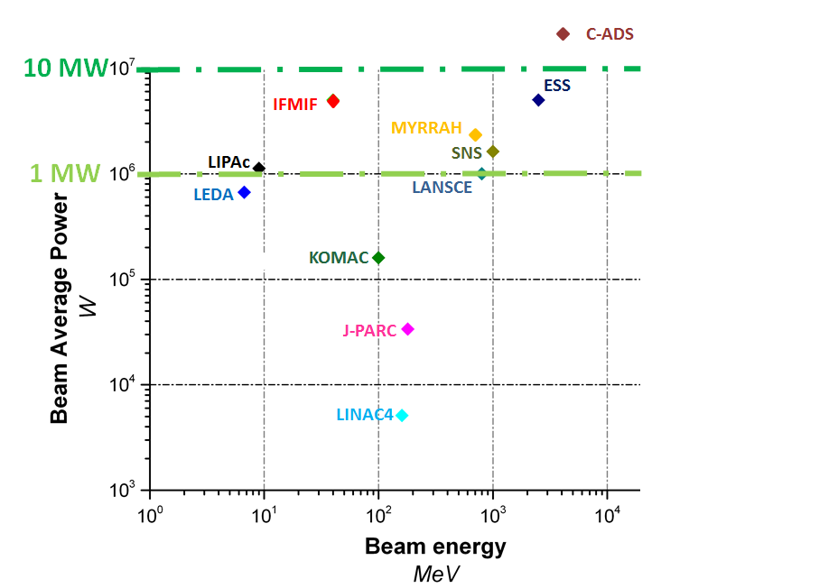
What do we call as High Power Linac?
Beam power vs Beam average power
I x E x duty cycle
but energy is measured in eV
thus the energy gives the voltage that the particle undergoes
P = I x V

Slide 3
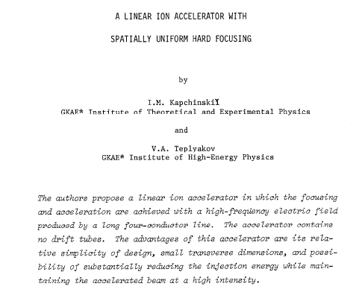
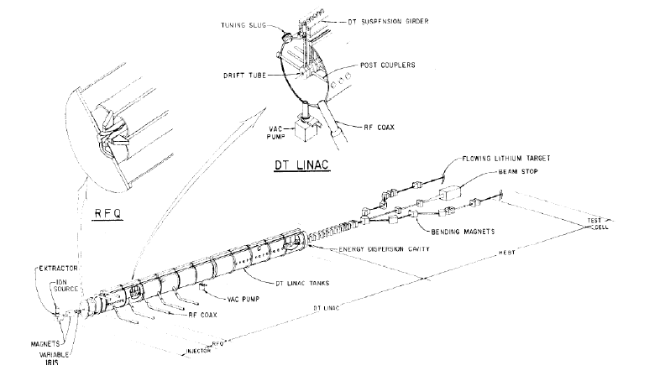
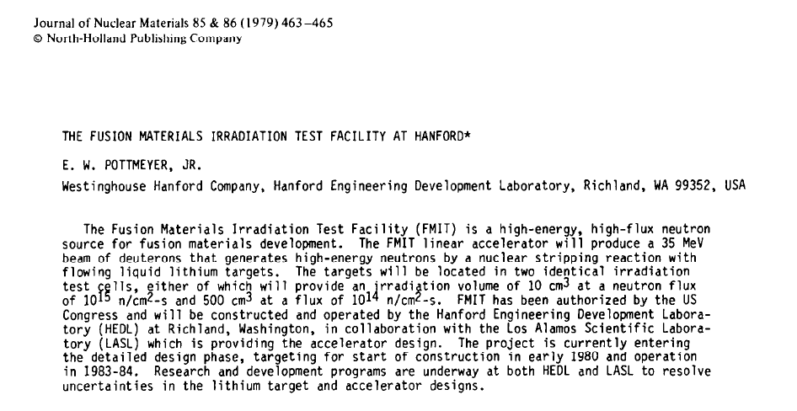
Proton Linacs have exhibited basically same structure
since the invention of the RFQ in 1969 in the URSS
its invention led to an enormous enthusiasm

Slide 4
About FMIT
it was cancelled in 1985

Slide 9
We don’t need to operate with H₂⁺
to learn how D⁺ would behave
We can operate in far better conditions with H⁺

Slide 10
Injector
RFQ
DTL
RF cavities
~100 keV
~ 5 MeV
> 100 MeV
High current accelerators face space charge phenomena
intra-beam non-linear repulsive forces lead to beam losses
Beam losses on high power linacs can be very damaging
1 W/m when talking of MW beam power is challenging
Acceleration can only be done in stages with specific hardware
all hardware has its operational limits

Slide 11
Injector needs to provide very high quality beam
in FMIT it was cathode based
DTL exhibits limits at high currents
drift tube linacs
Narrow tubes spaced a given distance
that the particle travels in phase with the RF power
Problems for low energies
Problems for high energies
Problems for high currents
Beam halo is enhanced by misaligment in interfacing equipment
FMIT targeted 200 μm alignment precision
In LIPAc we are aligning within 30 μm precision

Slide 12
For high currents Linacs
DTL is replaced by the novel concept of SC cavities

Slide 13
Technological breakthroughs to say goodbye to Alice
W.D. Cornelius, CW operation of the FMIT RFQ accelerator, Nucl. Instr. Meth. Phys. Res. B10/l1 (1985) 859-863
The 1st attempt to run a RFQ in CW was in Los Alamos (LANL)
for FMIT accelerator validation exercise
The ‘beam halo’ was discovered the rough way
Beam quality injected in RFQ was poor
ECR approach was technologically validated for H⁺ in Chalk River
LANL successfully operated LEDA
100 mA in CW at 6.7 MeV
with a dual electrodes capacitive/inductive part cooling RFQ tuning
and unraveled beam halo physics the following years
Alvarez type accelerating structure (DTL)
for beam energies within 0.2<β<0.6
is a difficult challenge for high currents in CW
the feasibility of superconducting resonators for low-β
was demonstrated in LANL in 2002
Operation of superconducting HWR cavities in CW
SARAF has operated 176 MHz HWR cavities in CW in 2013
T. Taylor and J.S.C. Wills, A high-current low-emittance dc ECR proton source, Nucl. Instr. Meth. Phys. Res. A309, (1991)
80s
90s
L.M. Young et al., High power operations of LEDA, LINAC 2000, Monterey
1999
2001
C.K. Allen et al., Beam-Halo Measurements in High-Current Proton Beams, Phys. Rev. Lett. 89, Number 21, 18 Nov. 2002
M. Kelly, Superconducting Radio-Frequency Cavities for Low-Beta Particle Accelerators, Reviews of Accelerator Science and Technology 5:185 (2012)
2001
T. Tajima, et al., Evaluation and Testing of a Low-β Spoke Resonator, PAC 2001, Chicago
2013
J. Knaster and Y. Okumura, Accelerators for fusion materials testing, Reviews of Accelerator Science and Technology 8, 115142 (2015)
A. Kreisel at al., Phase-I proton/deuteron linac beam operation status, Proceedings of LINAC2014, Geneva

Slide 15
D+ 10 mA CW at 40 MeV
BISOL
DONES
A-FNS
LIPAc
D+ 125 mA CW at 40 MeV
ImPACT
D+ >1 A CW at 40 MeV
MYRRHA
H+ <4 mA CW at 600 MeV

Slide 16
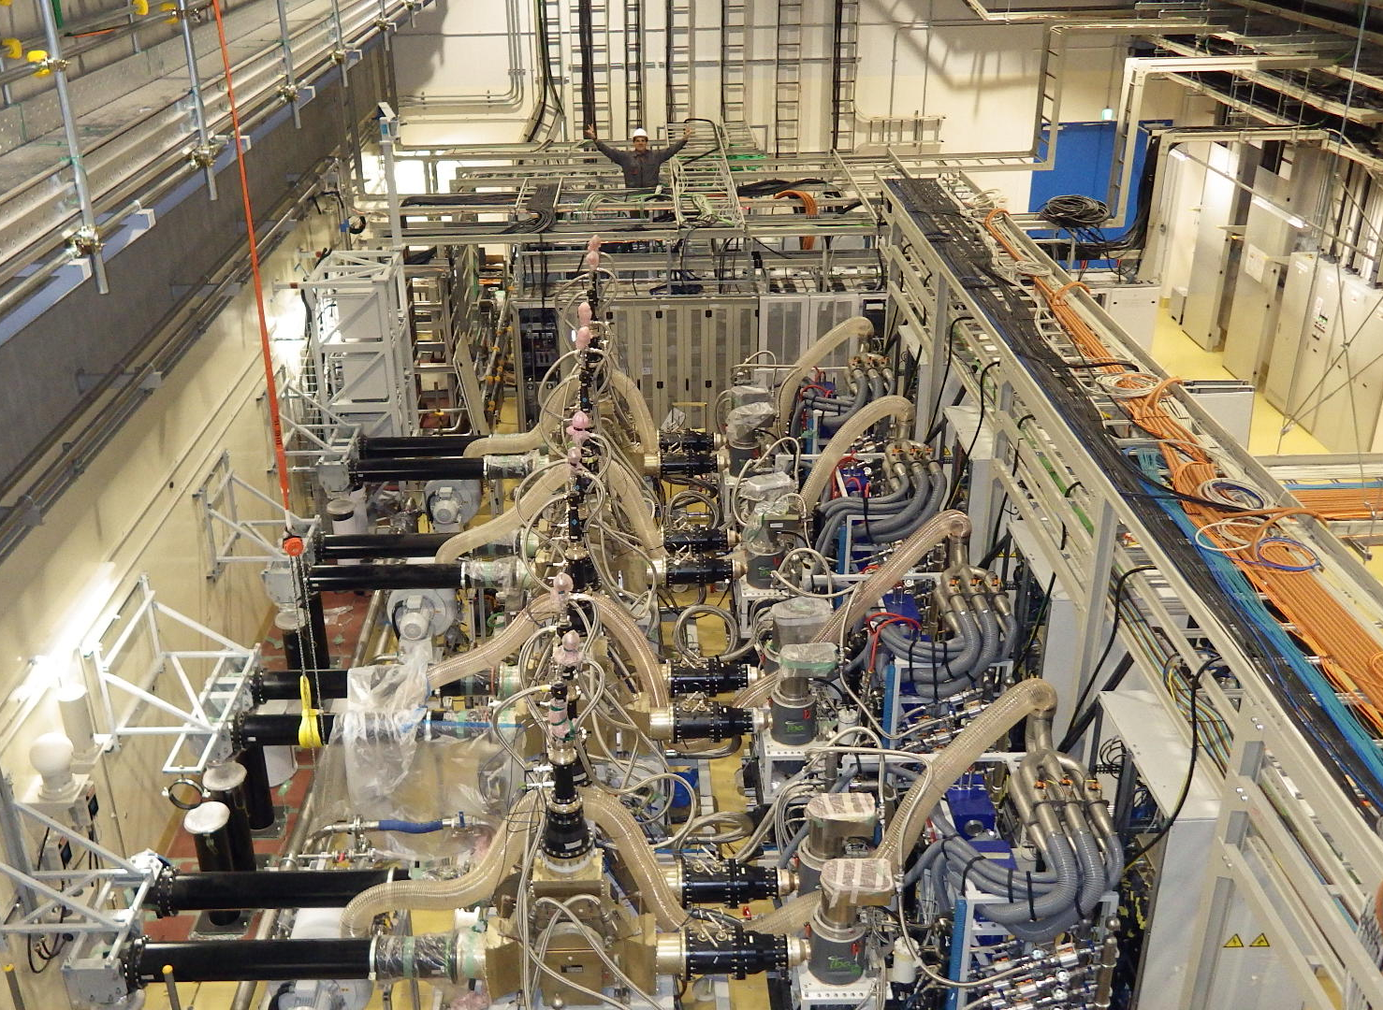
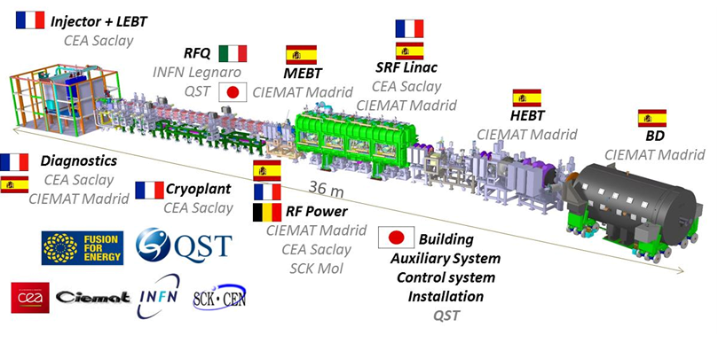
LIPAc is reality to test 125 mA in CW
at 9 MeV through 175 MHz HWR

Slide 17
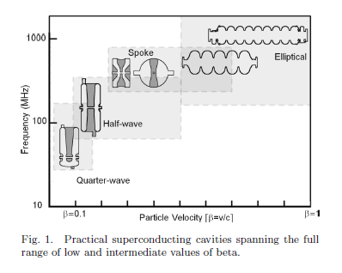
Yesterday there were two questions
Why ImPACT is pursuing QWRs?
M. Kelly, Superconducting Radio-Frequency Cavities for
Low-Beta Particle Accelerators, Reviews of Accelerator Science and Technology Vol. 5 (2012) 185–203

Slide 18
Has been properly assessed in BISOL injecting D⁺ at 50 keV
for higher currents tan 10 mA?
Actually,
the lower the energy, the space charge drawback is more severe

Slide 19
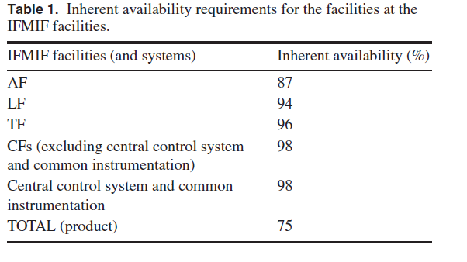
Another question raised
about availabilities
ADS dream with challenging availabilities
IFMIF has a careful RAMI analysis
J. Knaster et al, Overview of IFMIF/EVEDA project, Nuclear Fusion 57 (2017) 102016

Slide 20
A topic not addressed
but challenging
is beam instrumentation
High powers
prevent interceptive diagnostics
Low energies
makes challenging non-interceptive diagnostics
High power & Low energy beams
becomes an entertaining scenario

Slide 21
Where is the limit of currents in CW through a HWR?
We now know that is at 10 mA
LIPAc will show that 125 mA is feasible
Why not dreaming >1 A?
Anyhow,
don’t forget what means 1 MW beam power flying
at few cm of structures at 4 K

