Slide 1

The MYRRHA project
2017

Slide 2
Outline
What is Project MYRRHA?
MYRRHA technical description
MYRRHA Research & Development effort
MYRRHA planning
Notes:
The presentation will consists in four parts, what about, technical description, current status of R&D and time planning

Slide 3
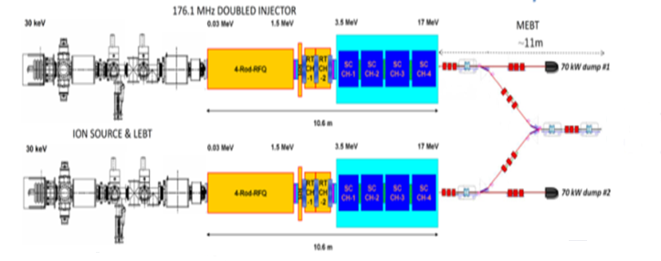


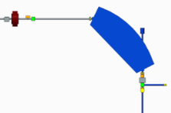
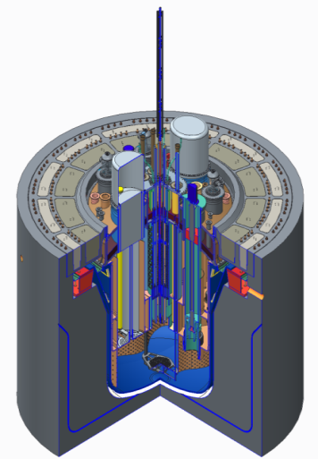
Key technical objective of the MYRRHA-project: an Accelerator Driven System
Construction of an Accelerator-Driven System (ADS) consisting of
A 600 MeV – 2,5 mA to 4,0 mA proton linear accelerator
A spallation target/source
A lead-Bismuth Eutectic (LBE) cooled reactor able to operate in subcritical & critical mode
Accelerator
particles | protons
beam energy | 600 MeV
beam current | 2.4 to 4 mA
Target
main reaction | spallation
output | 2·10¹⁷ n/s
material | LBE (coolant)
Reactor
power | 65 to 100 MW_{th}
k_{eff} | 0,95
spectrum | fast
coolant | LBE
Source: SCK•CEN MYRRHA Project Team
Notes:
The key technical objective of myrrha is to deliver two line accelerator on 600 MeV protons towards spallation target. Lead-bismuth cooled reactor would be ignited by neutrons generated on the spallation target. The designed power is from 65 to 100 MW.

Slide 4
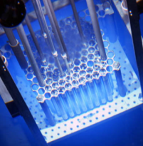






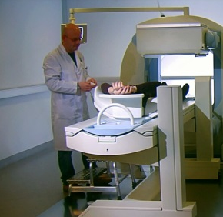

MYRRHA application portfolio
Multipurpose
hYbrid
Research
Reactor for
High-tech
Applications
Fission GEN IV
Fusion
Fundamental research
SNF*/ Waste
Radio-isotopes
SMR LFR
*SNF = Spent Nuclear Fuel
Source: SCK•CEN MYRRHA Project Team, MYRRHA Business Plan
Notes:
Myrrha has a number of applications which are listed on this slide

Slide 5




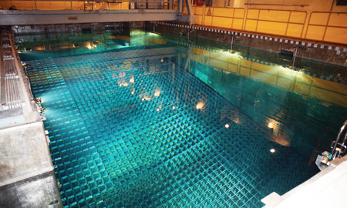


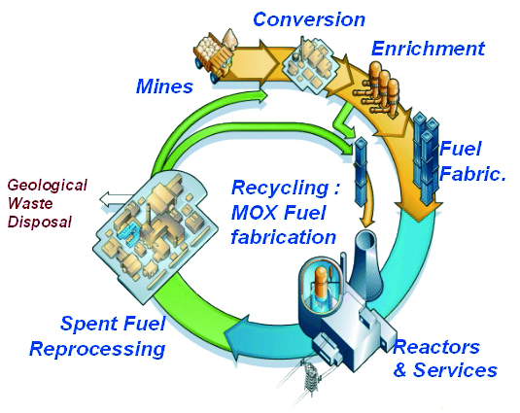
Global challenges for nuclear energy today: Closing the fuel cycle is priority number one
Burning legacy
of the past
Reducing cost of
ultimate waste
© Korea Times
Better use of resources
Common needs
Enhance Safety
Source: SCK•CEN MYRRHA Project Team
Notes:
One of the most important one is the recycle of spent fuel, in particular burning of minor actinides thus making close loop for the fuel operation.

Slide 6
Outline
What is Project MYRRHA?
MYRRHA technical description
MYRRHA Research & Development effort
MYRRHA planning

Slide 7
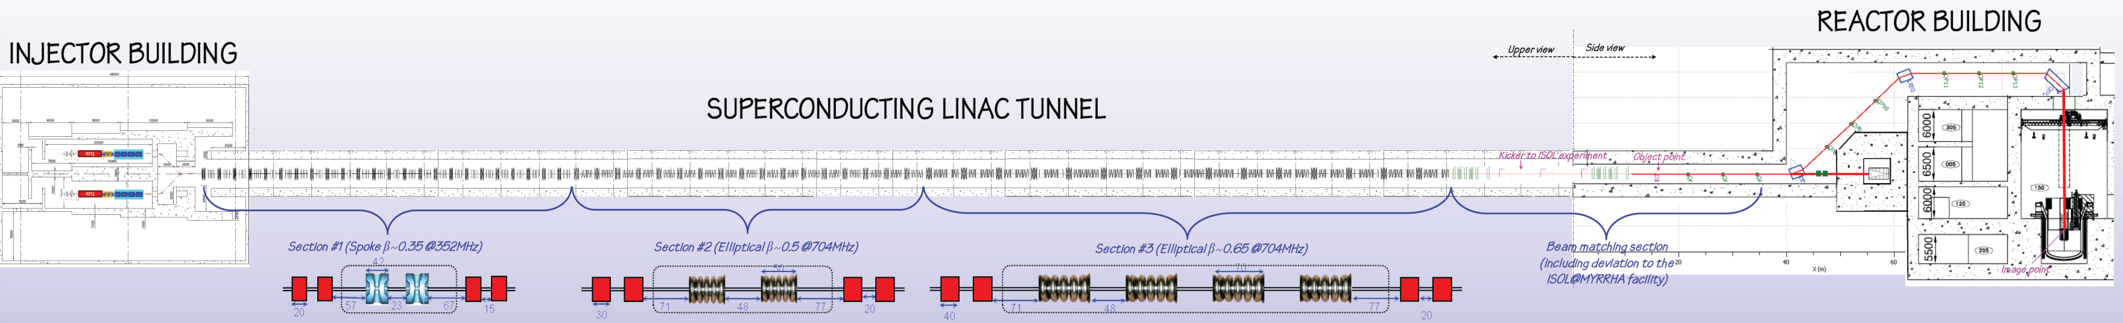
MYRRHA linac
Notes:
The linear accelerator will consist of injector building, several sections conducting the beam to the main building. Dump pit for the beam and bypath to drive the beam towards the spallation target.

Slide 8
Specific requirements of MYRRHA Accelerator
High power proton beam (up to 2.4 MW)
Proton energy | 600 MeV
Beam current | 0.1 to 4.0 mA
Repetition rate | Continuous Wave, 250 Hz
Beam duty cycle | 10⁻⁴ to 1
Beam power stability | < ± 2% on a time scale of 100ms
Beam footprint on reactor window | Circular ∅85mm
Beam footprint stability | < ± 10% on a time scale of 1s
# of allowed beam trips on reactor longer than 3 sec | 10 maximum per 3-month operation period
# of allowed beam trips on reactor longer than 0.1 sec | 100 maximum per day
# of allowed beam trips on reactor shorter than 0.1 sec | unlimited
Extreme reliability level: MTBF > 250 hrs
Notes:
Myrrha will operates in continuus wave mode not pulsed one. The beam current can deliver up to 4 mA. Beam duty cycle is enabled to measure multiplicity of neutorns (subcriticallity). Beam footprint stability = spatial stability.
There is an extreme a reliability requirements for the beam trips, depending on their duration. Long interruption of the beam imposes fatigue on reactor materials, therefore the parameters of the beam are interlinked with design and safety assessment.

Slide 9
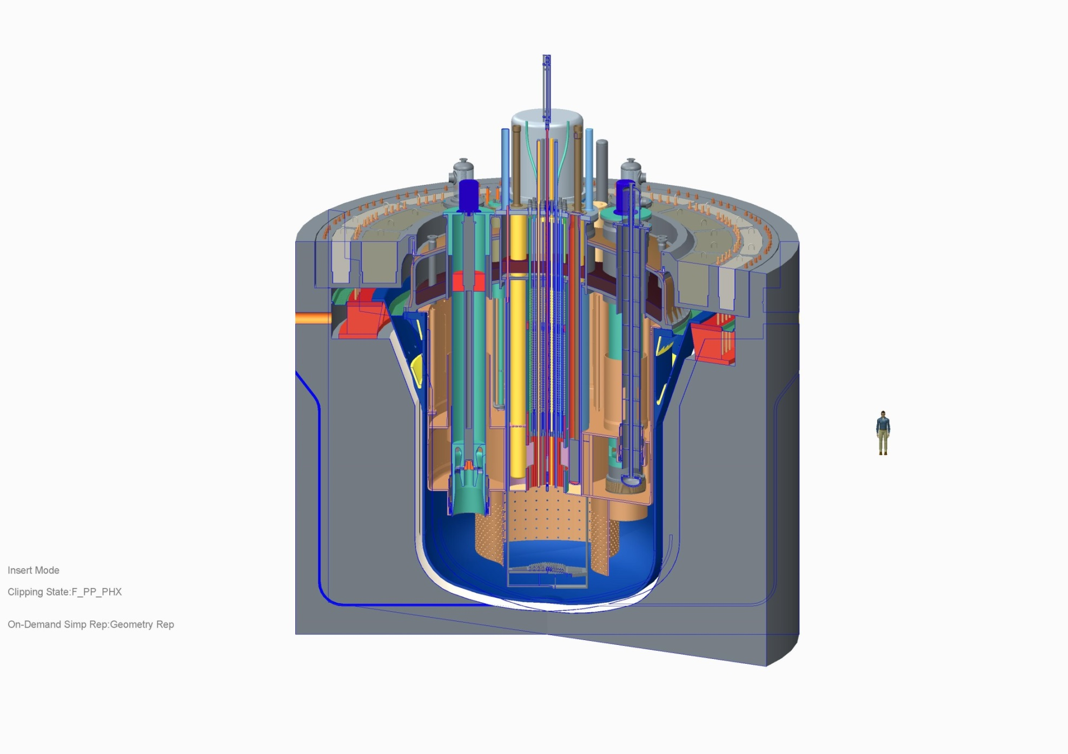
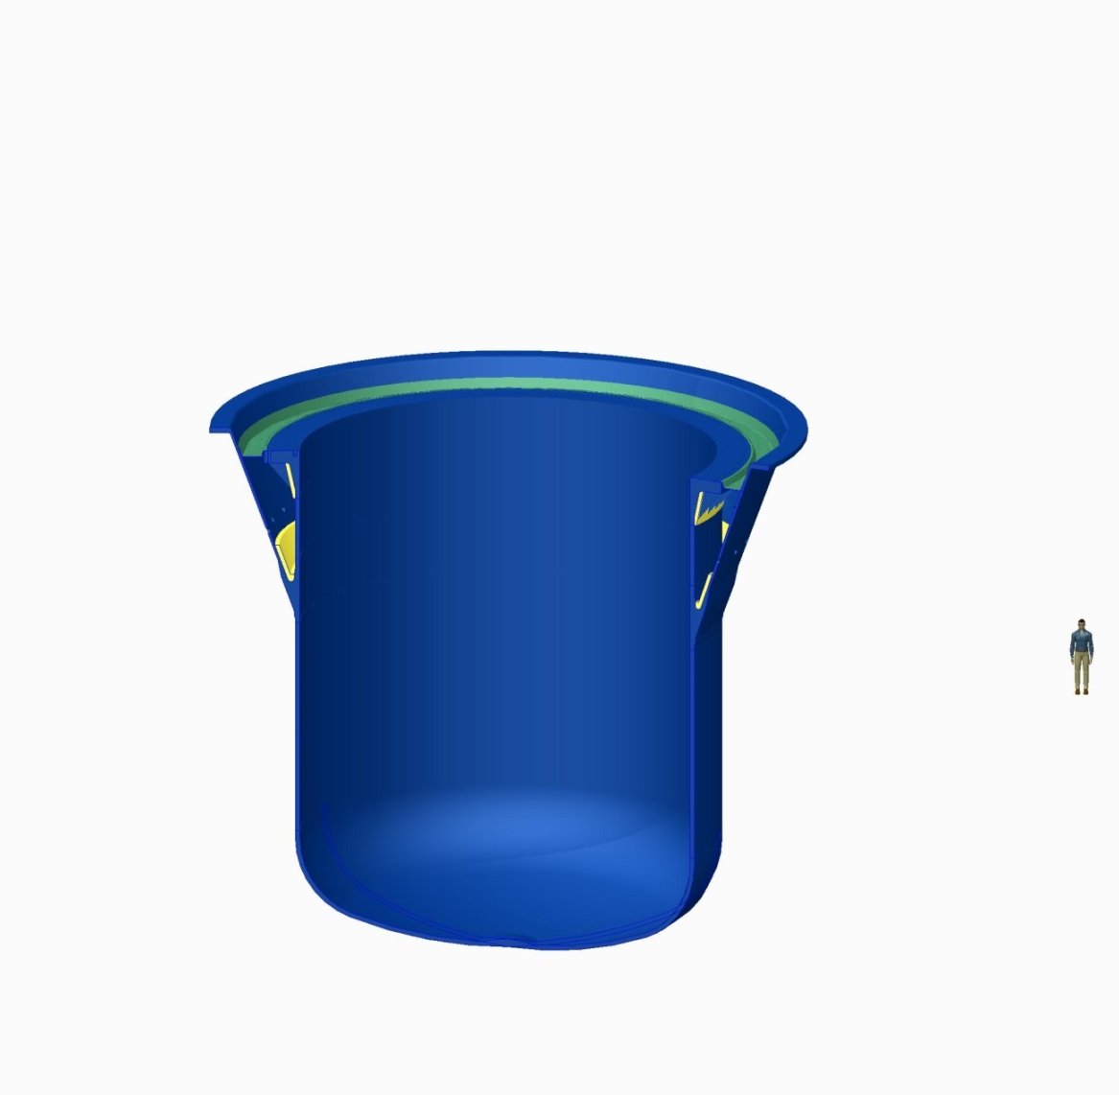
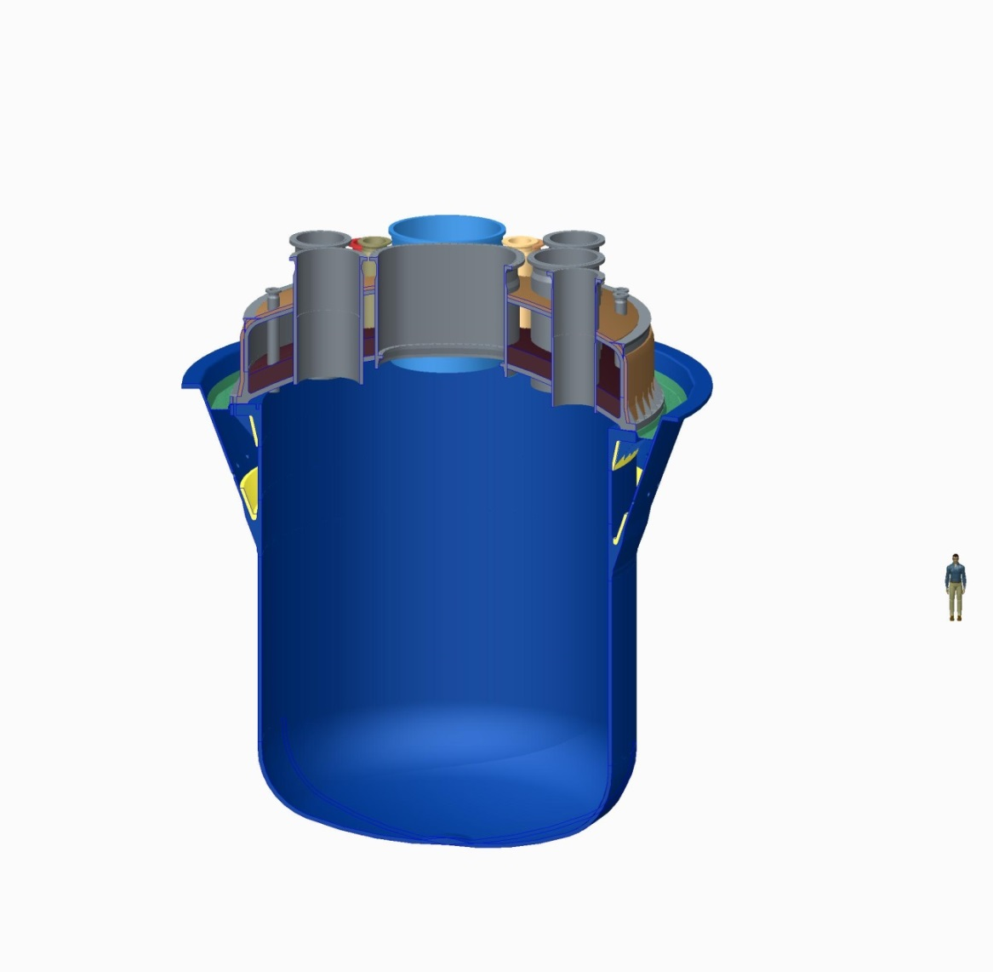


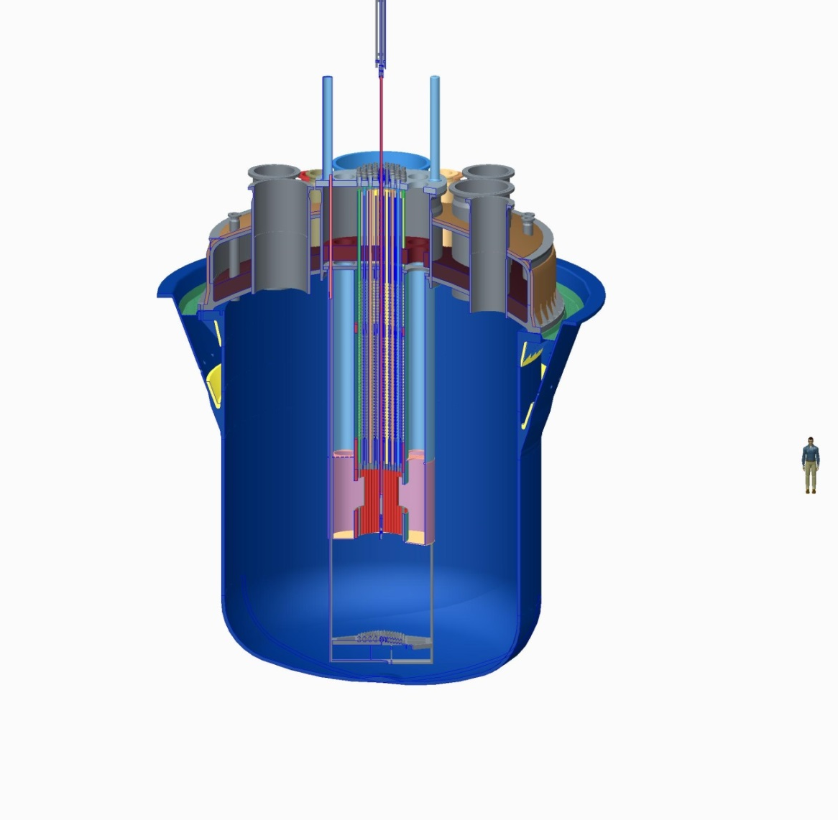
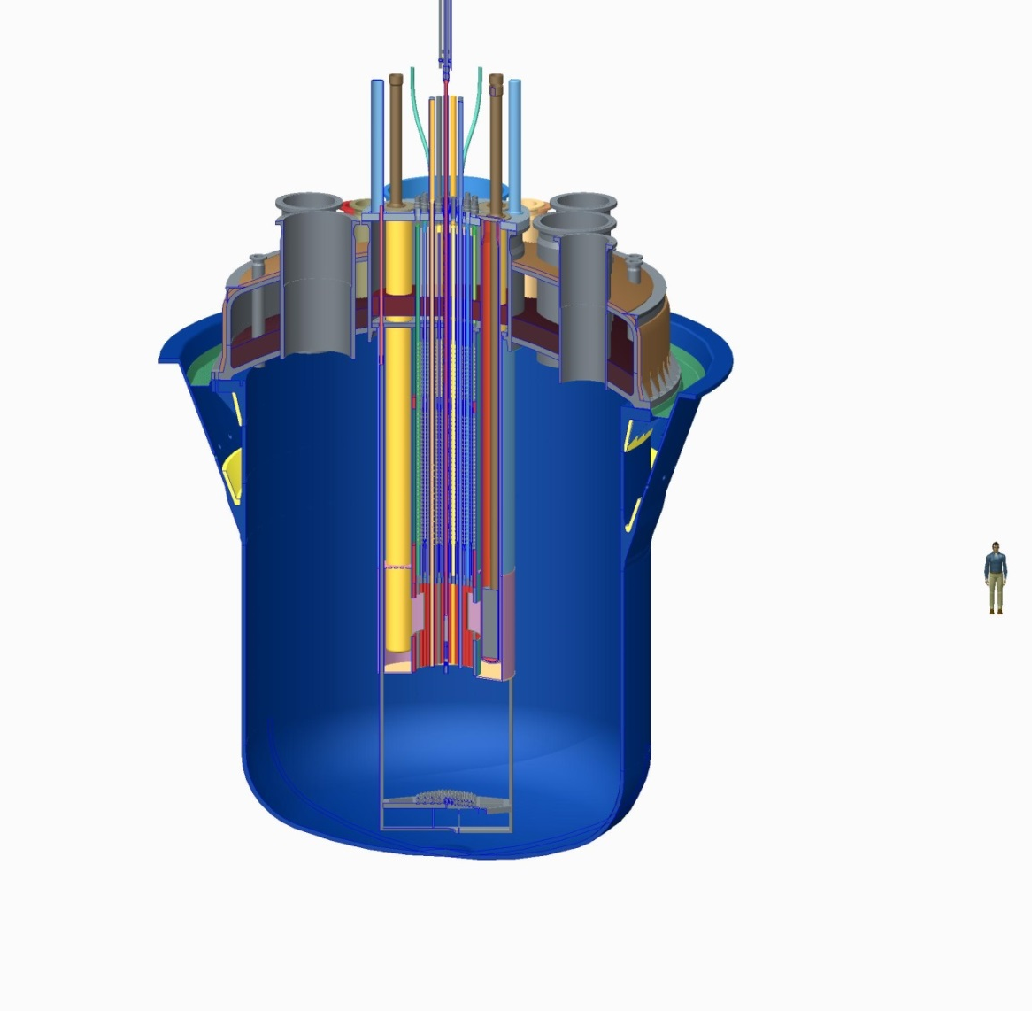
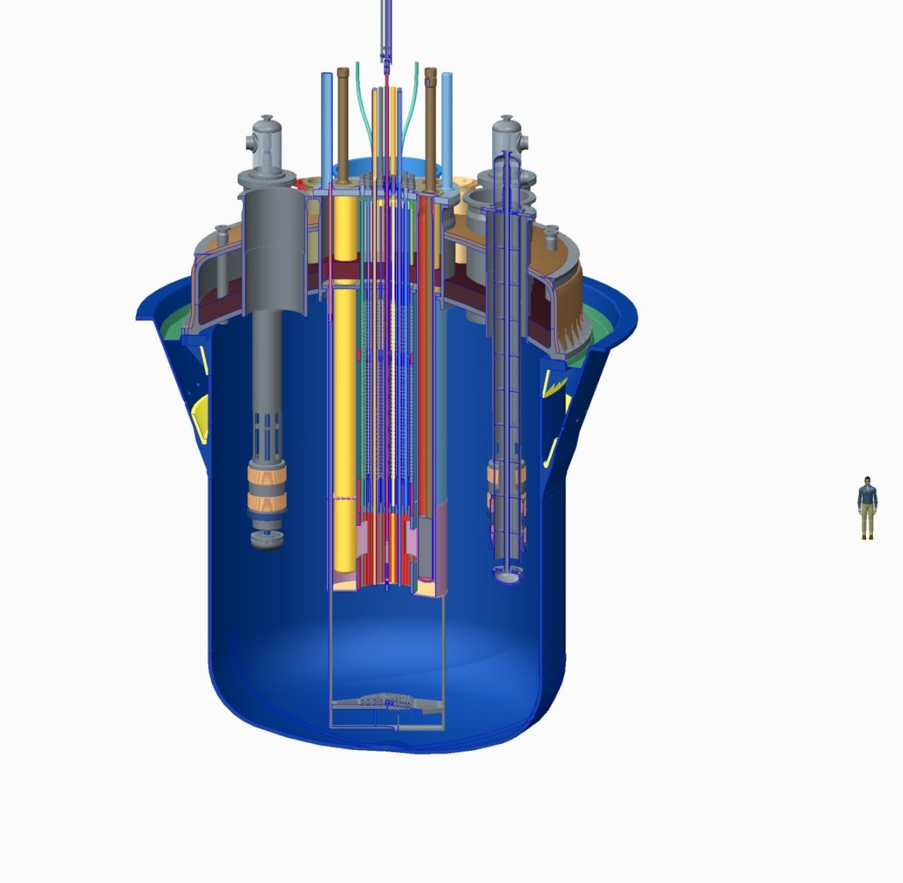
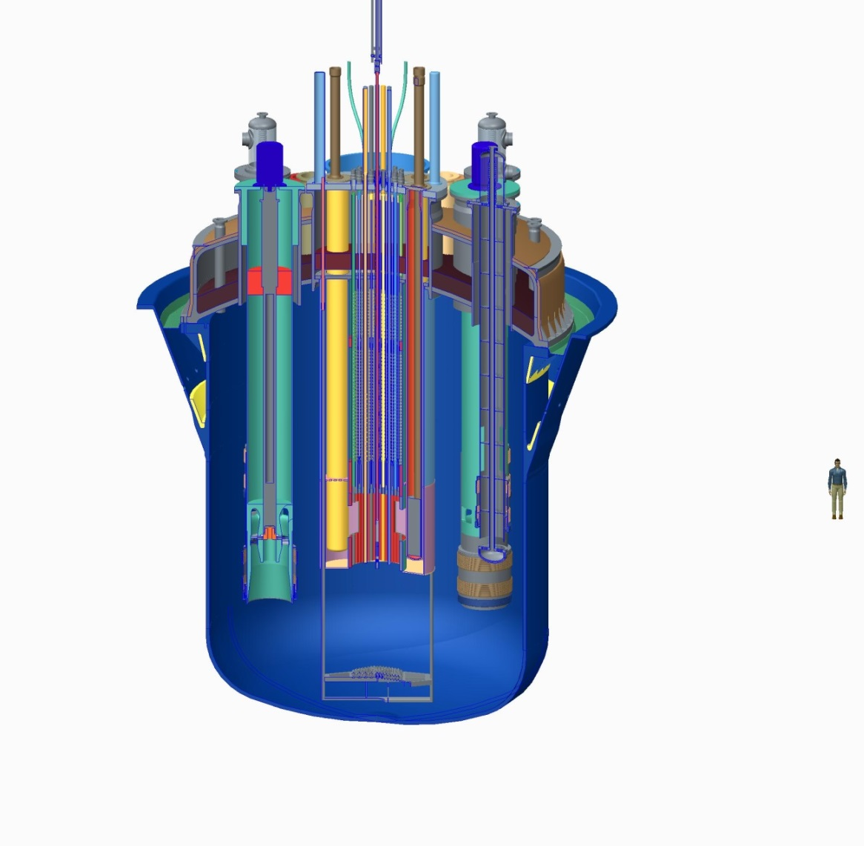
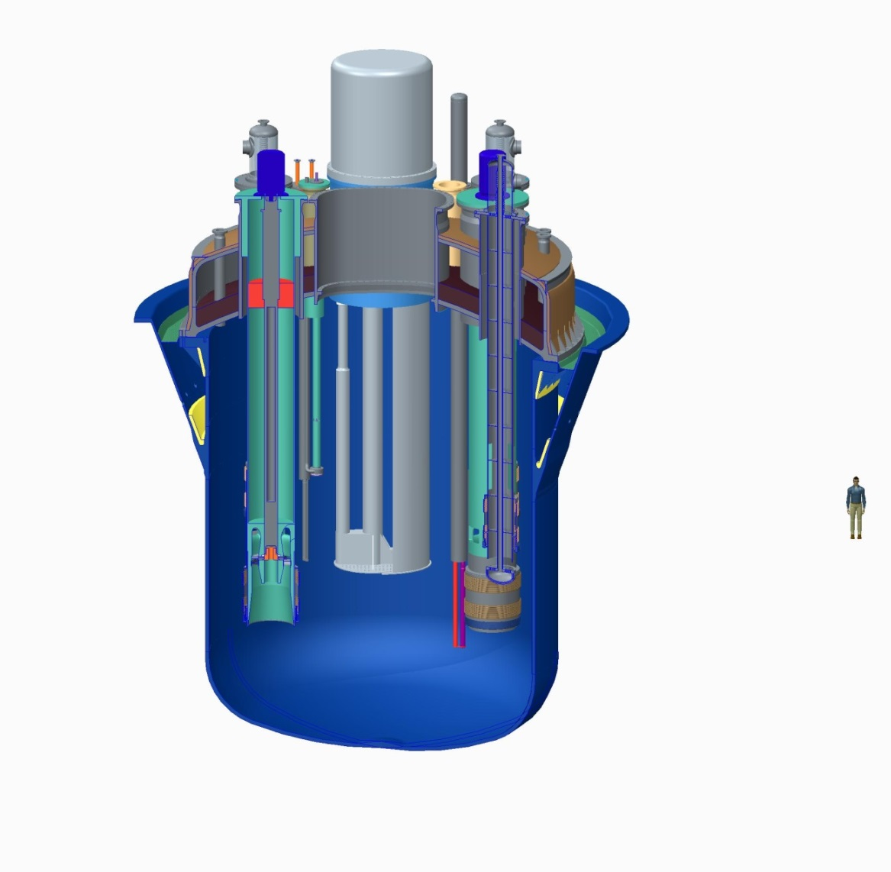
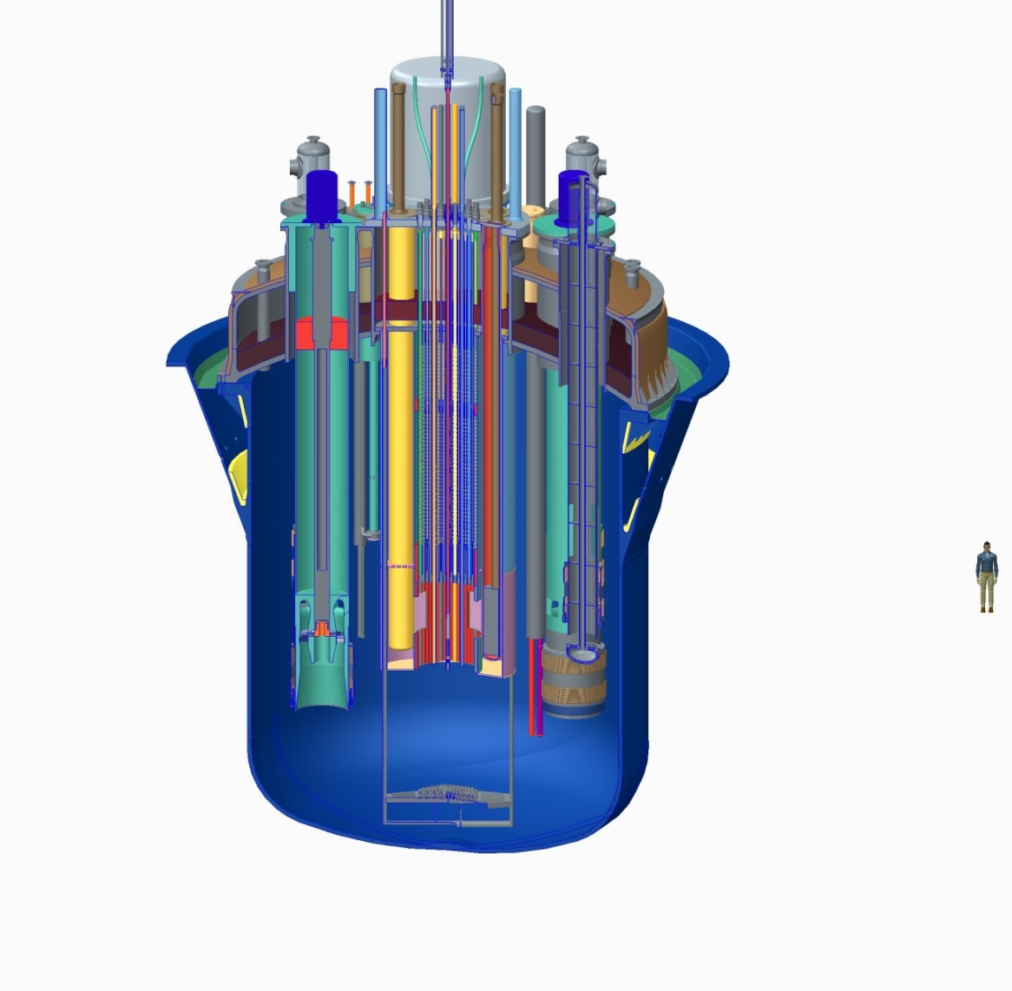
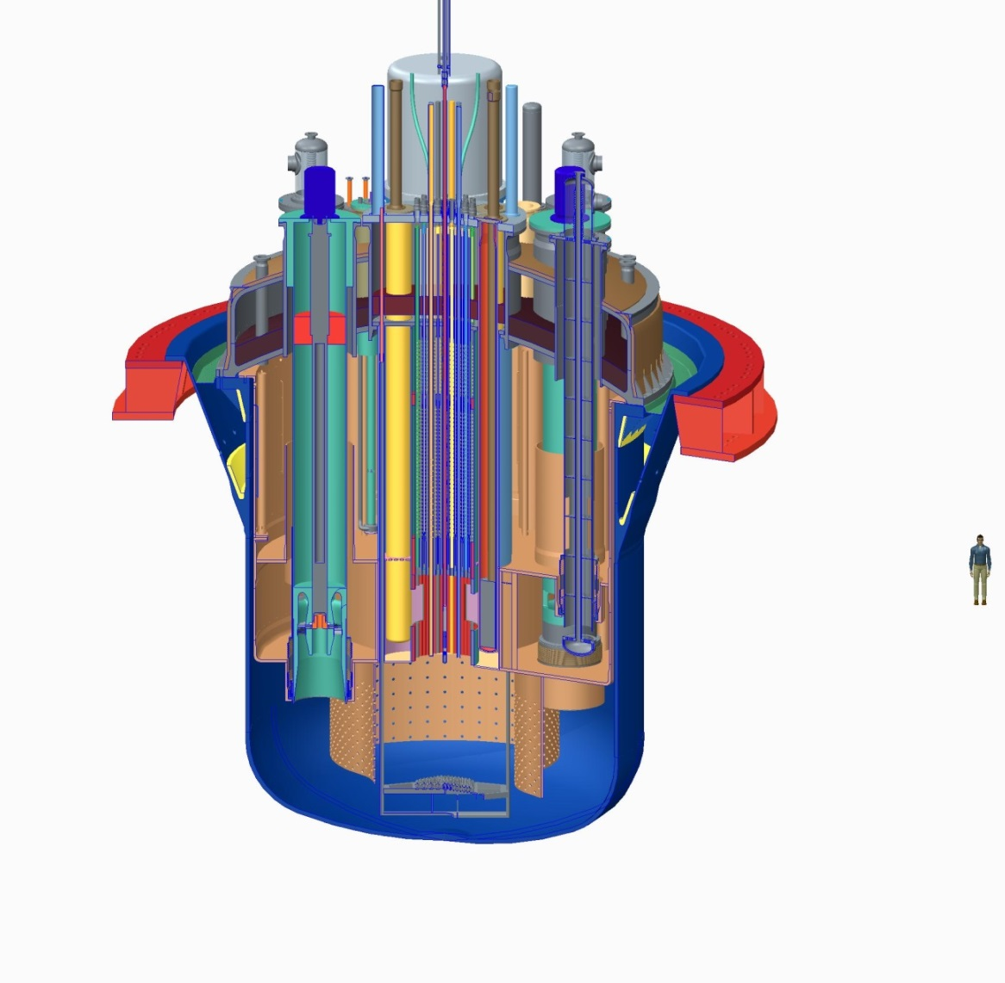
Reactor – Current Primary System design (v1.6)
Reactor layout
  Vessel
  Cover
  Core barrel and Multi-functional plugs
  Above Core Structure
  Cradle, Core Restraint System, beam line and window target
  Si-doping units, Mo-irradiation units, control rods and safety rods
  Primary Heat Exchangers
  Primary Pumps
  In-Vessel Fuel Handling Machines, Fuel Transfer Devices, Failed Fuel Detection Devices, Extraction Pumps
  Diaphragm and support structure
  Reactor pit, Reactor Vessel Auxiliary Cooling System
Source:SCK•CEN MYRRHA Project Team
Notes:
Multi-functional plugs : capacity to access core from the top. Primary heat exchanger = LM <-> Water

Slide 10
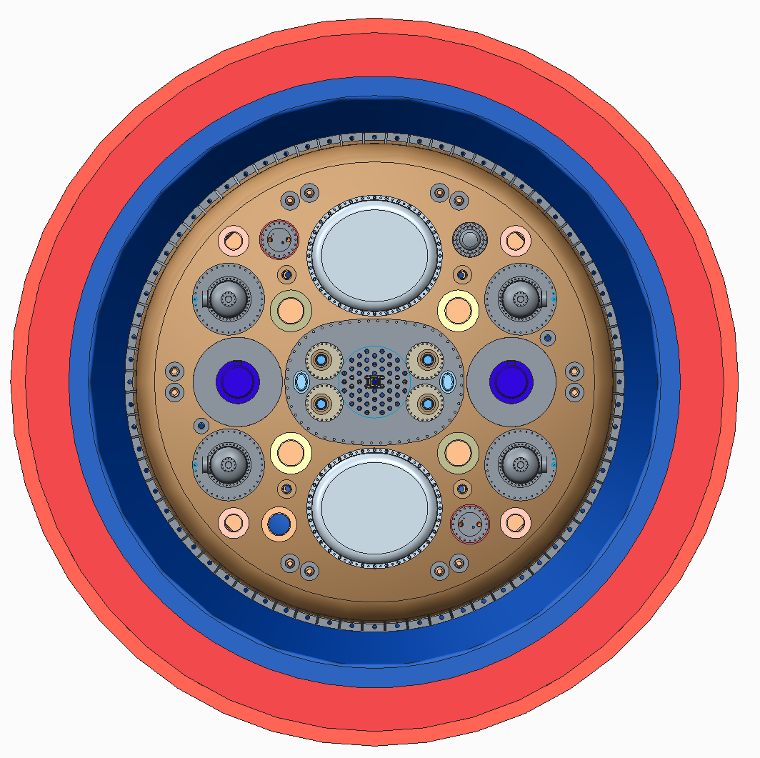
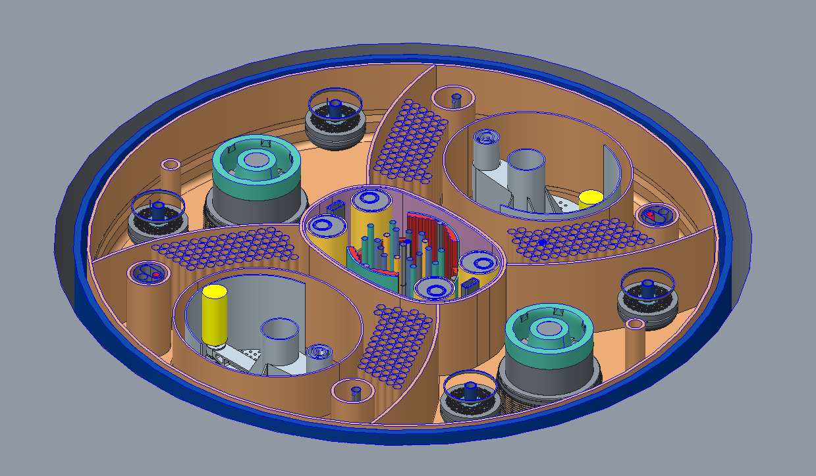
Current Primary System design
Reactor layout
  Top and core mid-plane
Notes:
Fuel recharging is to happen after 10 cycles. 1 cycle is 90 days. Flue are fuel assemblies

Slide 11
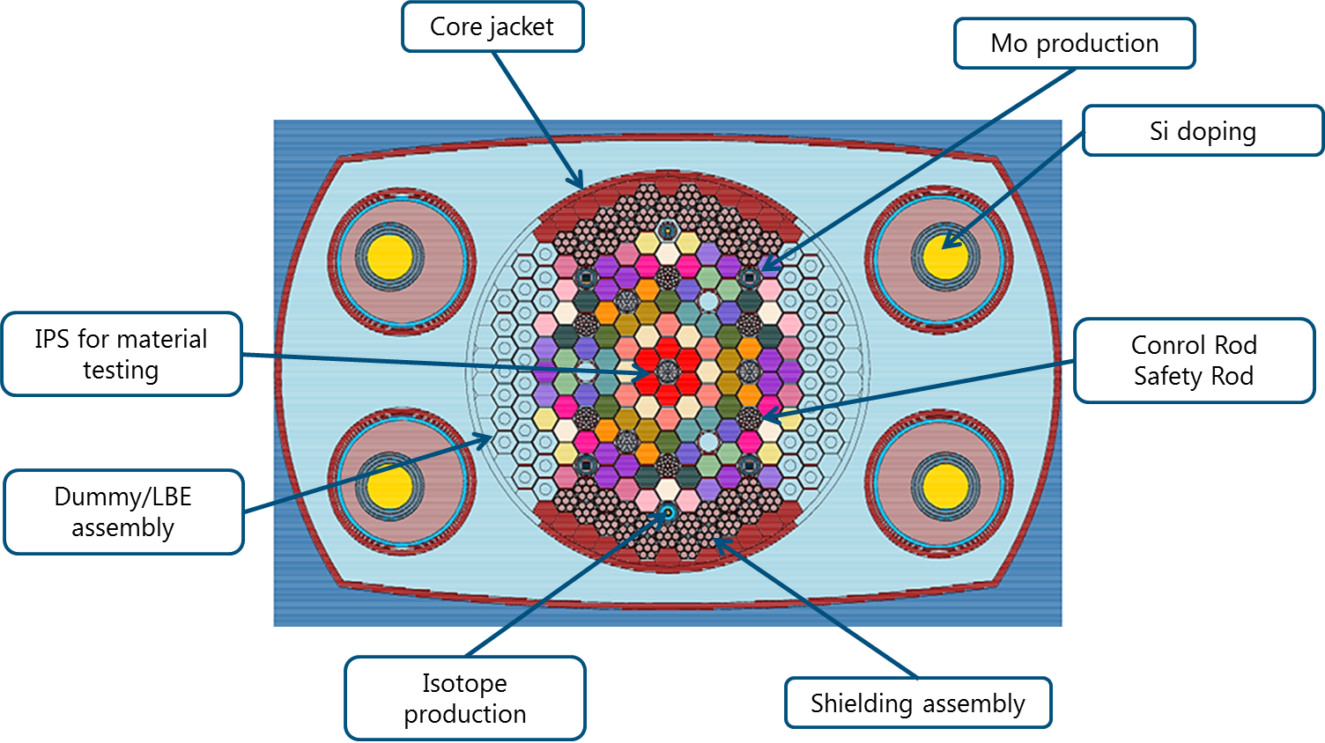
Current Primary System design
MYRRHA Core
  Critical
    108 FA
  Sub-Critical
    72 FA
Notes:
Everything that is not labeled is fuel assemblies. Multifunctional plugs are applied for Isotope production & IPS.

Slide 12
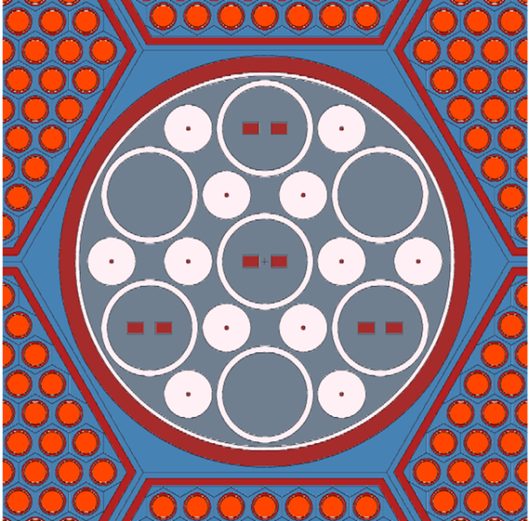
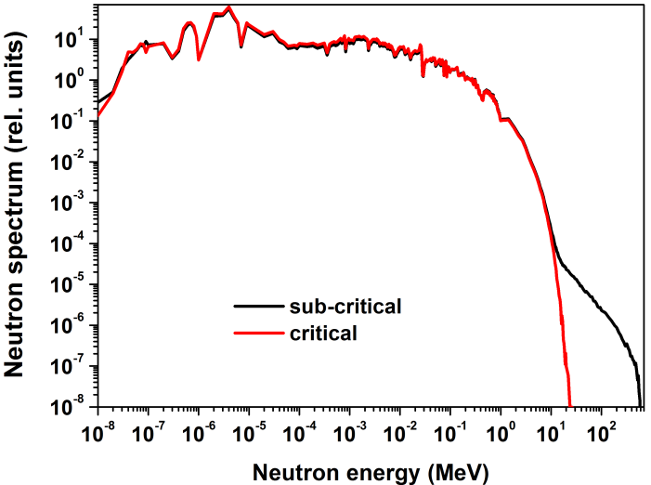
Irradiation performances
 |  | Critical | Sub-critical
Flux and DPA values normalised to | MWth | 96 | 72
Beam current | mA | - | 1.74 – 2.52
DPA damage in IPS
IPS in central channel | DPA/FPY | 21.7 | -
IPSs in off-central channel | DPA/FPY | 13.9 | 31
Neutron Flux in IPS
IPS in central channel / target
Φ≥ 0.75 MeV | n/cm² s | 4.05E+14 | 1.01E+15
Φtot | n/cm² s | 2.61E+15 | 3.75E+15
IPSs in off-central channel
Φ≥ 0.75 MeV | n/cm² s | 2.56E+14 | 4.2E+14
Φtot | n/cm² s | 1.75E+15 | 2.6E+15
Notes:
This is the zoom of IPS. It is timble tube principle with OPE on the top. DPA is specified for Full Power Year. Cycles go as 90c-30-90c-30-90c-90. per calder year, 64%*31 dpa is delivered. Operation in critical mode = removal of the spallation target. In this case, OPS can be placed instead of Spallation Target.

Slide 13

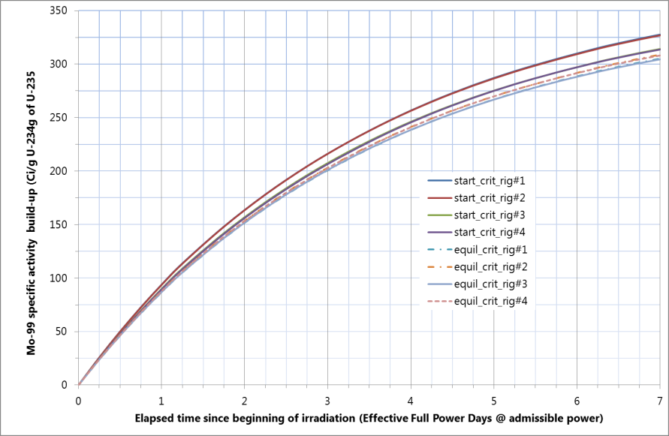
Radioisotope production
Mo99 production
  Fission of U targets
  Moderation needed!
  H₂O device
Notes:
Production of isotopes requires thermal neutrons, and those we can get in IPS. AT the same time, we can have fast spectrum.
BR2 delivers about 300 Curie/gram within approximately same number of days. To do so, we need to have a rig with water inside.

Slide 14
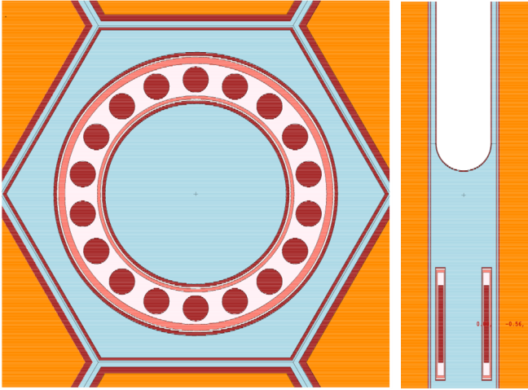
Irradiation for fusion-like conditions
Below spallation target
  Very high + hard neutron flux
  Proton flux
Irradiation of samples
  High dpa’s & dpa rates
  High appmHe/dpa rates

Slide 15
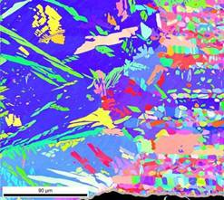
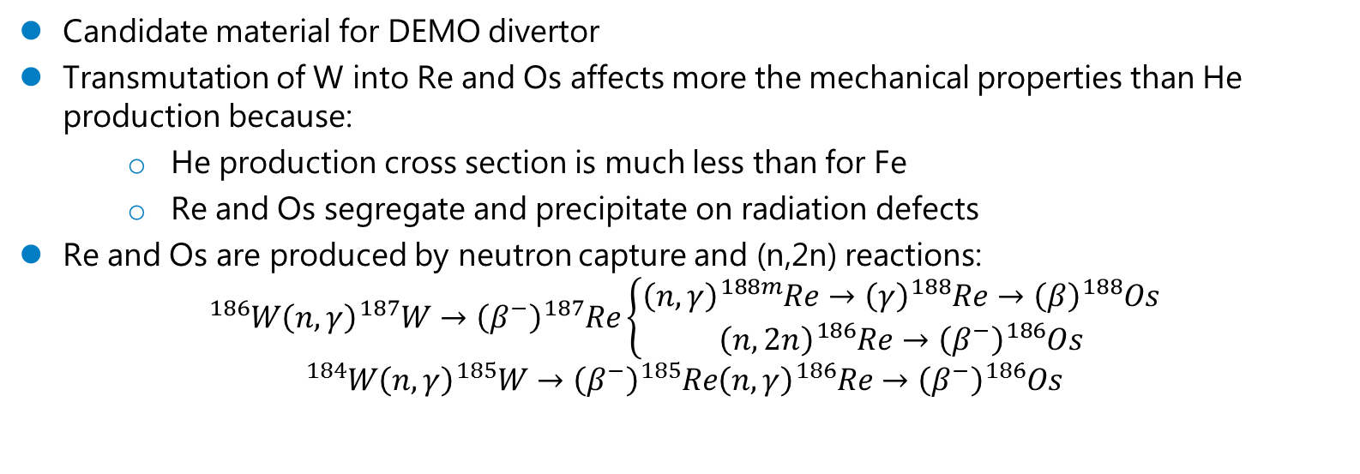
Damage of W samples
Candidate material for DEMO divertor
Transmutation of W into Re and Os affects more the mechanical properties than He production because:
He production cross section is much less than for Fe
Re and Os segregate and precipitate on radiation defects
Re and Os are produced by neutron capture and (n,2n) reactions:
$${}_{}^{186}{W\left(n,γ\right)}{}_{}^{187}{W→\left(β^{−}\right)}{}_{}^{187}{Re\left\{\begin{aligned}\left(n,γ\right){}_{}^{188m}{Re→\left(γ\right){}_{}^{188}{Re→\left(β\right){}_{}^{188}{Os}}} \\ \left(n,2n\right){}_{}^{186}{Re→\left(β^{−}\right)}{}_{}^{186}{Os}\end{aligned}\right.}$$
$${}_{}^{184}{W\left(n,γ\right)}{}_{}^{185}{W→\left(β^{−}\right)}{}_{}^{185}{Re\left(n,γ\right){}_{}^{186}{Re→\left(β^{−}\right){}_{}^{186}{Os}}}$$
Need for dedicated neutron irradiation source
High neutron flux
Specific/adjustable transmutation rates
Notes:
This is just informative slide why tungsten and why we are looking primarily into its transmutation in Re and Os. You can probably replace it by your slides which I believe are more informative.

Slide 16
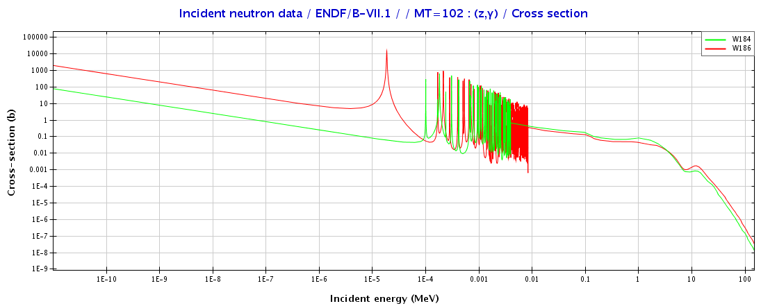
Transmutation of W
MYRRHA conditions require adjustment:
spectrum is harder than in DEMO divertor → lower production rates by (n,γ)
But dpa damage is accumulated much faster → the ratio of W transmutation/dpa could be close to DEMO values !
Notes:
The neutron spectrum what we have below the spallation target is very hard. We can try to moderate it if we organize water flow through samples. But even in this case we will have the spectrum harder than DEMO (plot to the right). But because transmutation rate is defined as cross section (left plot) multiplied by the flux (right plot), the total energy-integrated transmutation rate can be comparable to DEMO.

Slide 17
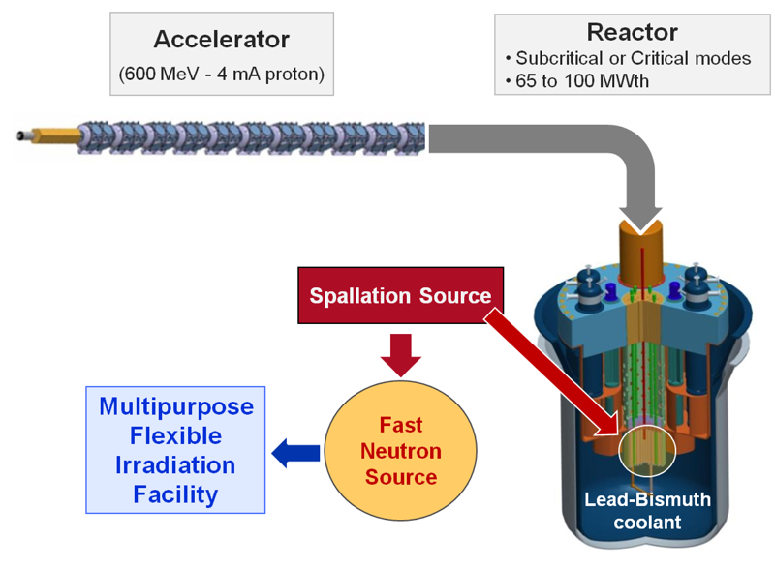
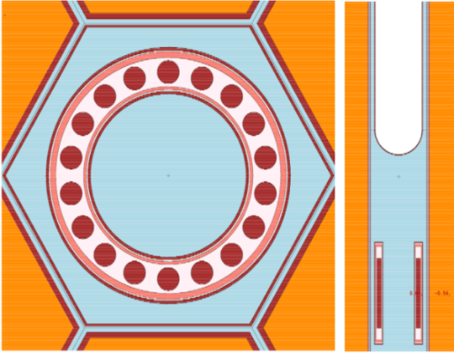
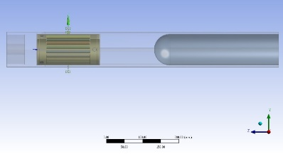
MYRRHA-IMIFF (600 MeV@ 2.5 mA)
Innovative Material Irradiation Facility for Fusion
Damage of steels:
Dpa faster, more He
 | DEMO | MYRRHA
Time to 1 dpa, days | 39.9 | 11.4
appmHe/dpa | 10.4 | 7 to 18
Damage of tungsten:
Transmutation into Re and Os is important
 | DEMO | MYRRHA
Time to 1 dpa, days | 123.5 | 67.7
Elemental fractions at 1 dpa
74-W, % | 99.86 | 99.84
75-Re, % | 0.12 | 0.153
76-Os, % | 0.02 | 0.005
Comparable transmutation rates !
Notes:
Table above: irradiation of steels. Ratio appm He/DPA is flexible, peak value is much higher than in DEMO.
Table below: irradiation of W. DPA is achieved 2 times faster than in DEMO, the ratio of transmutation/DPA is comparable.

Slide 18
Outline
What is Project MYRRHA?
MYRRHA technical description
MYRRHA Research & Development effort
MYRRHA planning

Slide 19
R&D Topics
  Materials
  Fuel
  LBE Technology
    Components & Experiments
    Chemical Conditioning Programme
  Instrumentation & Control
  Computer codes
  Accelerator
  ISOL@MYRRHA
Notes:
These are actions in support of licencing of Myrrha, next slides will show that Myrrha is beyond the paper project

Slide 20
LBE Facilities @ SCK•CEN
CRAFT
LIMETS 1,2,3,4
HELIOS 3
Heavy Liquid Metal Lab
MEXICO
LiLiPuTTeR-II
RHAPTER
COMPLOT
ESCAPE
US lab
Materials
LBE conditionning
Component testing & TH
Instrumentation

Slide 21
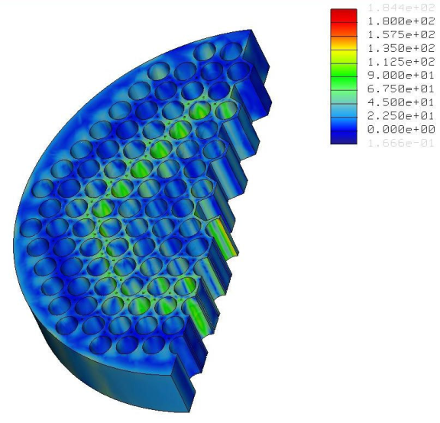
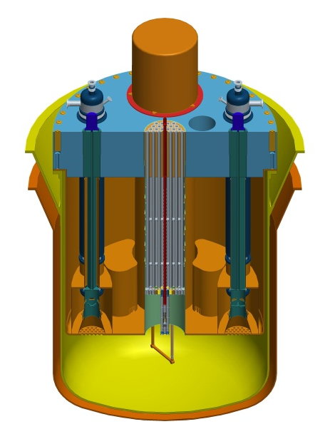
Role of materials research for development of MYRRHA
Design tools:
Nuclear manufacturing codes: RCC-MRx, …
Fuel codes
FE calculations
Design
Construction
Materials properties
Approaches
Missing data for MYRRHA:
Basic characteristics of candidate materials
Effects of LBE & irradiation on material properties
Physical effects
Data

Slide 22
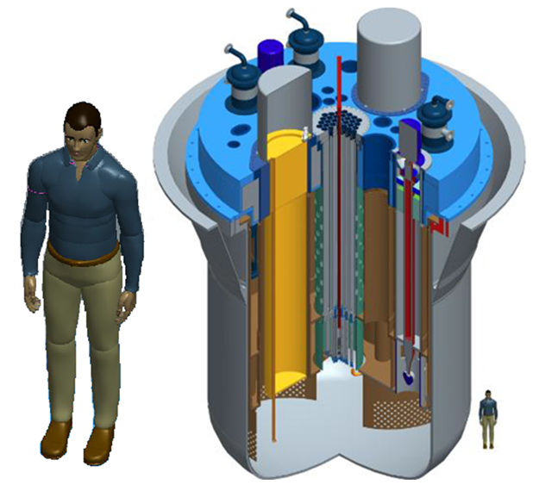
E-SCAPE
E-SCAPE = European SCAled Pool Experiment
Thermal-hydraulic behaviour of a flowing liquid metal in a pool geometry
Purpose
  Characterisation of pool T/H phenomena
  Qualification of CFD and system tools
  Operational experience on LBE systems
Characteristics
  1/6 geometrical scale factor
  LBE as working fluid
  Forced and natural circulation
Partially funded by FP7 THINS

Slide 23
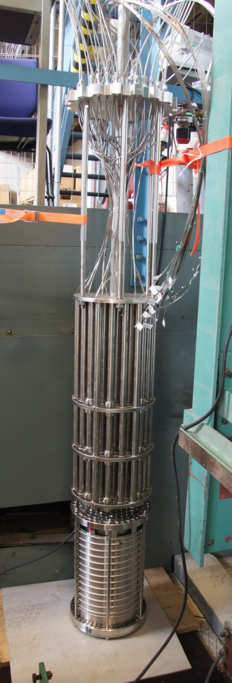
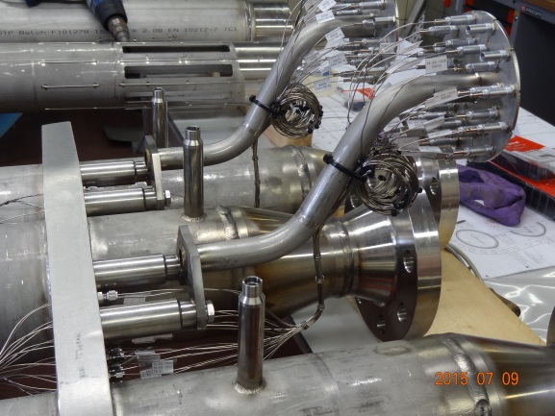
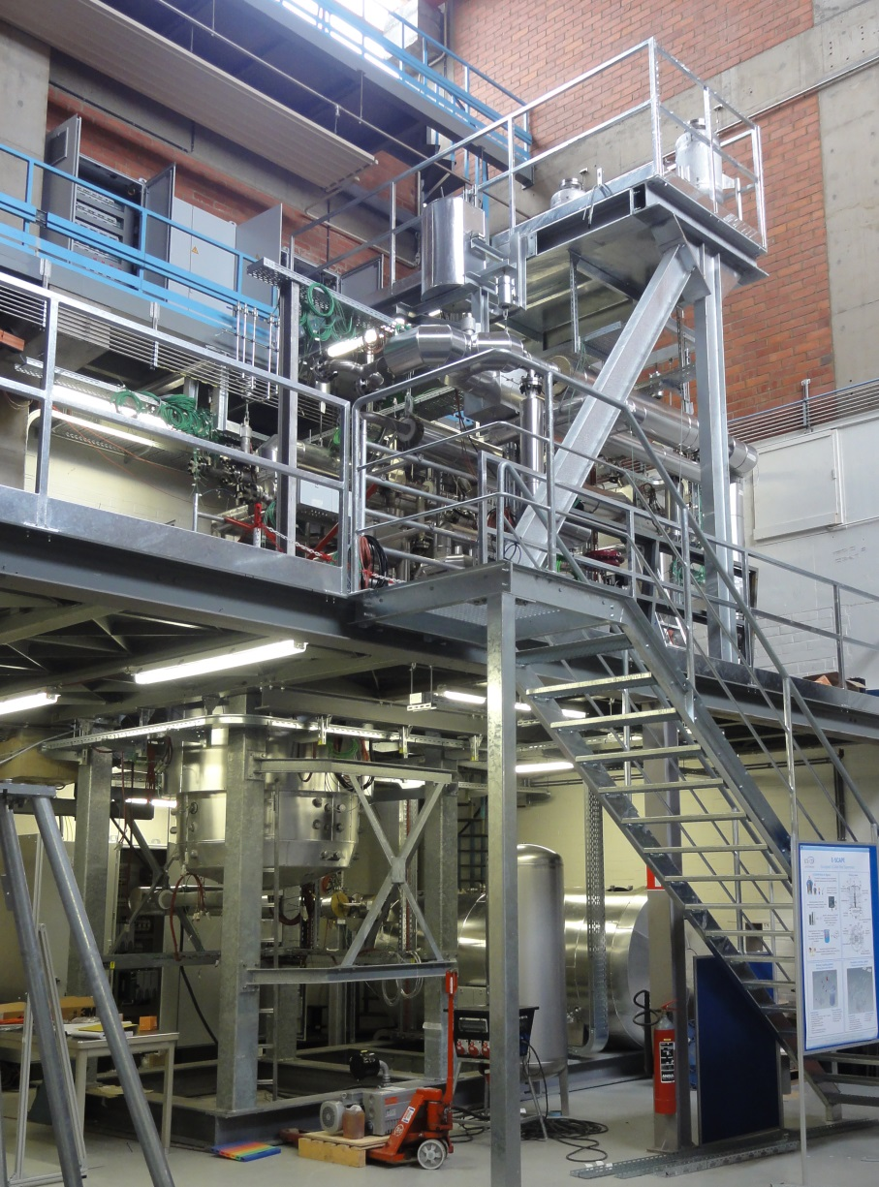
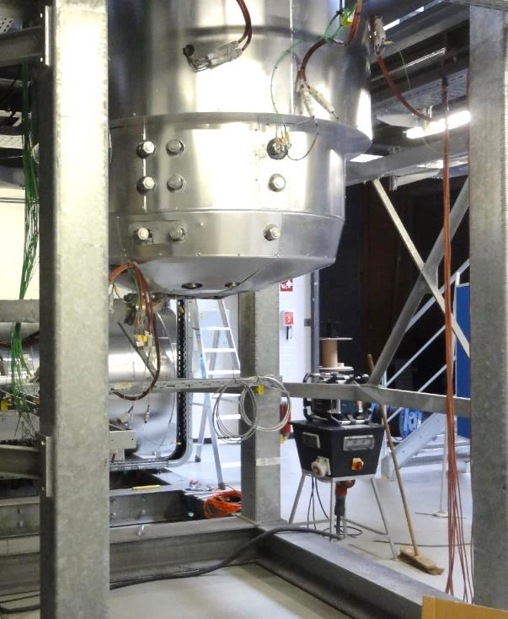
E-SCAPE facility
PUMP + HX + INSTR
CORE
VESSEL + INSULATION
ASSEMBLY + INSUL + CABLING

Slide 24
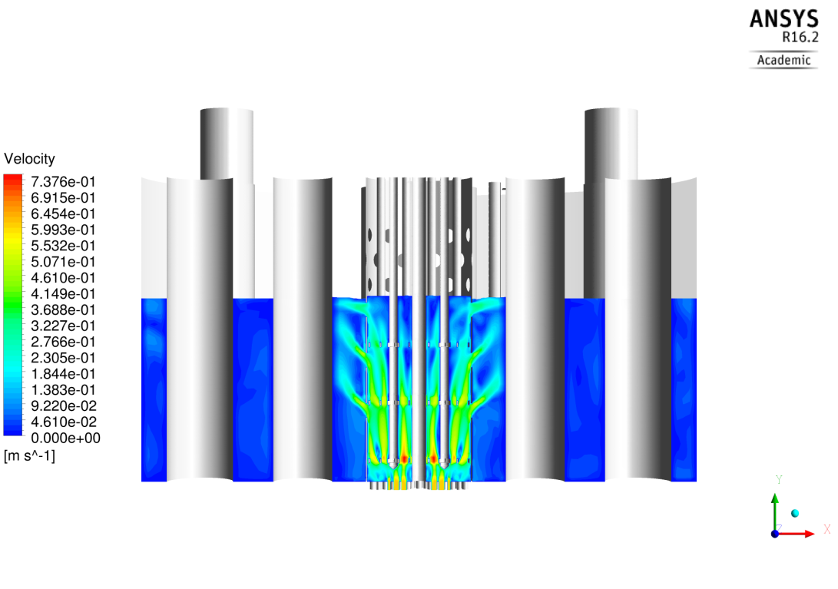
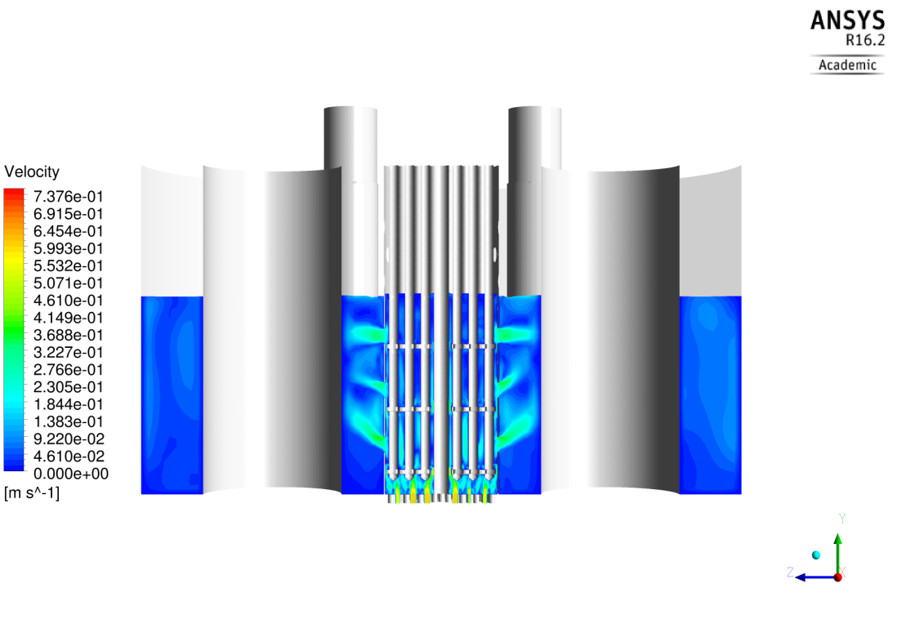
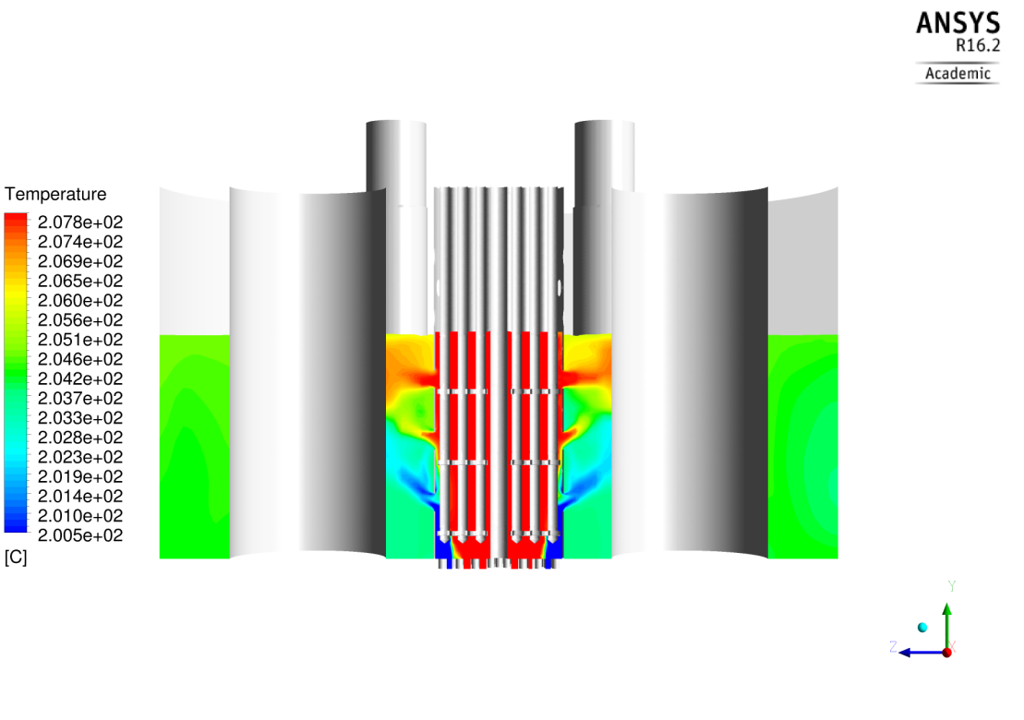
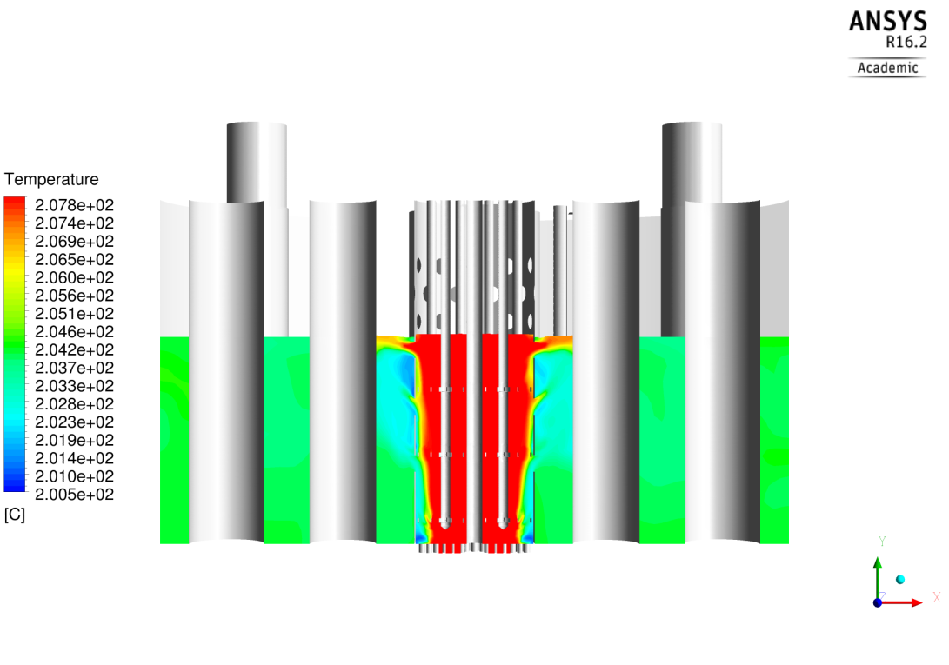
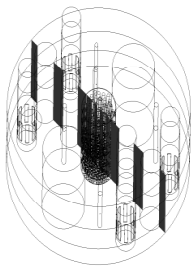
Forced circulation simulation
Forced Circulation
Core power (kW) | 82.9
Bypass power (kW) | 8.29
Core mass flow rate (kg/s) | 62.5
Bypass mass flow rate (kg/s) | 57.5
Average HX mass flow rate (kg/s) | ̴ 30
Core outlet temperature (˚C) | 208
Core inlet temperature (˚C) | 200
Average HX inlet temperature (˚C) | 204

Slide 25
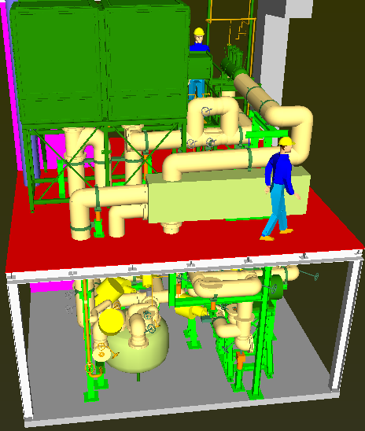
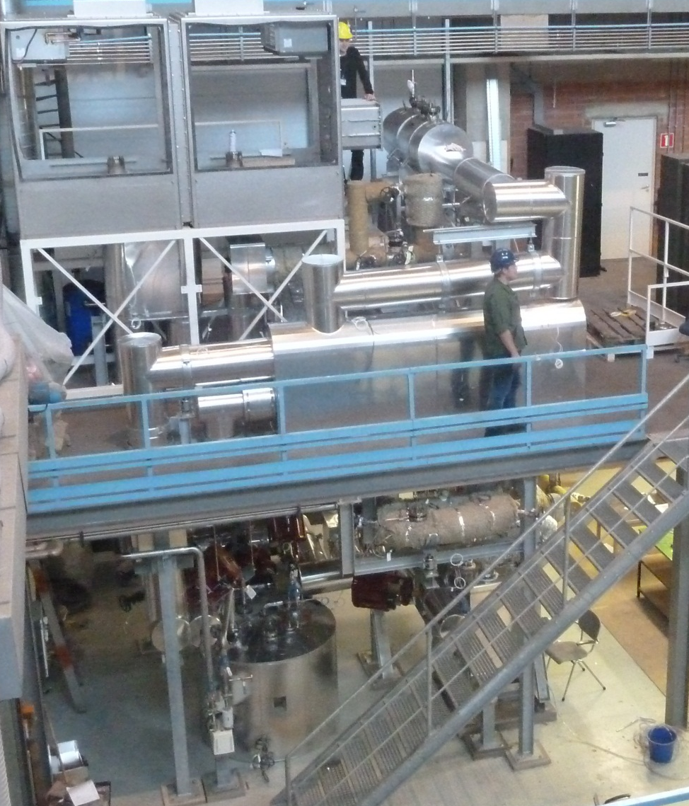
CRAFT corrosion/erosion loop

Slide 26
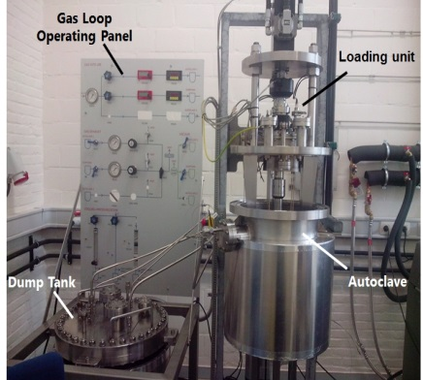
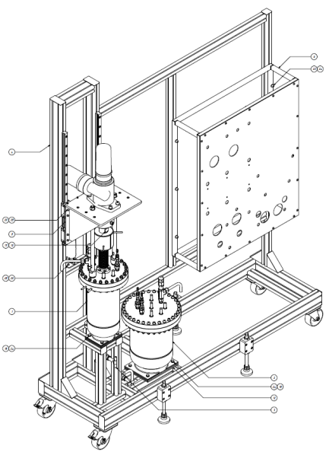
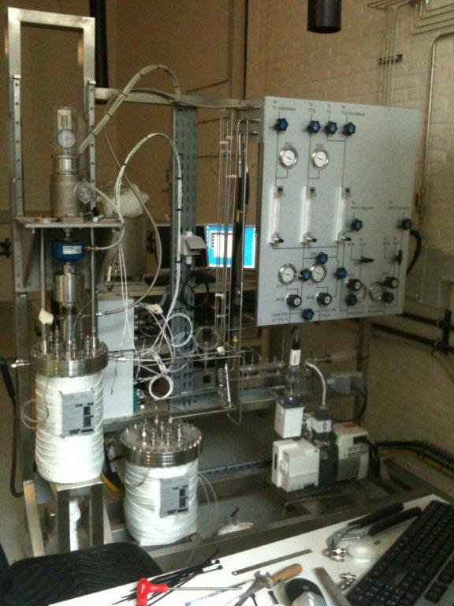
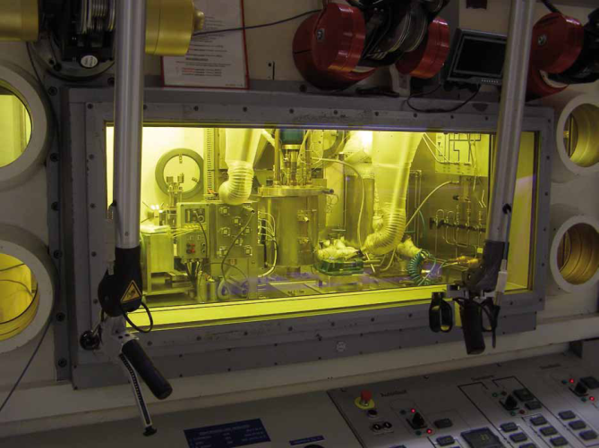
Set-ups for mechanical tests in LBE
LIMETS 1
Tensile & Fracture toughness tests in LBE
LIMETS 3
Fatigue tests in LBE
LIMETS 4
Tensile & Fracture toughness tests in LBE
Hot cell 12 &
LIMETS 2
Tensile and FT tests of irradiated* steels in liquid metal
*Licensed for α (Po) contaminated specimens

Slide 27
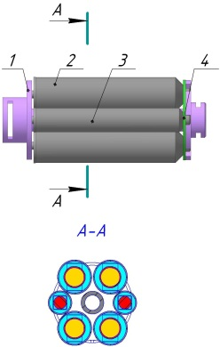






Irradiation of materials
Irradiation of MYRRHA candidate materials in LBE environment
Irradiation rig
Capsules holder
Holder with
pressurized tubes &
corrosion specimens capsules
Capsule with specimens for mechanical tests
Capsule with pressurized tube
Capsule with corrosion specimens

Slide 28

Heavy Metal lab

Slide 29

Heavy Metal lab
R&D activities on chemistry in LBE
  chemistry and control of dissolved oxygen in LBE
  oxygen sensor development
  evaporation spallation and fission products from LBE
  Capture of spallation and fission products

Slide 30

Heavy metal lab - R&D
contaminant evaporation
mercury
evaporation & capture
oxygen
chemistry
oxygen sensors
oxygen control

Slide 31

MEXICO LBE loop
  over 10000 h of experiment time, 100.10⁶ kg LBE circulated
pilot-scale demonstration of oxygen control technologies:
accurate & stable oxygen control of 7000 kg of LBE
oxygen control ON
MEXICO loop
Notes:
In 7000kg of LBE it is possible to control oxygen level down to precision of 10-7 wt% thanks to the R&D in Heavy Liquid Metal Lab

Slide 32

RHAPTER
Mechanical component tests for in-LBE robotics
Isothermal pool facility
Interchangeable test modules
Specifications
  150 - 450°C
  50 l LBE
  Vacuum or gas cover
Drive axle and load axle
  Variable torque and rotation speed
Instrumentation
  Torque sensor
  Position encoder
  Accelerometer
  Thermocouples
  Pressure gauge
Status: in operation since September 2011
Notes:
Rhapter is for bear rings R&D and qualification

Slide 33




Fuel identification system
Physical code on fuel assemblies
  12 notches at the entrance nozzle of a MYRRHA fuel assembly
  Each notch can have five different depths
Ultrasonic code reader
  12 ultrasonic transducers at the gripper of the fuel manipulators
  Differential depth measurement allows for reliable notch depth measurement
  Error detection and error correction algorithms make the system robust against failing transducers or other misreadings
Notes:
Manipulator must select correct fuel pin, this is realized by utrasonic scanning.

Slide 34

ISOL@MYRRHA Concept
+ molten-metal
targets
ISOL@MYRRHA
MYRRHA ADS
Focus on long-term operation without interruption
Notes:
Proton source, then mass separation line is realized to get the isotopes. RIB – radio active ion beams. Separation is realized by mass and by charge.

Slide 35


Slide 36

Challenges of 100 MeV proton accelerator regarding fusion material testing
MYRRHA-IMIFF: proton beam 600 MeV,@ 2.5 mA
Proton beam 100 MeV @ 4 mA protons + target
15 neutrons per proton
0.3 neutrons per proton
Neutron flux > 2×10¹⁵ n/(cm²s)
Neutron flux < 1×10¹⁴ n/(cm²s)
Neutron spectrum:
mostly fission neutrons easy to thermalize
(for tungsten transmutation)
Neutron spectrum:
Spallation neutrons difficult to thermalize
To achieve similar damage rates:
the displacement damage (dpa) must contain the proton component
use moderated neutrons to transmute tungsten
Notes:
100 MeV protons can not generate as many neutrons as 600 MeV → neutron flux is less
Therefore, because we are looking primarily to the ration of W transmutation to dpa, we can apply the following trick:
We obtain necessary dpa by protons while the transmutation of W goes by neutrons

Slide 37
Irradiation by 100 MeV protons: feasibility
water
SS sample
100 MeV @ 4 mA
Ta
W sample
Target material: Tantalum
Target thickness: < proton range ( ~ 1 cm)
Moderator: water
Neutron spectrum is softer than in DEMO:
to compensate reduction of neutron flux
Optimal thickness: ~7.5 mm
Notes:
This slide demonstrates how to organize the irradiation by 100 MeV protons.
Preliminary model is used, consisting of conical Tantalum target in water tank. The idea is to make ta target thinner than the range of protons in tantalum (range of protons 10 mm, optimal thickness should be <7.5 mm). In this way, protons which slowed down in tantalum still have some energy to penetrate certain distance in water to be definitively stopped right inside the sample. The plot on the left side demonstrates this.
So, they produce the damage in the sample. Neutrons are born in tantalum target and fly into the water where they are moderated and create thermal flux in the sample. See the comparison of the spectra on the right-hand side.

Slide 38
Rotation window and converter DISK
Rotative disc with Ta converter
Heat flux 2x2 3 mm Al
  → 60 MW/m²
Rotative 1 m disk 3,14 m
3,14/0,02=157
  0,4 Mw/m²
Ta converter +- 350 kw
Area = 0,02*3m x2
  Heat flux about 3 MW/m²
  is possible and area could be increased
    Not structural element!
sample
Proton beam
Vacuum
water
Water in
Water out
Motor
Notes:
This slide proposes the realization of the target, taking into account challenges in the cooling (100 MeV* 4 mA = 400 kW which is a lot). We propose a rotative target where the blades made of Ta and Al are alternating. Protons will face Al certain fraction of time and penetrate through it to deposit their energy in the sample (and to produce dpa). Another fraction of time the protons will interact with tantalum (thickness of the blade must be grater than the range of protons to stop them there) to protrude neutrons that will transmute W in the sample.

Slide 39

Preliminary results
Irradiation of tungsten samples
 | IMIFF100 | MYRRHA-IMIFF | DEMO
Time to reach 1 dpa, days | 123.27 | 67.47 | 123.45
Appm He/dpa | 1.26 | 1.76 | 0.58
Neutron flux, n/(cm²s) | 8.21×10¹³ | 2.40×10¹⁵ | 5.27×10¹⁴
${}_{}^{184}{W\left(n,γ\right)}{}_{}^{185}W$ cross section, b | 0.36 | 0.21 | 0.33
${}_{}^{186}{W\left(n,γ\right)}{}_{}^{187}W$ cross section, b | 0.64 | 0.30 | 0.52
Elemental concentrations at 1 dpa
72-Hf, % | 1.5×10⁻⁴ | 1.04×10⁻³ | 8×10⁻⁵
73-Ta, % | 6.2×10⁻⁴ | 1.31×10⁻³ | 0.012
74-W, % | 99.85 | 99.84 | 99.86
75-Re, % | 0.149 | 0.153 | 0.12
76-Os, % | 8.2×10⁻⁴ | 4.86×10⁻³ | 2.3×10⁻³
dpa @ transmutation rates comparable to DEMO
Irradiation of steel samples
 | IMIFF100 | MYRRHA-IMIFF (max/min) [2] | DEMO [2],[7]
Radiation damage rate, dpa/s | 3.29×10⁻⁷ | 1.65×10⁻⁶ / 1.01×10⁻⁶ | 2.90×10⁻⁷
Time to reach 1 dpa, days | 35.20 | 11.41 / 7.02 | 39.90
appm He/dpa | 14.27 | 18.04 / 7.12 | 10.42
dpa rates comparable to DEMO
He production rates 40% higher
Notes:
The table shows the results of dpa and transmutation rate calculations for W (above) and Fe (below). Comparison to DEMO conditions shows that we can obtain quite impressive results.

Slide 40
Outline
What is Project MYRRHA?
MYRRHA technical description
MYRRHA Research & Development effort
MYRRHA planning

Slide 41

MYRRHA’s phased implementation strategy
Benefits of phased approach:
Reducing technical risk
Spreading investment cost
First R&D facility available in Mol end of 2024
Phase 1 – 100 MeV
Phase 2 – 600 MeV
Phase 3 – Reactor
Source:SCK•CEN MYRRHA Project Team
Notes:
Phase 1: 100 MEV acc. + proton multi-puspose target facility; reason for phase-approach: because we need to demonstrate the realablity of the acceleratore. End of Phase I:
Phase 2: extension to 600 MeV
Phase 3: adding reactor

Slide 42

Phased implementation plan MYRRHA Project (2016-2030)
> Implementation High-Level overview
1st Facility at Mol in 2024
Phase 1: ‘16-’24
Phase 2&3: ‘25-’30
Source: SCK•CEN MYRRHA Project Team

Slide 43















































MYRRHA is embedded in an international R&D network
Source: SCK•CEN MYRRHA Project Team

Slide 44

A jump in the future for pioneering innovation in Belgium
For sustainable nuclear energy in Europe and the world

Slide 45
Copyright © 2017 - SCK•CEN
PLEASE NOTE!
This presentation contains data, information and formats for dedicated use ONLY and may not be copied, distributed or cited without the explicit permission of the SCK•CEN. If this has been obtained, please reference it as a “personal communication. By courtesy of SCK•CEN”.
SCK•CEN
Studiecentrum voor Kernenergie
Centre d'Etude de l'Energie Nucléaire
Belgian Nuclear Research Centre
Stichting van Openbaar Nut
Fondation d'Utilité Publique
Foundation of Public Utility
Registered Office: Avenue Herrmann-Debrouxlaan 40 – BE-1160 BRUSSELS
Operational Office: Boeretang 200 – BE-2400 MOL

