Slide 1

Neutron sources for transmutation of long-lived fission products in the ImPACT* Program
Nov. 4, 2017
Hiroki OKUNO
RIKEN Nishina Center for Accelerator-based Science
This work was funded by ImPACT Program of Council for Science, Technology and Innovation (Cabinet Office, Government of Japan).
*www8.cao.go.jp/cstp/sentan/about-kakushin.html
Notes:
Thank you, chairman.
It’s my great pleasure to have an opportunity to talk about neutron sources for transmutation of long-lived fission products in ImPACT program.

Slide 2
Contents
Introduction to ImPACT program (PJ 1,2,3,4,5)
Project 1-3,5 Outline and current progresses
  PJ1: (Separation and Recovery technique namely Partitioning)
  PJ2: (Nuclear data measurement for transmutation and new control system of Nuclear reactions)
  PJ3: (development of nuclear reaction model and improvement of PHITS reaction model)
  PJ5: (scenario of resource recycling and reduction of HLW, conceptual design of Partitioning and Transmutation (P&T) system)
Project 4: Transmutation system and elemental technologies development (Accelerators and targets for high power beams)
Notes:
The contents of my talk are the following.
After a brief introduction to the ImPACT program which consists of five projects, I will show outlines and current progresses of PJ1,2,3 and 5.
Finally, I will touch with the details of PJ4 which studies on accelerators and targets for high power beams.

Slide 3
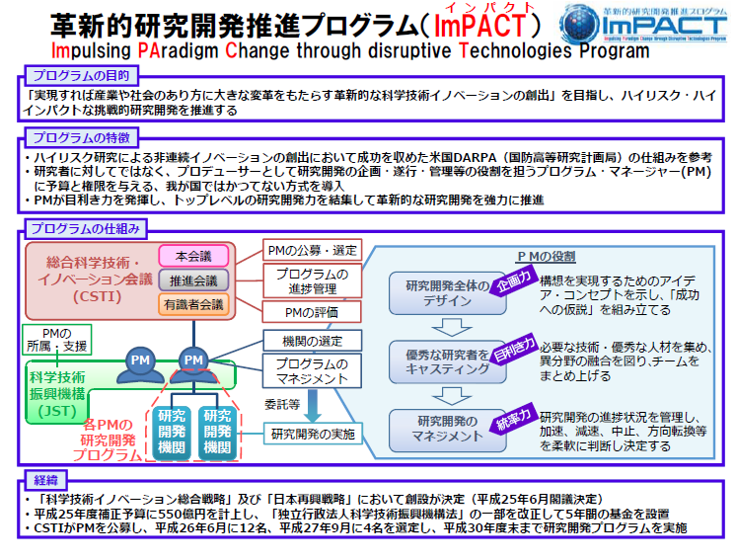
ImPACT (Impulsing PAradigm Change through disruptive Technology)
Purpose
The Japanese Government declared the new R&D Program named “ImPACT” has started 2014 till 2019 after the “First” Program.
Characteristics
Structure
Objectives of the ImPACT Program
Promotion of high-risk and high-impact R&D for societies or industries with not-continuous innovations.
Features of the ImPACT Program
The DARPA in the US is the model of ImPACT Program.
The Program Manager is not a researcher but completely managing
the whole program with the budget and the authority.
Background
Notes:
Let me begin with the introduction.
This slide shows the purpose, characteristics, structure and background of the ImPACT program.
I am sorry that they are written in Japanese, but please remember that Impact stands for impulsing Paradigm change through disruptive technology.
The Japanese government declared the new R&D program named “ImPACT” has started 2014 till 2019 after the “First” Program.
Objectives of the ImPACT Program is promotion of high-risk and high impact R&D for societies or industries with not-continuous innovations.
In this program, the Program manager is not a researcher but completely managing the whole program with budget and the authority.

Slide 4
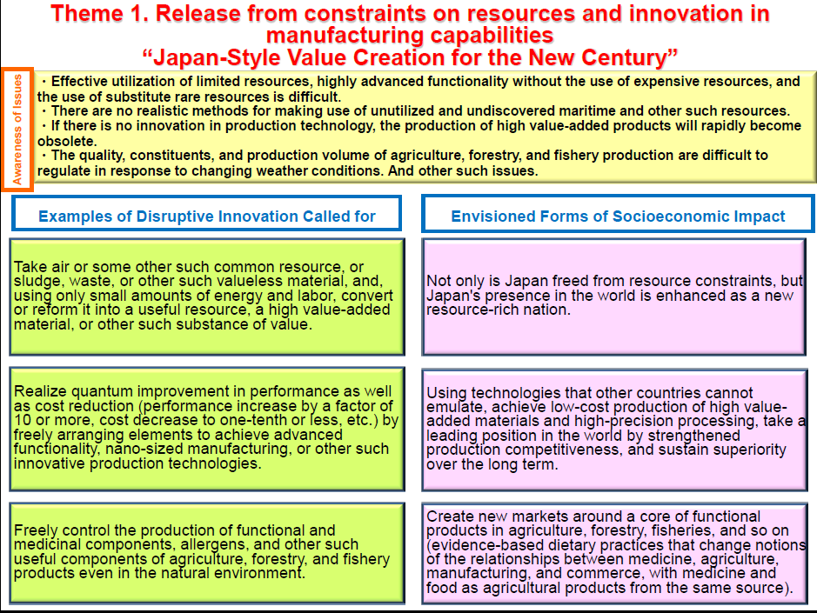

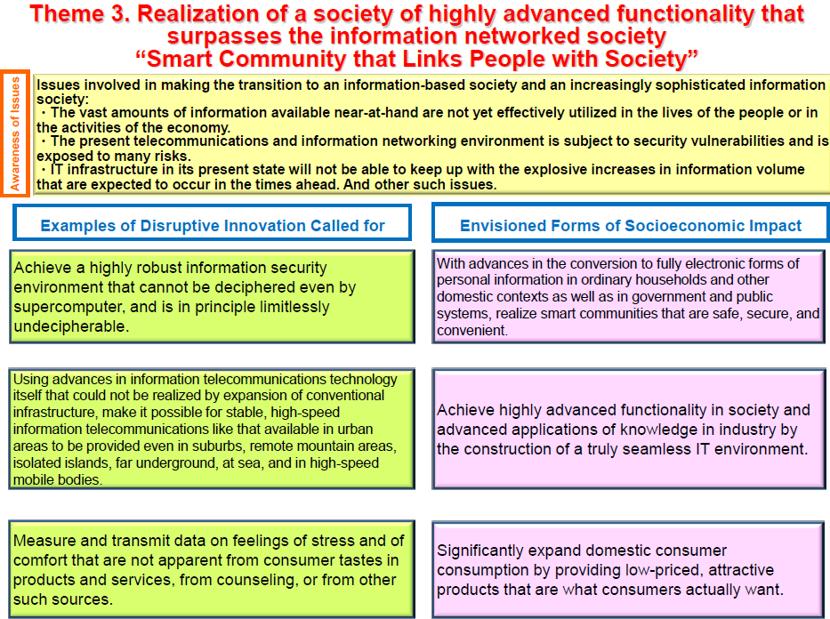

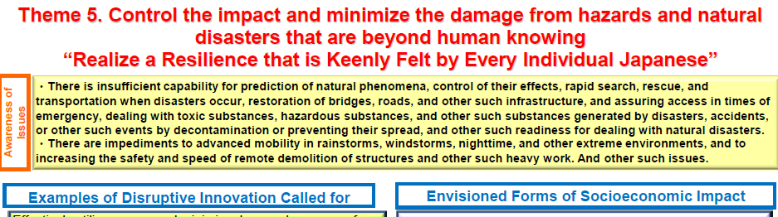
ImPACT (Impulsing PAradigm Change through disruptive Technology)
Reiko Fujita
Title: Reduction and resource recycling of High-level radioactive wastes through nuclear transmutation
Notes:
The Japanese Cabinet office collected officially Program manager for 5 fields as shown here.
12 PMs are adapted in 2014 and 4 PMs are added in 2015.
Our program manager Fujita Reiko is here. Title of the project is Reduction and resource recycling of High-level radioactive wastes through nuclear transmutation.

Slide 5
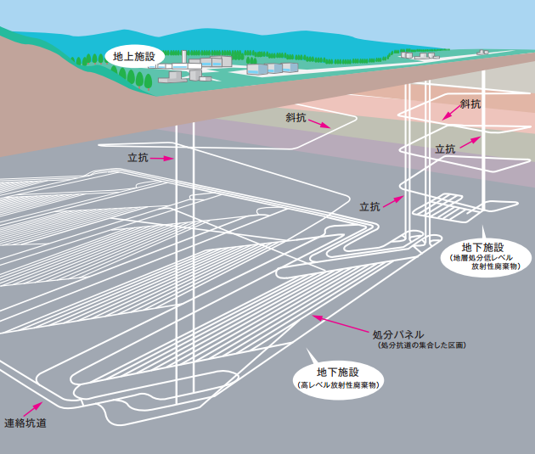
Issues of HLW (High-Level radioactive Wastes) disposal
High level radioactive
wastes (HLW) are vitrified
in glass* and disposed in
geological repository.
However, Japanese public are
worried about HLW disposal
scenario for long-term storage.
*Already production about 24,800
Example of disposal in geological repository
Grand Facility
Slop pit
Slop pit
Pit
Pit
Pit
We would like to propose
some of solution candidates for HLW
disposal in geological repository.
Under-grand Facility (Low –level Wastes)
Disposal panel
（Disposal pit area)
Under-grand Facility (High-level Wastes)
Connection pit
Depth：300m deeper
https://www.numo.or.jp/q_and_a/01/
5
Notes:
The most important issue in Nuclear Energy is HLW disposal.
Japanese baseline plan is that HLWs are vitrified in glass and disposed in geological repository.
This figure shows an example of disposal in geological repository.
The HLW is stored in the facility which is 300 m in depth.
However Japanese public are worried about HLW disposal scenario for long term storage.
We would like to propose some of solution candidates for HLW disposal in geological repository.

Slide 6
Long Lived Fission Products of Spent Nuclear Fuel
Nuclides | Half life (Billion year) | Radiation conversion coefficient (μ Sｖ/ kBq) | Content (Spent fuel /ton)
U-235 | 0.7 | 47 | 10 kg
U-238 | 4.5 | 45 | 930 kg
Nuclides | Half life (Million year) | Radiation conversion coefficient (μ Sｖ/ kBq) | Content (kg/ Spent fuel ton)
Se-79 | 2.95 | 2.9 | 6g
Sr-90 | 28.8 year | 28 | 0.6
Zr-93 | 15.3 | 1.1 | 1
Tc-99 | 2.11 | 0.64 | 1
Pd-107 | 65 | 0.037 | 0.3
Sn-126 | 1 | 4.7 | 30ｇ
I-129 | 157 | 110 | 0.2
Cs-135 | 23 | 2.0 | 0.5
Cs-137 | 30.1year | 13 | 1.5
Nuclides | Half life (year) | Radiation conversion coefficient (μ Sｖ/ kBq) | Content (Spent fuel/ ton)
Pu-238 | 87.7 | 230 | 0.3 kg
Pu-239 | 24000 | 250 | 6 kg
Pu-240 | 6564 | 250 | 3 kg
Pu-241 | 14.3 | 4.8 | 1 kg
FP
Ac
TRU
Nuclides | Half life (year) | Radiation conversion coefficient (μ Sｖ/ kBq) | Content (Spent fuel/ ton)
Np-237 | 2.14Million | 110 | 0.6 kg
Am-241 | 432 | 200 | 0.4 kg
Am-243 | 7370 | 200 | 0.2 kg
Cm-244 | 18.1 | 120 | 60 g
MA
Radiation Conversion Coefficient:
The effect coefficient of nuclides on Human
Citation: Hiroyuki Oigawa, “Tokai Forum lecture 9” (2014)
Notes:
High-level waste (HLW) is a type of nuclear waste created after reprocessing of spent nuclear fuel.
Spent nuclear fuel consists of the nuclei as shown here.
The High Level Wastes (HLW) contain many kinds of Minor Actinides (MAs) and Long Lived fission Products (LLFPs).

Slide 7
High Level Wastes (HLW) converted to ILW or LLW
Both Minor Actinides（MAs）and Long Lived Fission Products (LLFPs*） should be reduced.
MAs Transmutation research has already started in the Nuclear Fuel Cycle by JAEA’s ADS-PJ.
LLFPs transmutation research has no started yet.
LLFPs in radioactive wastes are contained in vitrification as HLW for deep disposal which has still issue of no candidate of disposal site in Japan.
*LLFPs：Long Lived Fission Products, Cesium（Cs）-135, Palladium (Pd)-107 etc.
LLFPs transmutation research should be done to show alterative options to deep disposal for Japanese public.
Notes:
This graph shows radioactivity of HLW versus years after treatment.
It clearly shows that we need to reduce both of MAs and LLFPs when we like to convert HLW to the intermediate Level Wastes such as Trans-uranium Wastes in Japan,
MAs Transmutation research has already started in the Nuclear Fuel Cycle by JAEA.
However, LLFPs Transmutation research has not started yet.
LLFPs in radioactive wastes are contained in vitrification as HLW for deep disposal which has still issue of no candidate of disposal site in Japan.
LLFPs Transmutation Research should be done to show alternative options to deep disposal for Japanese public.

Slide 8
High Level wastes (HLW) for Resource Recycling
LLFPs in HLW contain some of rare metals for usable elements.
Rare metals can be easily recovered from HLW, but it is impossible to recycle for re-use because the rare metals contain radioactive nuclides.
Transmutation research in the reactors, OMEGA Project has been started since 1980’s in Japan but new data for various nuclear reactions couldn’t be obtained because there was no facility which make such measurements possible.
（unit: t）
Notes:
LLFPs in HLW contain some of rare metals such as platinum Group metals and rare earth elements for usable metals.
These rare metals can be easily recovered from HLW but it is impossible to recycle for re-use because they contain radioactive nuclides.
Transmutation research in the reactors, OMEGA Project has been started since 1980’s in Japan but new data for various nuclear reactions couldn’t be obtained because there was no facility which make such measurements possible.

Slide 9
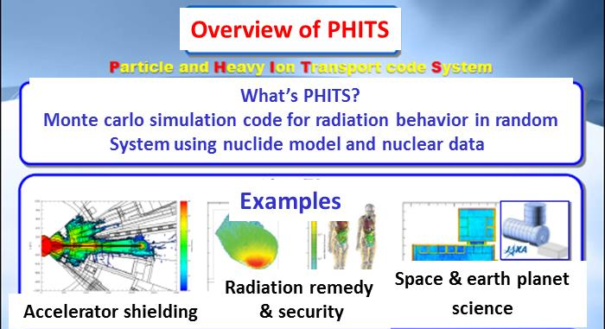
Scientific Progress and Present Situation
21st Century
Recently, the most powerful accelerator, RI beams factory such as 100 times stronger of heavy ion beam strength in any other facilities at present has been completed, and any kind of nuclear reaction data is possible to be measured by the innovative technique.
The excellent simulation software “PHTIS” and evaluated nuclear database “JENDL” have already been developed in Japan.
RI Beam Factory
Such scientific progresses make the advanced transmutation system possible to be developed by combination with partitioning technique.
PHTIS
Notes:
Now it is twenty first century. Recently, the most powerful RI beams factory such as 100 times of heavy ion beam strength of any other facilities at present has been completed.
Any kind of nuclear reaction data are possible to be measured by the innovative technique.
The excellent simulation software “PHITS” and evaluated nuclear database “JENDL” have already been developed in Japan.
Such scientific progresses make the advanced transmutation systems possible to been developed by combination with partitioning technique.

Slide 10
Previous Studies on Transmutation of MAs and LLFPs in HLW
*SCNES: Self-Consistent Nuclear Energy System
Notes:
This table shows the previous studies on Transmutation of MAs and LLFPs in HLW.
Omega project made research and development on Tc and I.
Self- consistent Nuclear System (SCNES) proposed by Professor emeritus of Tokyo Institute of Technology, Fujiie, has been studied in scientific research of LLFPs transmutation with isotope separation.
The aim of our ImPACT program is new nuclear reaction path for transmutation without isotope separation.
Our target nuclei are here.

Slide 11
Changing the definition of LLFPs on industries and societies
Nuclides | Half-life | Disposal | Resource recycling
Cs(Cesium)-135 | 2.3million year | Disposal of Ba (Barium) transmuted from Cs-135
Cs(Cesium)-137 | 30.1year
Sr(Strontium)-90 | 28.5 year | Disposal of Rb (Rubidium) -85,87 and Sr-86,88 transmuted from Sr-90
Pd(Palladium)-107 | 6.5million year |  | Reuse of stable Pd transmuted from Pd -107 for catalysts for vehicles
Sn(Tin)-126 | 0.23million year | Transmutation for stable nuclides of Sn(Tin) or Sb(Antimony)
Zr(Zirconium）-93 | 1.53 million year |  | Reuse of stable Zr transmuted from Zr-93 for Zircalloy cladding and Channel boxes
Se(Selenium)-79 | 0.30million yesr | Stable Se transmuted from Se-79
Tc（Technetium）-99 | 0.21million year | Ru（Ruthenium）-110 transmuted from Tc-99
I（Iodine）-129 | 15.70 million year | Xe（Xenon）ｰ130 transmuted from I- -129
・ Contribution to safety and security of disposal with converting from High level radioactive wastes to
Transuranium (TRU) wastes (ILW) or low level radioactive wastes.
・ Most-advanced and only one technology will be established and activate our country’s economy.
11
Notes:
Our target LLFPs in our program are Pd-107, Zr-93, Se-79 and Cs-135.
Pd-107 and Zr-93 are Resource Recycling materials for reuse.
We would like to change the definition of LLFPs on industries and societies from something disposed to something useful.

Slide 12

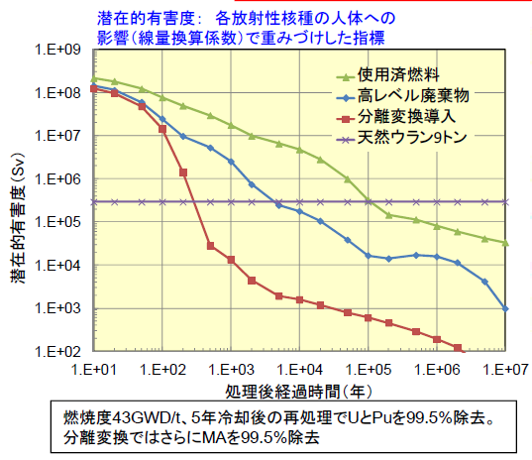
Effect on Partitioning &Transmutation
Long term risk reduction
Reduction of potential risk on HLW
Decrease of volume of HLW in disposal
Possible Integrated disposal by MAs transmutation and long storage for Cs & Sr as
heat nuclides in the future : the present glass solid system and present technology
in the spent fuel reprocessing plant should not be changed
Reduction of burden in HLW disposal
Potential Hazard: Influence of radiation
dose of parameter in human
Spent fuel
HLW
P&T
Natural U
Sr and Cs storage for about 100 years
Decrease of disposal area by 1/100
Because of converting HLW to TRU waste, namely ILW
Potential hazard (Sv)
Years after treatment (Years)
43 GW/dt of burn up, 5 years cooling time,
99.5% removal of U & Pu and MA
Citation: JAEA presentation in P&T committee of MEXT, Sep.9 2013
Notes:
Effect on partitioning and transmutation is shown here.
Firstly, long term risk on HLW can be reduced.
Secondly, volume of HLW in disposal can be decreased. Or burden in HLW disposal can be reduced.
After SR and Cs are stored for about 100 years, disposal can be decreased by 1/100 because HLW can be converting to TRU waste, namely ILW.

Slide 13
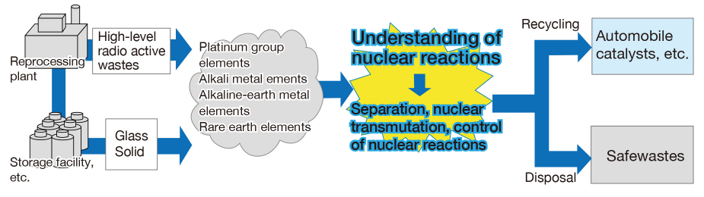
ImPACT* Program
13
Reduction and Resource Recycling of HLW through Nuclear Transmutation
Goal: To be the first in the world to obtain nuclear reaction data for LLFPs, and to confirm the world’s first nuclear reaction path for conversion to short lived nuclides or stable nuclides without isotope separation
*One of the ImPACT (Impulsing PAradigm Change through disruptive Technology) publicly offered research program by Japanese Cabinet (JFY2014-JFY2018)
(Target) Recovery rate >90%
Transmutation rate >90%
Notes:
Based on such backgrounds, we proposed ImPACT program, “Reduction and Resource Recycling of HLW through Nuclear Transmutation” in order to obtain Japanese Cabinet Research Budget.
Our goal is to be the first in the world to measure nuclear reaction data for LLFPs, and to confirm the world’s first nuclear reaction path for conversion to short lived nuclides or stable nuclides without isotope separation.
Targets for recovery rate and transmutation rate are 90%.

Slide 14
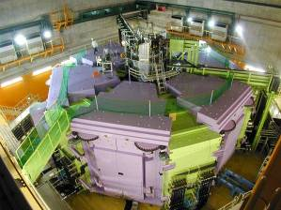
Outline of Our program
Project1
Automobile
catalysts
Magnetic materials,etc
Nuclear
medicine
Stable wastes
Separation and recovery techniques
Reprocessing
plant
High-level
wastes
Alkali metals
Alkaline earth metals
Palladium
Neodymium
Dysprosium
Xenon
Barium
Cesium
Platinum group metals
Rare earth elements
Strontium
Selenium
Resource recycle
Stable Isotopes
for disposal
Yttrium
Molybdenum
Rhodium
Zirconium
Storage
facility
Glass
Solid
Transmutation plant for practical use
Short Lived FP
～2050
Nuclear data measurement for transmutation
Project2
Pilot plant for demonstration
★Worlds leading facilities enable world’s first data acquisition
Stable nuclides or short lived nuclides
～2030
Cs-135(2.3million years*)
Conceptual P&T system
～2019
Neutron
Project5
Proton
New control of nuclear reaction systems
Transmutation system and elemental Techniques
Reverse reaction with neutrons,
protons, Photons
RI Beam Factory
Se*79(0.3 million years*)
Project4
Beam contained various
Nuclides including unstable
nuclides
Transmutation in condensed matter
Resonant absorption
Effective reactions and systems for neutron generation
Nuclear transmutation based on new control method
LLFP transformation systems of reasonable cost and energy balance (beam species,strength,energy region,FP target materials)
muon
Muon atonic nuclei capture reaction
Neutrino Target
Pd-107(6.5 million years*)
Zr-93 (1.53 million years*)
（*half-life）
Synchrotron
Synchrotron
J-PARC／Riken RAL
neutron
Composition of nuclear
reaction products
Reaction Model and simulation code
Use of pulsed,muon beam
and neutron beam
Fast neutron～ slow Neutron reaction
Cross section data
14
Feedback
Bulk nuclear simulations
Project3
Notes:
This viewgraph shows outline of our program.
Our program consists of 5 projects
Project 1 studies on Separation and Recovery technique namely Partitioning from HLW or glass solid.
Project 2 measures Nuclear data for transmutation using the advanced accelerator facility such as RIBF or J-Parc
Project 3 is development of nuclear reaction model and improvement of PHITS reaction model based on the results from PJ2.
Project 4 searches new control system of nuclear reaction, evaluates Transmutation system and study on elemental technologies development.
Project 5 is scenario of resource recycling and reduction of HLW, conceptual design of Partitioning and Transmutation (P&T) system.
We proposed conceptual P&T system at the end of this project in 2019, followed by pilot plant for demonstration in 2030 and transmutation plant for practical use in 2050.

Slide 15
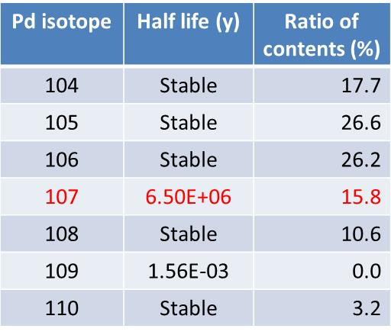
Purpose：Separation of odd nuclides from even ones by ionization of odd ones for easy transmutations
Project 1 Current Progress (I)
Principle of even-odd separations with polarizing laser
After
Ionization of odd nuclides
62.7
Third step of excitation
Ionization limit (8.34eV)
Ionization with laser
λ₃ < 843 nm）
37.3
Medium lever２ 4d⁹5d (³P₀)
Second step of excitation
521 nm
Medium level 1 4d⁹5p ( ³P₁)
Excitation of Pd odd nuclides with polarization laser
276 nm
First step of excitation
Base level of Pd 4d¹⁰(¹S₀)
Notes:
As I told, Project 1 studies on Separation and Recovery technique namely Partitioning.
This slide show one of the current progresses in the PJ1.
This progress aims that separation of odd nuclides from even ones by ionization of odd ones for easy transmutation.
Odd nuclei can be ionized by three types of lasers.
The first laser excites Pd atom in ground state to medium level 1.
The second step is important for separation because polarized laser can excite only odd nuclides of Pd to the second medium level.
The third type of laser for ionization.
This separation technique can make the transmutation of 107Pd easier because purity of Pd107 increase from 15.8 to 37%

Slide 16
Project 1 Current progress （II）
Efficiency 1 10000 100000
Pd II 4d⁹ (²D_{3/2})
70779.8
Pd II 4d⁹ (²D_{5/2})
Automatic ionization level
67241.3
4d⁹(²D_{3/2})6s ²[3/2]º
4d⁹(²D_{5/2})5d ²[1/2]º
J=1
52336.5
55373.2
(ii) 836 nm
Linear polarization ray
(ii) 521 nm
Circle polarization ray
4d⁹(²D_{3/2})5p ²[3/2]º
J=1
40368.8
4d⁹(²D_{5/2})5p ²[3/2]º
Even-odd separation possible
with linear polarization ray！
Previous even-odd separation scheme
36180.7
New even-odd separation scheme
Common
ion core
(i) 276 nm
Circle polarization ray
(i) 248 nm
Linear polarization ray
0 cm⁻¹
Pd I 4d¹⁰ ¹S₀
J=0
Notes:
We found the new even-odd separation scheme that linear polarized rays separate even-odd nuclides.
The merit of this new scheme is efficiency of the separation is 10 thousand or 100 thousand times larger than that of previous method because the new methods utilize automatic ionization.

Slide 17
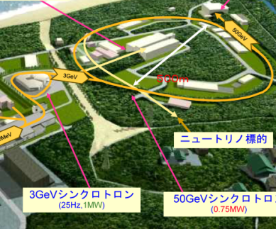
Project ２ Contents
Purpose：Measurement of nuclear reaction data to find the best path
Target LLFP | Half life
Palladium 107 | 6.50 M.Y
Zirconium 93 | 1.53 M.Y
Selenium 79 | 0.30 M.Y
Cesium 135 | 2.30 M.Y
Project２
(Obtained nuclear reaction data）
・Neutron Knockout（RIKEN）
・First neutron nuclear spallation（Kyushu
University）
・Coulomb breakup（TIT）
・Negative muon capture reaction（RIKEN）
・Neutron capture（JAEA）
・Low-speed RI beam（The university of
Tokyo, RIKEN）
(New nuclear reaction control method)
・Nuclear fusion（NIFS/Chubu
Univ.）
・Compact cyclotron（Osaka Univ.）
・Muon（Kyoto Univ./JAEA）
Adaption and overhaul of measure apparatus
LLFP
Stable nuclides or Short-lived nuclides
RIKEN RI Beam
Factory
Neutrons
Photons
Measurement of reaction cross section with inverse kinematics
Inverse kinetics with neutrons, Protons, Photons
Negative muon
LLFP
Negative muon capture reaction
J-PARC RIKEN RAL
Proton, Neutron
LLFP
Measurement of neutron and muon capture cross section
Neutrino Target
First neutron, slow neutron reaction
Others, new neutron reaction control methods
Synchrotron
Synchrotron
17
Notes:
This slide shows contents of Project 2.
Purpose of PJ2 is measurement of nuclear reaction data for these target LLFP to find best path for transmutation.
Nuclear reaction data for LLFP are very rare.
However, the advanced accelerator facility such as RIKEN RI Beam Factory and J-Parc give us the opportunity to measure them.
We have plan to measure reaction cross section with inverse kinematics and neutron capture reaction
We have already measured some of new nuclear reaction data in RIBF with inverse kinematics.

Slide 18
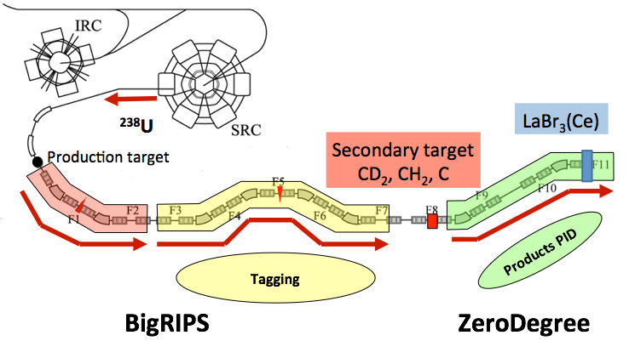
Project 2 Current Progress
Four experiments have been carried out to obtain new nuclear reaction data at RIKEN RIBF.
LLFP : Pd-107, Zr-93(+Sr-90), Cs-135(+137), (Se-79) production
event by event was tagging
and irradiated.
Nuclear reaction products are identified.
Bρ+TOF+ΔE
+Total Energy
Detector
345 MeV/u
RIKEN
RI Beam Factory
18
Notes:
Four experiments have been carried out to obtain new reaction data at RIKEN RI Beam factory.
Accelerator complex at RIBF can accelerate uranium ion up to 345 MeV/u with high intensity.
The accelerated uranium beam hits the target to produce various isotope beam including these four LLFP.
The target LLFP was seperated from the other fragment beam through BigRIPS beam line and hit the secondary target.
Reaction products after the secondary reaction are identified to obtain reaction cross section.

Slide 19
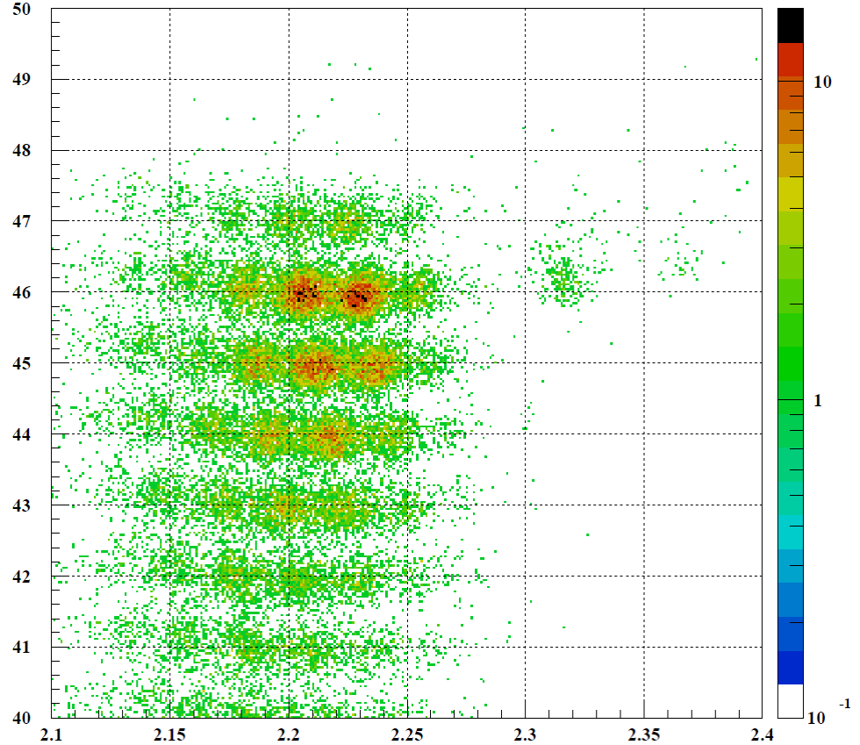
Project 2 Current Progress
Measurement results
Atomic number
ターゲット
Pd-103（17 days of half life）
Pd-102
（Stable）
Pd-106（Stable）
104（Stable）
Residual nuclides by reaction of Pd-107
Pd-105（Stable）
A/Q
Mass number/Charge
Nuclides | Pd-101 | Pd-102 | Pd-103 | Pd-104 | Pd-105 | Pd-106 | Pd-107
Half life | 8.47h | Stable | 16.991d | Stable | Stable | Stable | 6.5x10⁶ｙ
Notes:
This is an example of measured reaction products.
Each product is plotted according to atomic number and mass number.
This region is residual nuclei by reaction of Pd107.
Pd106 and Pd105 are mostly blank in this reaction condition.
We can see Pd103 and Pd102 which are stable ore short lived nuclides.

Slide 20



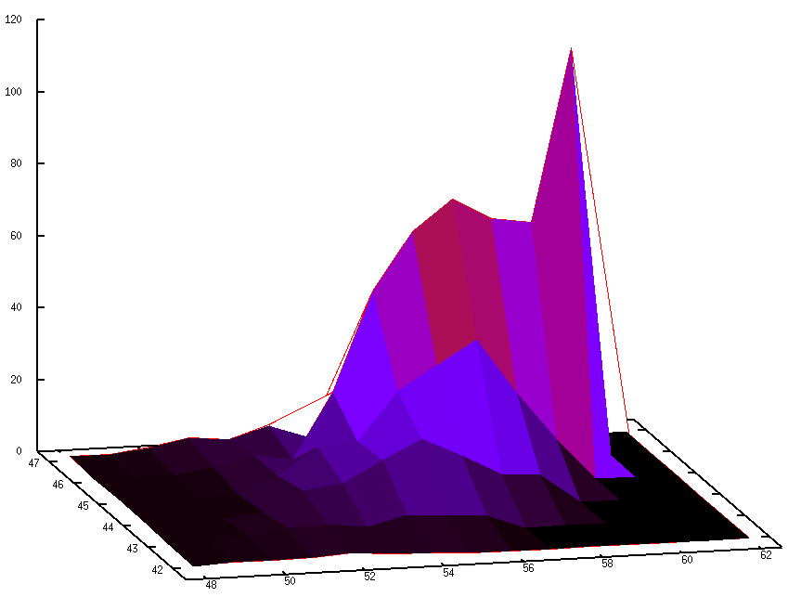
Project 2 Current Progress
Pd-107 is transmuted by nuclear reaction with H⁺ .
The estimation for ¹⁰⁷Pd 100 MeV/u
Primary
nuclides
Distribution after nuclear reaction ; H⁺ target
Main channel for transmutation: Neutron knockout from ¹⁰⁷Pd was transmuted by Neutron knockout reaction
Ag
＋1p
Pd
n knockout
101
102
103
104
105
106
¹⁰⁷Pd
Rh
- 1p
Ru
- 2p
Measurement
region (C)
Tc
- 3p
Mo
- 4p
Nb
Isotope
neutrons(N)
Zr
50
55
60
61
Transmutation
number
No. of 107Pd = 1 million/hour
Total No. of transmutation =10 k/hour (about 1%)
Index of transmutation volume
Proton
number
Neutron number
Nuclides | Pd-101 | Pd-102 | Pd-103 | Pd-104 | Pd-105 | Pd-106 | Pd-107
Half life | 8.47h | Stable | 16.991d | Stable | Stable | Stable | 6.5x10⁶ｙ
20
Notes:
This slide shows the obtained results for the nuclear reactions of Pd107 with H+.
These graphs show the estimation for 107Pd at 100MeV/u based on the measured cross section.
Main component of reaction products come from neutron knock-out of 107Pd, resulting in stable or short lived nuclei
These data show that 1% of irradiated 107Pd is transmuted when 107Pd collide with proton.

Slide 21

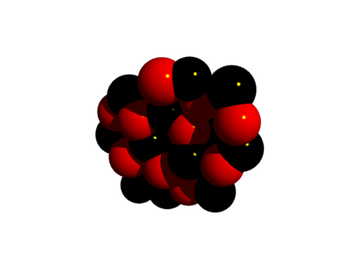
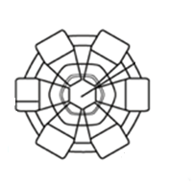
Current estimation of transmutation rate
Inverse kinematics ＋ Simulation code
Uranium (U) beam is made nuclear fission by accelerator to produce fission product beams, which are separated to long-lived fission product one.
Separated LLFPs collide hydrogen (P+) target in Figure.
Many kind of nuclides produced from collision are tagged and measured to estimate cross section of ones.
The nuclear reaction rate is estimated by cross section data and by simulation code such as PHITS code and developed to design of
actual apparatus.
Uranium
Nuclear fission
LLFP
Accelerator
Separation apparatus
Other FPs
H（P⁺）Target
21
Notes:
We obtain reaction data in inverse kinematics of LLFP.
We need help of a simulation code to estimate transmutation rate in the normal reaction where LLFP is stopped and proton or deuteron is accelerated.

Slide 22



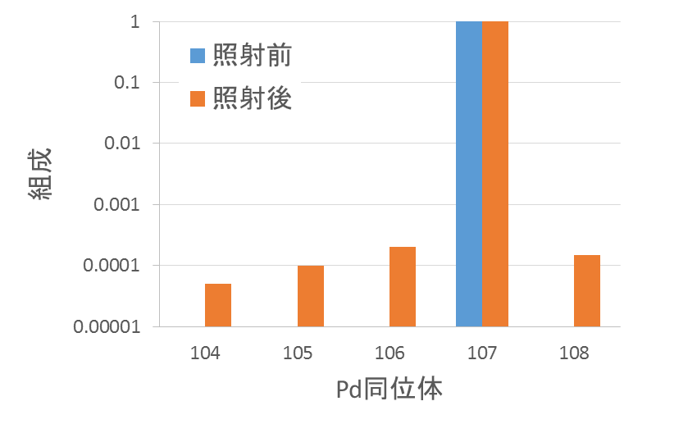
How to do nuclear reaction experiments
Neutron
Implant target
Irradiated test（about １month）
Accelerator
(Compact Cyclotron)
Deuteron beam
24 MeV
Proton
Base material （Carbon etc.）
Produced nuclides by nuclear reactions detected
It is necessary to be irradiated for long time in order to detect amount of nuclear reaction.
Before
After
Composition
If Amount of increase of ¹⁰⁴⁻¹⁰⁸Pd are detected and measured, it is possible to confirm ¹⁰⁷Pd knockout reaction with ratio of isotopes by TIMS (Thermal Ion Mass Spectro.).
Pd isotopes
22
Notes:
We are preparing for the nuclear reaction experiment in the normal kinematics.
In this experiment, deuteron beam accelerated in a compact cyclotron up to 24 MeV is irradiated to paladium 107 implanted in the carbon.
The irradiation test lasts for one month. Transmutation ratio is as small as 10-4 because beam intensity and energy is low compared to those of real facility for transmutation.
To recognize this small amount transmutation. Magnetic isotope separation is used to implant 107Pd with very high purity and Isotope ratio is measured using TIMS (thermal ionization mass spectroscopy).

Slide 23
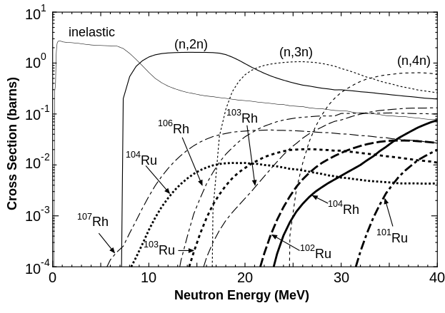
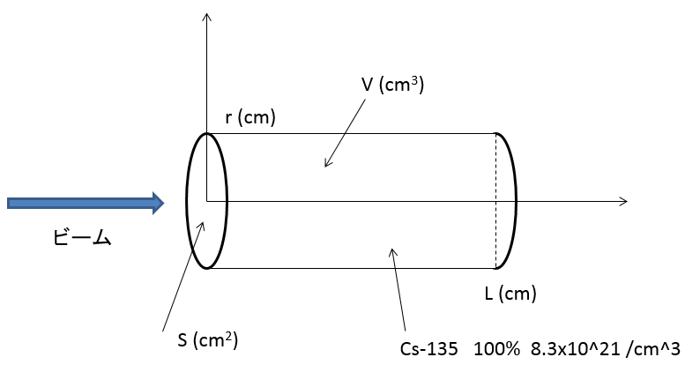
Project 3 Contents
Purpose：Improvement of simulating precision for LLFP nuclear reactions
Project３(Reaction model and simulation)
・Standard model based on theory（Osaka University）
・Achievement of high precision through structural calculation (University of Tsukuba）
・Database for nuclear spallation (JAEA)
・Nuclear reaction simulation (RIST)
・Nuclear reaction data compiling (Hokkaido University)
Improvement of nuclear data base
Pre-estimation of nuclear reactions
Improvements of PHITS code for nuclear reactions
An example of calculations for cross sections of Pd-107 nuclear reactions by fast neutrons
Ratios of nuclear reactions estimated in target of practical apparatus with a cascade reaction calculated by single nuclear reactions
Compare with the new data
Target（Image）
Requirement to accelerator and target
(Energy, intensity, heat deposit)
23
Notes:
This viewgraph shows contents of Project 3.
Purpose of PJ3 is Improvement of simulation code, PHITS precision for LLFP nuclear reactions.
This graph shows an example of calculations for cross sections of Pd107 nuclear reactions by fast neutron.
These calculations are compared with measured cross section to improve the accuracy of prediction.
PHITS can estimate ratios of nuclear reactions in target of practical apparatus with a cascade reaction calculated by single nuclear reaction.
Such calculations can show requirements to accelerator and target such as beam intensity, beam energy, heat deposit to the target and so on.

Slide 24
Project 3 Current Progress
Beam current requested for LLFP transmutation in actual nuclear reaction time* is much higher than present one such as 1mA in every case of isotope separation, even-odd separation and spent fuel without isotope separation.
Without Isotope separation
Even-odd separation
With Isotope separation
Current potential
Beam current for transmutation (mA)
Beak through requested
for nuclear reaction
(Not continuous innovation)
Not-Continuous innovation
to have breakthrough in the
technology of accelerator and
target.
Yield of year (kg/ｙ） | 5 | 250 | 417 | 767
* : one year yield of LLFP transmuted by proton beam with 1000 MeV for 3 years of effectual half years
24
Notes:
Beam current requested for LLFP transmutation in actual nuclear reaction time* is much higher than present one such as 1mA in every case of isotope separation, even-odd separation and spent fuel without isotope separation.
We need more than 1A in most cases.
So we need not-continuous innovation to have a breakthrough in the technology of accelerator and target.

Slide 25
Project 4 Contents
Purpose：Development of elemental technologies for transmutation.
Accelerator and Target development of elemental technologies
・ Superconducting Quarter-Wave Resonators (Key in the low energy)
・ Vacuum window between accelerator area (High vacuum)and target area
(Atmosphere)
・Target development using liquid metal（Heat removal at Transmutation）
【Example of Accelerator and elemental development area】
Accelerated ion beam
Transmutation
Ion source 四重極加速 Superconducting Resonator Vacuum Target
(RFQ Accelerator) （QWR) （HWR etc) window (LLFP)
Evaluation of nuclear transmutation system
・Competitive evaluation in nuclear transmutation techniques
・Chosen nuclear transmutation system
25
Notes:
To realize requirement for accelerator and target from PJ3, PJ4 are developing elemental technologies for transmutation as listed here.
First technology is superconducting qwr which is the key device n the low energy region of high power linear accelerator.
The second technology is vacuum window between accelerator high vacuum and target area vacuum as shown here
The third one is target development using liquid metal for removal of huge heat deposit to target material.
Furthermore, PJ4 evaluates the proposed nuclear transmutation system.
We choose the best nuclear transmutation system after competitive evaluation.

Slide 26
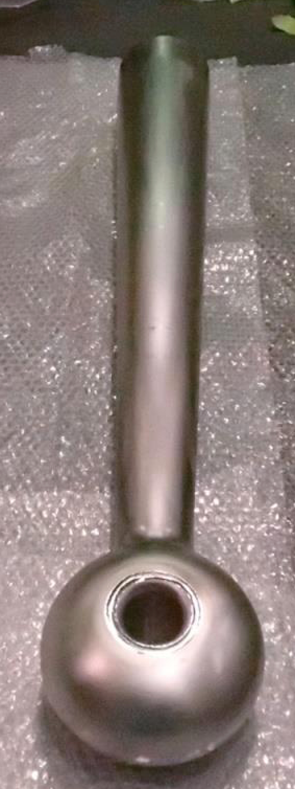
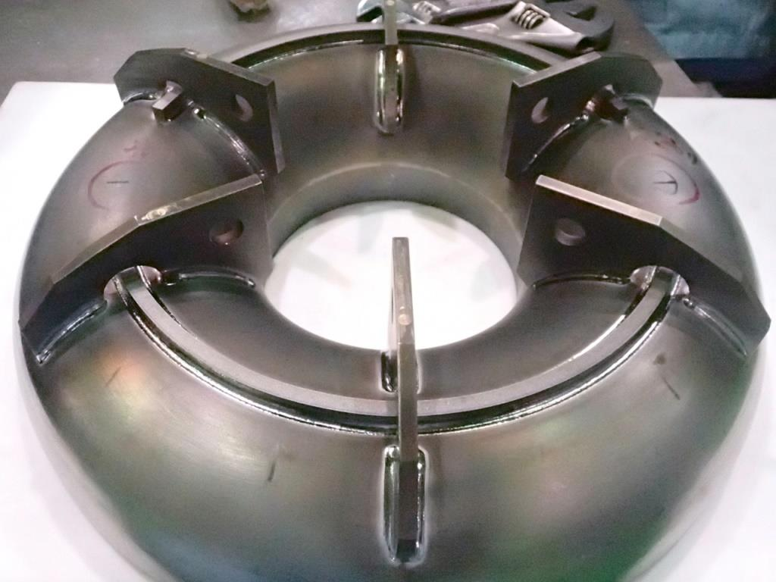
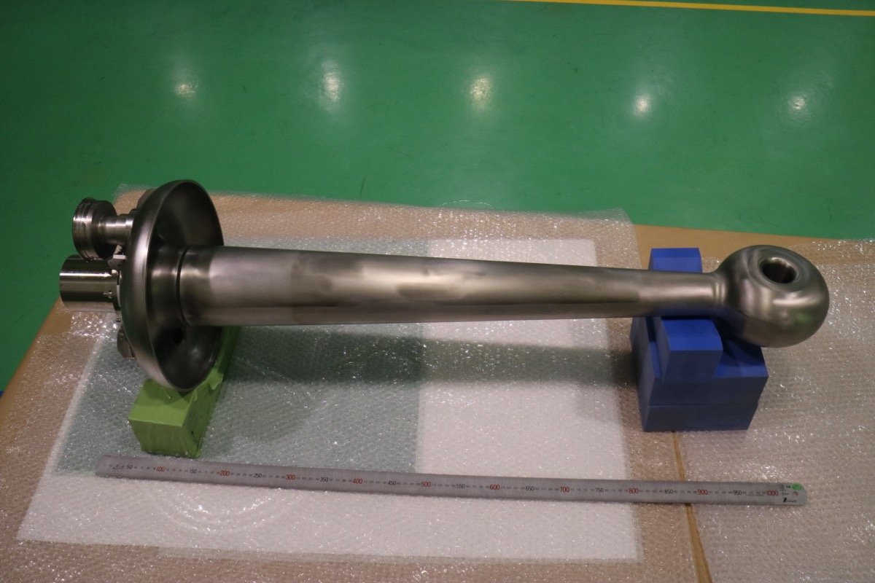
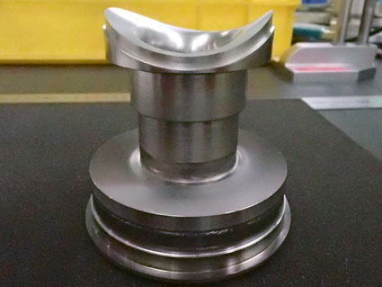
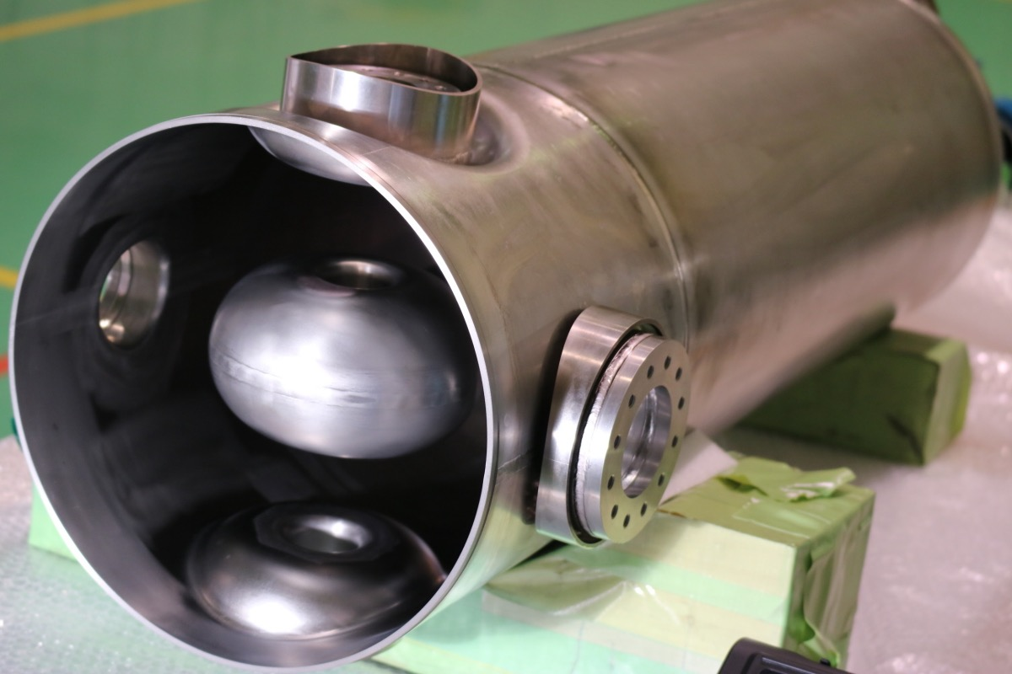
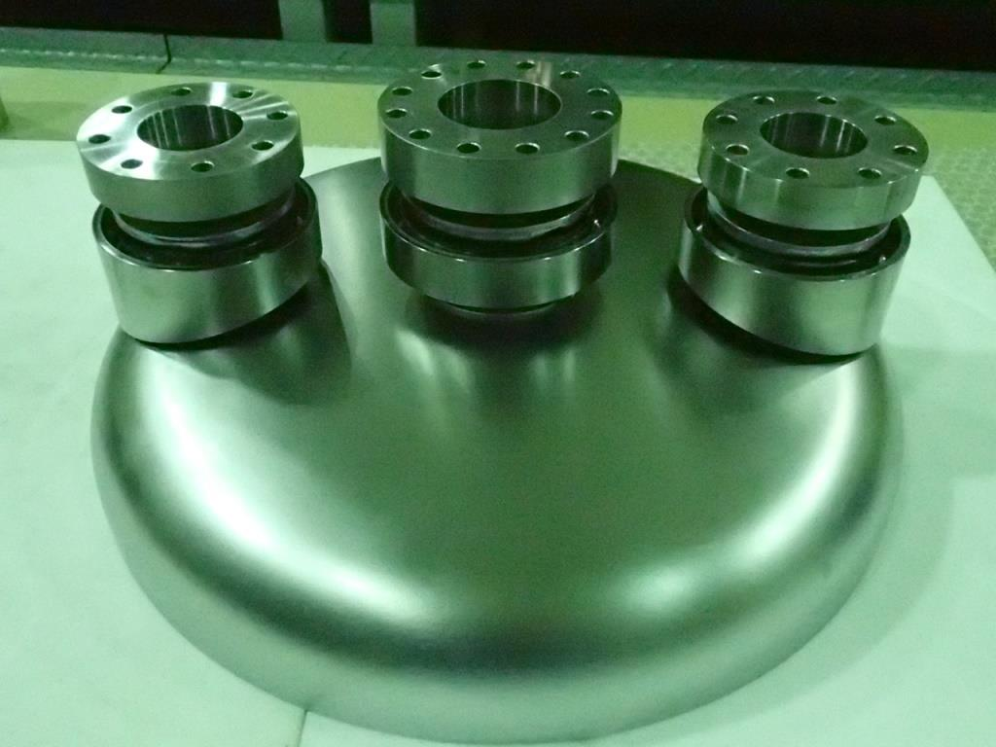
Development of SC-QWR
Inner conductor
After welding the inner conductor
and the top torus part
Top torus part
After welding the outer conductor
Rinsing port
Bottom part
Courtesy of N. Sakamoto
Notes:
These photos show the important parts of developed SC-QWR in the program.
Inner conductor, top torus part rinsing port, bottom part,
The inner conductor and the top torus part are welded and installed in the outer conductor.

Slide 27
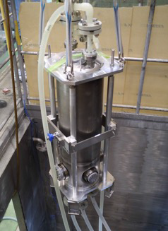
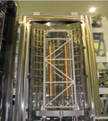
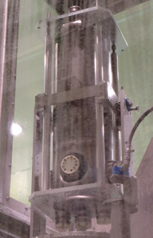
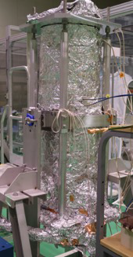
Development of SC-QWR
Cleaning procedure of the inner surface of the resonator is one of the most important issues in the fabrication of bulk Nb resonator.
  Fairly standard processing.
  Processing should be made under clean circumstances.
Manufacturing and surface preparation was made by Mitsubhisi Heavy Industries Co., Ltd
Observation of the inner surface was performed carefully.
Low Power RF test has been performed at AR-Higashi (KEK) since July 2016
BCP(100 μm)
Annealing
BCP(20 μm)
HPR
Baking
Courtesy of N. Sakamoto
Notes:
Cleaning procedure of the inner surface of the resonator is one of the most important issues in the fabrication of bulk Nb resonator.
BCP, annealing, BCP HPR and Baking
The processing is fairly standard but should be made under clean circumstances.

Slide 28
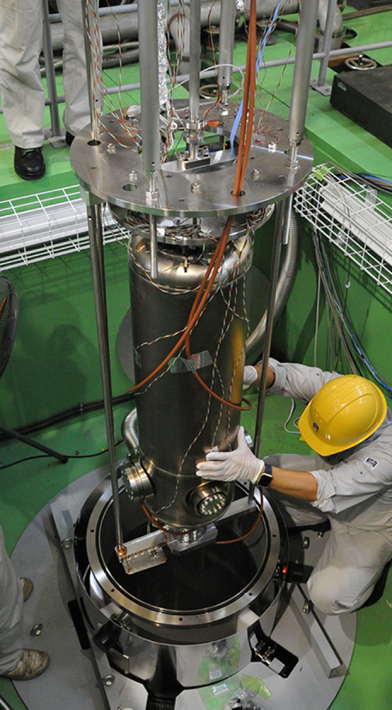
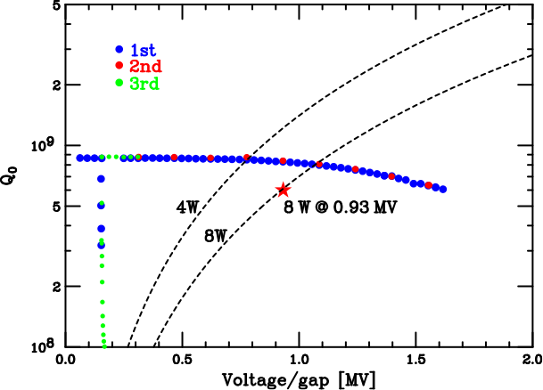

Development of SC-QWR
    Performance test was carried out at KEK on September 7th, 2016.
    The bulk Nb resonator was cooled down to 4 K by liquid He.
1.6 MV
High acceleration voltage of 1.6 MV was successfully obtained.
Courtesy of N. Sakamoto
Notes:
The first performance test was carried out at KEK on September 7th, 2016.
The bulk Nb resonator was cooled down to 4 K by liquid He after installing it in the vertical cryostat as shown in this photo.
This graph shows the result of the first vertical test.
High acceleration voltage of 1.6 MV was successfully obtained.
Star indicates the design value.
3rd line shows recovery from the multifactering.
This cavity is made in Japan.
This cavity is now installed in the cryomodule for the tests about coupler for power input, tuner and microphonic vibration.

Slide 29
Introduction to R&D on Targets in PJ4
The technical challenge
１：High capability of heat removal, uniformity in thickness
２：Beam window for high power beam
Beam transmits the target
Beam
Beam
Acc.
Tgt.
Beam
Thin liquid lithium target, Granular target
Beam stops in the target
Beam
Beam
Tgt
Target
“Windowless” vacuum interface （Plasma window）
29
Notes:
I will touch with R&Ds on targets in PJ4.
The technical challenge are the high capability of heat removal and uniformity in thickness, beam window for high power beam
IN the case when beam transmits the target, thin film of lithium or granular, we need to produce thin and uniform target without back plate
When beam stops in the target, windowless vacuum interface is very important. In many cases, beam windows limits the current.
We have developed large aperture plasma window.

Slide 30
Toward Large aperture plasma window
Plasma Window: vacuum interface using arc plasma
2~6mm
Beam
High pressure
Low pressure
Arc
Plasma
Motivation: Large aperture for high power beam
Notes:
Plasma window is vacuum interface using arc plasma invented by Ady hershcovitch.
It consists of cathode, cooling plate, anode.
This part is high pressure and this parte is low pressure
The existing plasma window has diameter as small as 2-6 mm.
We need larger aperture for high power beam, that is our motivation.

Slide 31
Large aperture plasma window (<20 mmφ)
・Design is based on the PW developed at Namba Laboratory[1], Hiroshima University.
・Cathode : CeW
・Insulator : Alumina
・Inside and outside of electrode are made CuW and SUS respectively.
(CuW high melting point and high thermal conductivity)
・Diameter is variable.
[1] S. Namba et. al., Rev. Sci. Inst., 87, 083503 (2016).
Notes:
We designed and fabricated the large aperture plasma window.
Cathode is made of CeW.
All insulators are made of Alumina.
Inside and outside of electrodes are mad of CuW and SUS, respectively because CuW shows high melting and high conductivity.
Size of the aperture is variable by replacing the parts colored by yellow.

Slide 32
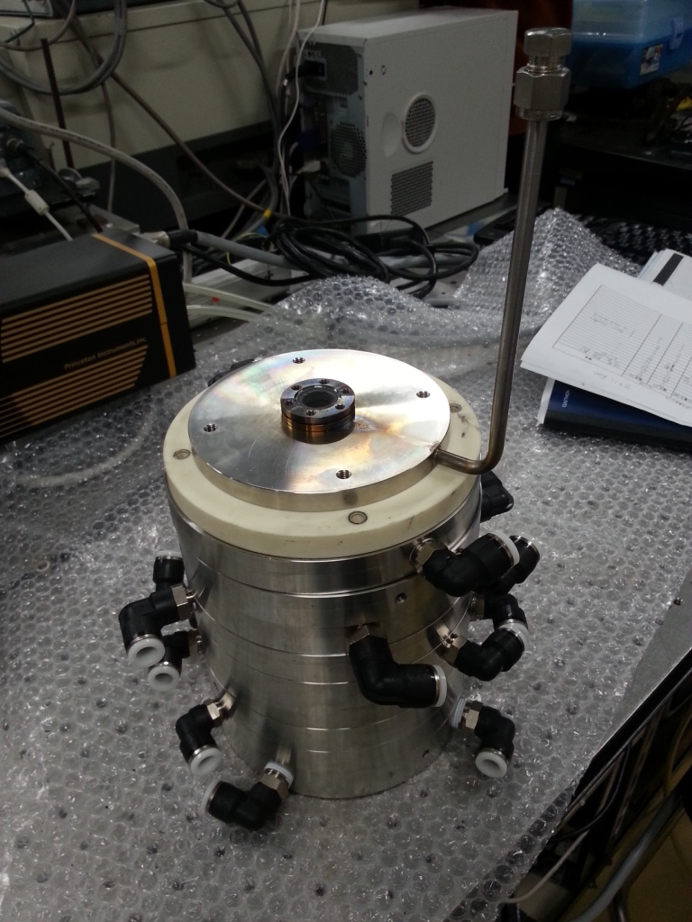
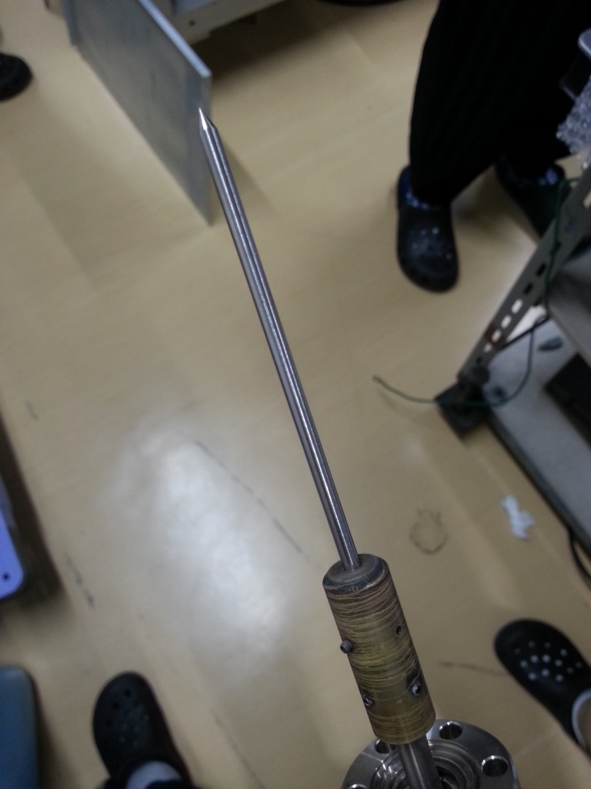
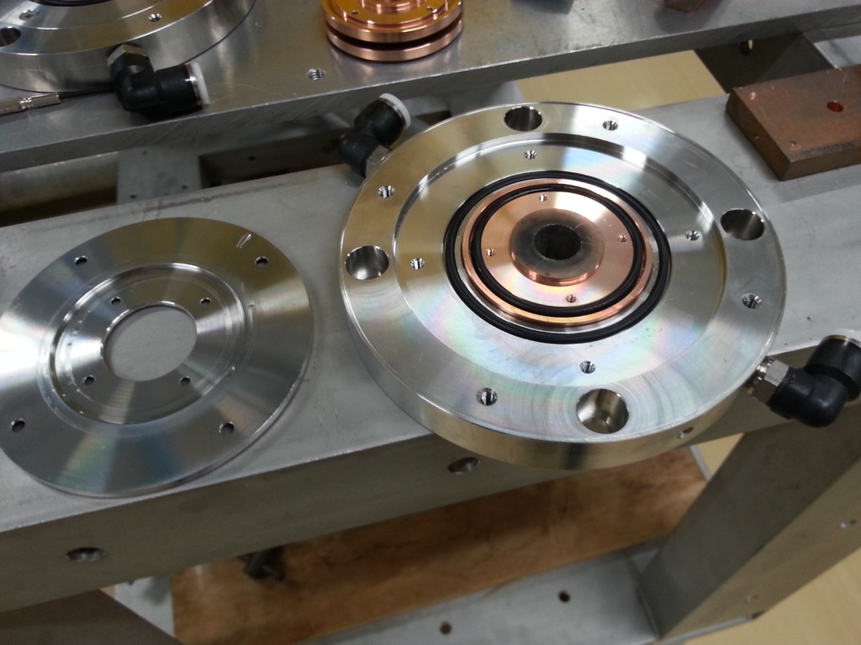
Large aperture plasma window
CeW cathode
Performance test is underway.
Cooling plate (SUS & CuW)
Notes:
These photos show real one of the large aperture plasma window.
The whole vies is here.
This is CeW cathode. Cooling plate made of SUS and CuW are here.
Performance test is underway.

Slide 33
R&D on high power target
Technical issues
  High capability of heat removal
  Target made of LLFP（Pd or Zr)
  Uniformity in thickness (internal target)
Candidates
  Liquid Metal （Liquid Lithium ）
  Granular target
Previous Studies
  Liquid lithium: IFMIF/EVEDA, BNCT
  Granular target: Chinese-ADS
Notes:
The next topic is R&D on the high power target.
The technical issues are the following.
Firstly, the target need high capability of heat removal because energy deposit is huge.
Secondly, we need to keep an option that LLFP such as PD and Zr can be used for target themselves.
Thirdly, uniformity in thickness is very important especially in cases of the internal targets.
Now we study on the two candidates of liquid metal target and granular target.
There are the previous studies of liquid lithium target in IFMIF/EVEDA and BNCT and granular target in Chinese-ADS which we can learn from.

Slide 34
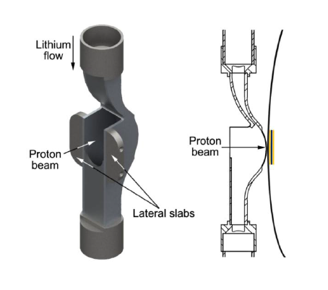
Liquid Lithium target
Direct ejection to produce free surface flow with out back wall （internal target、frequent change of back wall, etc)）
Nozzle
Deuteron
beam
Liquid lithium
film
back wall for
centrifugal force
Nozzle with a back wall for BNCT
Nozzle for ImPACT
Notes:
The point of our study on liquid lithium target are that we remove back walls which make the liquid lithium films smooth with centrifugal force.
We can’t use back wall when we use it as an internal target. And back wall should be changed frequently due to the radiation damage.
We eject liquid lithium directly to make free surface flow.

Slide 35
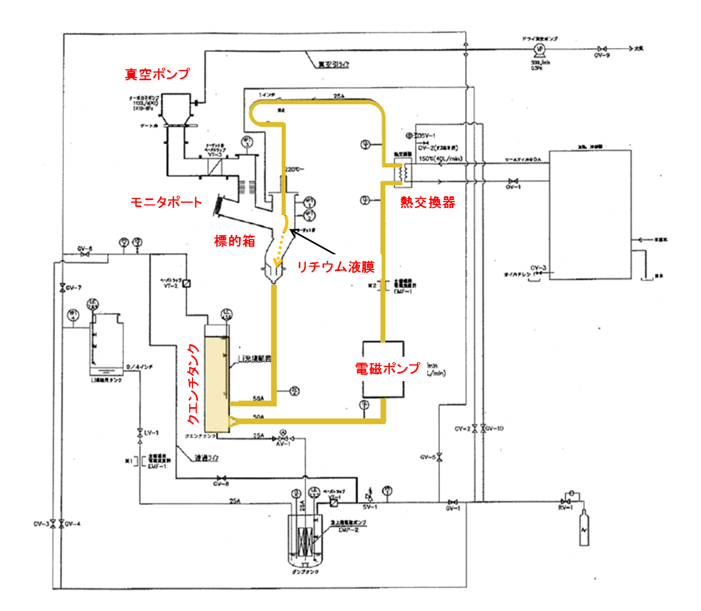
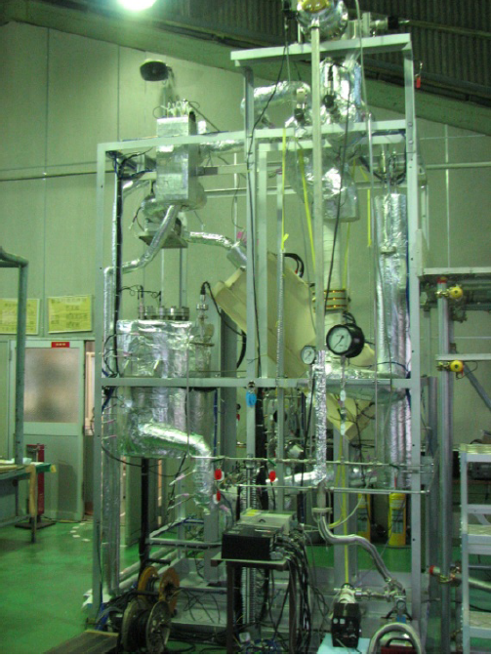
Test loop for liquid lithium target
Vacuum pump
Target
chamber
Heat exchanger
Monitor port
Heat
exchanger
Target chamber
Quench tank
Lithium film
2 m
Electromagnetic pump
Quench tank
Electromagnetic pump
Dump tank
This loop was developed for BNCT by Prof. Hayashizaki (TIT) .
The back wall was removed for this study.
Notes:
We had started the test using the test loop as shown here.
Originally this loop was developed for BNCT by prof. Hayashizaki.
We removed the back wall around the nozzle for this study.

Slide 36
Photos of liquid lithium film with long exposure
Notes:
These photos show liquid lithium films without back wall with long exposure.
It looks very smooth although we can see some deformation due to surface tension of liquid lithium.

Slide 37
Photos of liquid lithium film with 10μs exposure
Deformation due to surface tension
Fluctuation of free surface
How to suppress the deformation and fluctuation → Magnetic field
Fluctuation of free surface
Fluctuation of free surface
Notes:
However, photos with 10microsecond exposure reveal the real surface of the film.
We can see some fluctuation in the film in every flow velocity.
Ion beam can feel this fluctuation, generating its emittance growth.
Especially when we use it in the accelerator as an internal target, condition will be severe.
We are measuring this fluctuation quantitatively to study how to suppress it by magnetic field applied along this flow.

Slide 38
Project 4 Contents (Nuclear Reaction Experiments)
Advanced control technique of nuclear reaction （Selected candidates in PJ2）
・Energy recovering Internal target （ERIT) with acceleration（Accelerating efficiency improvement ＋Higher current＋Neutron utilization）
・Efficiency improvement of Small cyclotron （r.t. superconducting or mermanent magnet + multi layer cyclotron）
・Transmutation facility using fusion neutrons（Millar type fusion＋Muon catalized fusion）
【Principle of ERIT accelerator & Transmutation by neutrons 】
Acceleration+Accumulation
Slow down ions by inner target
Internal target
Producing neutrons
Incident
ions
Target（LLFP)
FFAG type magnet
ERIT at KURRI (2005~)
POP experiment!
(~FY2017)
Path after accelerated
Serpentine acc.
rf cavity to compensate
38
Notes:
The advanced control technique of nuclear reaction selected from PJ2 are joined in the scope of PJ4.
Energy recover type accelerator ERIT, efficiency improvement of small cyclotron and transmutation facility using fusion
Especially we pay attention to ERIT.
ERIT consists FFAG ring with strong focus, internal target and rf resonator which compensate energy loss in the target. This
Ions are injected to a orbit in the ERIT and accelerated by this rf cavity. As ion gains energy, trajectory go outward in ERIT to reach internal target When ion hits the target neutrons are produced for transmutation and the part of ion energy are loosed. This rf cavity is used for compensate energy loss of ion and recover to the trajectory to hit target again.
The ERIT concept of beam accumulation is proved in 2005.
This new erit is aiming at not only accumulation of the beam but also acceleration. This pop experiment is ongoing in this fiscal year using the KURRI erit.

Slide 39
Summary
”Reduction and Resource Recycling of HLW through Nuclear Transmutation”
PJ1: Separation and Recovery technique namely Partitioning
  The new scheme of Odd-even separation (gain efficiency by 100000)
PJ2: Nuclear data measurement for transmutation
  We successfully obtained various reaction data for LLFPs using RIBF and J-PARC
PJ3: development of nuclear reaction model and improvement of PHITS reaction model
  Requirement to Accelerator
PJ4: Transmutation system and elemental technologies development (Accelerators and targets)
  Superconducting Cavity of QWR (Quarter Wave Resonator) was successfully test.
  Large aperture plasma window
  Liquid Lithium target and granular target
  New types of ERIT which allows acceleration and accumulation
  Design of 1A linac is underway.
Notes:
”Reduction and Resource Recycling of HLW through Nuclear Transmutation”
PJ1: Separation and Recovery technique namely Partitioning
The new scheme of Odd-even separation (gain efficiency by 100000)
PJ2: Nuclear data measurement for transmutation
We successfully obtained various reaction data for LLFPs using RIBF and J-PARC
PJ3: development of nuclear reaction model and improvement of PHITS reaction model
Requirement to Accelerator
PJ4: Transmutation system and elemental technologies development (Accelerators and targets)
Superconducting Cavity of QWR (Quarter Wave Resonator) was successfully test.
Large aperture plasma window
Liquid Lithium target and granular target
New types of ERIT which allows acceleration and accumulation

Slide 40
Project 5 Contents
Purpose：to evaluate of practicability with specific scenario of LLFP P&T system and proposed conceptual design of new transmutation system by using results of PJ1 to PJ4.
Scenario study of LLFP P&T
・Disposal improvement by P&T
（Volume reduction of high-level radioactive waste both LLFP
and MA Transmutation）
・Rare metal materials for resource
recycling by P&T
（LLFP’s Pd and Zr for resource recycling）
Conceptual design of process
・Study on separation and recovery system
・Study on transmutation system
・Specific design of P&T system and economic feasibility assessment
40
Notes:
The contents of the final project, PJ5 are shown in this slide.
Its purpose is evaluation of practicability with specific scenario of LLFP P&T system and of proposed conceptual design of new transmutation system by using results from PJ1 to PJ4
It includes scenarioi study of LLFP and conceptual design study of process.

