Slide 1













DONES: DEMO-Oriented Neutron Source
Workshop on Advanced Neutron Sources and its Applications. Aomori (Japan) November 4-5, 2017
A. Ibarra (CIEMAT) representing the complete WPENS team
February 2005

Slide 2

Outline
DONES objective and overall approach
Accelerator Systems summary
Test Systems summary
Li systems summary
Remote Handling & Building systems
Summary

Slide 3
Outline
DONES objective and overall approach
Accelerator Systems summary
Test Systems summary
Li systems summary
Remote Handling & Building systems
Summary

Slide 4
Neutron source requirements
Along the time, it has been widely recognized that a fusion-like neutron source is needed for fusion materials qualification both for DEMO and the power plant development
The requirements are to produce fusion-like neutrons
  Intensity large enough to allow accelerated (as compared to DEMO) testing,
  Damage level above the expected operational lifetime,
  Irradiation volume large enough to allow the characterization of the macroscopic properties of the materials of interest required for the engineering design of DEMO (and the Power Plant)
Requirements based on EU DEMO needs
> 10 dpa(Fe)/fpy
20 dpa(Fe) in 1.5 y
50 dpa(Fe) in 3.5 y
300 cm3
The most feasible approach based on Li(d,xn) sources
The IFMIF-DONES project!!!
The IFMIF project since 90´s

Slide 5
What is IFMIF-DONES?
It is the minimum neutron source required to fulfill the materials fusion-like irradiations needs of DEMO
IFMIF-DONES (Demo-Oriented Neutron Source)
Main technical characteristics
Based on IFMIF Preliminary Engineering Design simplified as much as possible:
  One full energy (40 MeV) accelerator with angular incidence
  Full size IFMIF Test Cell: only half cooling needed
  Full size IFMIF Li loop: only half cooling, half purification system needed
  Reduced number of irradiation modules to be used: no need of Tritium online measurements and strong simplification of Pipes & Cables Plugs
  Minimum irradiated materials (modules, target,…) manipulation in the plant: irradiated materials transferred to external facilities, if possible
  Waste management reduced to the minimum
  Upgrade to full IFMIF could be feasible

Slide 6
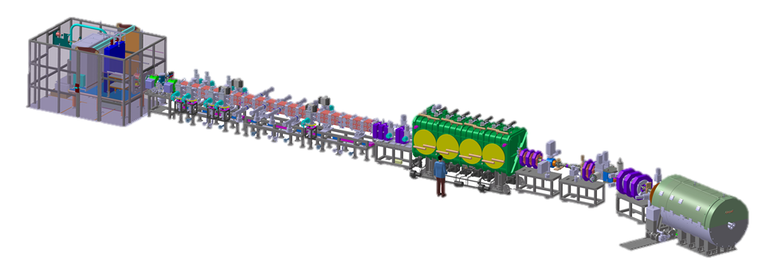
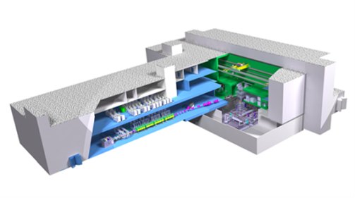
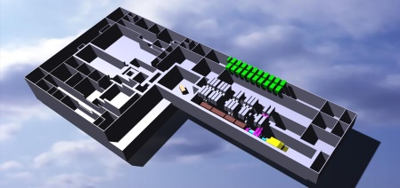
Design process of IFMIF-DONES Plant
IFMIF-EVEDA validation activities: Orai loop, Heloka, Lifus6, LIPAc
IFMIF-DONES validation activities
Critical technical issues analysis (quench tank location, TA approach, AC configuration,…
IFMIF EDR 2013
WPENS Project timeline
Plant and systems requirements definition
Design guidelines
Boundaries and interfaces identification
Implementation of design choices
Systems design
Integrated analysis
IFMIF-DONES Conceptual Design Report 2014
Preliminary Safety Analysis Report
Reference Design
Second half 2016
Preliminary Engineering Design report 2017

Slide 7
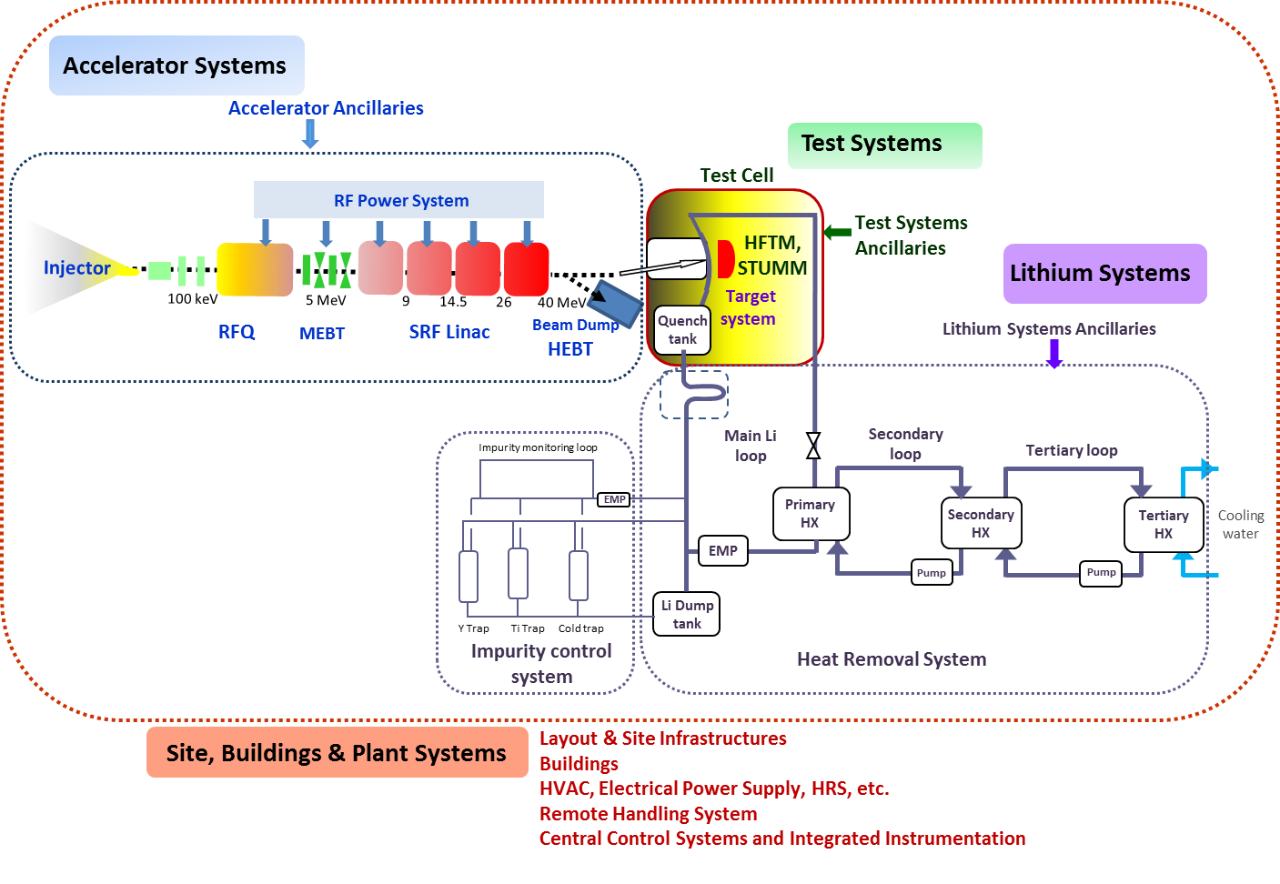
IFMIF-DONES Plant Configuration

Slide 8
Outline
DONES objective and overall approach
Accelerator Systems summary
Test Systems summary
Li systems summary
Remote Handling & Building systems
Summary

Slide 9
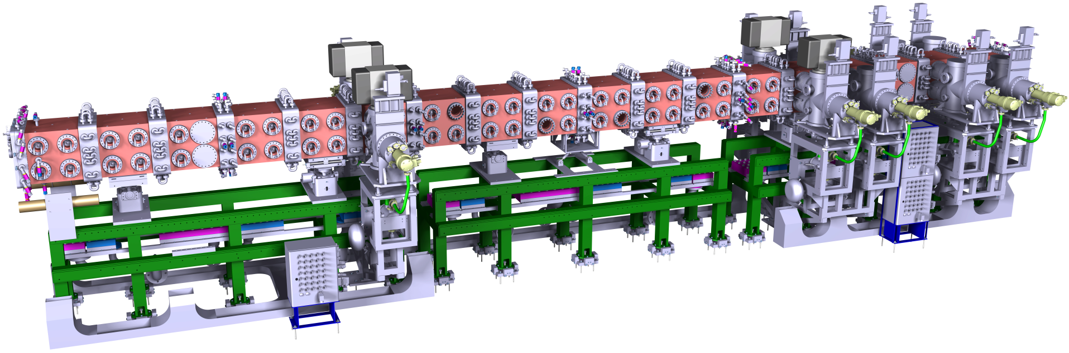
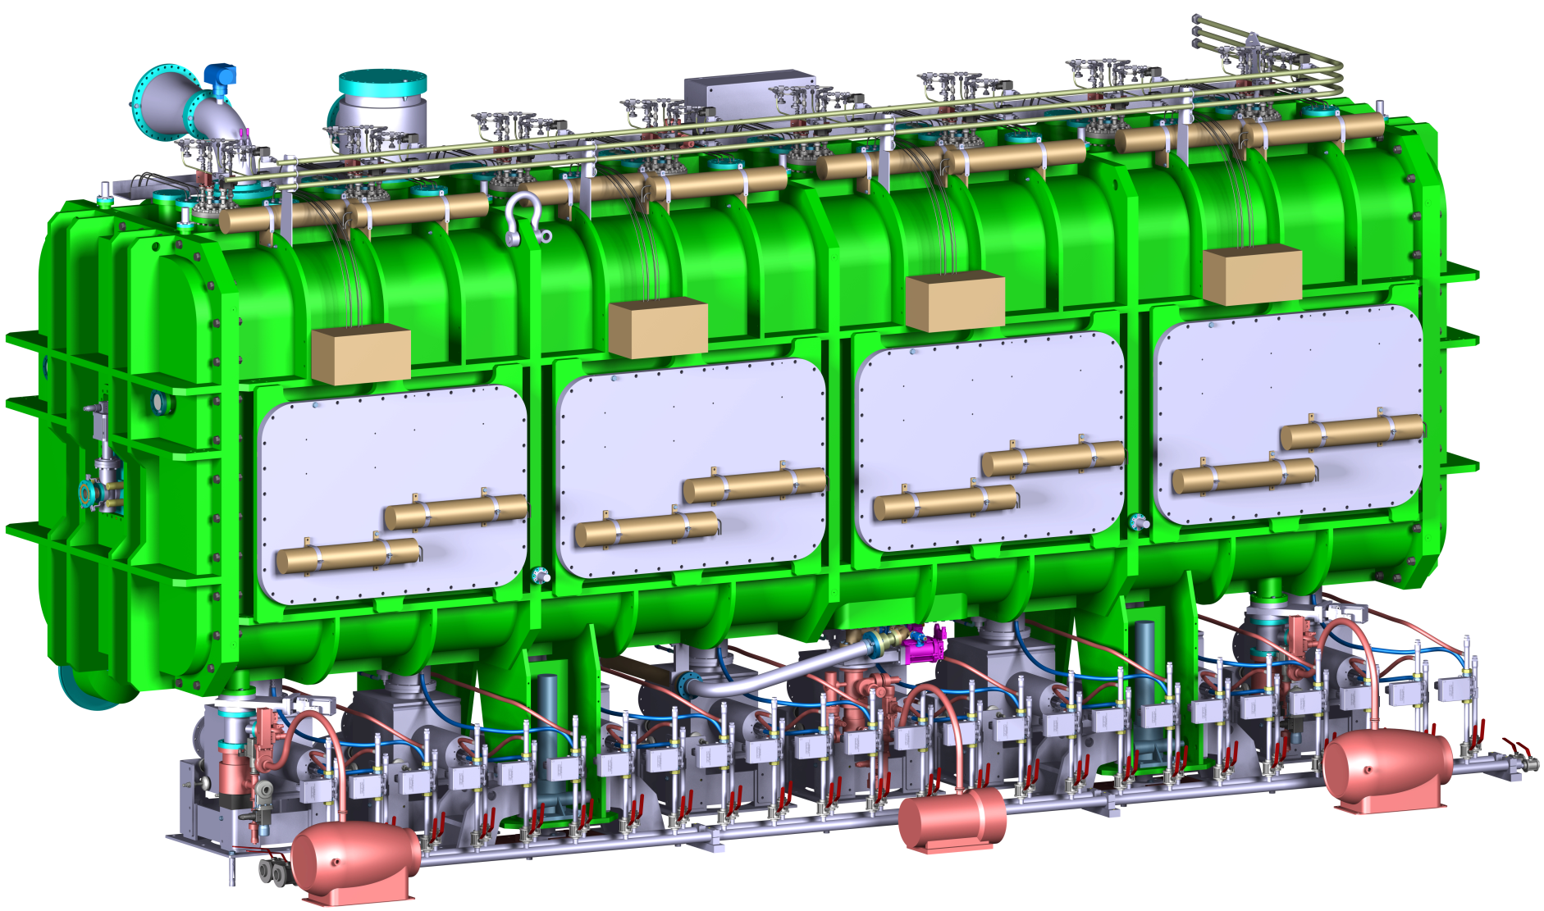
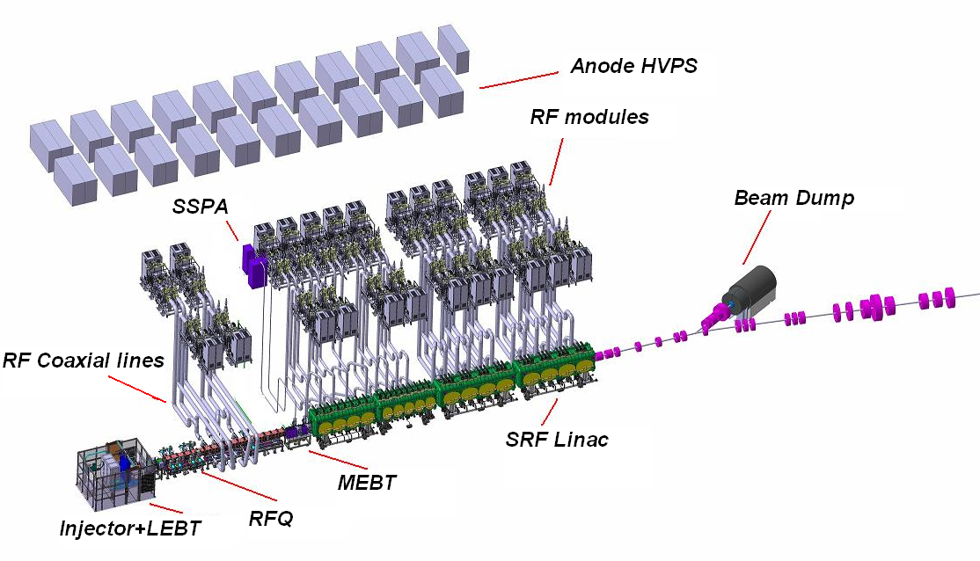
Accelerator systems summary
SRF cryomodule
RFQ
175 MHz, 5MW, 125 mA, CW, high availability: One of the more powerful accelerators in the world. Waiting for validation results from LIPAc (Rokkasho)
Very similar to the IFMIF one but some changes implemented….

Slide 10
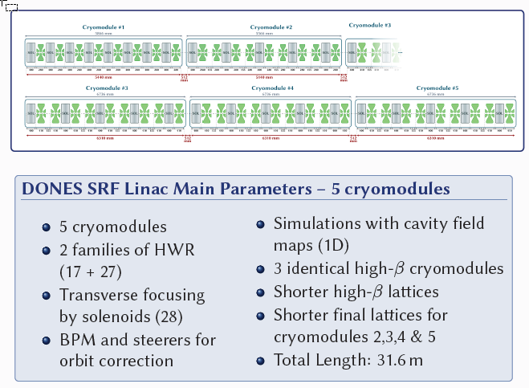
AS main changes: SRF configuration
Reference design for SRF linac system: 5 Cryomodules!
Implemented to assure the D final energy and reduced beam losses

Slide 11
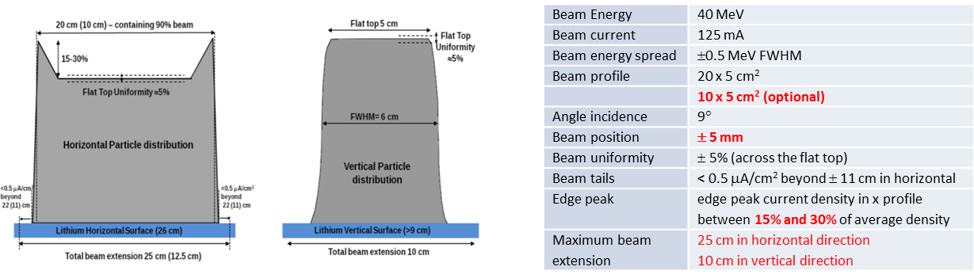
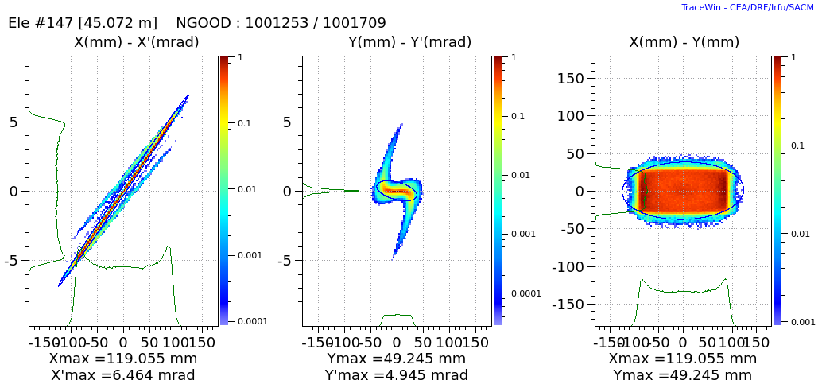
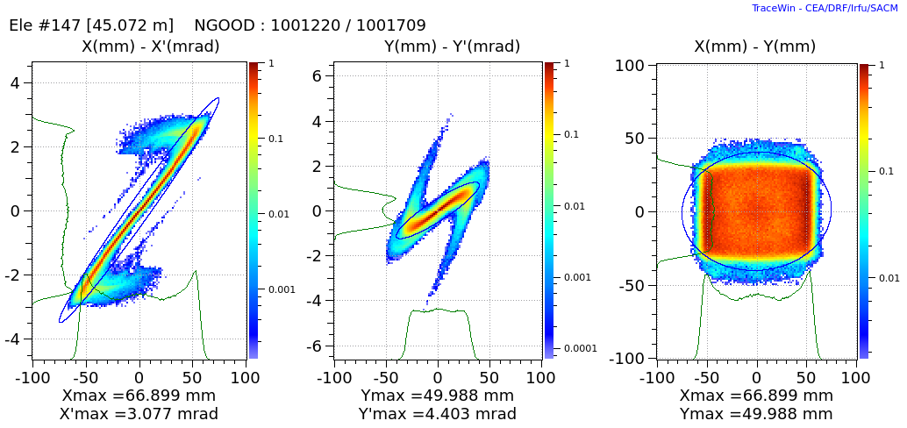
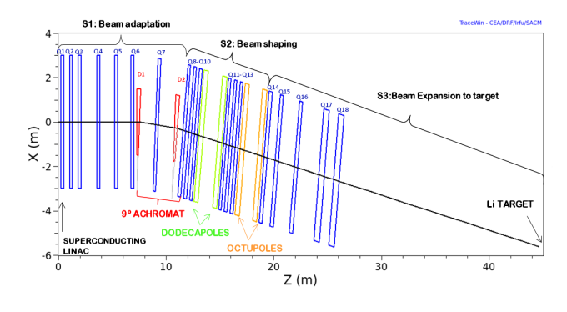
AS main changes: Beam specifications on target
SRF cryomodule
RFQ

Slide 12
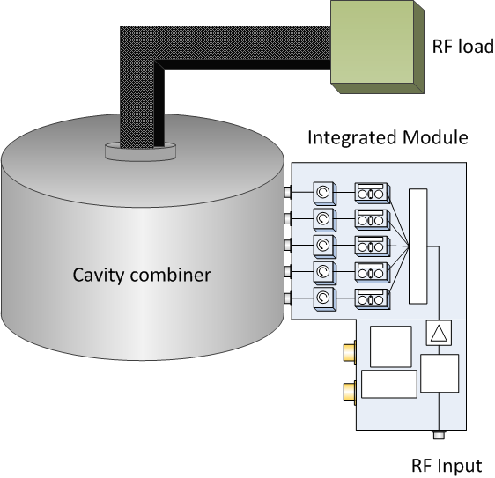
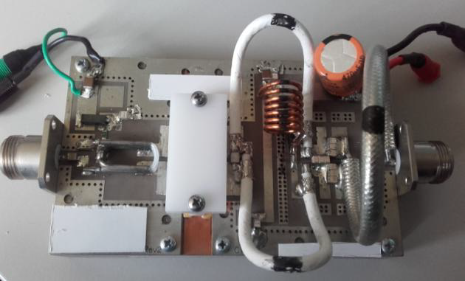
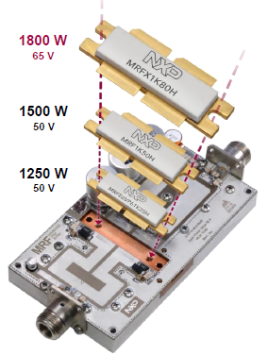
AS main changes: Solid state RF
LIPAc Project: 2x20kW SS RF chains
50V 1200W LDMOS Transistor
Freescale MRFE6VP61K25H
New 65V 1800W LDMOS NXP MRFX1K80 (pin-compatible)
2017
2016
RF source can be tuned for each cavity
On-operation maintenance is feasible
Higher availability
2010-2012

Slide 13
Outline
DONES objective and overall approach
Accelerator Systems summary
Test Systems summary
Li systems summary
Remote Handling & Building systemx
Summary

Slide 14
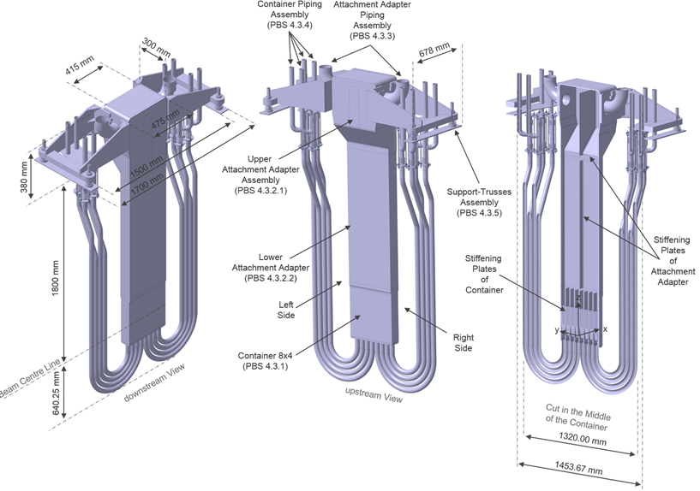
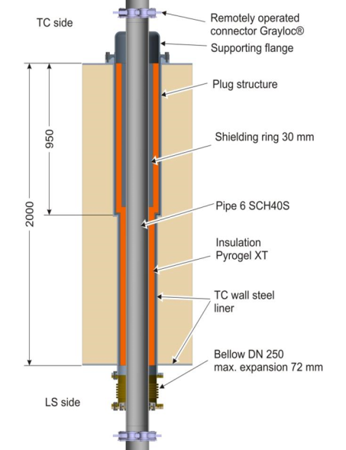
Test Systems summary
Irradiation module
Cooled shielding plug
Duct penetration

Slide 15
Test Systems summary
Irradiation module
Cooled shielding plug
Main characteristics driven by the presence of neutrons and Li
  Internal components cooling by He
  Remote Maintenance required
Similar to the IFMIF one but some changes implemented (or to be implemented)…
Duct penetration

Slide 16
Test Systems Changes: Test Cell configuration & others
Test Cell configuration:
Enlarged to host the Quench Tank
New volume added to define Li loop fixed points:TC-LS Interface Cell (extended liner)
HFTM design:
NaK must be avoided (Na filled proposed)
Improved fabrication methods

Slide 17
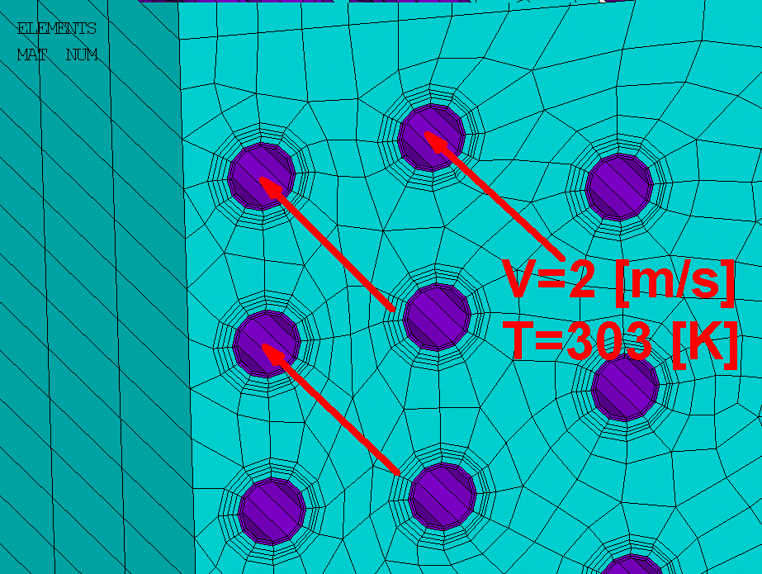
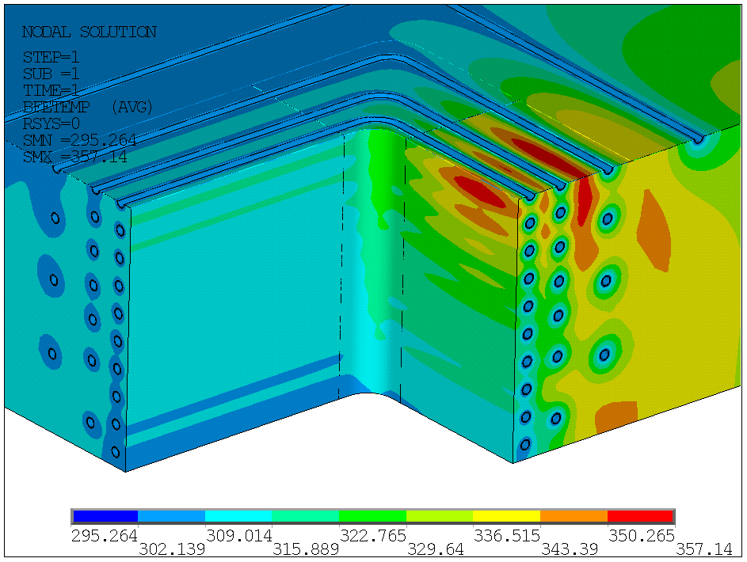
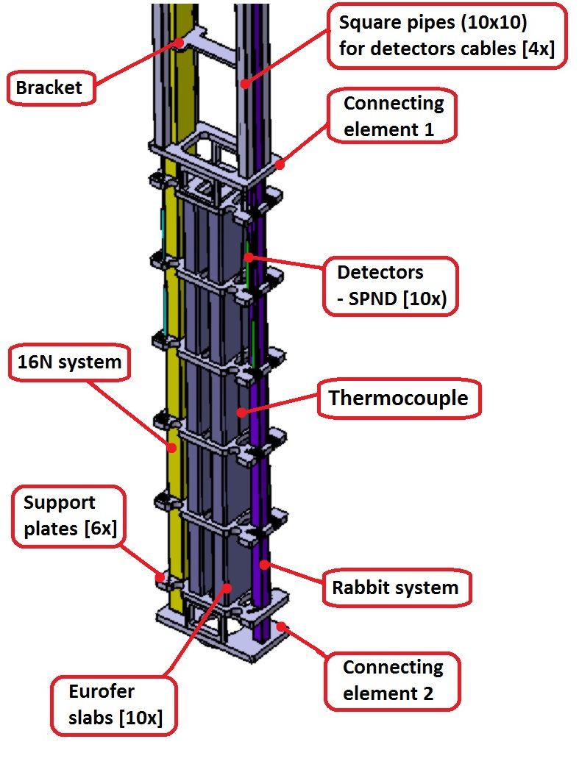
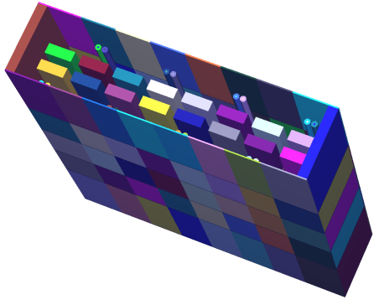
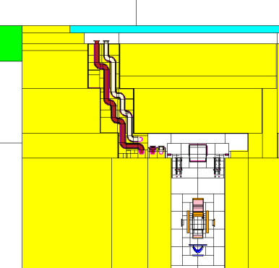
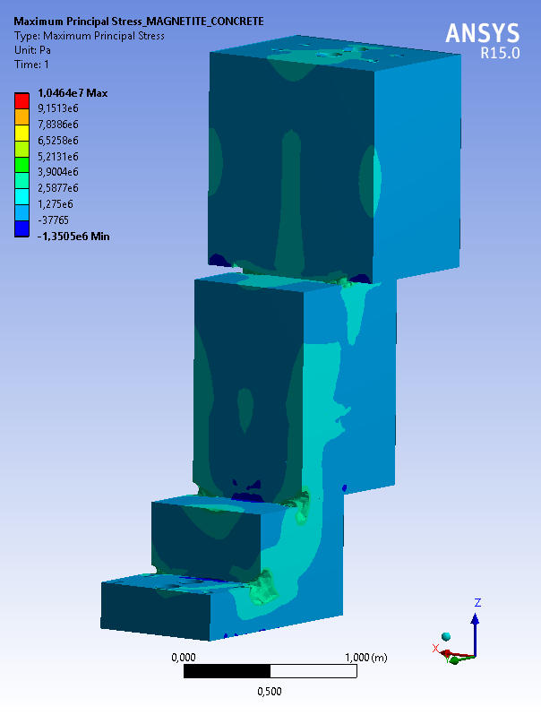
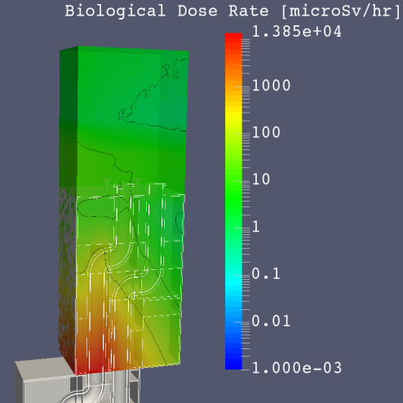
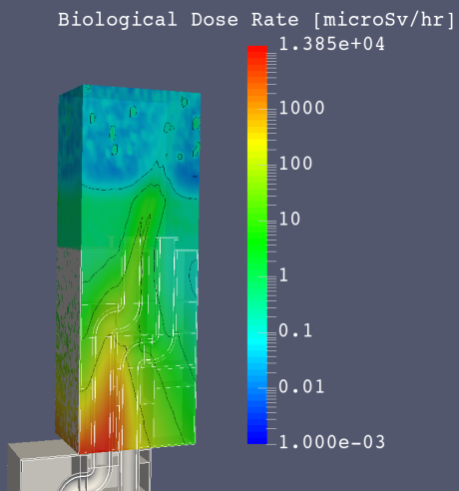
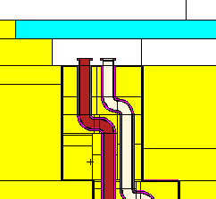
Test Systems: Progress of engineering design
STUMM module to characterize the facility during the commissioning phase
Water cooling of concrete walls
Detailed design of PCP
(including radiation streaming)
Neutrons
Photons

Slide 18
Outline
DONES objective and overall approach
Accelerator Systems summary
Test Systems summary
Li systems summary
Remote Handling and Building systems
Summary

Slide 19
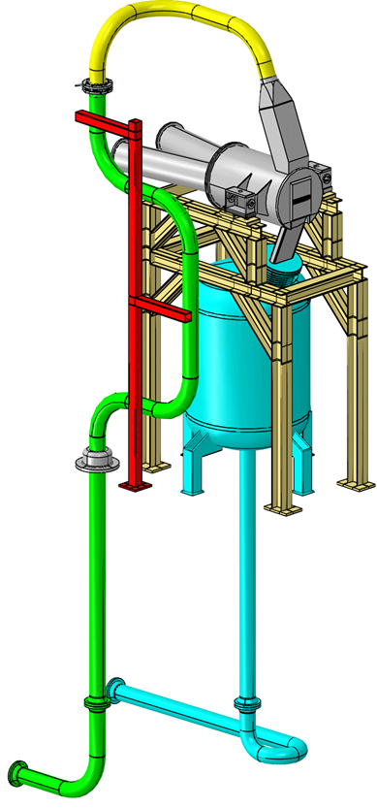
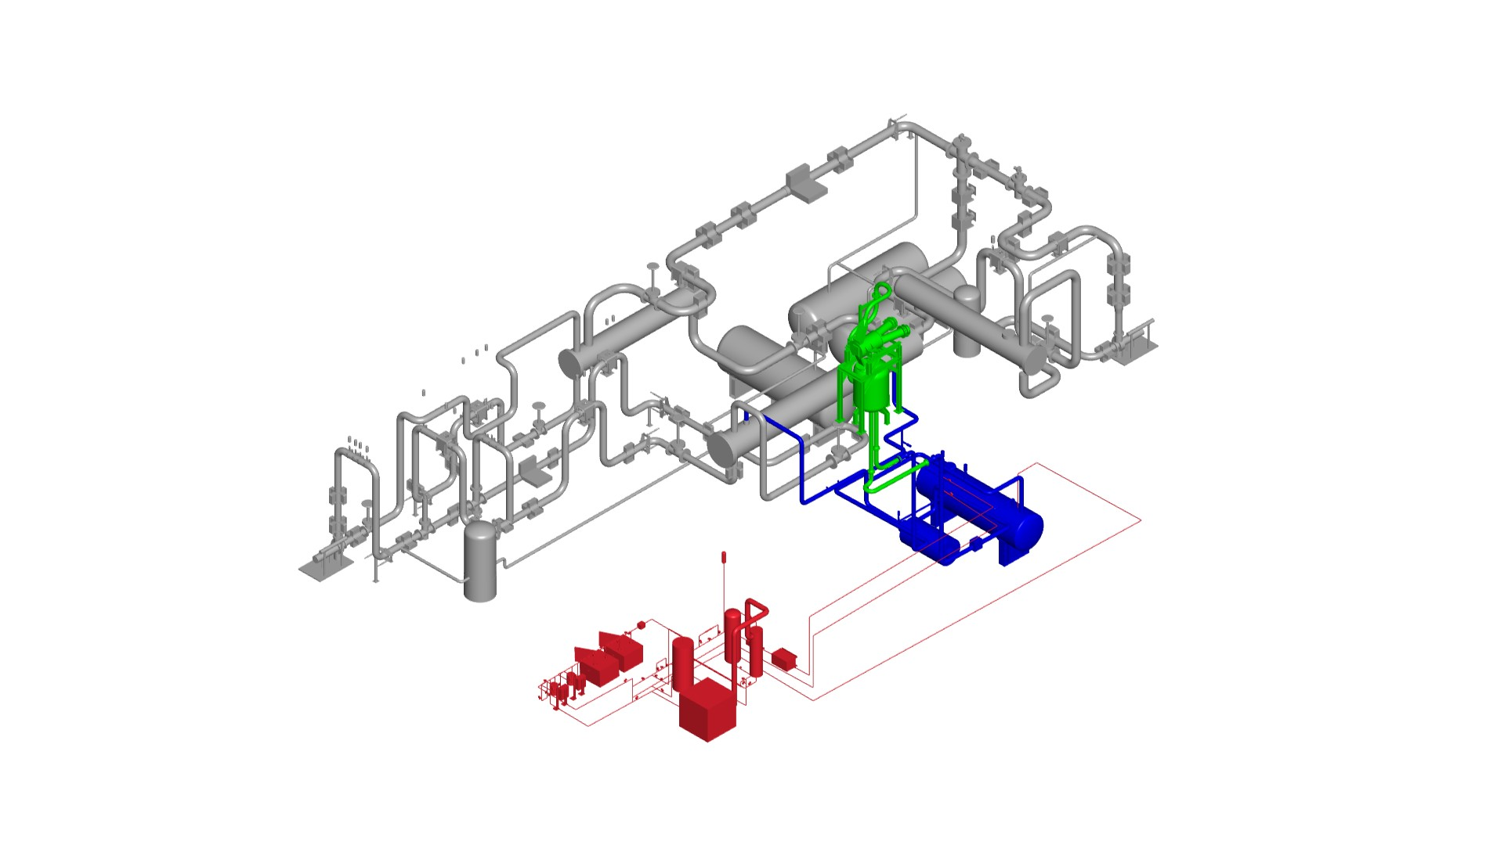
Li systems summary
Inlet nozzle
FDS
Target
chamber
Beam duct
Back-Plate
Lithium inlet pipe
Oil-Oil secondary HX
IISP
TC floor
level
Quench
Tank
Outlet nozzle
Support
structure
Oil-Water tertiary HX
Target assembly
Lithium outlet pipe
Li-Oil tertiary HX
Inlet pipe
fixed point
LI main loop
Li monitoring
Li purification loop

Slide 20
Li systems summary
5 MW power handling, 15 m/s Li velocity, remote handling
Main requirements: Li flow stability and Li impurities control
Main challenges to be considered:
  Target Assembly lifetime
  Risk of cavitation, Li evaporation
  T (and other radioactive ions) inventory
Very relevant results from IFMIF/EVEDA validation activities
Very similar to the IFMIF one but some changes implemented…
Inlet nozzle
FDS
Target
chamber
Beam duct
Back-Plate
Lithium inlet pipe
Oil-Oil secondary HX
IISP
TC floor
level
Quench
Tank
Outlet nozzle
Support
structure
Oil-Water tertiary HX
Target assembly
Lithium outlet pipe
Li-Oil tertiary HX
Inlet pipe
fixed point
LI main loop
Li monitoring
Li purification loop

Slide 21
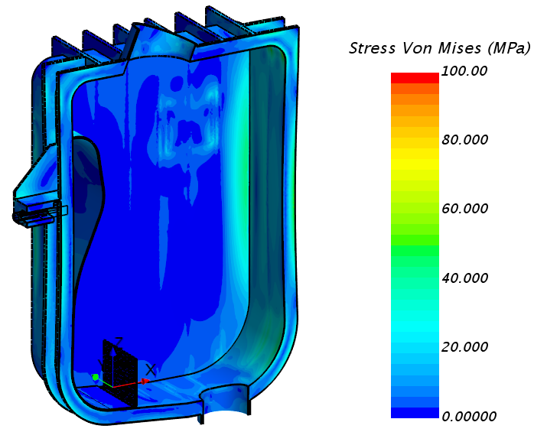
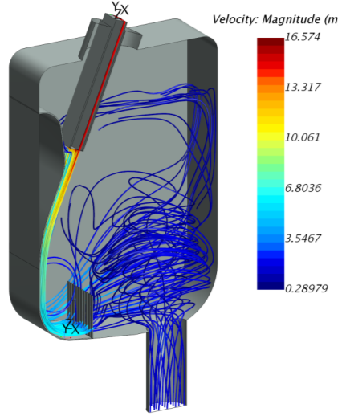
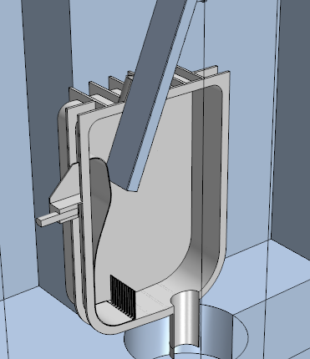
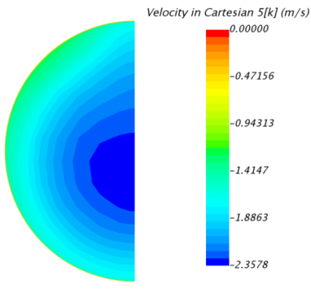
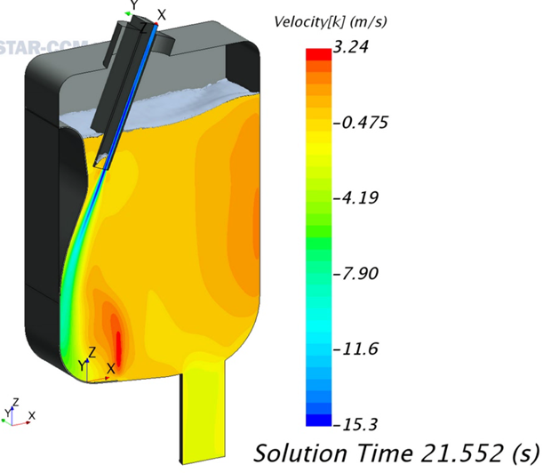
LS main changes: quench tank design
Conditioning
grid
Stress distribution
Stream lines
Quench tank must be located as close as possible to the target assembly outlet to reduce the risk of cavitation
Quench tank must have some internal structure to assure uniform outlet flow with a reduced volume (and stable surface)
Remote maintenance must be feasible

Slide 22
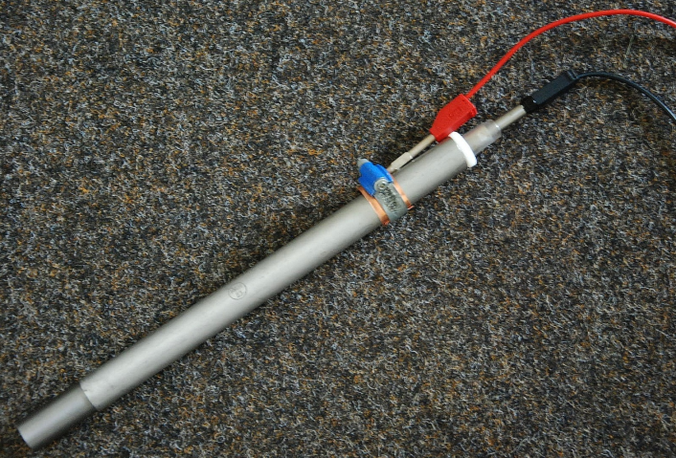
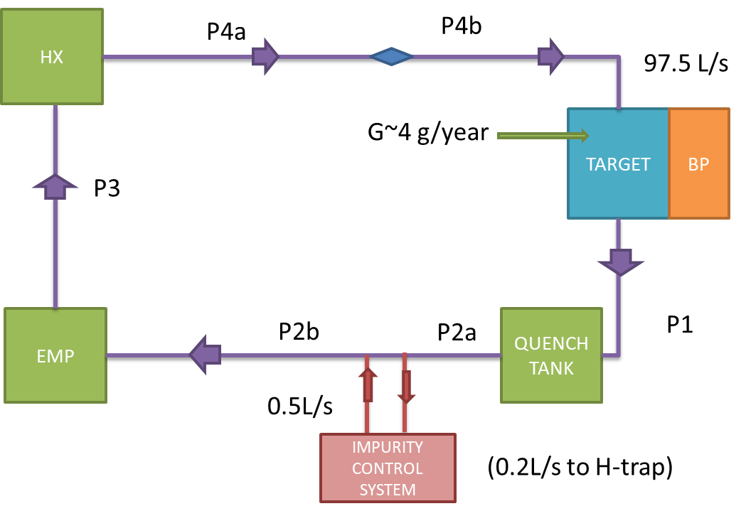
LS main changes: Impurities control
Purification requirements
Hydrogen electrochemical sensor
Item | Value | Remarks
H content in Li | (≤10 wppm) | target values, Under review
T content in Li | (≤1 wppm)
N content in Li | (≤30 wppm)
O content in Li | (≤10 wppm)
Be-7 content in Li | (-) | Under review
Corrosion product content in Li | (-) | Under review
Erosion/corrosion rate | (≤1 m m/year) | for nozzle and BP. Under review
 | (≤ 50 m m/30 years) | for the other. Under review
Tritium modelling by Ecosimpro
Review of impurity contents requirements
Purification strategy improved: N trap off-line integrated in the dump tank
Mass transfer modelling
Hydrogen isotopes modelling
Target and Li monitoring diagnostics

Slide 23
Outline
DONES objective and overall approach
Accelerator Systems summary
Test Systems summary
Li systems summary
Remote Handling and Building systems
Summary

Slide 24
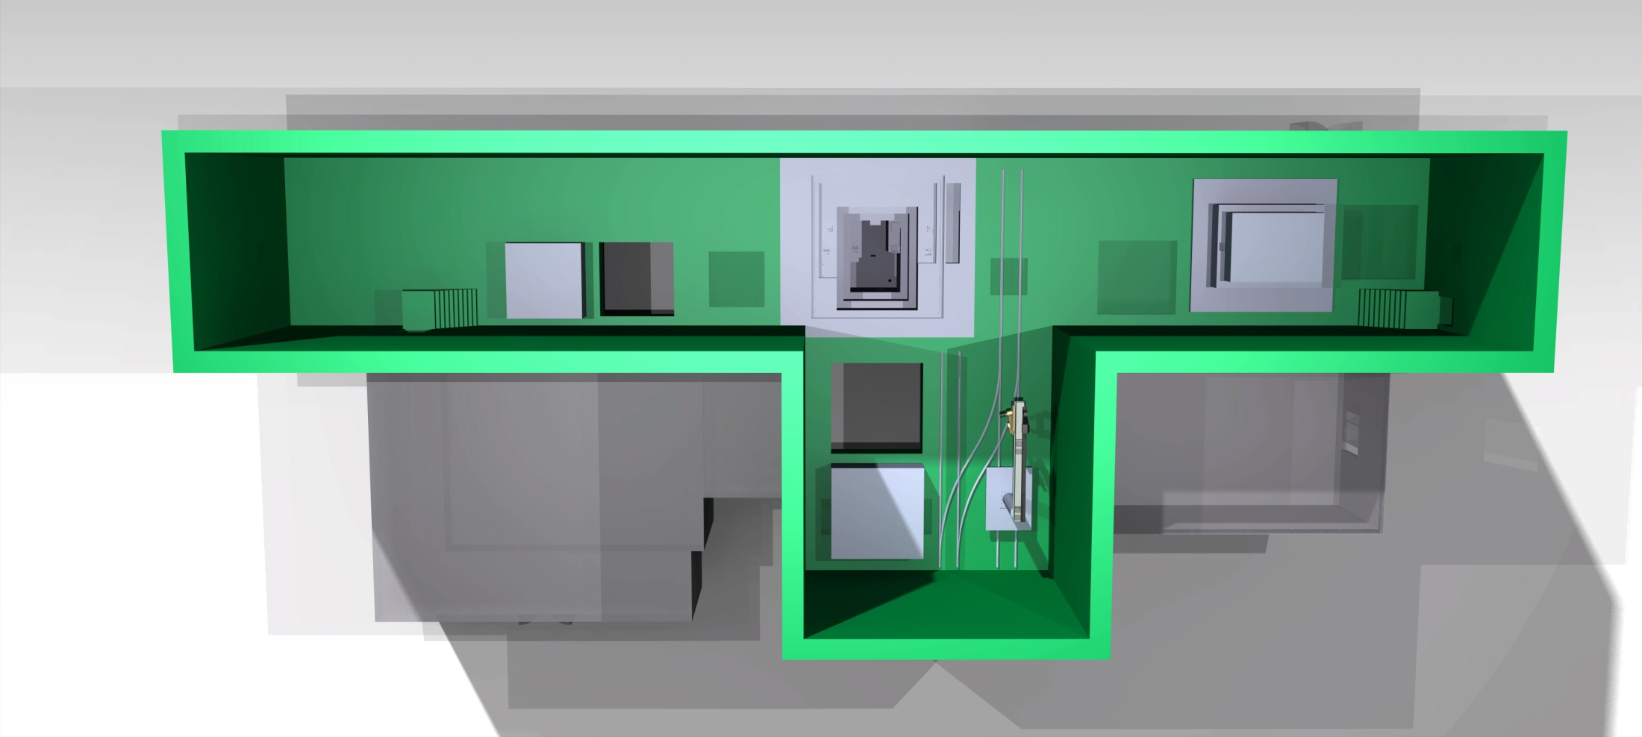
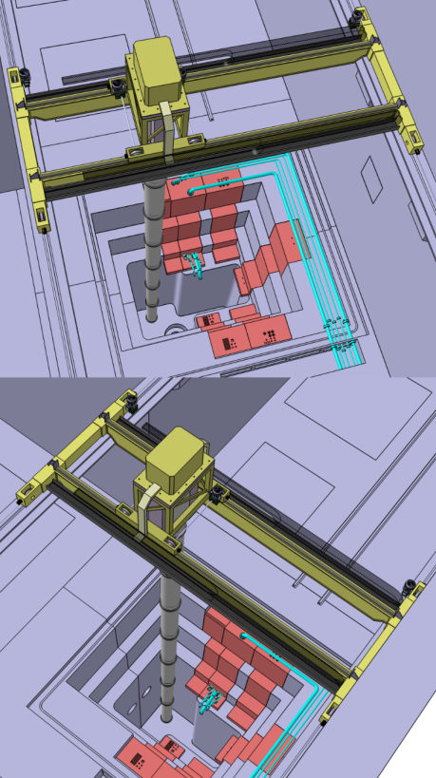
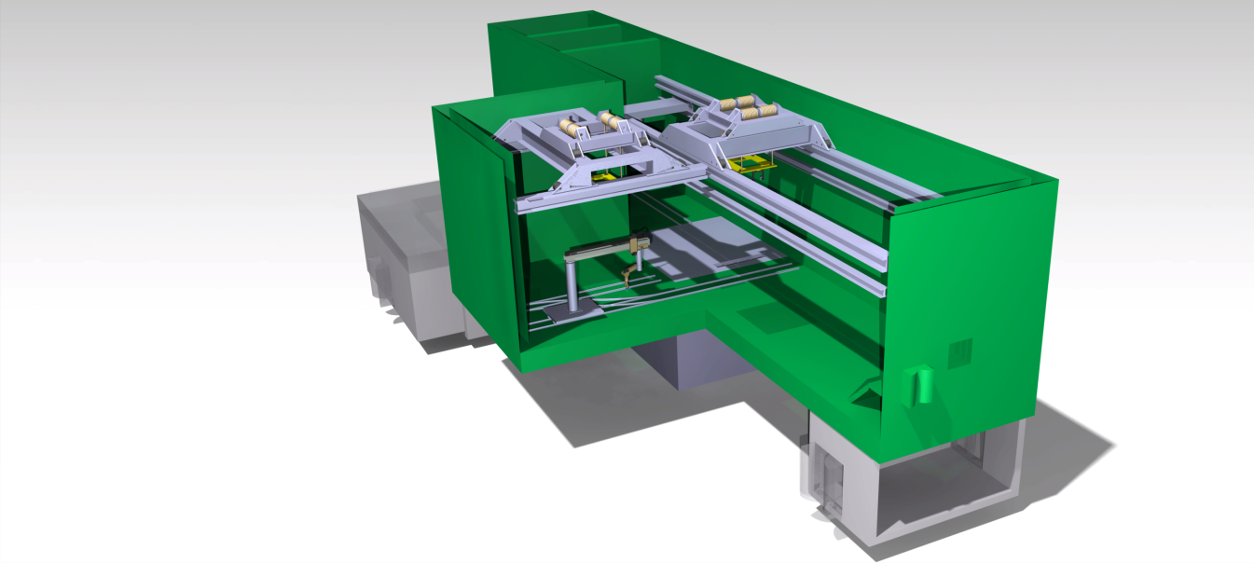
Remote Handling System
HFTM & positioning systemC
TA & storage support
TA positioning system
Stillage support for tooling
TCCP, USP & LSP
Plug for IWTC hatc
Stillage support for tooling
Plug for TIR hatc
Key and complex system
It requires evaluation of maintenance needs and dose maps, identification of all the required operations, design of common and specific tools, evaluation of the operations,…

Slide 25
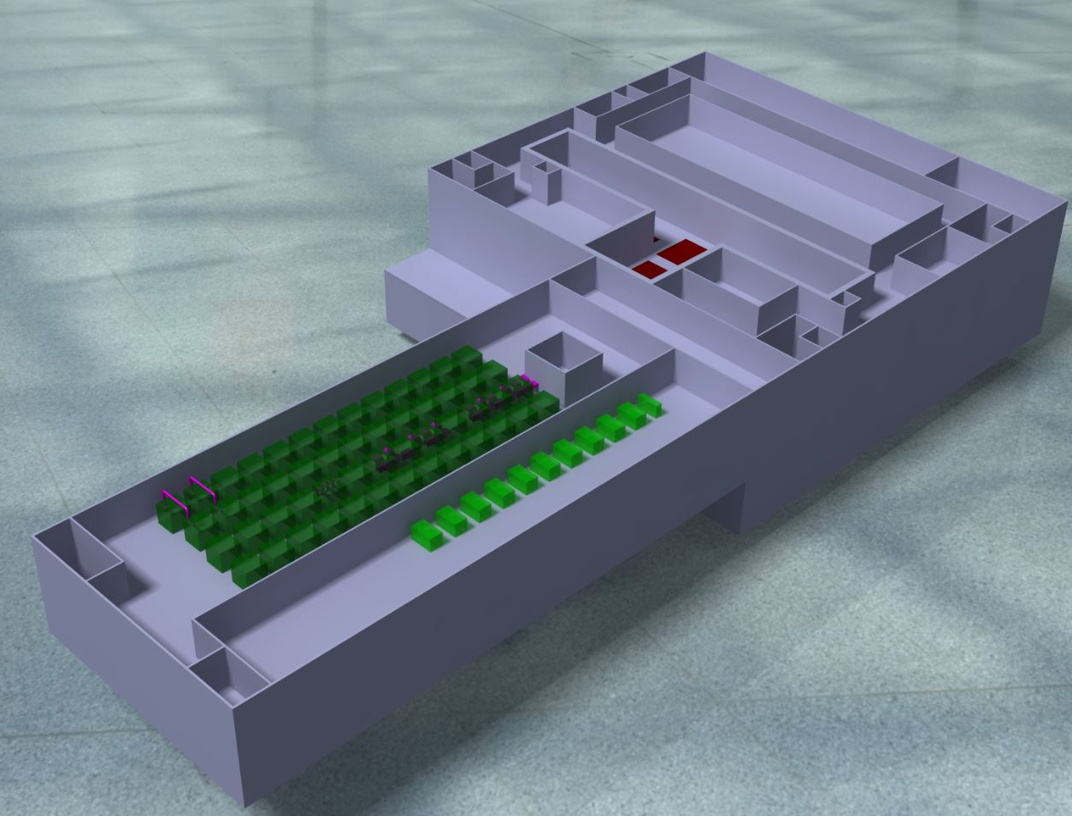
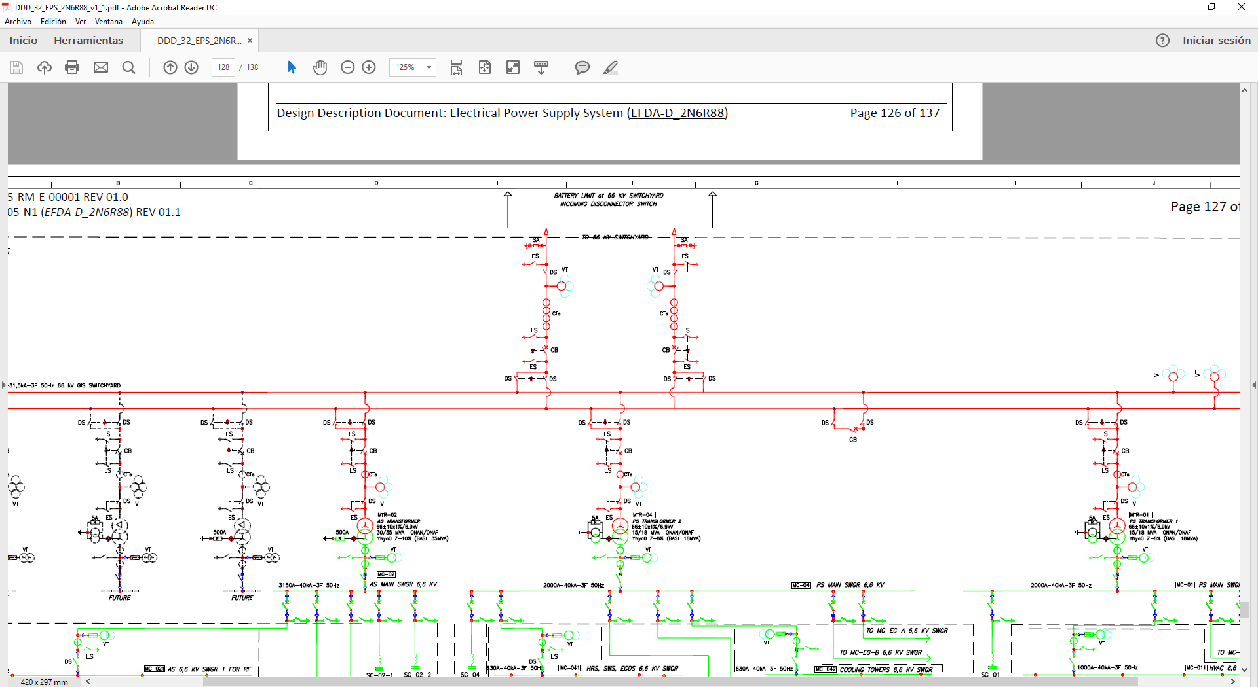
Building and Plant Systems
Main Building (generic site)
Dimensions ~ 160 x 75 ; Three – story
Basement/foundation slab, three suspended floors at different elevations, and one additional roof slab
Main structural system is formed by a combination of bearing walls, columns, suspended slabs and beams, all of them in-situ cast with concrete.
Included and area for Other Complementary experiments
Plant Systems
HVAC; Electrical Power System (~45 MVA); Heat Rejection System (~18 MW); Service Water System (Potable/Industrial/Demi); Service Gas Systems (Argon, Helium, Nitrogen, CA)
Radioactive Waste Treatment System (Solid, Liquid and Gas/Detritiation)
Fire Protection System (Det./ Ext.)

Slide 26
Outline
DONES objective and overall approach
Accelerator Systems summary
Test Systems summary
Li systems summary
Remote Handling and Building systems
Summary

Slide 27
Summary
A fusion-like neutron source is needed as soon as possible for DEMO design and IFMIF-DONES is the proposed European alternative to be implemented in the near future
IFMIF-DONES design is based on IFMIF design evolved to take into account a reduced scope and results obtained during the prototyping phase
If everything moves on properly, construction can start in 2020
Engineering design for the different systems is progressing steadily. Key results must be obtained from LIPAc in Rokkasho

Slide 28
End

