Slide 1
Multi-Aimed Intense Neutron Source (MAINS) based on BISOL
Yan Sha (on behalf of BISOL-MAINS team)
State Key Laboratory of Nuclear Physics and Technology
Peking University
Workshop on Advanced Neutron Source and its Application
Nov. 04-05, 2017 Aomori, Japan

Slide 2
OUTLINE
Background
Brief history of BISOL
Concept of MAINS
  D⁺ Accelerator
  Liquid Lithium Target and Irradiation Unit
  Liquid Li Loop
  Neutron field properties
Outlook

Slide 3
OUTLINE
Background
Brief history of BISOL
Concept of MAINS
  D⁺ Accelerator
  Liquid Lithium Target and Irradiation Unit
  LLi Loop
  Neutron field properties
Outlook

Slide 4
BISOL
Beijing Isotope-Separation-On-Line Neutron-Rich Beam Facility
— A facility to producing neutron rich rare isotope ions by means of ISOL+PF
Notes:
PF: particle fragmentation

Slide 5
Double sources
CARR (China advanced research reactor)
Intense D⁺ Accelerator
Notes:
PF: particle fragmentation

Slide 6
Requirements of Intense Fast Neutron Source
Material research for fusion and fission energy, neutronics, imaging, material analysis,single particle effects, ……
Basic nuclear scientific research

Slide 7
China fusion energy roadmap
CFETR:
5-10 dpa in Phase I
50-100 dpa in Phase II
Wan, et. al., Nucl. Fusion, 57, 102009, 2017

Slide 8
BISOL-MAINS
Multi-Aimed Intense Neutron Source driven by D⁺ accelerator
CARR
Exp. Term.
⁷⁸Ni 250 pps
¹²⁰Sr 2X10⁻⁴ pps
PF
Secondary BL
¹³²Sr 4X10¹⁰ pps
⁹¹Kr 4X10¹¹ pps
¹⁴²Xe 9X10⁹ pps
2X10¹⁵ fission/s
Isol Exp.
Isol
10-70 MeV/u
SC Accelerator
SC Accelerator
RI Ions
10 PμA
Exp. Term.
2X10¹⁴ fission/s
Neutron
Lab
MAINS
L-Li target
5X10¹⁴ n/cm²s
D⁺
RFQ+SC Accelerator
ECR IS
40 MeV
10 mA
Notes:
PF: particle fragmentation

Slide 9
MAINS
Multi-Aimed Intense Neutron Source driven by D+ accelerator
Irradiation Unit
Side view
RIS
TA
TM
TA
TA
TA
TA
TA
Laser
Top view
TM
TA
TA
RIS
TA
Material irradiation
(Test modules)
Neutron science and other applications
(neutron beams)
ISOL (Fission ion source)

Slide 10
OUTLINE
Background
Brief history of BISOL
Concept of MAINS
  D⁺ Accelerator
  Liquid Lithium Target and Irradiation Unit
  LLi Loop
  Neutron field properties
Outlook

Slide 11
Major Milestones
2011: CIAE and PKU signed agreement to jointly promoting an ISOL-type RIB facility in Beijing area. As a result the previously proposed CARIF and ImPUF were merged into Beijing-ISOL

Slide 12
Major Milestones
Oct. 2012: An IAC was formed and a review meeting was held at PKU to evaluate the “Initial Conceptual Design of the
BISOL”.
“The Committee considers the research potential of the proposed facility in both, basic as well as applied and interdisciplinary research, as excellent and highly competitive on the world level. It promises a unique science reach in several respects, in particular with regard to the most neutron rich exotic nuclei and the study of the astrophysical r-process.”

Slide 13
Major Milestones
2013: the advanced ISOL-type facility was adopted in “the national mid- and long-range plan ( till 2030) of the major facilities for science and technology development”.
Aug. 2014: a Xiang Shan Forum ( 503th meeting in the series) was successfully organized and a road map for major nuclear physics research facilities was established, including the BISOL as the next major facility.
May 2016: a domestic expert meeting was held at CIAE to evaluate the preparation works of the BISOL, aiming at a proposal to the 13th 5-year plan of the central government of China.
Notes:
Xiangshan meeting: national science and technology development strategy discussion.

Slide 14
Major Milestones
May-June 2016: proposed large-scale science facilities (more than 50 proposals in all) were reviewed by the National Development and Reform Council. BISOL was successfully classed into the list of the preparation facilities (10+5 facilities in total).
Dec. 2016: the government has officially announced the results for the 13th 5-year plan.
Notes:
10 Priority +5 alternate (waiting for vacancy)

Slide 15
Major Milestones
Jan. 2017: a specialized IAC meeting was held at PKU-CIAE, dedicated to the accelerator based intense neutron source, in particular the high-power target systems.
Mar. 2017: the 1st BISOL user meeting was held at PKU, with ～ 150 participants and very active discussions.
Jun. 2017: BISOL proposal was finalized and evaluated by an internal committee, being ready for the next national review and the next IAC review.

Slide 16
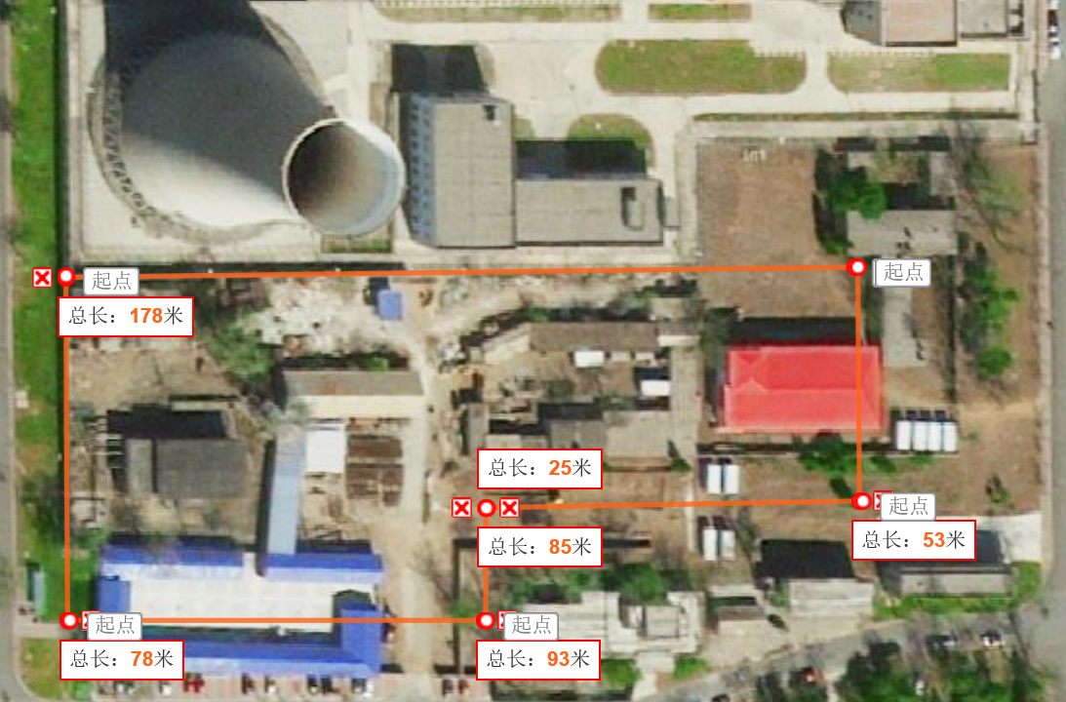
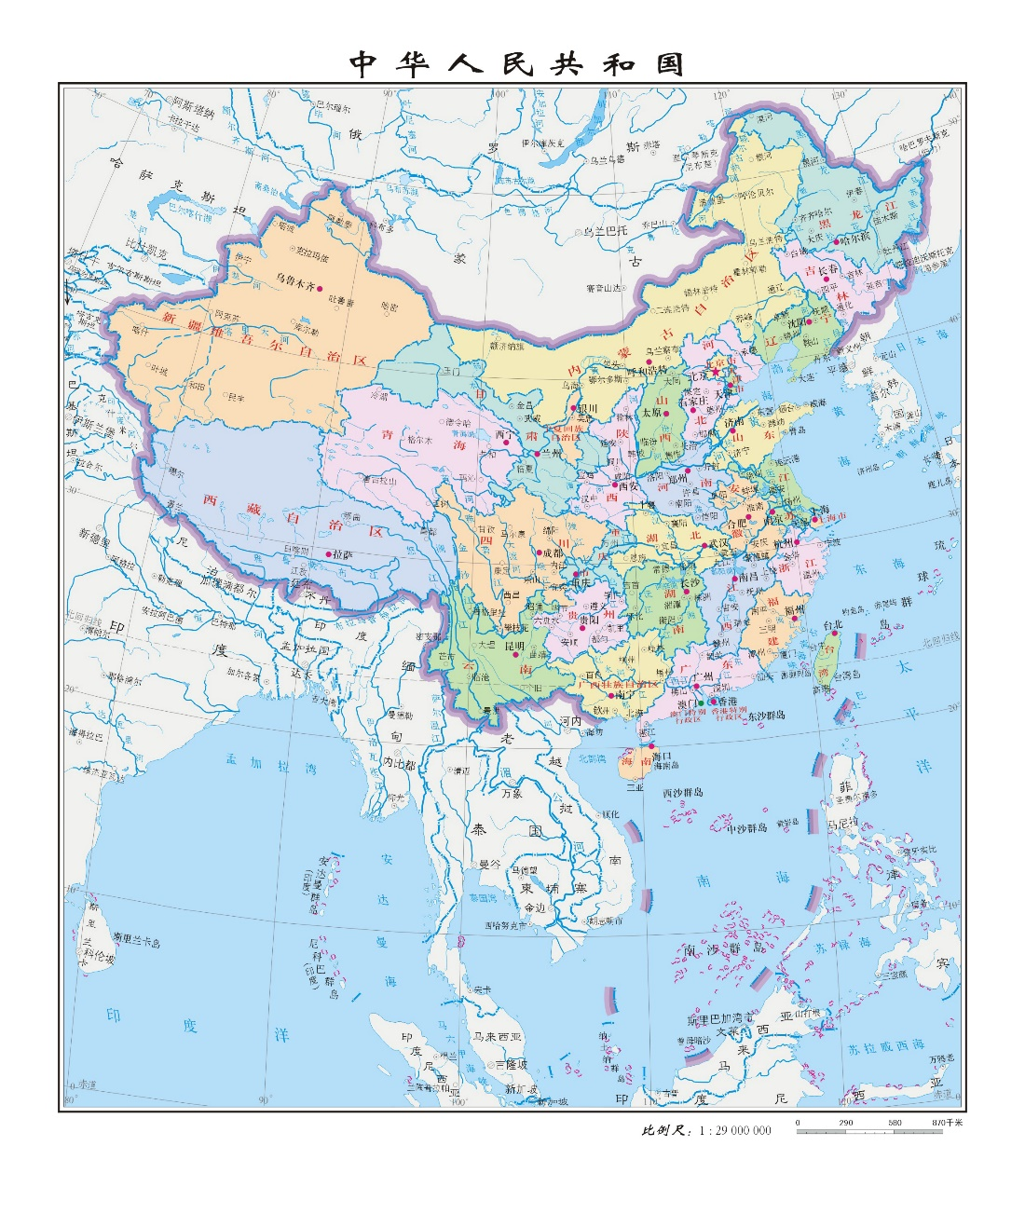
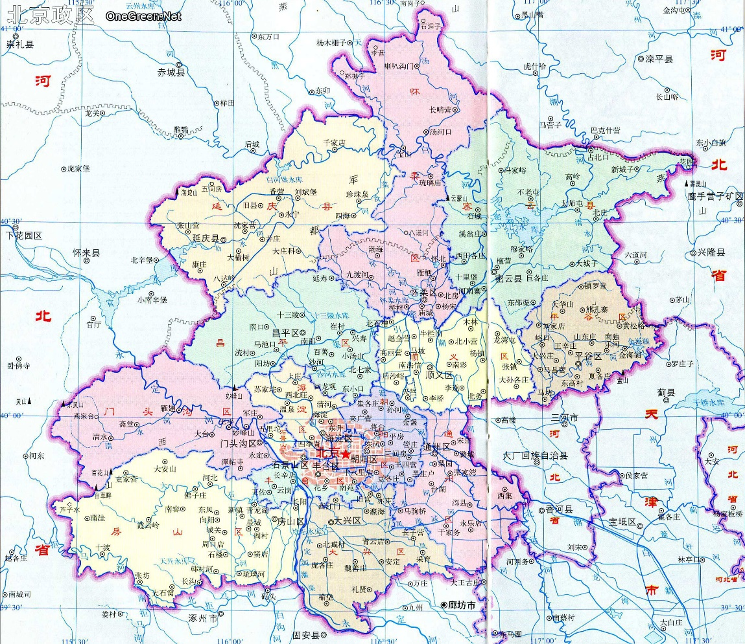

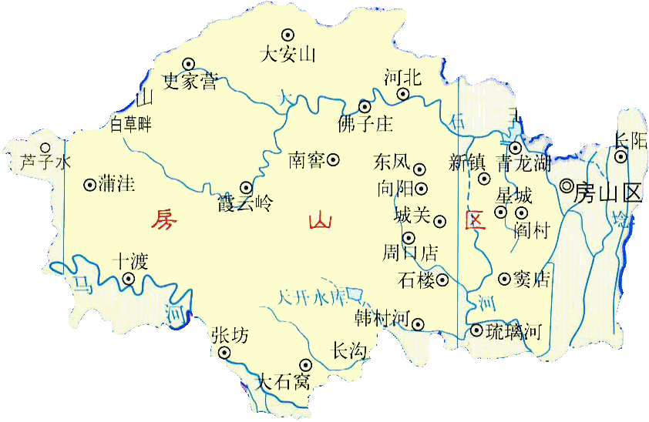
SITE of BISOL - CIAE
China
Fangshan
District
~11760 m²
Beijing
Notes:
PF: particle fragmentation

Slide 17
SITE of BISOL - MAINS
Notes:
PF: particle fragmentation

Slide 18
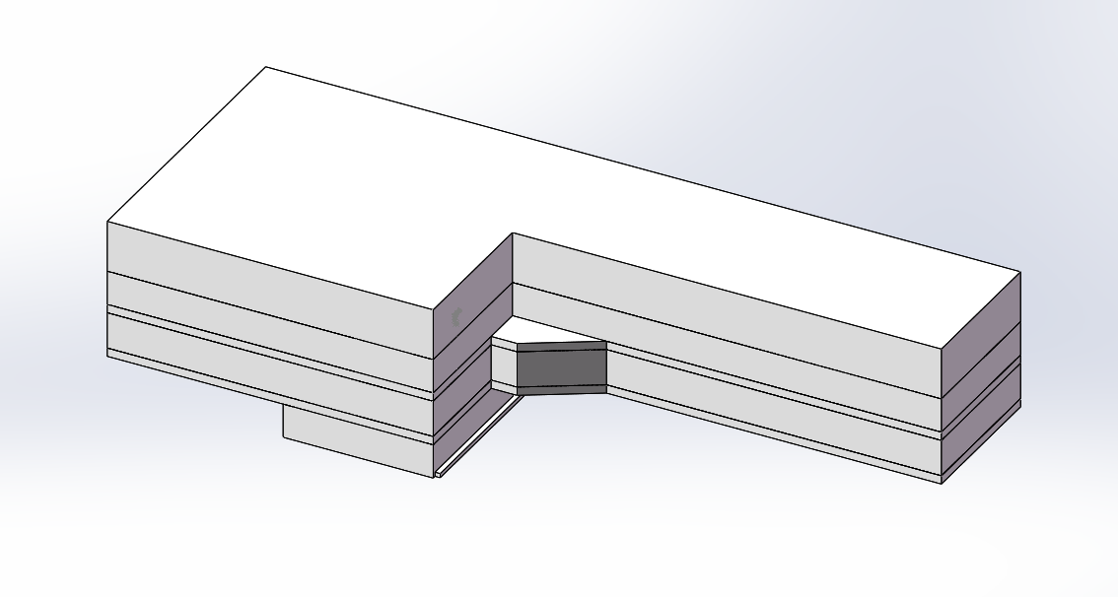
Infrastructure
Notes:
PF: particle fragmentation

Slide 19
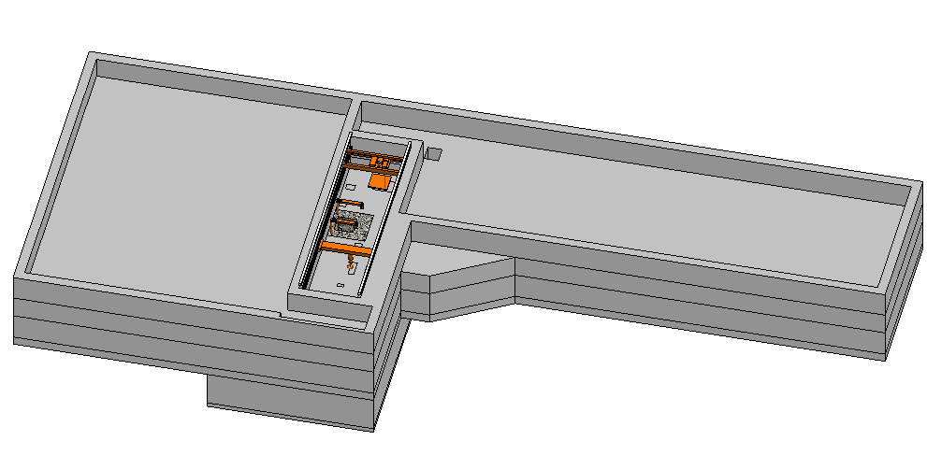
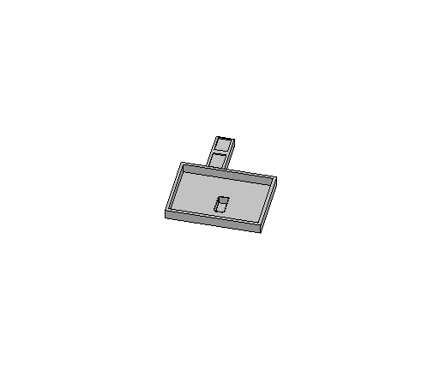
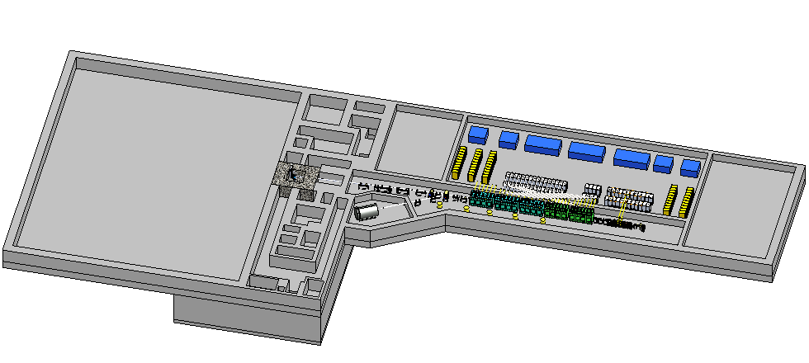
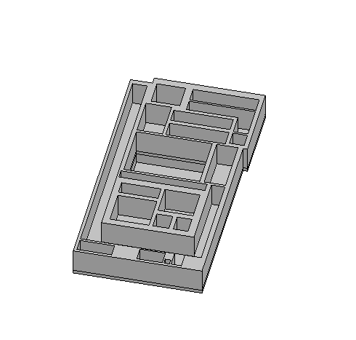
Infrastructure
Notes:
PF: particle fragmentation

Slide 20
OUTLINE
Background
Brief history of BISOL
Concept of MAINS
  D⁺ Accelerator preliminary design
  Liquid Lithium Target and Irradiation Unit
  LLi Loop
  Neutron field properties
Outlook

Slide 21
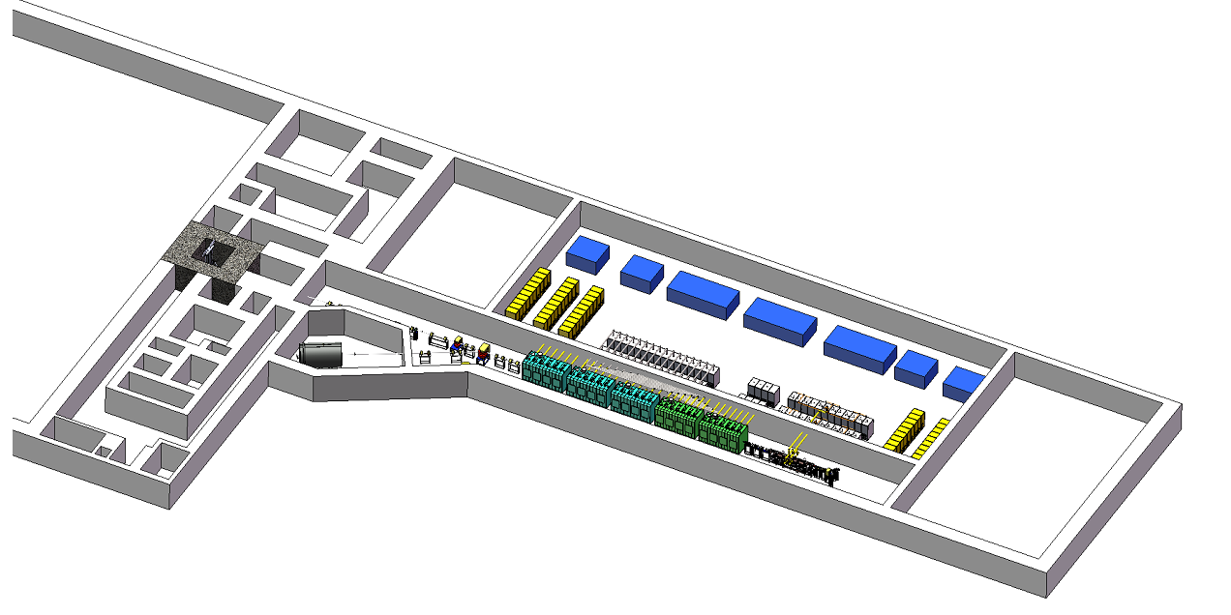
MAINS
CW D⁺ beam: 40 MeV, 10mA (Phase I); L-Li target: 100(W)×25(T), 20 m/s
main part in -1 ~-3 layer of the BISOL building

Slide 22
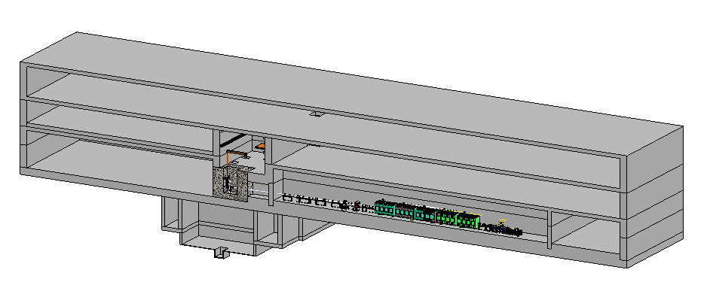
MAINS
Notes:
PF: particle fragmentation

Slide 23
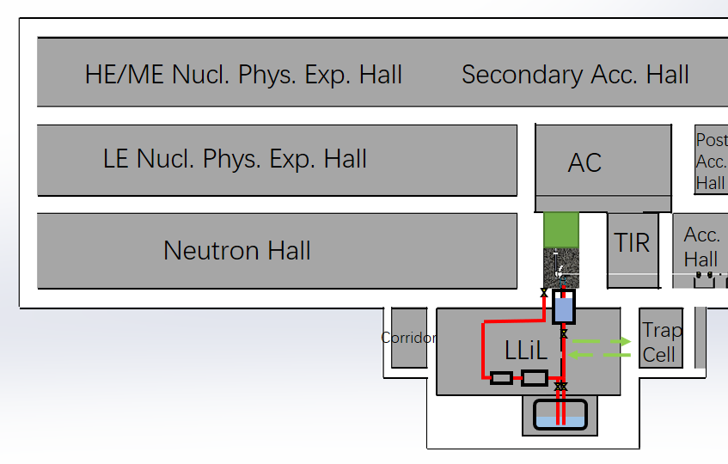
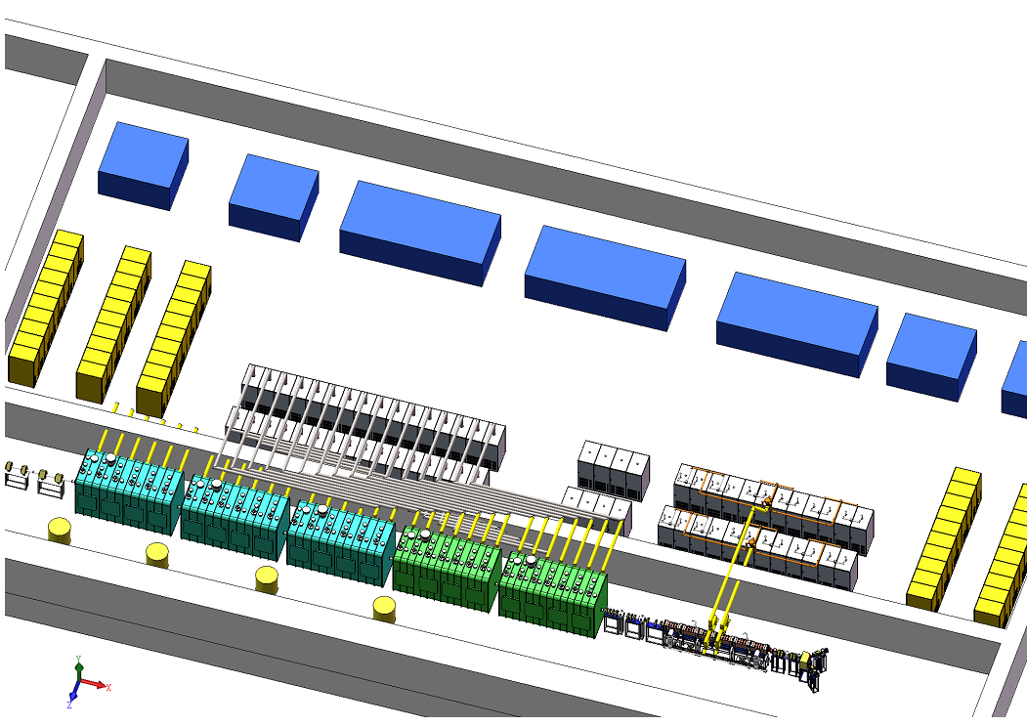
MAINS
Accelerator
Irradiation facility, Li target and Li Loop

Slide 24
BISOL-MAINS
BISOL-MAINS parameters compared to IFMIF
 | Energy (MeV) | Ion | Current (mA) | Target | Irradiation Volume (cm³)
 |  |  |  |  | >10¹⁵ n/cm²·s | >5·10¹⁴ n/cm²·s | >10¹⁴ n/cm²·s | >5·10¹³ n/cm²·s | >10¹³ n/cm²·s
BISOL-MAINS I | 40 | D⁺ | 10 | Liquid Li | 0 | 0 | ~12 | ~60 | ~700
BISOL-MAINS II | 40 | D⁺ | 20 | Liquid Li | 0 | 0 | ~60 | ~170 | ~2000
BISOL-MAINS III | 40 | D⁺ | 50 | Liquid Li | 0 | ~12 | ~240 | ~700 | ~7900
IFMIF | 40 | D⁺ | 2×125 | Liquid Li | BP | ~500 (HF) | ~6000 (MF) |  | LF

Slide 25
OUTLINE
Background
Brief history of BISOL
Concept of MAINS
  D⁺ Accelerator
  Lithium Target and Irradiation Unit
  L-Li Loop
  Neutron field properties
Outlook

Slide 26
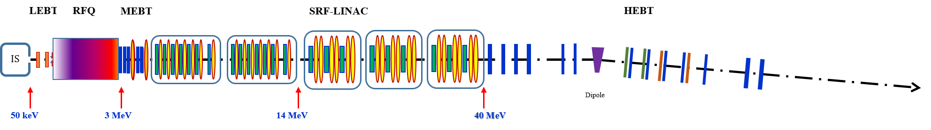
D⁺ accelerator
Particles | Deuteron
Energy | 40 | MeV
Current | 10 | mA
Beam power | 400 | kW
rf frequency | 162.5 | MHz
Duty factor | 100 | %
Beam loss (E>3 MeV) | <1 | W/m
LEBT, RFQ, MEBT, SRF, HEBT
SRF Linac: 5 cryomodules, HWR
Total length: 75 m
Code: ParmteqM, Toutatis, TraceWin

Slide 27
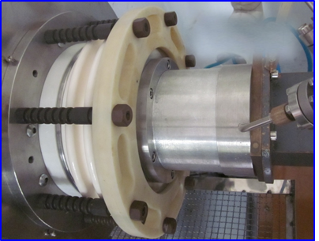
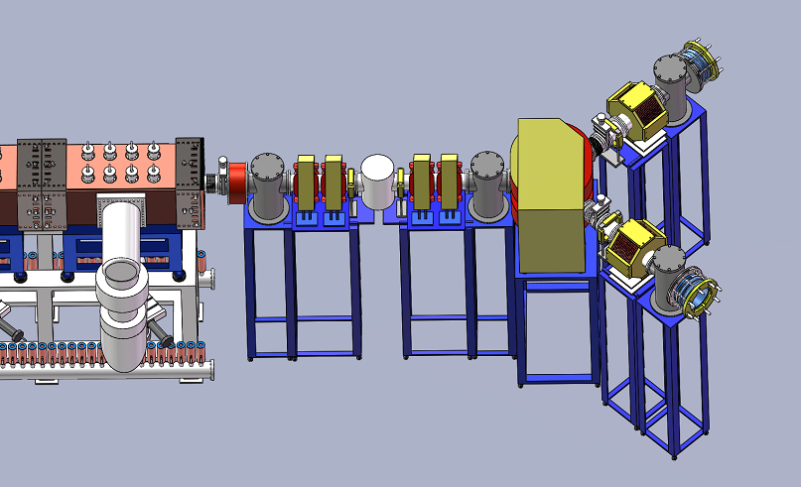
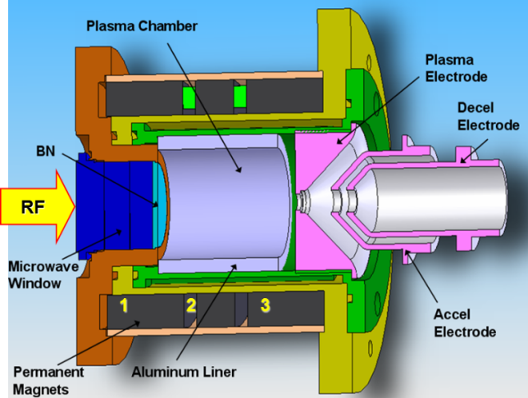
Ion Sources
For commissioning of accelerator instead of D⁺
Providing H₂⁺ beam for experiment terminal;
As a redundancy of D⁺ source
2.45 GHz, 20 mA, 50 keV H₂⁺
PKU PMECRIS
120 mA H⁺
83 mA D⁺
2.45 GHz, 20 mA, 50 keV D⁺

Slide 28
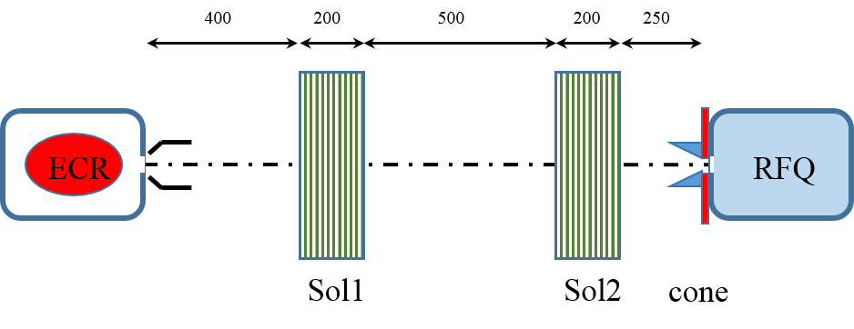
LEBT
2 identical solenoids whose effective pole length is 200 mm.
2 steerers (BPMs) in solenoids.
Solenoids magnetic field: 0.35T & 0.41 T, aperture 120 mm.
The total length of beam line: 1.55 m
diagnose instruments: ACCT, FC, emittance meter

Slide 29
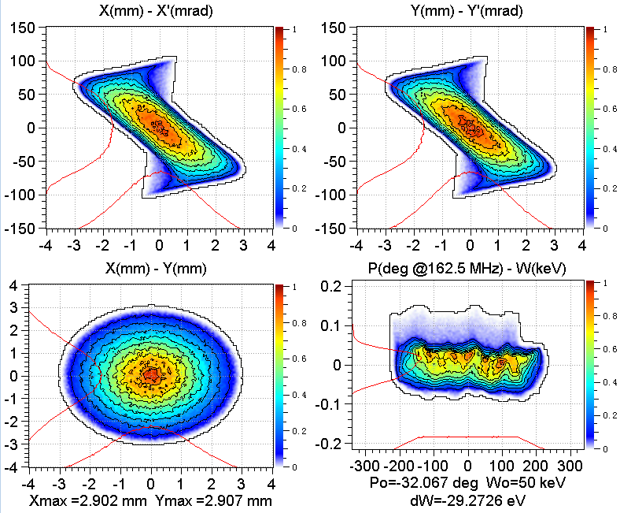
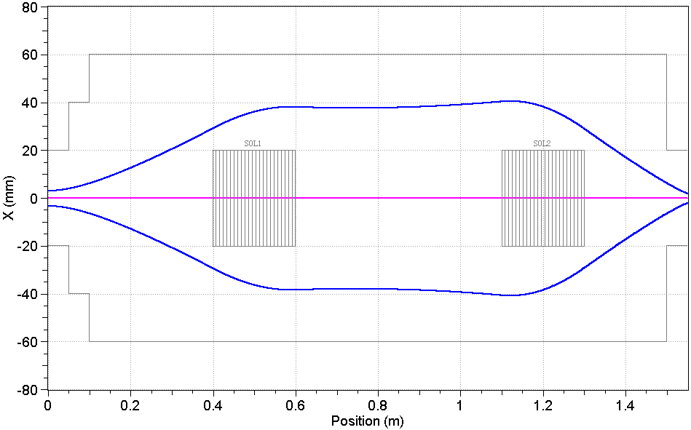
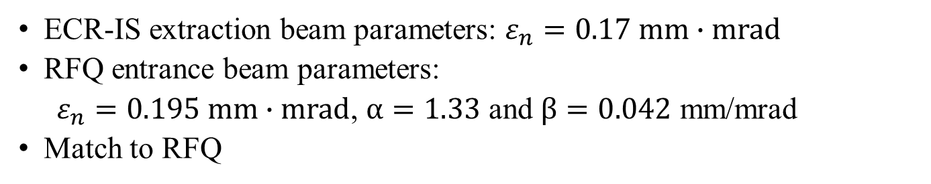
LEBT
ECR-IS extraction beam parameters: $ε_{n}=0.17 mm∙mrad$
RFQ entrance beam parameters:
$ε_{n}=0.195 mm∙mrad$, $α=1.33$ and $β=0.042$ mm/mrad
Match to RFQ

Slide 30
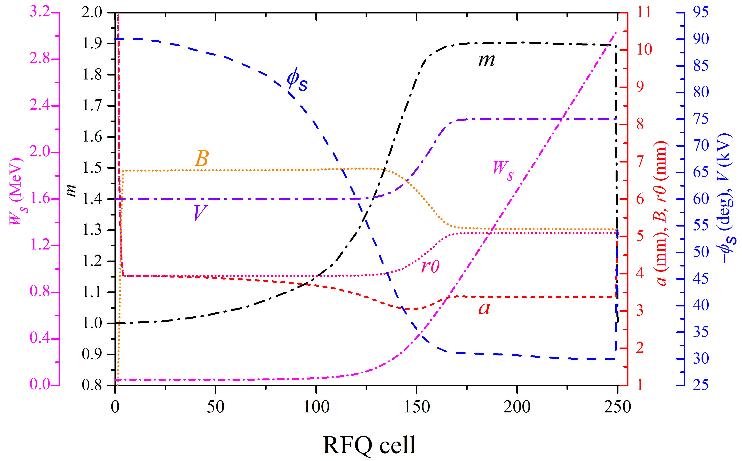
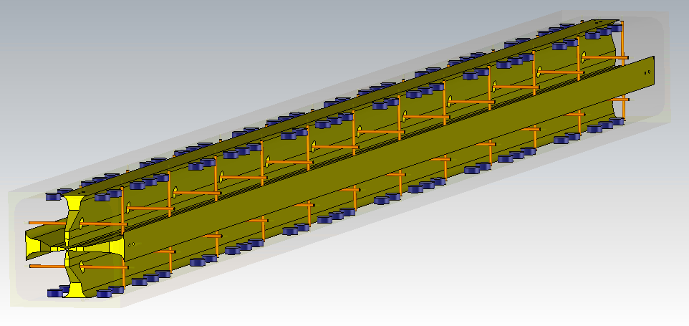
RFQ accelerator
4 vane RFQ, quadrilateral cavity
with π mode stabilizing rods
Deposited power 96 W
RFQ CST model
RFQ kinetic parameter curves

Slide 31
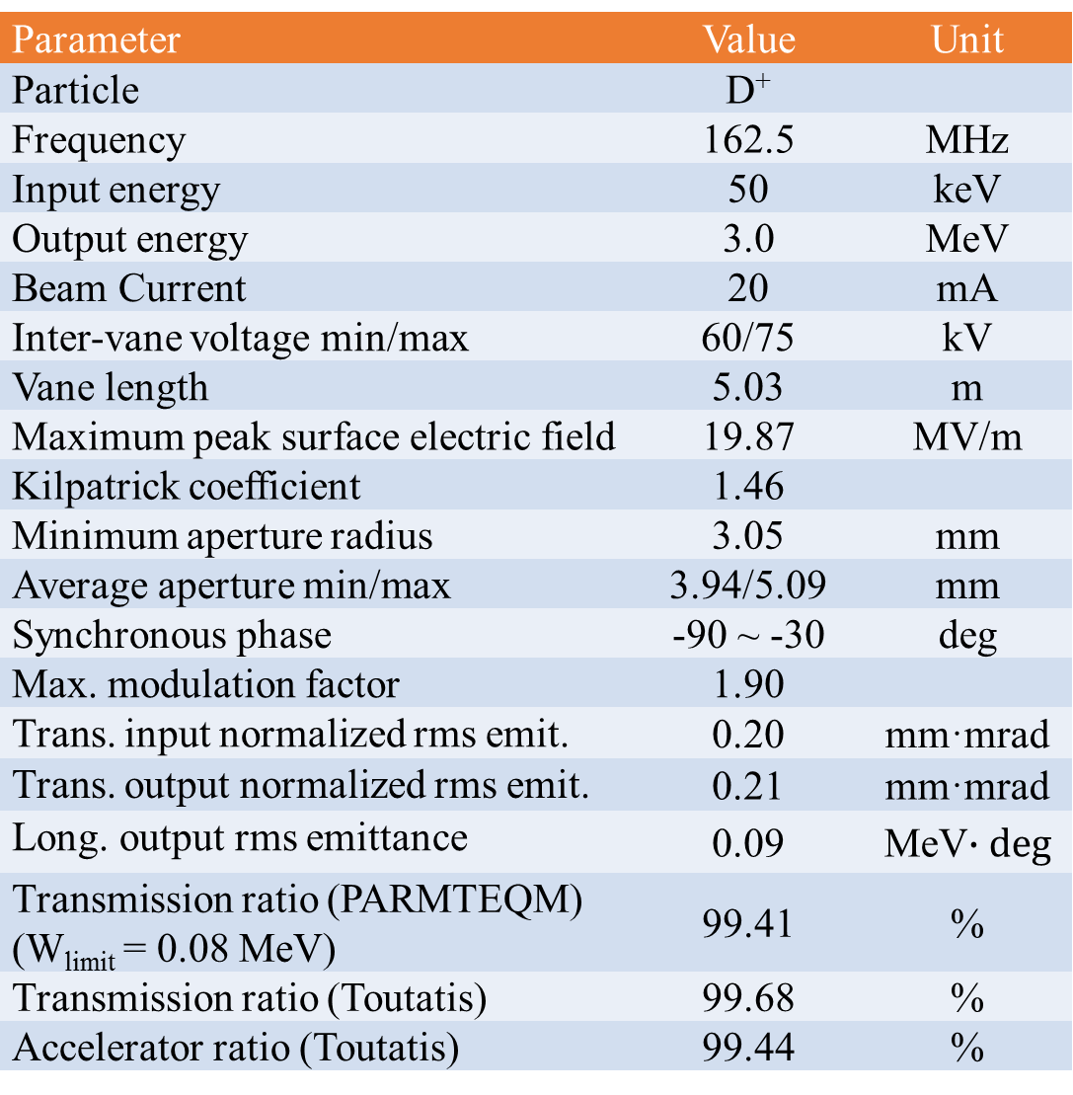
RFQ
Parameter | Value | Unit
Particle | D⁺
Frequency | 162.5 | MHz
Input energy | 50 | keV
Output energy | 3.0 | MeV
Beam Current | 20 | mA
Inter-vane voltage min/max | 60/75 | kV
Vane length | 5.03 | m
Maximum peak surface electric field | 19.87 | MV/m
Kilpatrick coefficient | 1.46
Minimum aperture radius | 3.05 | mm
Average aperture min/max | 3.94/5.09 | mm
Synchronous phase | -90 ~ -30 | deg
Max. modulation factor | 1.90
Trans. input normalized rms emit. | 0.20 | mm·mrad
Trans. output normalized rms emit. | 0.21 | mm·mrad
Long. output rms emittance | 0.09 | MeV$∙deg$
Transmission ratio (PARMTEQM) (W_{limit} = 0.08 MeV) | 99.41 | %
Transmission ratio (Toutatis) | 99.68 | %
Accelerator ratio (Toutatis) | 99.44 | %
Design strategy:
High beam transmission
Low rf power dissipation
Low surface peak field
High beam quality at the RFQ exit
Short RFQ length

Slide 32
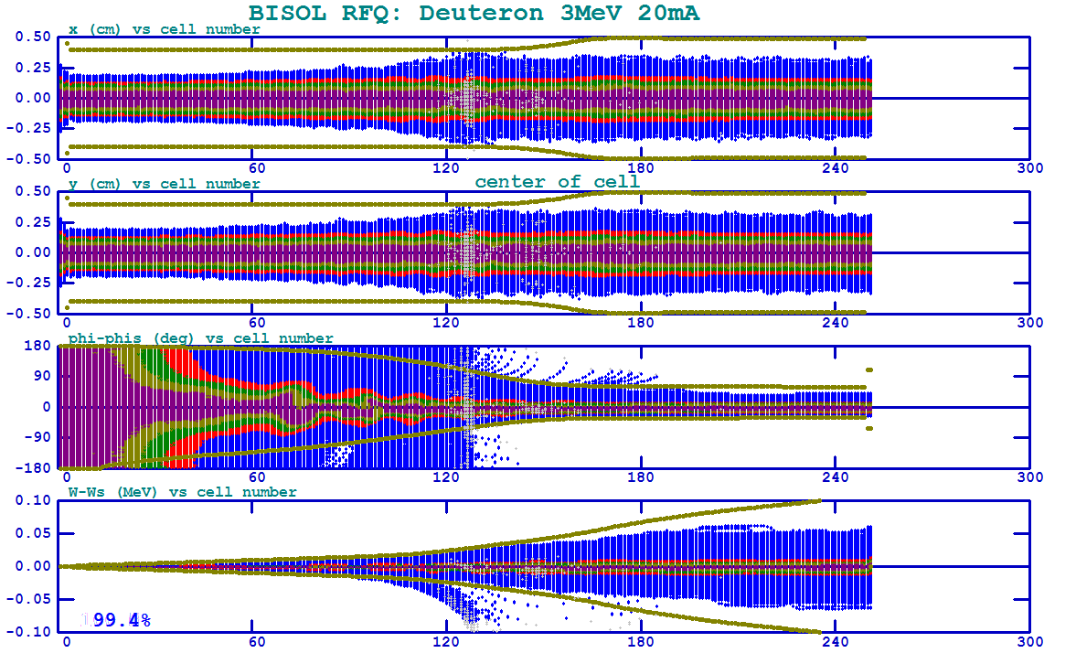
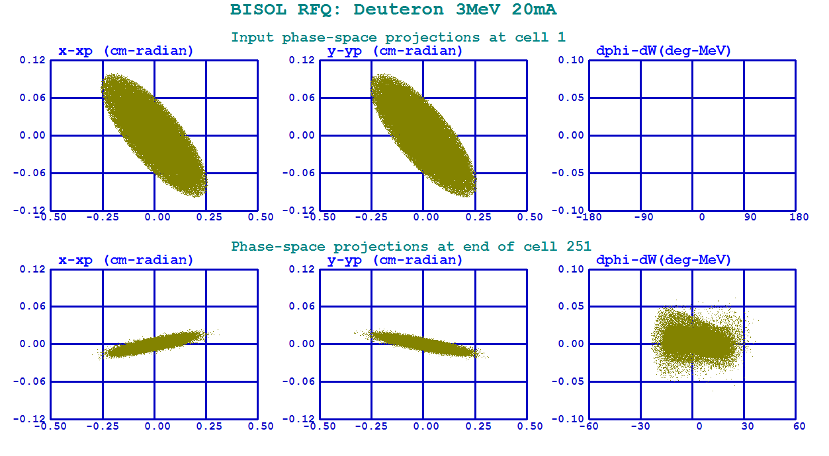

RFQ
Envelope-X
Envelope-Y
Phase disperse
Energy disperse
ParmteqM multi-particle tracking with ${10}^{5}$ macro-particles

Slide 33
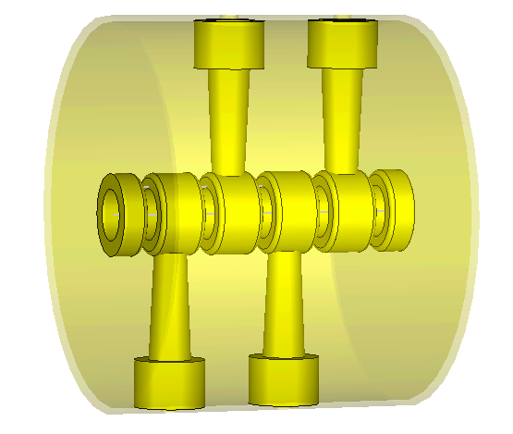
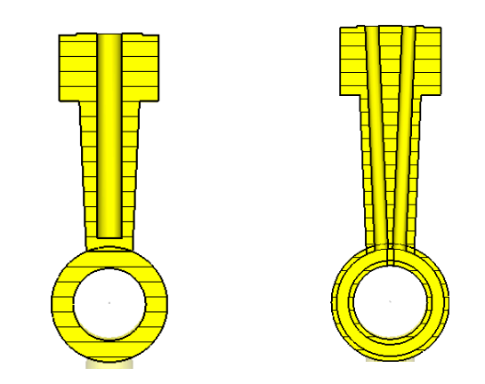
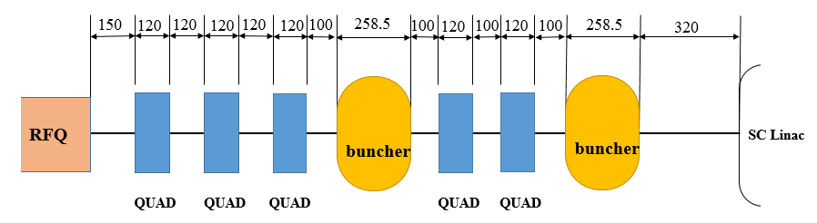
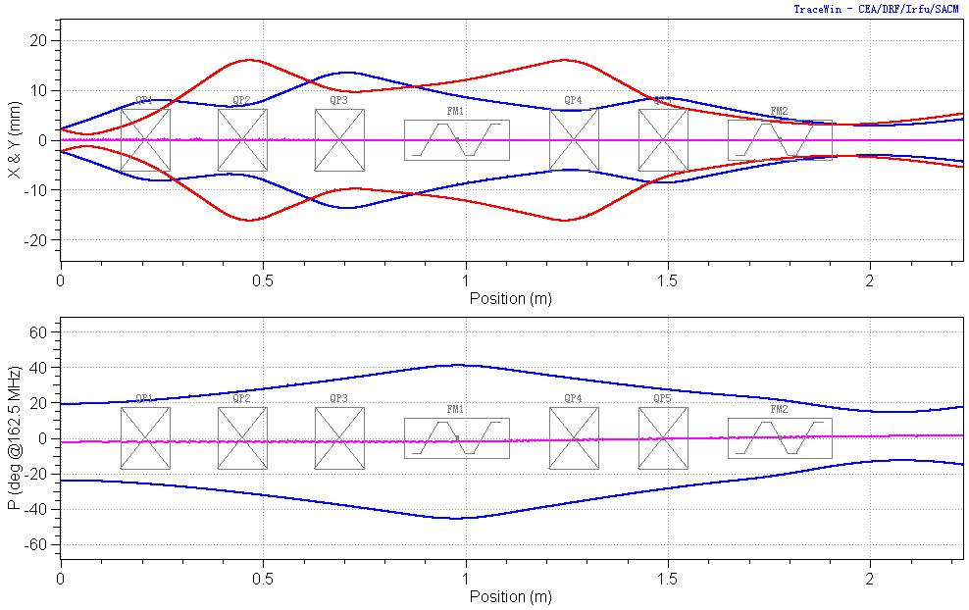
MEBT
3σ envelope
five gaps IH buncher
Element | Value
Cavity diameter (mm) | 370
Aperture diameter (mm) | 44
Cavity length (mm) | 320
Q value | 12000
Power (kW) | 1.9
Mode separation (MHz) | 162.3

Slide 34
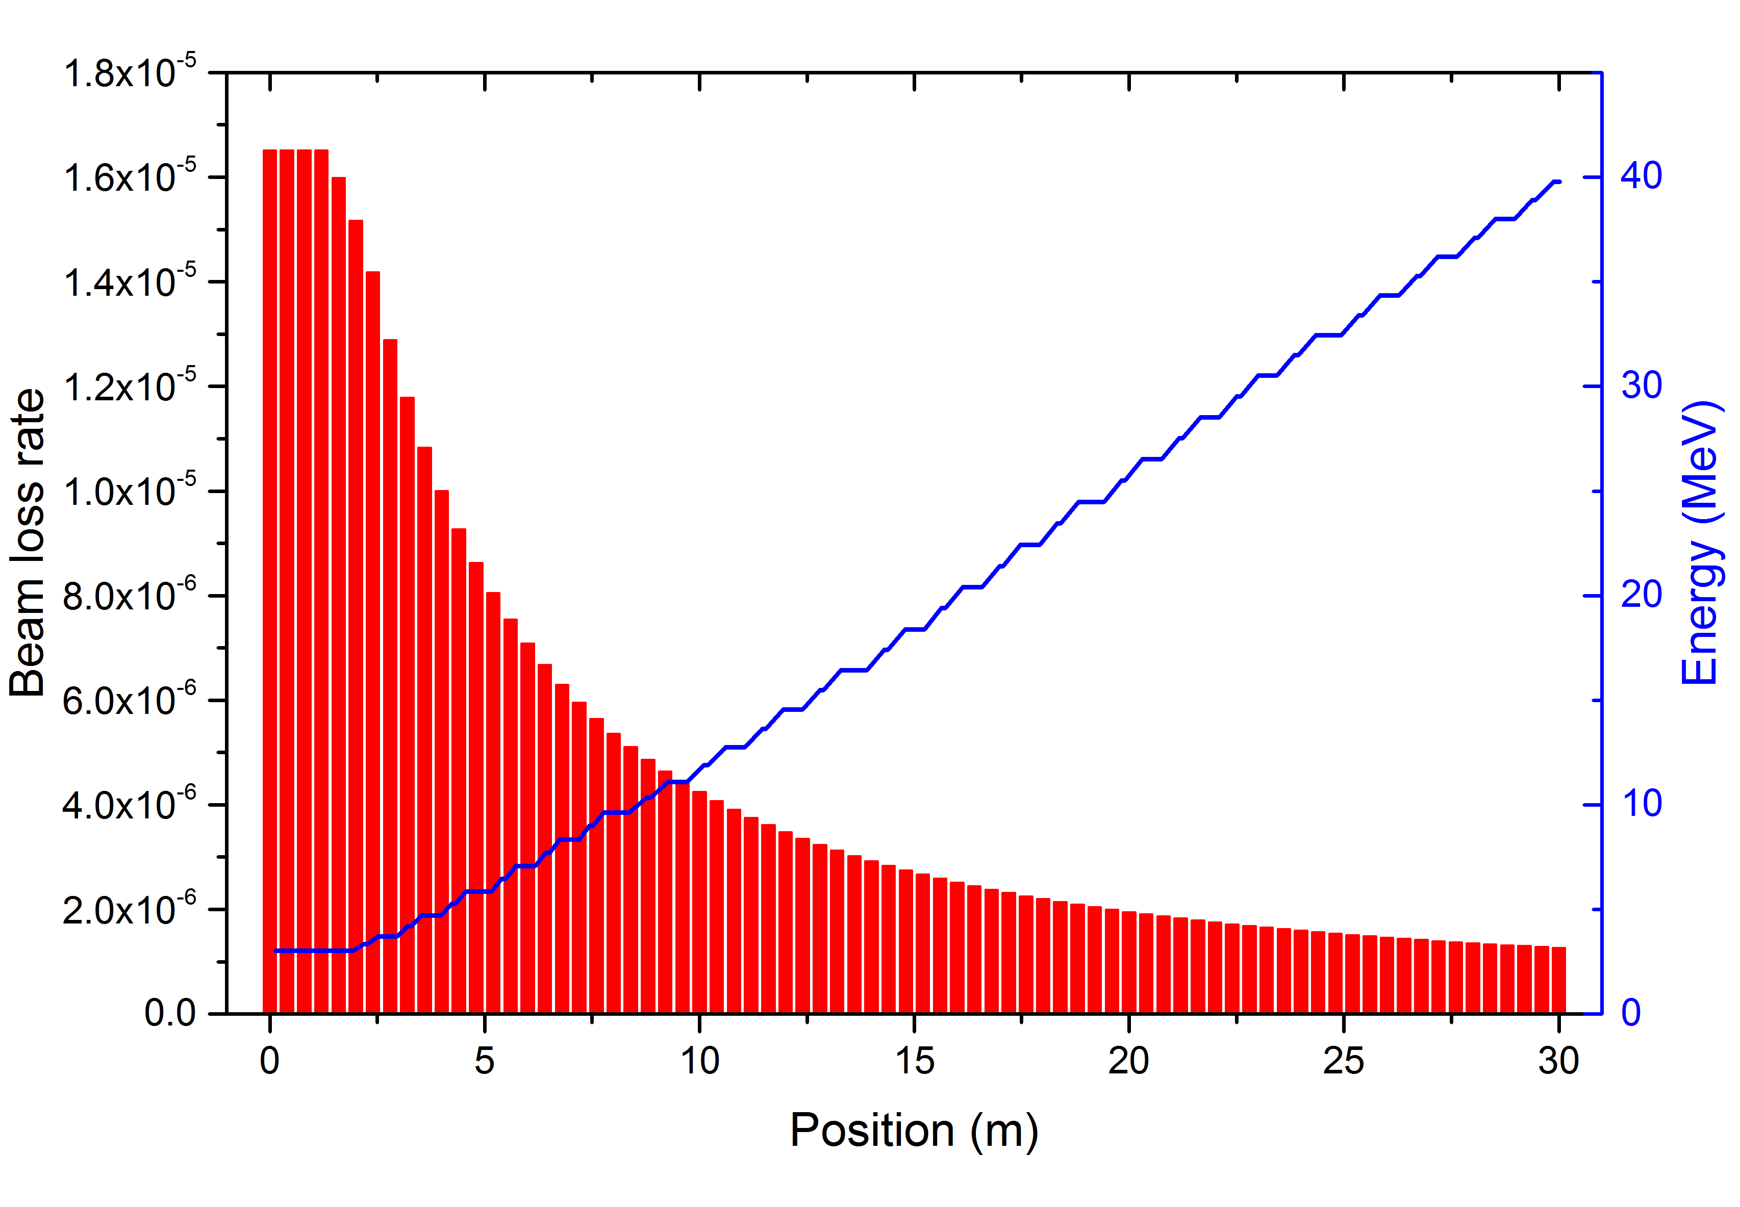
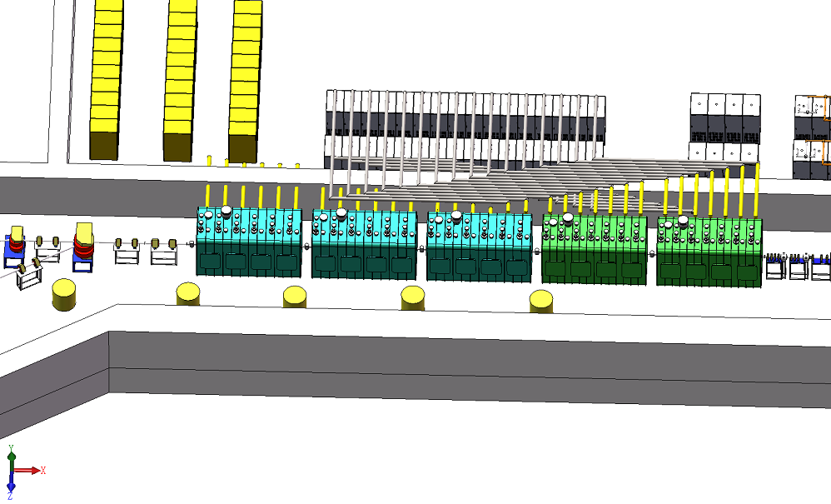
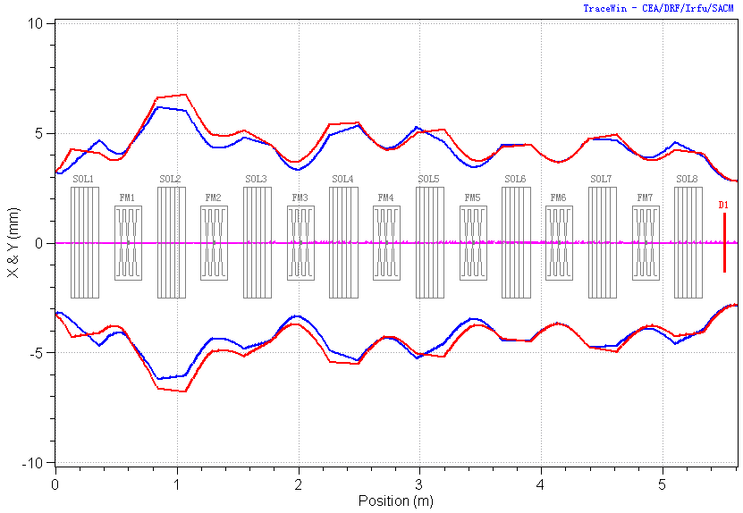
SRF linac
Beam loss control
Beam envelop in first cryomodule
5 cryomodules, 23 SC solenoid, 32 HWR SC cavities, main coupler, and so on.

Slide 35
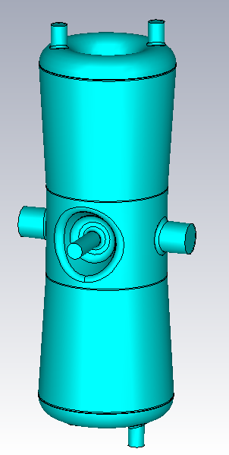
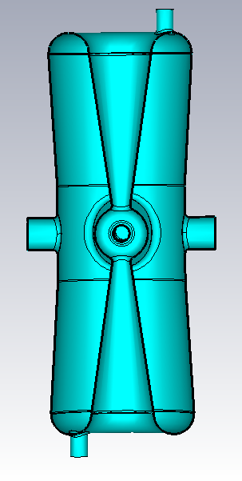
SRF linac
Parameters of HWR cavities
Property | Low-beta | High-beta
β_{opt} | 0.09 | 0.15
Bore diameter [mm] | 40 | 40
E_{p}/E_{acc} | 5.3 | 4.7
B_{p}/E_{acc} [mG/(MV/m)] | 6.4 | 6.8
r/Q [Ω] | 255 | 300
Operating E_{acc} [MV/m] | 6 | 6
Cavity length [mm] | 271 | 350
Thickness [mm] | 3.0 | 3.0
β=0.09
β=0.15

Slide 36
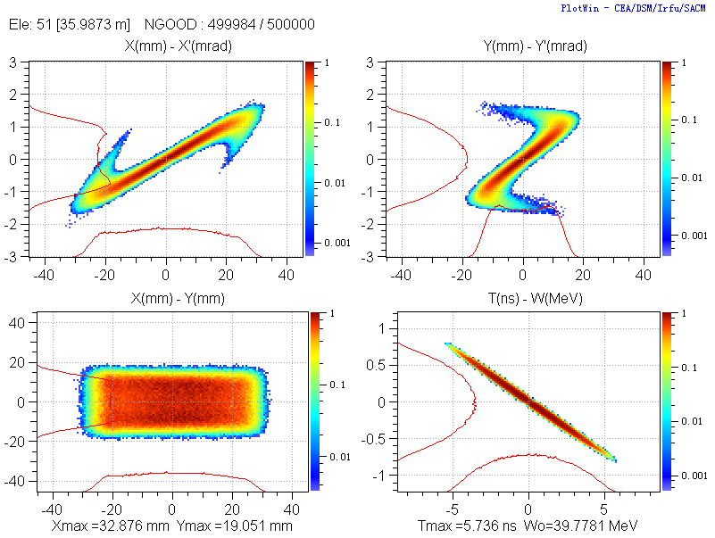
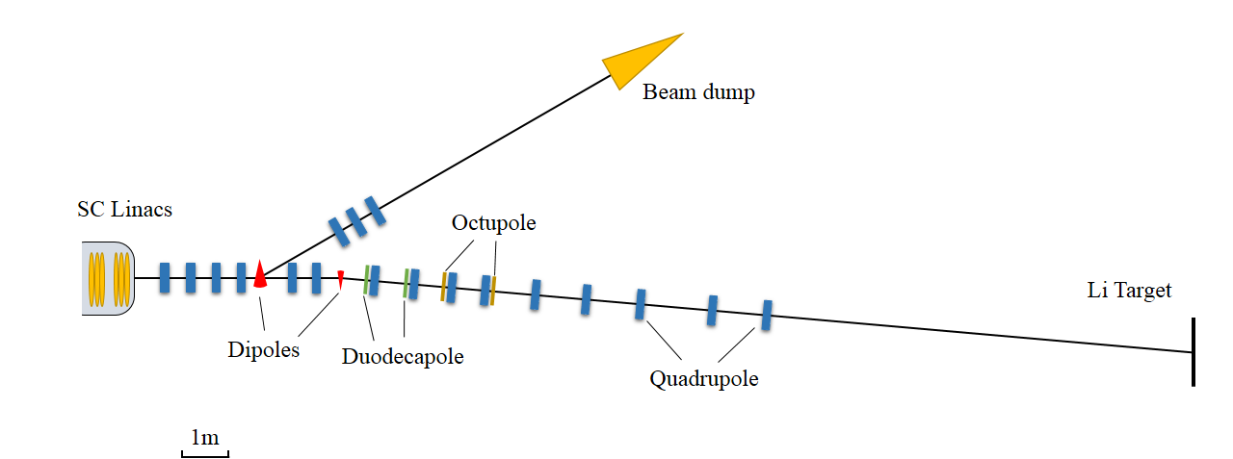
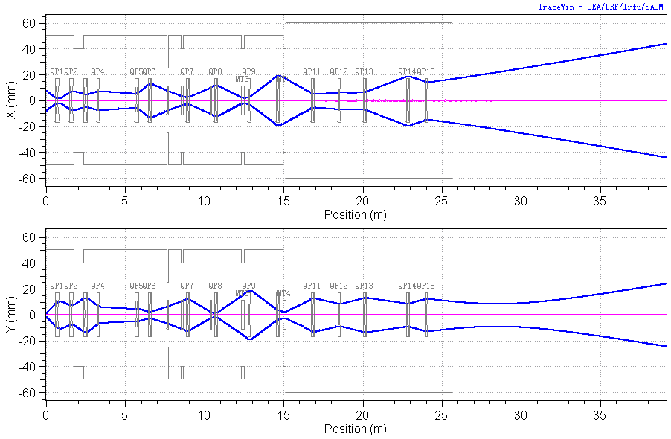
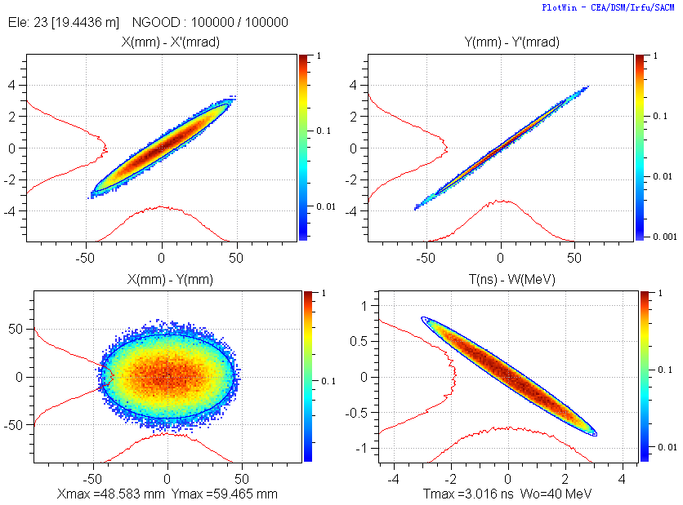
HEBT
Beam on Li target
Layout of HEBT
Beam 3σ envelope
Beam dump
Notes:
Including 8 quadrupole, 1 octupole, 1 duodecapole

Slide 37
OUTLINE
Background
Brief history of BISOL
Concept of MAINS
  D⁺ Accelerator
  Lithium target and Irradiation Unit
  L-Li Loop
  Neutron field properties
Outlook

Slide 38
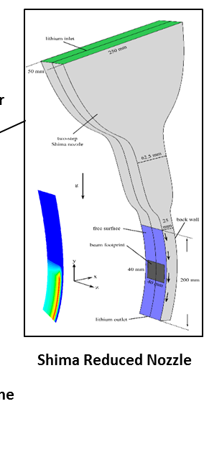
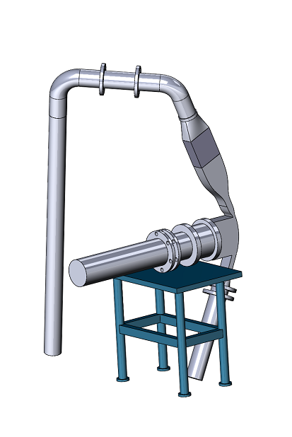
Liquid Lithium Target
Energy and current | 40 MeV, 10 mA
Beam Power | 400 kW
Footprint | 2x(2~4) cm²
Li jet width | 10 cm
Power Density | 100 kW/cm²
Li jet thickness | 25 mm
Inlet/outlet temperature | 250/300 ºC
Target Flow velocity/rate | 20 m/s, 50 L/s
Incidence angle | 5 º
Pressure in beam ducts | 10⁻⁴ Pa
Pressure in target chamber | 10⁻³-10⁻² Pa

Slide 39
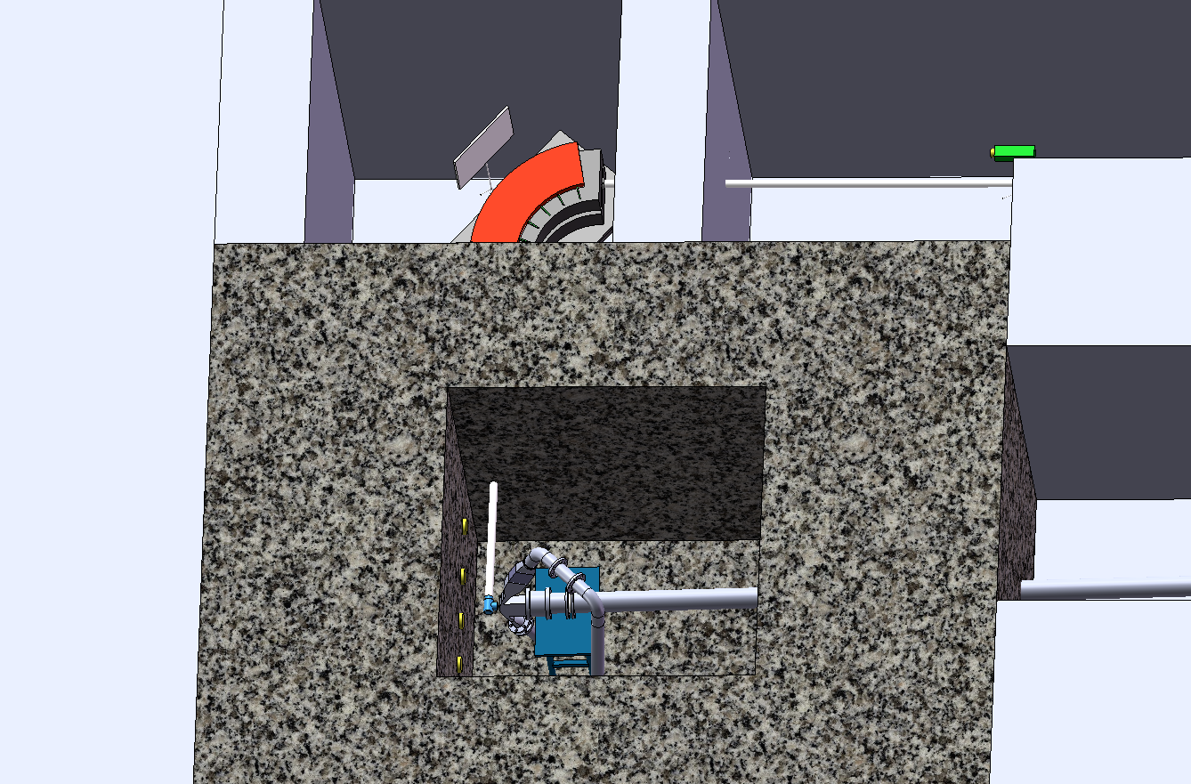
Operation Mode I: RIS

Slide 40
Rare Isotope Ion Source

Slide 41
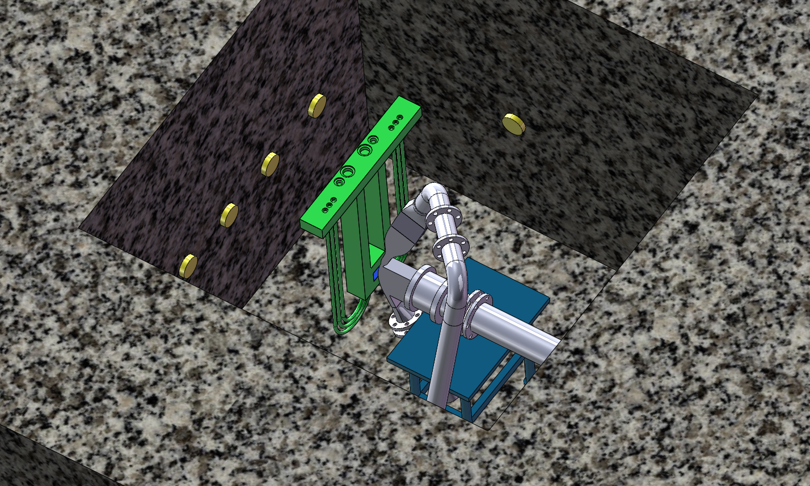
Operation Mode II: TMs

Slide 42
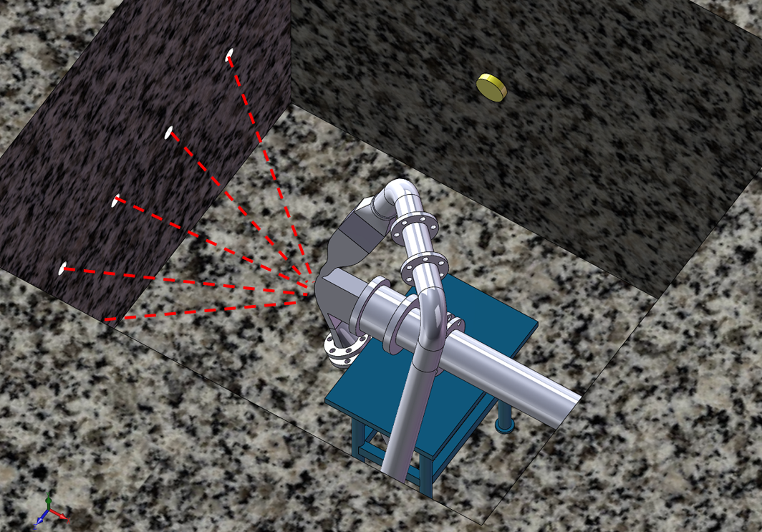
Operation Mode III: Neutron Science

Slide 43
OUTLINE
Background
Brief history of BISOL
Concept design of MAINS
  D⁺ Accelerator
  Lithium Target and Irradiation Unit
  L-Li Loop
  Neutron field properties
Outlook

Slide 44
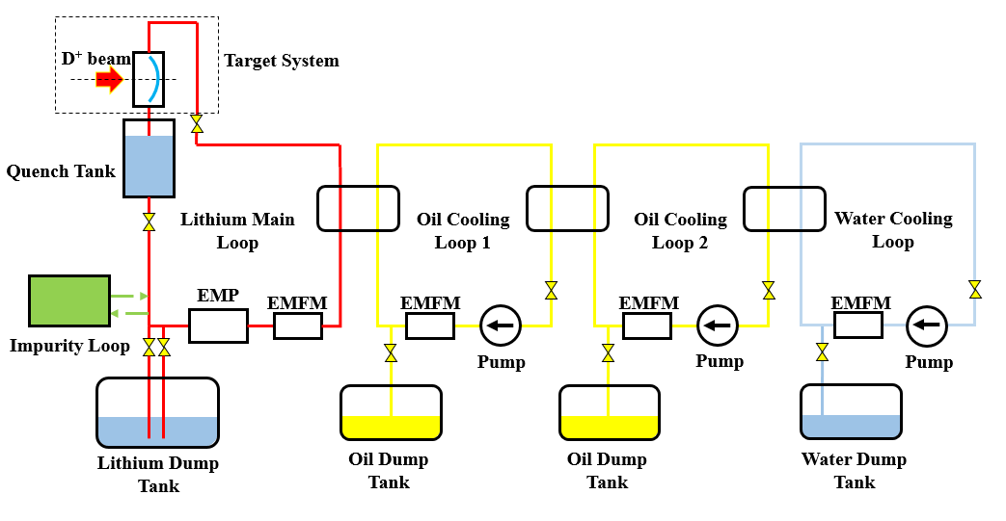
Li Loop
 | Main loop | Secondary loop | Third loop | Impurity loop
 |  |  |  | Cold trap | Heat trap 1 | Heat trap 2
Working Substance | L-Li | oil | oil | Ar | Ti | Y
Temperature(℃) | 250 | 185-220 | 50-75 | 200 | 600 | 280-300
Pressure (bar) | 4 | 5 | 5
Max Flux (l/s) | 65 | 85 | 130

Slide 45
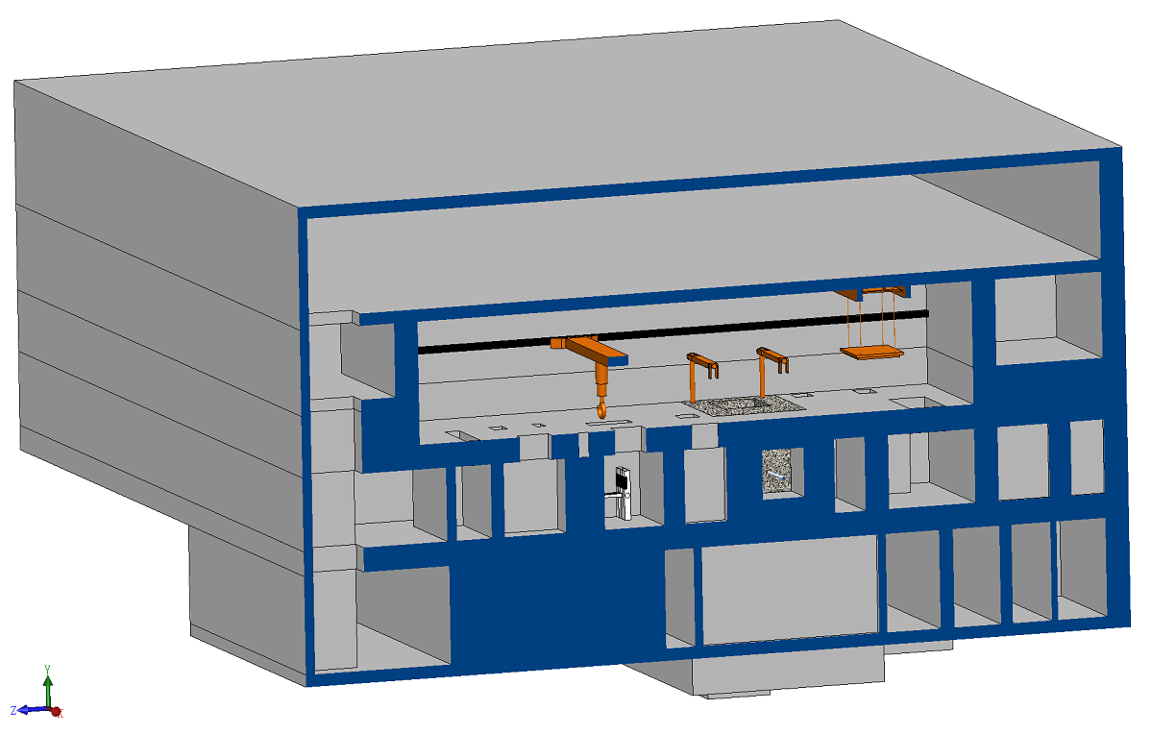
Access Cell
Notes:
PF: particle fragmentation

Slide 46
Access route
Taking out TA/TMs/RIS from TC
Waiting for cooling (short life Isotopes)
Disassembling TA/TMs/RIS (radioactive waste directly down)
Component handling
Rig handling
To PIE
Magnet maintenance
⑥
⑤
④
③
②
①
⑦
①
②
③
④
New components
Finished new TA/TMs/RIS
Replacing TA/TMs/RIS into TC
Magnet maintenance

Slide 47
OUTLINE
Background
Brief history of BISOL
Concept of MAINS
  D⁺ Accelerator
  Li target and Irradiation Unit
  L-Li Loop
  Neutron field properties
Outlook

Slide 48
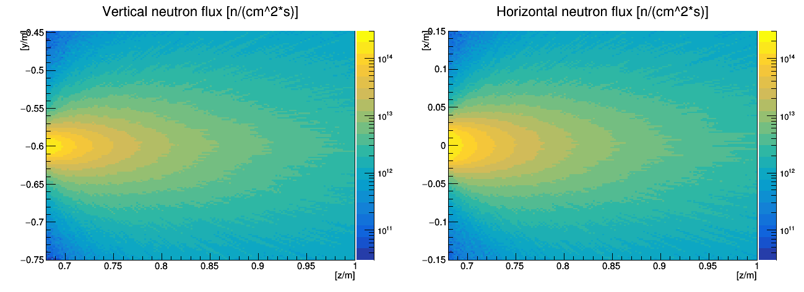
Neutron flux density distribution
Phase I
40 MeV 10 mA
D+→Li
n flux: > 10¹⁴ n/cm²s > 5X10¹³ n/cm²s > 10¹³ n/cm²s
dpa in steel > 8 dpa/fpy > 4.4 dpa/fpy > 1.3 dpa/fpy
Volume: ~ 12 cm³ ~ 60 cm³ ~ 700 cm³

Slide 49
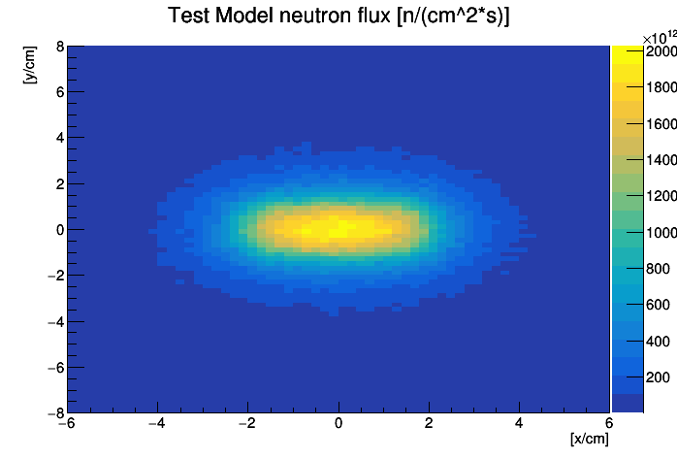
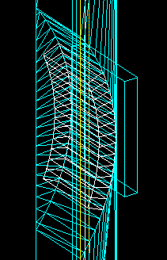
BISOL-MAINS
The neutron flux density distribution at the Test Module position (2 mm beyond BP)
Li target and the test module
The maximum neutron flux density reaches 2X10¹⁴ cm⁻²s⁻¹ on test module

Slide 50
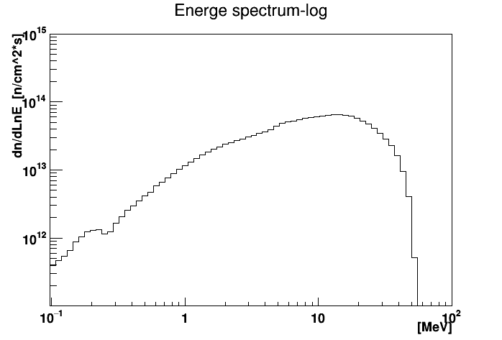

Neutron Energy
0°Neutron energy spectrum
BISOL-MAINS @10 mA D⁺
IFMIF and SPIRA II

Slide 51
OUTLINE
Background
Brief history of BISOL
MAINS concept D⁺ Accelerator
  Lithium Target and Irradiation Unit
  L-Li Loop
  Transportation and Waste Treatment
Outlook

Slide 52
Time Schedule for BISOL-MAINS
Year | 2018 |  | 2020 |  | 2022 |  | 2024 |  | 2026 |  | 2028 |  | 2030 |  | 203？
Re-evaluation
Concept & Engineering Design
Construction
Commissioning
Operation @ 5-10 mA
Commissioning & Operation @ 20 mA
From 20 mA to 50 mA

Slide 53
Oct. 2015
ELTL running 1560 h
Accumulated operation time of EVEDA Lithium Test Loop (ELTL) of the lithium target reached 1,560 h.
Notes:
Including 8 quadrupole, 1 octagon, 1 dodecahedron

Slide 54


June 5, 2017
25MeV 150-200 μA CW P Beam!
CiADS 25 MeV proton linac past CW proton beam with 150-200 μA CW current and >10 mA peak current (IMP and IHEP)
Notes:
Including 8 quadrupole, 1 octagon, 1 dodecahedron

Slide 55
Appreciation
We appreciate all helps and support from domestic and international experts and colleagues.
We need more communication, and cooperation with IFMIF-like neutron source partners.

Slide 56


Thanks for attention!

