Slide 1

Advanced-Fusion Neutron Source
Workshop on Advanced Neutron Source and its Application
4-5 November, 2017
Aomori-city, Japan
Kentaro OCHIAI
National Institutes for Quantum and Radiological Science and Technology (QST) Fusion Energy Research and Development Directorate Department of Fusion Reactor Materials Research Advanced Fusion Neutron Source Design Group

Slide 2
CONTENTS
Background and objectives
  Requirement from DEMO fusion reactor design
  Necessity of early neutron source
  Present status of IFMIF/EVEDA
Advanced Fusion Neutron Source
  A-FNS project based on IFMIF/EVEDA
  Site
  Basic parameters of A-FNS
  Schedule for A-FNS construction
  Issues for construction and operation
Summary
1

Slide 3
Background and objectives
  Requirement from DEMO fusion reactor design
Candidate material validation test by fusion neutron source irradiation is an essential issue for DEMO design and it should be done by the end of engineering design phase.
Relation of DEMO design (JA) schedule and required irradiation data for materials
2015
2020
2025
2030
2035
DEMO
Conceptual Design
Engineering Design
By 2035, main irradiation verification tests are required about,
Blanket
First data acquisition
・RAFM as FW
First wall
・Blanket materials
・Divertor materials
Divertor
・Diagnostic materials.
We have to explore a possibility of early intense fusion neutron source construction.
2

Slide 4
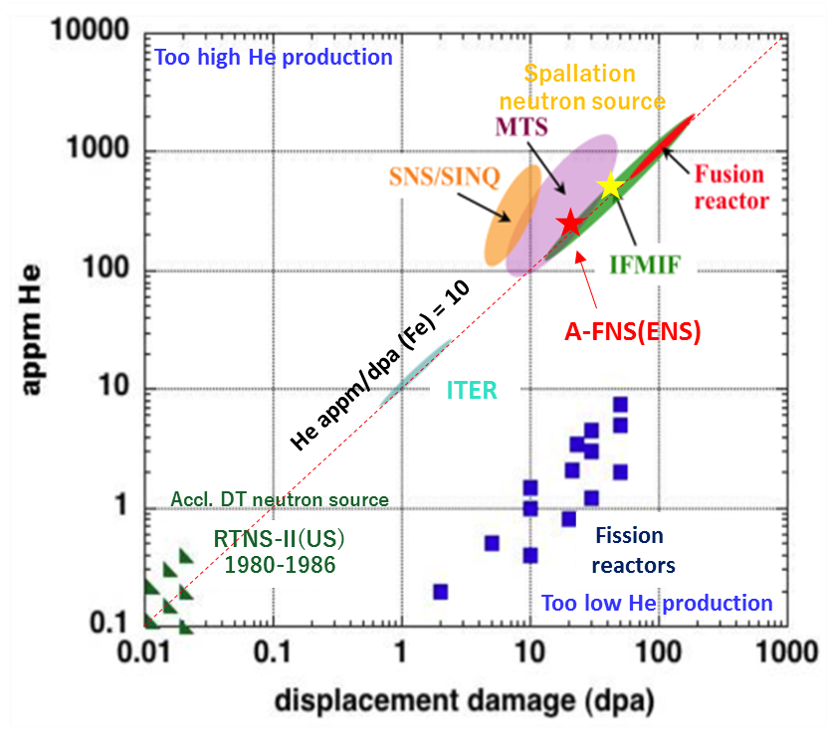
  Necessity of early neutron source
The DEMO reactor will finally exposed the structure materials up to around 80 dpa.
As an initial data for the DEMO design, we think to need the irradiation up to 10 dpa/year at least.
DEMO reactor
DT neutron source including ITER is quite not sufficient from the objectives.
Fission reactor and spallation neutron sources will not be appropriate for the verification in the viewpoint of the ratio of He and dpa.
Therefore, an fusion neutron source like a IFMIF should be operated around 2030 for the material irradiation.
Contour map of helium production rate and displacement per atom (dpa) for fusion reactor and neutron source.
We propose the complete achievement of irradiation examination with an advanced fusion neutron source facility ,A-FNS which is like a half intensity of IFMIF by 2035.
3

Slide 5
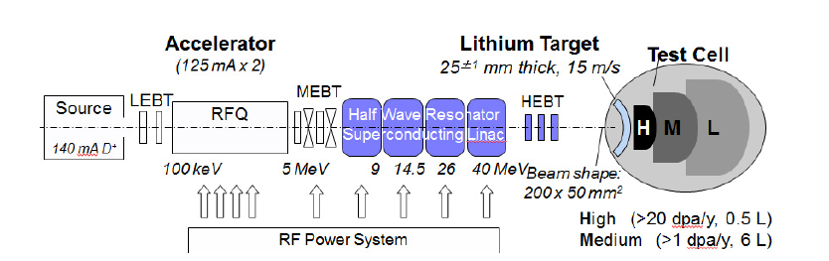
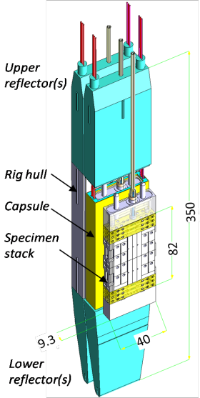
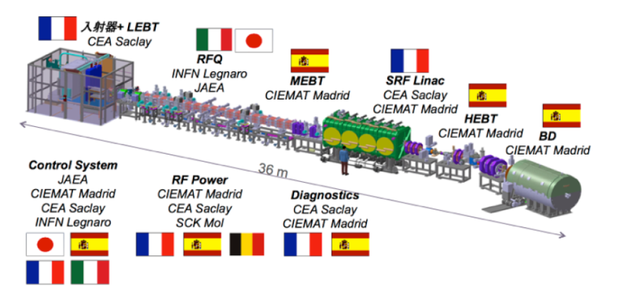
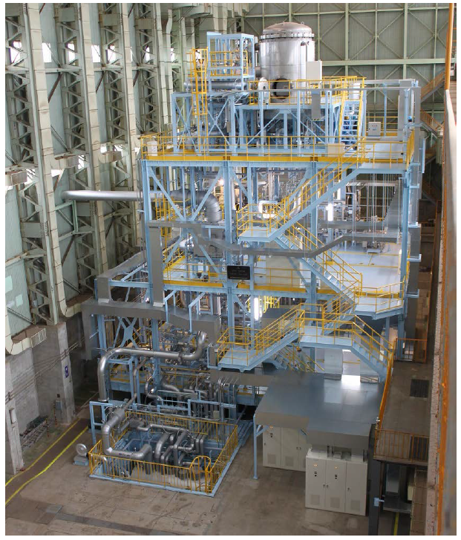
Present status of IFMIF/EVEDA
From 2007, IFMIF/EVEDA has started to validate the construction of IFMIF on BA phase.
IFMIF Intermediate Engineering Design Report（2014）
Rokkasyo
Oarai
Linear IFMIF Prototype Accelerator (ongoing)
EVEDA Lithium Test Loop (2014)
High Flux Test Module (2015)
To achieve 9 MeV(CW) operation
Long-term stability of high speed liquid flow validated!
Prototype manufactured,
remote handling tested!
We propose an A-FNS construction using by the IFMIF/EVEDA intellectual properties.
4

Slide 6
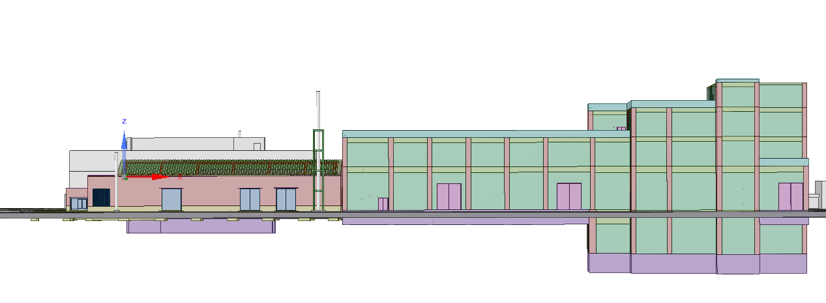
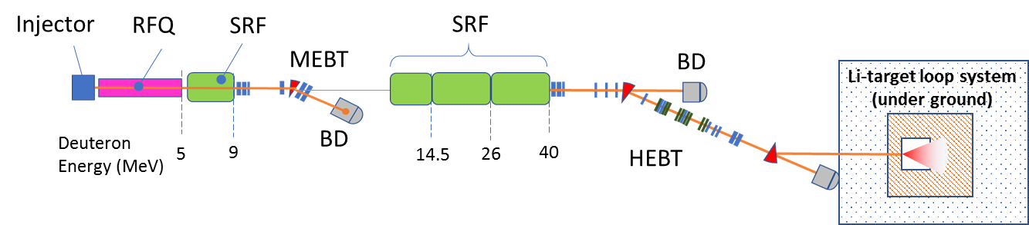
Advanced Fusion Neutron Source
Advanced Fusion Neutron Source based on IFMIF/EVEDA
From the viewpoint of the effective use, we will start to an conceptual design activity of an using by the IFMIF/EVEDA.
L 160 x W 80 x H 25
Accelerator facility
Test facility
Related facility
Injector and RFQ+SRF
SRF and Beam transport
11
Neutron point
15
Grand
IFMIF/EVEDA
9
58
60
18
18
Unit: meter
Post Irradiation Experiment
Radio Active Processing
Target handing system
Cross sectional views of an A-FNS construction
5
Horizontal cross sectional view of A-FNS accelerator

Slide 7
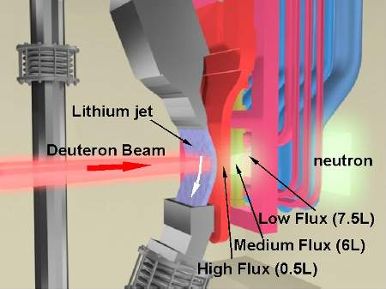
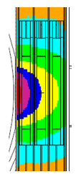
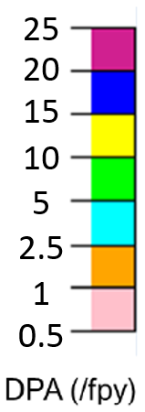
Basic parameters of A-FNS
Beam
Particle
Deuteron
Energy
40 MeV
Current
125 mA (CW)
Foot print
200 x 50 mm²
Incident angle
Normal
Availability
33% at least
Target
Material
lithium
Liquid target (jet)
Temp.
200 - 270 ℃
Schematic view of test cell (Ref. IFMIF design)
Velocity
10-15 m/s at target
Thickness
25 mm
Net volume for Irradiation
Window
Free surface (no window)
3cc at 25dpa/fpy
Neutron
Intensity
6.8 x 10¹⁶ neutron/s
15cc at 20 dpa/fpy
(at back plate)
Neutron
Average flux
6.0x 10¹⁴ n/cm²/s
80 mm
30cc at 15 dpa/fpy
Helium P. R
3.12×10² appm/fpy
60cc at 10 dpa/fpy
Displacement
24.7 dpa/fpy
HePR/dpa
12.6
High Flux Test Module
fpy: full power year
Relation of irradiation volume and dpa/fpy (A-FNS)

Slide 8
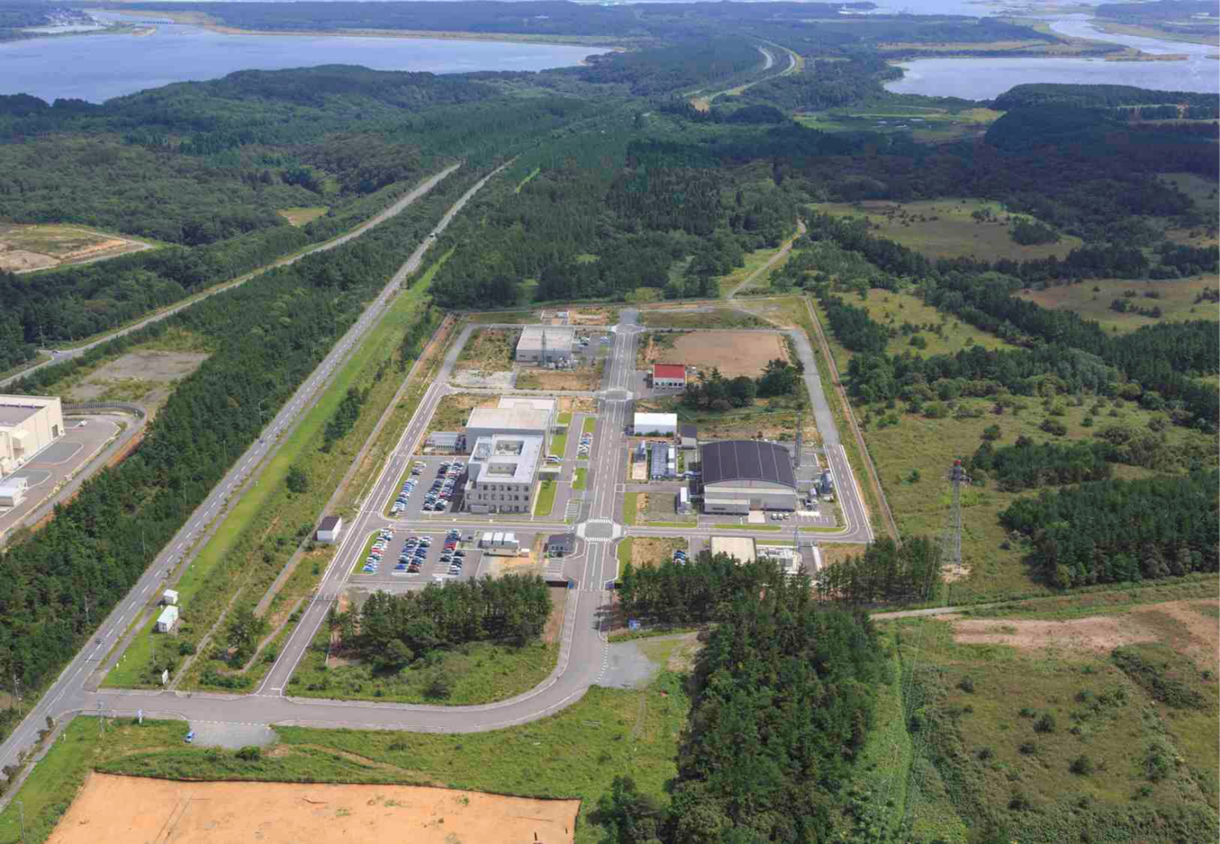
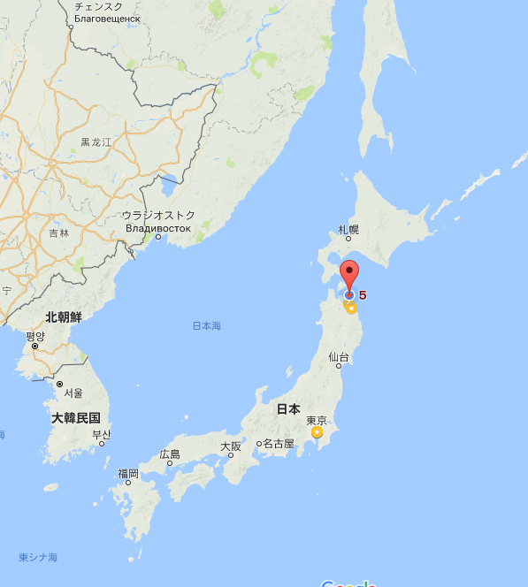
Site of A-FNS
The Pacific Ocean
Rokkasho, Aomori
Japan
245m
Construction area of A-FNS
450m
LIPAc building
IFERC Site
110,083.72㎡
6

Slide 9
  Schedule for A-FNS construction
2015
2020
2025
2030
2035
DEMO
Conceptual Design
Engineering Design
Neutron Source for irradiation
First data acquisition
Conceptual design
First irradiation
Pre-phase
EDA phase
Construction
Operation Phase
Construction decision
Start commissioning
7

Slide 10
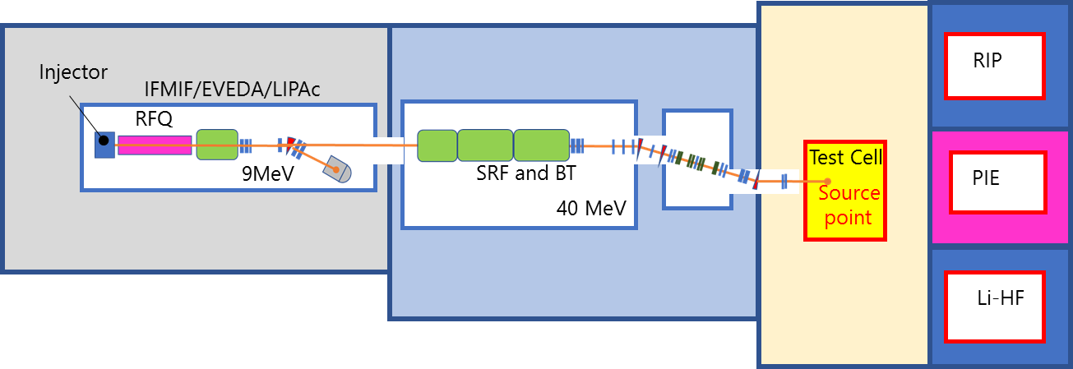
  Issues for construction and operation
Technical issues must be solved by 2025 based on the following items.
Precise irradiation plans and their schedules
Technical issues for plant safety and regulation
Cost estimation for construction and operation
As others
Storage building
Console area or building
Achievement of LIPAc
Extension of building
Purification system of Li target
Technical feedback from the LIPAc long operation
Extension of SRF and beam line
Optimization of lithium target system
Optimization of HFTM
Safety
Safety
Remote handing for TA and TM
Remote handing from TC to PIE
Designs of PIE, RIP and Li-HF
We just start to verify the design and their development.
8

Slide 11
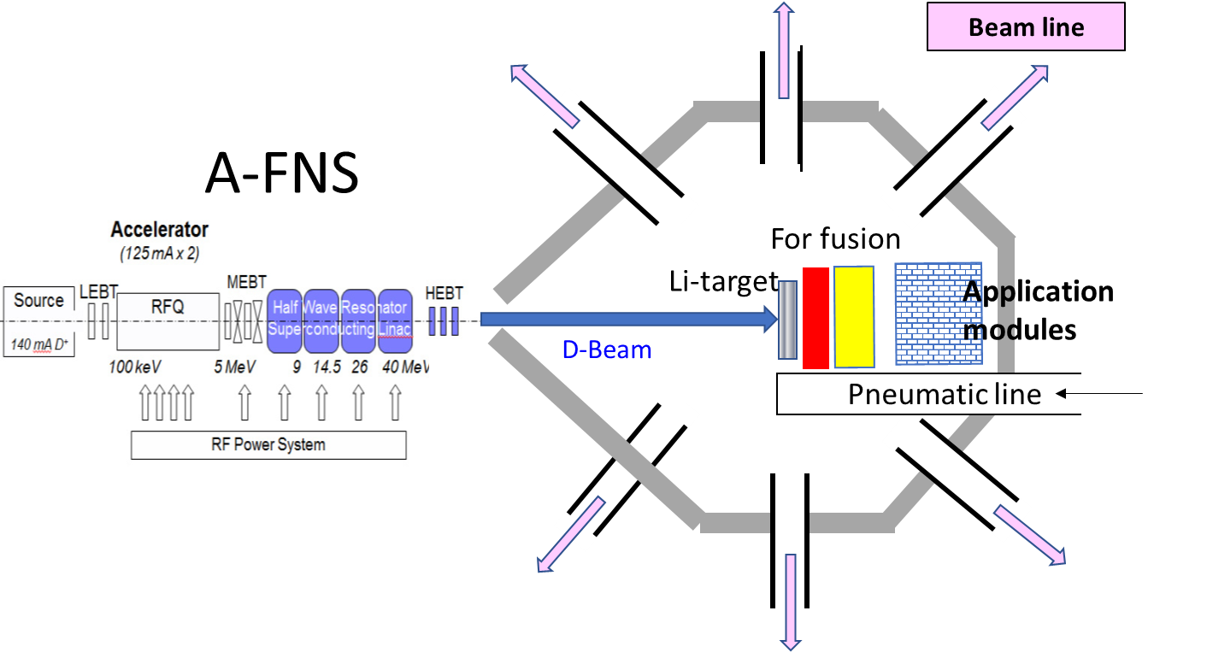
Another application proposal of A-FNS
A-FNS should be also utilized like multi-purposes neutron source.
Neutron beam station of A-FNS for material analysis
( it will be available to not only for general material analysises also fusion material micro-analysis)
RI production module installation (ex. Mo-99)
Pneumatic line to use the intense neutron field
We just start to the investigations for the muti-purpose on A-FNS
9

Slide 12
Summary
For fusion DEMO reactor design, we have started the design activity of an advanced fusion neutron source (A-FNS) facility.
From the viewpoint of the effective use of IFMIF/EVEDA intellectual properties, as a candidate, first of all, we propose the extension type .
A-FNS will be like a half size of IFMIF. The volume of irradiation will be narrow than half of IFMIF case.
A-FNS should be operated around 2030 for the data acquisition and the availability have to be 33% at least.
In case of the test facility, the hot area of remote handing will be most important issue. Especially, the exchange of Li-target assembly will be most serious action.
For the construction of A-FNS, we will need to organize a consortium, not only QST, also institutes, universities and corporations.
10

Slide 13
Related presentations in ICFRM-18
11.6 17:00-19:00 6PT56 S.Kwon (QST, Japan) Investigation on A-FNS Neutron Spectrum Monitor System
11.7 16:40-18:40 7PT55 M. Nakamura (QST, Japan) Impact of the Beam Injection Momentum on the Free Surface of the Liquid Lithium Target of Advanced Fusion Neutron Source
11.8 16:40 - 18:40 8PT56 Investigation of Mo-99 Radioisotope Production by d-Li Neutron Source M. Ohta
11.9 16:00-18:00 9PT55 H. Kondo (QST, Japan) Experimental Study on Application of Large-Scale Cold Trap and Impurity Monitoring to Liquid Lithium for Intense Fusion Neutron Source

Slide 15

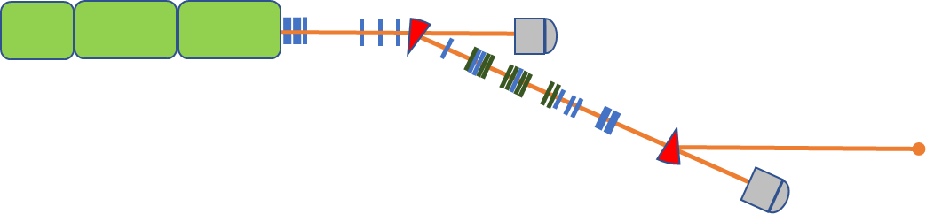
Conceptual view of A-FNS
ECR ion injector
RFQ
SRF
SRF
MEBT
BD
Deuteron
Energy (MeV)
BD
5
9
14.5
26
40
HEBT
Horizontal cross sectional view

